Slide 1
Chapter 1
Introduction
By
Cheng Few Lee
Joseph Finnerty
John Lee
Alice C Lee
Donald Wort

Slide 2
Chapter Outline
1.1 Objective of Security Analysis
1.2 Objective of Portfolio Management
1.3 Basic Approaches to Security Analysis and Portfolio Management
1.4 Source of Information

Slide 3
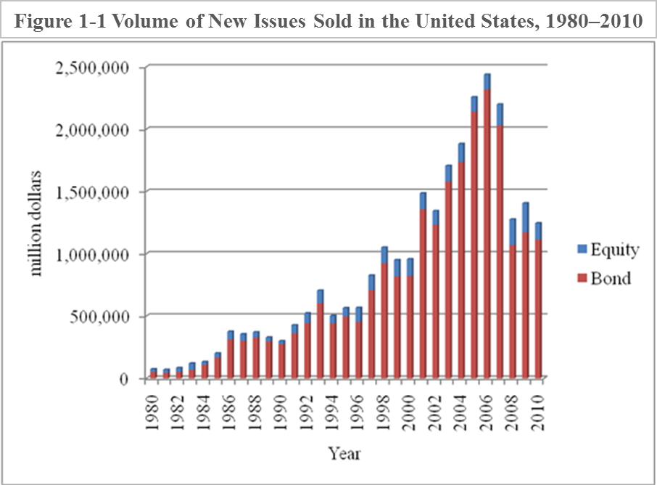
The volume of trade between 1980-2010 in new issues of stocks and bonds in U.S. primary markets can be seen here. The chart indicates that within the past 30 years, the volume of trade has increased greatly. Between 1980-1988, there was a large decline in interest rates, which probably induced the large growth in debt securities from then on. Likewise, common stock also experienced an increase during this period. This great amount of came down after 2006, when the economy was hit by the financial crisis in 2007.
Table 1-2 Average Daily Trading Volume in NYSE Listed Issues (millions of shares)
Year | Volume
1980 | 44.87
1981 | 46.85
1982 | 65.05
1983 | 85.33
1984 | 90.96
1985 | 109.17
1986 | 141.03
1987 | 188.54
1988 | 161.46
1989 | 165.47
1990 | 156.78
1991 | 178.92
1992 | 202.27
1993 | 264.52
1994 | 291.35
1995 | 346.10
1996 | 412.30
1997 | 525.68
1998 | 673.59
1999 | 809.18
2000 | 1041.58
2001 | 1239.96
2002 | 1441.02
2003 | 1398.40
2004 | 1466.79
2005 | 1647.13
2006 | 1826.67
2007 | 2119.63
2008 | 2609.83
Source: NYSE Statistics Archive in NYSE Euronext website (http://www.nyse.com/financials/1022221393023.html)

Slide 4
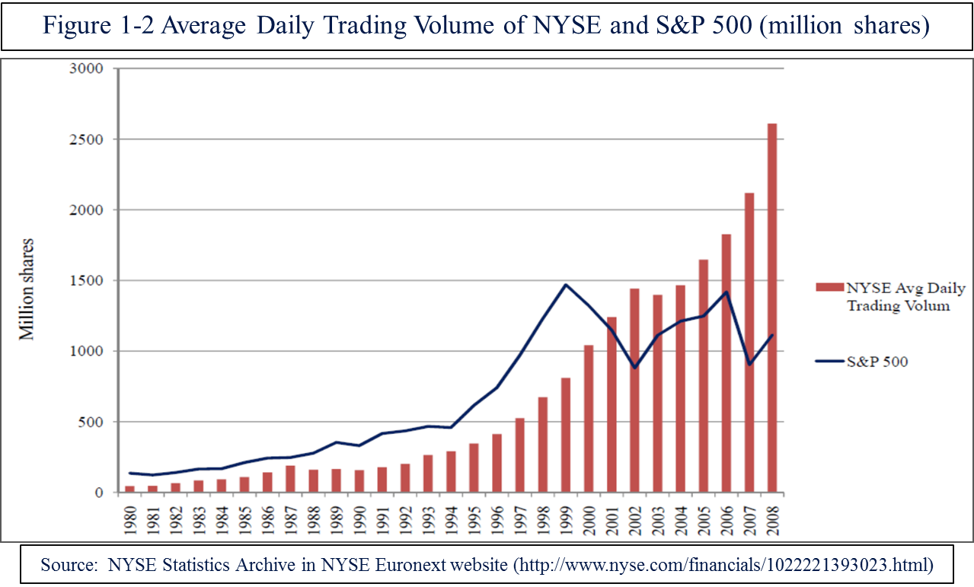
After corporations first issue stocks and bonds, investors like to engage in trading amongst themselves. In this case, financial instruments are traded between current investors and potential investors in a corporation. We call this the secondary market. The charts and figures below display trading trends for the past 30 years within the secondary market.
Table 1-2. Average Daily Trading Volume in NYSE Listed Issues (millions of shares)
Year | Stock | Bonds
1980 | 20,489 | 53,206
1981 | 25,349 | 44,642
1982 | 30,562 | 53,226
1983 | 51,579 | 68,370
1984 | 22,628 | 109,903
1985 | 35,515 | 165,754
1986 | 61,830 | 313,502
1987 | 53,349 | 301,349
1988 | 42,455 | 327,864
1989 | 32,203 | 297,114
1990 | 23,441 | 275,760
1991 | 65,268 | 361,971
1992 | 78,457 | 443,911
1993 | 101,554 | 603,119
1994 | 60,398 | 441,287
1995 | 68,473 | 496,296
1996 | 112,546 | 453,963
1997 | 117,880 | 708,188
1998 | 126,755 | 923,771
1999 | 131,568 | 818,683
2000 | 134,917 | 822,012
2001 | 128,554 | 1,356,879
2002 | 110,435 | 1,232,618
2003 | 127,141 | 1,579,311
2004 | 144,603 | 1,737,342
2005 | 115,256 | 2,141,496
2006 | 119,165 | 2,318,379
2007 | 168,654 | 2,030,248
2008 | 206,598 | 1,069,815
2009 | 233,967 | 1,171,218
2010 | 131,135 | 1,113,799
Source: Federal Reserve Bulletin.

Slide 5
In addition to traditional stocks and bonds, we also see growth in alternative financial instruments. A list of exchanges where these securities can be traded are shown in the table below.
Table 1.3 Options and Futures Exchanges
American Stock Exchange | COMEX | New York Mercantile Exchange | Chicago Board Options Exchange
Major Market Index Option | Gold | No. 2 Heating Oil | S&P 100 Option
 | Silver | Crude Oil | S&P 500 Option
Chicago Board of Trade | Gold Option | Leaded Gasoline | British Pound Option
T-Bond | Silver Option | Unleaded Gasoline | Canadian Dollar Option
T-Bond Option |  |  | Deutschemark Option
10-Year T-Note | FINEX | Pacific Stock Exchange | French Franc
10-Year T-Note Option | U.S. Dollar Index | Technology Index Option | Japanese Yen Option
Major Market Index | European Currency Unit |  | Swiss Franc Option
Maxi Stock Index |  | MATIF PARIS | T-Bond Option
Municipal Bond Index | Hong Kong Futures Exchange | French 7–10 Year Government Note | 5-Year T-Note Option
NASDAQ 100 Index | Hong Kong Stock Index | French 90–Days T-Bill
 |  |  | New York Futures Exchange
Chicago Mercantile Exchange | International Petroleum Exchange | Philadelphia Stock Exchange | NYSE Composite Index
British Pound | Gas Oil | British Pound Option | NYSE Composite Index Option
Canadian Dollar |  | Canadian Dollar Option | CRS Index
Deutsch mark | Kansas City Board of Trade | Deutschemark Option
Japanese Yen | Value Line Average Index | Japanese Yen Option | New York Stock Exchange
Swiss Franc |  | Swiss Franc Option | Composite Index Option
European Currency Unit | LIFFE | European Currency Unit Option | Double Index Option
British Pound Option | Eurodollar | Value Line Average Index Option | Beta Index Option
Canadian Dollar Option | Pound Sterling
Deutschemark Option | Sterling Currency | SIMEX | Tokyo Stock Exchange
Japanese Yen Option | Long Gilt | Deutsch mark | Yen Bond
Swiss Franc Option | FTSE 100 Index | Japanese Yen
S&P 500 Index | U.S. Treasury Bond | Eurodollar | Toronto Futures Exchange
S&P 250 OTC Index | Pound/Dollar Option |  | TSE 300 Index
S&P 500 Option |  | Sydney Futures Exchange
Eurodollar | Montreal Stock Exchange | All Ordinaries Stock Index 90-Day Bank Bill | Toronto Stock Exchange
T-Bill | T-Bill Option | U.S. Dollar | TSE 300 Index Option
Eurodollar Option | Canadian Bond Option | Australian 10-Year T-Bond
T-Bill Option
Source: NYSE Statistics Archive in NYSE Euronext website (http://www.nyse.com/financials/1022221393023.html)

Slide 6
Objective of Security Analysis
Section 1.1

Slide 7
Section 1.1-Objective of Security Analysis
The ultimate objective of security analysis is to develop theoretical models that determine the value of financial instruments to compare with the prices quoted in the market. Using these theoretical models, security analysts try to look for undervalued or overvalued situations. Undervalued situations, where theoretical value is higher than the present market value, offer the opportunity to invest in instruments that are expected to have above-average returns. Overvalued situations, where theoretical value is below the current market value, offer the opportunity to sell instruments whose prices are expected to fall.

Slide 8
Objective of Portfolio Management
Section 1.2

Slide 9
Section 1.2-Objective of Portfolio Management
Due to unforeseen macroeconomic events, stock for one company can reduce in value. Portfolio management seeks to combine securities so that the overall return of the portfolio is enhanced and the risk to the portfolio is reduced.

Slide 10
Basic Approaches to Security Analysis and Portfolio Management
Section 1.3

Slide 11
Section 1.3-Basic Approaches to Security Analysis and Portfolio Management
Two Main Approaches
Fundamental analysis-value is a relationship between theoretical determinants and access to relevant information
Technical analysis-prices move in trends that recur over time; it is based on the belief that information is not immediately reflected in prices

Slide 12
Section 1.3-Basic Approaches to Security Analysis and Portfolio Management
Fair Game Model-only relevant information that is available at the time can be used in the price-determination process
Efficient market hypothesis (EMH)-based on the “fair game” model
  Weak form-current stock prices fully reflect all historical information, include the historical sequence of price, price changes, trading volume, and so on. Knowledge of past events will not consistently generate above-average investment performance
  Semi-strong form-stock prices (in addition to historical information of the weak form) fully reflect all public information, such as corporate earnings, dividends, economic or political news. Investors who purchase securities based on information that is public will pay a price of a security that has already been adjusted for the value of the information
  Strong form-security prices fully reflect all information, but public and private. No group of investors or market participants can outperform the market, even though they have monopolistic access to information

Slide 13
Source of Information
Section 1.4

Slide 14
Section-1.4 Source of Information
Four Levels of Information
  Economy
  Financial Markets
  Industry Information
  Corporate Information

Slide 15
1.4 Source of Information
Table 1-4 Sources of Information about the U.S. and World Economies
GOVERNMENT SOURCES
Statistical Abstracts of the United States | Prepared by the Bureau of the Census, this contains extensive social, political, and economic statistics.
Survey of Current Business | A monthly publication of the Department of Commerce. Twice a year the Business Statistics Supplement is published; this contains more than 2,500 time series of monthly, quarterly and yearly data about the U.S. economy. A detailed description of each series is provided.
Federal Reserve Bulletin | A monthly publication of the Board and Governors of the Federal Reserve System, its major emphasis is on the monetary statistics and other financial statistics of the U.S. economy.
Business Conditions Digest | The Department of Commerce publishes a monthly series of data and charts of leading economic indicators, coincident indicators and lagging indicators of the U.S. economy.
Economic Report of the President | The President sends a report of the state of the U.S. economy to Congress at the beginning of each year. Each report contains a summary of the past year’s economic events and the major problems the economy will be facing the next year. Additionally there are statistical series of economic variables for the U.S. economy.
International Finance Statistics and U.N. Statistical Notebook | Good sources of data on worldwide economics and finance.
GENERAL FINANCIAL PRESS
The Wall Street Journal | A daily newspaper covering the economy and the financial markets. It offers extensive price data for securities.
Business Week | A weekly focusing on topics about business and the economy.
Fortune | A biweekly featuring articles about business and the economy.
Economist | A weekly filled with articles and reports relating to the world economy.
Table 1-4 lists sources of information on the economy

Slide 16
1.4 Source of Information
Table 1-5 Sources of Information about the Financial Markets
GENERAL FINANCIAL PRESS
The New York Times | Either local or national editions are available daily throughout the country, featuring articles and price information on the major financial markets.
Commercial and Financial Chronicle | A weekly offering price information on equity securities.
Barron’s | A weekly magazine featuring articles and price information on most financial markets, domestic as well as international.
Finance | A monthly magazine providing articles about financial markets.
Euromoney | A monthly magazine with articles and data on international capital and money markets.
Institutional Investor | A monthly featuring articles aimed at the managers of large institutional portfolios.
Financial Analysts Journal | A bimonthly featuring articles of interest to financial analysts.
Journal of Portfolio Management | A quarterly publishing articles of interest to portfolio managers.
GOVERNMENT SOURCES
Statistical Bulletin | A monthly publication of the Securities and Exchange Commission (SEC) emphasizing equity securities.
Annual Report of the SEC | A yearly report of the SEC highlighting major events in the financial markets.
PRIVATE SOURCES
New York Stock Exchange (NYSE) Fact Book | An annual published by the NYSE; it contains extensive data on the trading on the NYSE.
AMEX Statistical Review | An annual of the AMEX; it contains data on the trading on the AMEX.
Dow Jones Investor’s Handbook | A yearly publication of the earnings, dividends and prices of the Dow Jones Averages; published since 1939.
Standard & Poor’s Trading and Security Statistics | Published yearly, featuring historical data on all of the S&P indexes.
Table 1-5 lists sources of information on financial markets

Slide 17
1.4 Source of Information
Table 1-6 Sources of Information about Industries
TRADE ASSOCIATIONS AND INDUSTRY PUBLICATIONS
Iron and Steel Ages | Computers
Institute of Life Insurance | Chemical Week
American Bankers Association | Aviation Week
Machine Tool Association | Automotive News
PRIVATE SOURCES
Dun and Bradstreet Key Business Ratios | Lists financial ratios for 125 industries.
Robert Morris Associates | Lists financial ratios for medium- and small-sized firms in various industries.
Standard & Poor’s Investment Advisory Service, Industry Surveys, and Outlook | Provides information and data on major events in various industries.
Moody’s Manuals | Provides information and financial data on various industries.
GOVERNMENT
U.S. Industrial Outlook | An annual analysis of 200 industries.
Reports on specific industries | Census of Mineral Industries Census of Selected Service Industries Census of Construction Industry Census of Transportation Census of Retail Trade Census of Wholesale Trade Annual Survey of Manufactures Financial Census for Manufacturing Corporations
Table 1- lists sources of information on industries

Slide 18
1.4 Source of Information
Table 1-7 Sources of Information about Individual Companies
CORPORATE
Annual and Quarterly Reports | All firms whose securities are publicly held and traded are required to disseminate to their security holders an annual report of operations and financial position. Basic financial statements such as income statement, balance sheet, sources and uses of funds, as well as changes in retained earnings are included in all annual reports.
Security Prospectus | If a firm is issuing new securities, financial information about the firm must be released to the public before the new securities can be issued.
GOVERNMENT
Required Report | Form 10K: Form 10K is a very detailed annual report that publicly traded firms must submit to the SEC. These reports will be furnished to the public upon request to the firm. Information is also submitted every quarter in the form of a 10Q report.
PRIVATE
Standard & Poor’s Corporation Record | Provides annual financial data on individual companies.
Moody’s Manuals | Provides annual historical and financial data on individual firms.
Value Line Investment Service | Offers historical and financial information on 1,700 companies, as well as quality recommendations as to the investment value of specific firms.
Brokerage Firms’ Reports | Usually offer specific recommendations about the investment worth of individual firms’ securities—for example, buy, sell, hold.
PRIVATE COMPUTERIZED DATABASES
Compustat | S&P computerized database has approximately 3,500 companies covering twenty years of financial and market-price data.
University of Chicago Stock Price Tapes | The Center for Research on Security Price (CRSP) offers monthly and daily price data from various exchanges.
I/B/E/S | Provides detailed and consensus estimates featuring up to 26 forecast measures including GAAP and pro-forma EPS, revenue/sales, net income, pre-tax profit and operating profit, and price targets and recommendations for more than 60,000 companies in 67 countries worldwide.
Wharton Research Data Service | Provides data compiled from independent sources that specialize in specific historical data. Some sources include Capital IQ, NYSE Euronext, CRSP, and Thomson Reuters.
Table 1-4 lists sources of information on companies

Slide 19
Summary
The volume in trading of securities in financial markets is ever increasing. Therefore, it requires a firm foundation in relevant theories and methods of valuation to make the right decision in investing in financial instruments.
This chapter has identified the objectives of portfolio management and security analysis. In addition, we also discuss the sources of economy-wide information, financial market information, industry information, and individual company information which are necessary for the security analyst and portfolio manager.

