Slide 1
Chapter 26 Bankruptcy, Workouts, and Corporate Reorganization

Slide 2
Chapter Outline
26.1 Introduction
26.2 What is Financial Distress and Failure?
26.3 Voluntary Restructuring and Corporate Focus
26.4 Bankruptcy
26.5 Out-of-Court Settlement and Private Workout Arrangement
26.6 Bankruptcy and Financial Distress Analysis
26.7 Summary
Appendix 26A: Financial Z-Score Analysis Example needs to be completed

Slide 3
26.1 Introduction
Macy’s. Bradlees. Caldor. Penn Square. Eastern Airlines. Chrysler (almost, in the 1970s). Bankruptcy claims many firms, large and small, each year. Although the immediate reason why a firm may file for bankruptcy protection is financial, that is usually the symptom rather than the cause, which may include poor management, bad marketing, excess costs, outdated products, and so on. Some firms are able to work out their problems, restructure their finances, and remain a going concern. Others whose root problems run too deep or who are in too big of a financial hole end up selling their assets and disappearing from the business pages. In this chapter, we’ll learn about the process, the problems, and the issues that are involved in bankruptcy and corporate reorganizations.

Slide 4
26.1 Introduction
Ideally, the management, shareholders, employees, and other stakeholders in a firm, given the choice, would like to see the firm stay in existence as a profitable entity. However, firms do fail for a variety of macro- and microeconomic reasons. Regardless of the reason for failure, all of the stakeholders are losers. The main objective of this chapter is to present an overview of the bankruptcy procedure. We begin with a look at what constitutes financial distress and failure. The terms insolvency and illiquidity are defined and are shown to lead to bankruptcy. The legal forms of bankruptcy then are discussed. Bankruptcy and reorganization are very technical legal process governed by federal and state laws. Therefore, legal advice is mandatory during these processes.

Slide 5
26.1 Introduction
In Section 2 we discuss financial distress and failure. Voluntary restructuring and corporate focus is discussed in Section 3. The basic concepts and procedures of bankruptcy is detailed in Section 4. Out-of-court settlement and private workout arrangement is discussed in Section 5. An analysis of bankruptcy and financial distress is provided in Section 6, and Section 7 summarizes the chapter. Appendix 26A discusses how financial z-score is estimated.

Slide 6
26.2 What is Financial Distress and Failure?
Financial distress is surprisingly hard to define precisely. This is true partly because of the variety of events befalling firms under financial distress. For example, these events can include: i) Dividend reductions, ii) Plant closings, iii) Losses, iv) Layoffs, v) CEO resignations, and vi) plummeting stock prices.
Financial distress means that a firm’s short-run operating and financial cash inflows are less than its outflows. This may be good or bad. Table 26.1 shows the quarterly sources and uses of funds for two firms, Firm A and Firm B.

Slide 7
26.2 What is Financial Distress and Failure?
As can be seen in Table 26.1, neither firm is currently failing; each has a positive net income of $10. Yet we might wonder if Firm A is facing financial distress because it is selling assets and not making any investments for future operations. Firm B, although paying only half as much in dividends as Firm A, appears to be in better financial shape. It has the ability to raise capital in the debt market and it is investing for future growth and profitability.
If Firm A were to continue to operate in this fashion, eventually the financial distress would lead to insolvency and/or failure. Insolvency means that the firm does not have sufficient cash inflows to meet all of its cash outflows. If Firm A continues to sell assets left to sell and no operating plant and equipment to produce a product. At this point, it is bankrupt, out of business. Prior to going bankrupt, Firm A will have become insolvent, without cash inflows from operations to meet legally binding outflows. On the other hand, because of its investments (indicated by the line “Buy assets” in Table 26.1), Firm B will have the capacity in the future to manufacture a product to generate operating cash flows that can be used to meet its obligations.

Slide 8
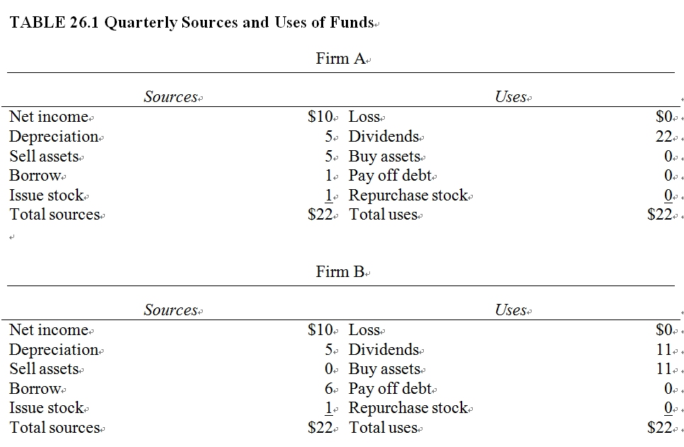
26.2 What is Financial Distress and Failure?

Slide 9
26.2 What is Financial Distress and Failure?
Financial failure has much more to do with the legal concept of bankruptcy than does financial distress. Financial failure means that the firm’s assets are smaller than its liabilities. The firm has a negative net worth. A negative net worth implies that the firm cannot meet its legal obligations, so it is bankrupt. These definitions raise two important and related issues: illiquidity and insolvency. One is a cash flow concept, and the other is a legal term related to the balance sheet.

Slide 10
26.2 What is Financial Distress and Failure?
26.2.1 Illiquidity
The term liquidity can be defined as the ease with which assets can be converted into cash at a fair price in a reasonable amount of time. Liquidity is the most important factor that the financial manager must deal with on a day-to-day basis. By supplement cash inflows from investment with financing inflows, the financial manager ensures the survival of the firm. Illiquidity is the opposite of liquidity. Either an asset cannot be converted into cash (e.g., a leased machine cannot be sold for $1 million, but the best offer from another buyer is $100,000). In the latter case, if the firm keeps the asset and uses it, it is worth ten times more than the amount of cash it could raise in a sale in the market.

Slide 11
26.2 What is Financial Distress and Failure?
26.2.1 Illiquidity
In the short run, many firms may be illiquid, that is, they may lack cash. They remedy this situation by short-term borrowing. A firm borrows cash to meet its current obligations, knowing that is cash flow will improve in the future. This kind of illiquidity is transitory and is not associated with insolvency or bankruptcy. On the other hand, if a firm faces illiquidity with no expectation of future cash flow improvement, illiquidity may lead to insolvency and bankruptcy.

Slide 12
26.2 What is Financial Distress and Failure?
26.2.2 Insolvency
Although all businesses expect to succeed, many do not. Various financial indications of serious difficulty often are apparent. Cash shortages may cause illiquidity, borrowing may increase, accounts may be overdrawn, and maintenance of plant and equipment may be delayed. Careful observation of either profit or cash receipt and disbursement trends may signal pending financial troubles. However, frequently occurring illiquidity can make the difficulty so acute that the problem can no longer be ignored.

Slide 13
26.2 What is Financial Distress and Failure?
26.2.3 Kinds of Insolvency
Cash flow problems can create either technical or legal insolvency. Technical insolvency is the inability of the firm to meet c ash payments on contractual obligations. The lack of cash to meet accounts payable, wages, taxes, interest, and debt retirement will constitute technical insolvency, even if the enterprise has adequate assets and generates both economic and accounting profits.

Slide 14
26.2 What is Financial Distress and Failure?
26.2.3 Kinds of Insolvency
When assets are plentiful in relation to liabilities, a financial manager usually can plan ahead and arrange for sufficient cash through various sources to prevent any embarrassment. Most liquidity problems can be overcome by borrowing or through the planned liquidation of certain assets. A sound, profitable business should have no difficulty in this regard, and reasonably intelligent planning should ward off the danger of technical insolvency. However, if the firm is technically insolvent because of successive losses, poor management, or insufficient investment in working capital, then lenders will be less willing to place funds at its disposal.
The financial manager also should be aware of the potential for variability in the availability of funds. Even a willing lender often is hesitant during periods of tight money, great financial uncertainty, or panic.

Slide 15
26.2 What is Financial Distress and Failure?
26.2.3 Kinds of Insolvency
Legal insolvency is a more serious financial problem than technical insolvency. Legal insolvency exists when a firm’s recorded assets amount to less than its recorded liabilities. This condition arises when successive losses create a deficit in the owners’ equity account, rendering it incapable of supporting the firm’s legal liabilities. The firm may be legally insolvent even when it is liquid and has plenty of cash to pay its current bills. Outsiders may not be aware of the insolvency as long as the liquidity of the firm enables it to meet its cash obligations. A protracted period of legal insolvency usually leads to bankruptcy.

Slide 16
26.2 What is Financial Distress and Failure?
26.2.3 Kinds of Insolvency
Violation of a bond indenture agreement also may prove a source of financial insolvency for a firm. A bond indenture is the contract between the firm and its bondholders. A third-party trustee acts to represent the collective interests of the bondholders to monitor compliance with the indenture. Besides giving bondholders a contractual claim to interest payments, the indenture may require the firm to may annual payments to a sinking fund along with certain other provisions designed to protect the security of the bondholders.

Slide 17
26.2 What is Financial Distress and Failure?
26.2.3 Kinds of Insolvency
If a firm fails to make a sinking fund payment, or to meet any other obligation under the indenture, the trustee is responsible for undertaking appropriate action. Pressure by the trustee on the firm usually will do little to alleviate a problem already in the advanced stage. However, the trustee can warn bondholders of the difficulties and help to form a bondholders’ committee to be activated in the event of in-court or out-of-court adjustments. Usually by the time a creditors’ committee has been formed, the hope of getting all—or even any—of the creditors’ money back is quite small.

Slide 18
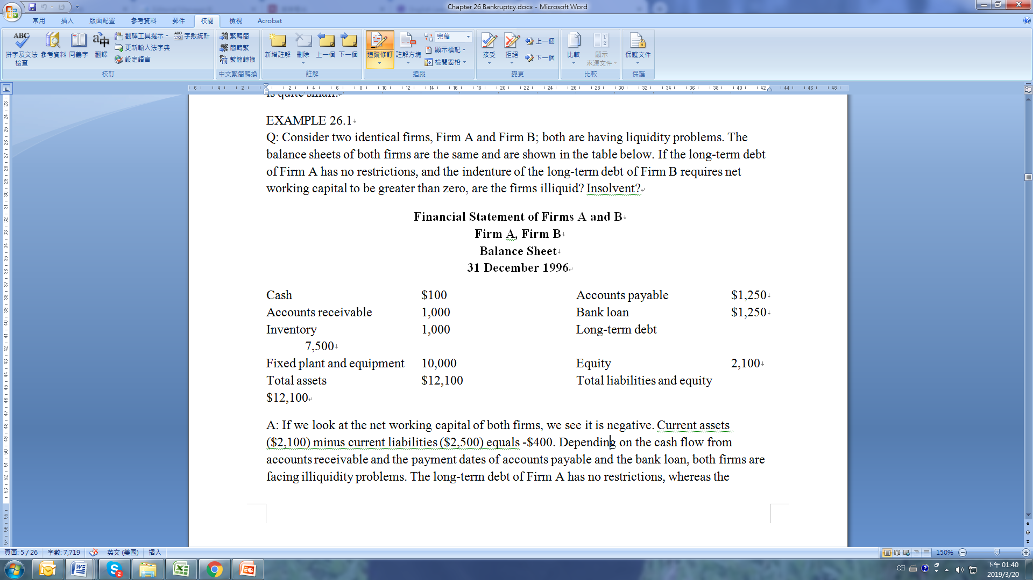
26.2 What is Financial Distress and Failure?
EXAMPLE 26.1
Q: Consider two identical firms, Firm A and Firm B; both are having liquidity problems. The balance sheets of both firms are the same and are shown in the table below. If the long-term debt of Firm A has no restrictions, and the indenture of the long-term debt of Firm B requires net working capital to be greater than zero, are the firms illiquid? Insolvent?

Slide 19
26.2 What is Financial Distress and Failure?
EXAMPLE 26.1
A: If we look at the net working capital of both firms, we see it is negative. Current assets ($2,100) minus current liabilities ($2,500) equals -$400. Depending on the cash flow from accounts receivable and the payment dates of accounts payable and the bank loan, both firms are facing illiquidity problems. The long-term debt of Firm A has no restrictions, whereas the indenture of the long-term debt of Firm B requires that working capital be greater than zero. In this case, both firms are illiquid, but Firm B also is insolvent.

Slide 20
26.2 What is Financial Distress and Failure?
Responses to Insolvency. A firm that finds itself in financial distress due to one of the above states of insolvency or failure to satisfy a bond indenture has several alternatives: 1. Do nothing, but hope something will come along to save the situation. 2. Attempt to sell out. The firm can try to find a buyer, but buyers of troubled firms may be few. Even if one can be found, the seller frequently feels fortunate to walk away with any portion of the original equity. 3. Seek adjustments with creditors outside of the judicial process, commonly called a workout. Some arrangements between the firm and its creditors may permit it to keep operating with the hope that it can work its way out of trouble. Such adjustments usually take the form of extensions of repayment schedules and/or compositions of credit, as described in the section below. 4. Seek court relief in bankruptcy proceedings in the form of a reorganization or liquidation. 5. Assign assets to a third party for liquidation. 6. Liquidate.

Slide 21
26.3 Voluntary Restructuring and Corporate Focus
Firms sell assets to other firms—a process referred to as restructuring—for three reasons. First, the asset is worth more to the buyer than the seller. Second, the divested asset interferes with the seller’s operations. Third, the buyer is willing to overpay for the asset.
Selling unrelated assets leads to a more efficient operation of the firm’s remaining core businesses. The motives for selling the asset include the elimination of negative synergies with the divested assets and/or increased efficiency arising from better allocation of management time and other resources. Once a firm has sold the unrelated assets, whether the decision is the correct one or not depends upon how well management focuses on the remaining assets. Improved corporate performance occurs only if the business’ focus is more sharply defined on the remaining assets.

Slide 22
26.3 Voluntary Restructuring and Corporate Focus
Today, management has three basic approached to voluntary restructuring. Carve outs occur when the parent sells a partial interest in a subsidiary through an IPO. The carve out may increase the selling firm’s value due to benefits from restructuring the asset composition of the firm. Again, value is enhanced if the manager focuses more on the remaining assets. Spin-offs occur when the parent transfers complete ownership of a subsidiary to the existing shareholders. The spin-off allows the shareholders to retain control over a given asset base while allowing management to focus on a smaller segment of the firm’s assets. Finally, sell offs involve the direct sale of assets to a third party. The selling firm receives cash, which can be used for debt repayment or reinvestment in the remaining assets. Management in this case cannot only refocus on the main line of core business but also now has the wherewithal to finance any necessary changes.
Any of these voluntary approaches may be used by managers of troubled firms in order to fend off the legal complications stemming from bankruptcy.

Slide 23
26.4 Bankruptcy
Most corporations that fail do so because of inappropriate management oversight, although firms also fail for a wide range of other reasons, as shown in Table 26.2. When corporations fail either due to repeated illiquidity or bad management, the firm must go through the legal process of bankruptcy. The first “Capital Ideas” box in this chapter discusses how bankruptcy differs in a few countries.
Bankruptcy includes a range of court procedures in the United States that may result in the firm being liquidated or financially reorganized to continue operations. This may occur voluntarily if the firm permits a petition for bankruptcy, or a creditor’s petition may force the firm into the courts.

Slide 24
26.4 Bankruptcy
Such a petition by a creditor charges the firm with committing one of the following acts of bankruptcy: (1) committing fraud while legally insolvent, (2) making preferential disposition of firm assets while legally insolvent, (3) assigning assets to a third party for voluntary liquidation while insolvent, (4) failing to remove a lien on the firm within 30 days while insolvent, (5) appointment of a receiver or trustee while insolvent, or (6) written admission of insolvency. As an example, the Revel, a casino in Atlantic City, New Jersey, cost $2.4 billion to build and opened on April 2, 2012. It filed for bankruptcy less than a year later in February 2013 and then again in September 2014.

Slide 25
26.4 Bankruptcy
TABLE 26.2 Reasons for Corporate Failure 1. An imbalance of skills within the top echelon. A manager tends to attract other managers of similar skills. For example, corporation management may consist principally of individuals with sales backgrounds who lack production experience. 2. A chief executive who dominates a firm’s operations without regard for the advice of peers. 3. An inactive or ill-informed board of directors. For instance, the board of directors for Penn Central, even including the members who were bankers, supposedly did not become aware of the firm’s impending financial disaster until a few weeks before its declaration of insolvency. 4. A deficient finance function within the firm’s management. Not infrequently, the only substantial input provided by the financial officer occurs when the budget is submitted back to the board. A company may have an effective financial information system; however, this information is of no avail if it does not flow to the board through a strong financial officer. 5. An absence of responsibility for the chief executive officer. Although all other managers within a company are responsible to a superior, the chief executive seldom must account for the increased separation of management and stockholders, this link may be tenuous or even lacking altogether. 6. Extremely variable sales for a capital-intensive product. R.F. Murray, “The Penn Central Debacle: Lessons for Financial Analysis,” Journal of Finance, Vol. 26, No. 2, May 1971, pp. 327-332.

Slide 26
26.4 Bankruptcy
26.4.1 Agency Problems
A company’s shareholders and its creditors usually get along. As long as the firm is profitable, shareholders receive dividends and creditors get their interest payments. If a firm becomes insolvent, the interests of shareholders and creditors quickly diverge. Creditors care nothing about the firm’s ongoing business, as long as they get their money; to assure this, they are willing to sell the assets of the firm. Shareholders are desperate to keep the firm going for as long as possible in hopes that the firm can be turned around and made profitable, thereby saving their investment.

Slide 27
26.4 Bankruptcy
26.4.1 Agency Problems
Many legal systems around the world don’t try to resolve these divergent viewpoints; most try to protect one side or the other. A law that backs the creditors might make the liquidation of the firm easy, allowing a good firm to be destroyed before it has a chance to work through bad times. On the other hand, when the law backs the equityholders by making liquidation difficult, it may penalize the creditors by depriving them of their legal right to payments of interest and principal. This, in turn, will make creditors less willing to lend and will raise the cost of borrowing. The second “Capital Ideas” box in this chapter presents an example of the problems faced by both stockholders and creditors when a business has financial difficulties.

Slide 28
26.4 Bankruptcy
26.4.1 Agency Problems
U.S. law tries to give equal weight to the concerns of creditors and shareholders. Its various chapters govern difficult bankruptcy situations. When a firm files under Chapter 11 of the U.S. Bankruptcy Code, any reorganization plan must be approved by both creditors and shareholders.

Slide 29
26.4 Bankruptcy
26.4.2 Chapter 11
Chapter 11 of the Federal Bankruptcy Reform Act of 1978 tries to allow for a planned restructuring of the corporation while providing for payments to the creditors. Chapter 11 proceedings begin when a petition is filed by the corporation or by three or more creditors. A federal judge either approves or disapproves the petition for protection under Chapter 11. During the petition period, the judge protects the managers and shareholders from creditors and tries to negotiate a rescue plan between the shareholders and creditors. During this time, the corporation continues to do business.

Slide 30
26.4 Bankruptcy
26.4.2 Chapter 11
Once in Chapter 11, the firm’s management has 120 days to submit a reorganization plan, which usually includes debt rescheduling and the transfer of equity rights. Anyone has the right to submit a plan, but only very rarely does anyone but management submit a reorganization plan. The plan must secure the agreement of two-thirds of the shareholders and two-thirds of each class of creditors; for example, senior creditors whose debt is secured and junior creditors whose debt is unsecured are considered separate classes.

Slide 31
26.4 Bankruptcy
26.4.2 Chapter 11
Reorganization. Current law allows the bankrupt firm to be reorganized under Chapter 11. The general objective of reorganization is to keep the firm alive while settling creditor’s claims and attracting new capital into the firm.

Slide 32
26.4 Bankruptcy
EXAMPLE 26.2
Reorganization
Q: A firm that is undergoing reorganization under Chapter 11 has the balance sheet shown in Table A below. The firm’s creditors are in agreement that the present value of the firm’s earnings will exceed the liquidation value of the firm and the firm’s cash flow can support a debt structure of $50 million. The short-term creditors agree to a 50-percent settlement, as shown in Table B.

Slide 33
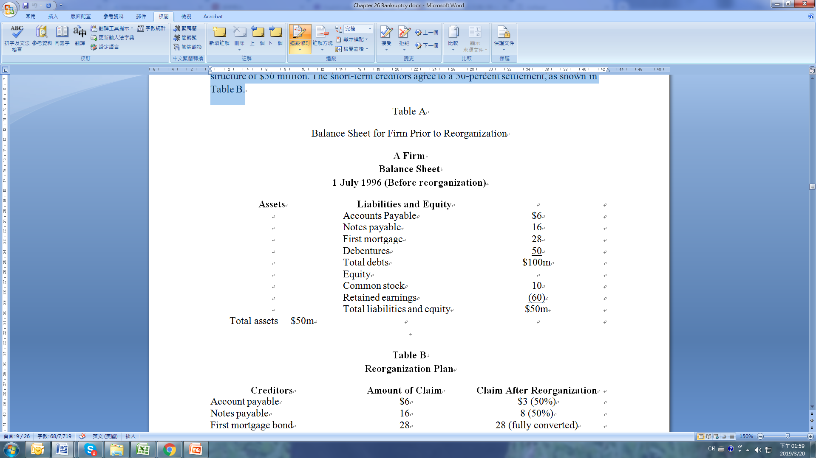
26.4 Bankruptcy
EXAMPLE 26.2

Slide 34

26.4 Bankruptcy
EXAMPLE 26.2
Within the required 120 days, the firm’s management has submitted the reorganization plans shown in Table B, along with the plan for issuing new securities shown in Table C.

Slide 35

26.4 Bankruptcy
EXAMPLE 26.2
The creditors and shareholders approve the plan and the bankruptcy court confirms it. After the reorganization, what is the firm’s capital structure?

Slide 36
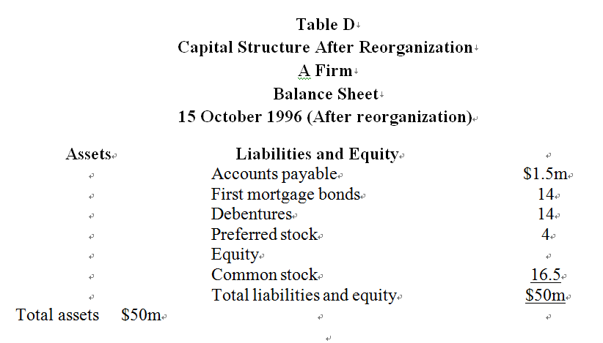
26.4 Bankruptcy
EXAMPLE 26.2
A: Using the information in Table C, we obtain:

Slide 37
26.4 Bankruptcy
26.4.2 Chapter 11
Reforming Chapter 11. Some critics argue that Chapter 11 is flawed and needs reform because it favors shareholders over creditors and junior creditors over senior creditors. They claim it is unfair that shareholders and junior creditors can vote to approve the reorganization plan as equals with the senior creditors.
Also, time works against creditors in Chapter 11. Upon approval of a reorganization plan by the court, interest payments to creditors stop and legal fees begin to erode the remaining value of the firm. Often senior creditors settle for less than their full debts simply to save time. Shareholders, on the other hand, wish to draw out the reorganization period as long as possible hoping for a turnaround; they have little or nothing left to lose.

Slide 38
26.4 Bankruptcy
26.4.2 Chapter 11
In general, this delay is bad for the company. IF a firm’s managers know they can default on debts and still keep their jobs, they may tend to abuse creditors. This could cause shareholders to require larger returns on their capital and creditors to be less willing to risk their funds.
Critics have presented two basic ideas for reforming Chapter 11: (1) increase the bureaucracy, and (2) allow the market to decide. The first proposes setting time deadlines after which independent arbitrators (more bureaucracy) decide a firm’s fate. This would put bankruptcy more firmly in the hands of bureaucrats. The second reform proposal involves creating opportunities for creditors and owners to sell their positions to each other or third parties at prices determined competitively in the market. This market-based solution would encourage whoever ends up with equity control to make the firm as valuable as possible.

Slide 39
26.4 Bankruptcy
26.4.3 Liquidation
Bankruptcy law favors reorganization through Chapter 11, but if the firm cannot be preserved as a going concern, the law requires liquidation. Liquidation involves selling the firm’s assets and distributing the proceeds to the creditors in order of the priority of their claims. Chapter 7 of the Bankruptcy Reform Act of 1978 covers liquidation of a firm.
In determining whether or not to liquidate a firm, the law asks: Is the firm worth more dead than alive? In other words, is the net present value of the liquidated parts of an enterprise greater than the present value of the firm as a going concern? If the answer is yes, the firm’s assets are sold and the creditors are paid off. If the answer is no, then Chapter 11 proceedings usually are followed.

Slide 40
26.4 Bankruptcy
26.4.3 Liquidation
Once the liquidation of assets has begun, it usually becomes painfully clear that few, if any, assets except cash bring their balance sheet values. Indeed, a significant reduction in asset values is to be expected. Because of this, not all claims on these assets will be satisfied in full; no liquidation generates enough cash to cover all claims.
In this event, available cash must be allocated to the various claims according to a rule called the absolute priority of claims. This rule requires satisfaction of certain claims prior to the satisfaction of other claims.

Slide 41
26.4 Bankruptcy
26.4.3 Liquidation
The priority of claims in liquidation or reorganization typically takes the following order: 1. Special current debt, which includes trustee expenses, unpaid wages that employees have earned in the 90 days preceding bankruptcy (not to exceed $2,000 for any one case), and contributions to employee benefit plans that have fallen due within the 180 days preceding bankruptcy. 2. Consumer claims on deposits not exceeding $900 per claim. 3. Tax claims. 4. Secured creditors’ claims, such as mortgage bonds and collateral trust bonds, but only to the extent of the liquidating value of the pledged assets. 5. General creditors’ claims, including amounts owed to unsatisfied secured creditors and all unsecured creditors, but only to the extent of their proportionate interest in the aggregate claims of their classes. 6. Preferred stockholders’ claims, to the extent provided in their contracts, plus unpaid dividends. 7. Residual claims of common stockholders.

Slide 42
26.4 Bankruptcy
EXAMPLE 26.3 Absolute Priority of Claims
Q: To illustrate the application of the absolute priority of claims, Table A shows the balance sheet for Dead Beat, Inc., a bankrupt firm. The book value of the company’s assets is $100 million, but this is substantially larger than the liquidation value of $30 million. What will be the distribution of the funds received from liquidation?

Slide 43
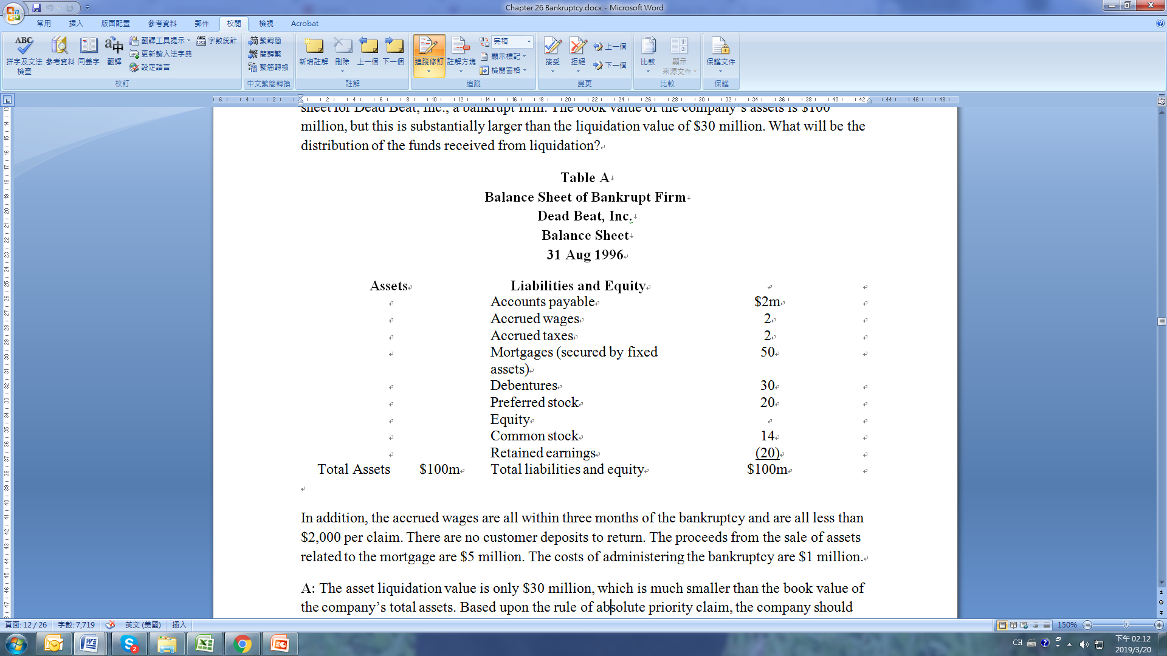
26.4 Bankruptcy
EXAMPLE 26.3 Absolute Priority of Claims

Slide 44
26.4 Bankruptcy
EXAMPLE 26.3 Absolute Priority of Claims
In addition, the accrued wages are all within three months of the bankruptcy and are all less than $2,000 per claim. There are no customer deposits to return. The proceeds from the sale of assets related to the mortgage are $5 million. The costs of administering the bankruptcy are $1 million.

Slide 45
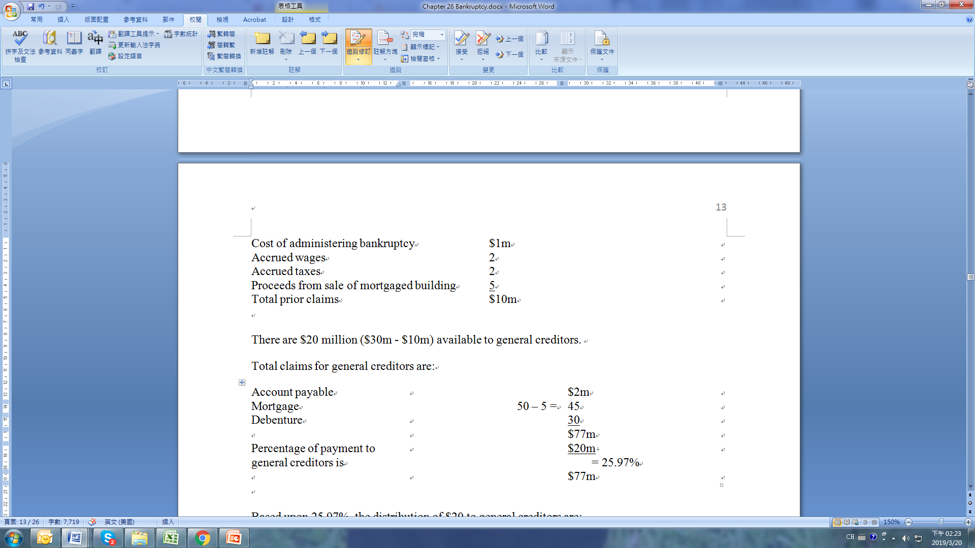
26.4 Bankruptcy
EXAMPLE 26.3 Absolute Priority of Claims
A: The asset liquidation value is only $30 million, which is much smaller than the book value of the company’s total assets. Based upon the rule of absolute priority claim, the company should first distribute to the claims of:

Slide 46
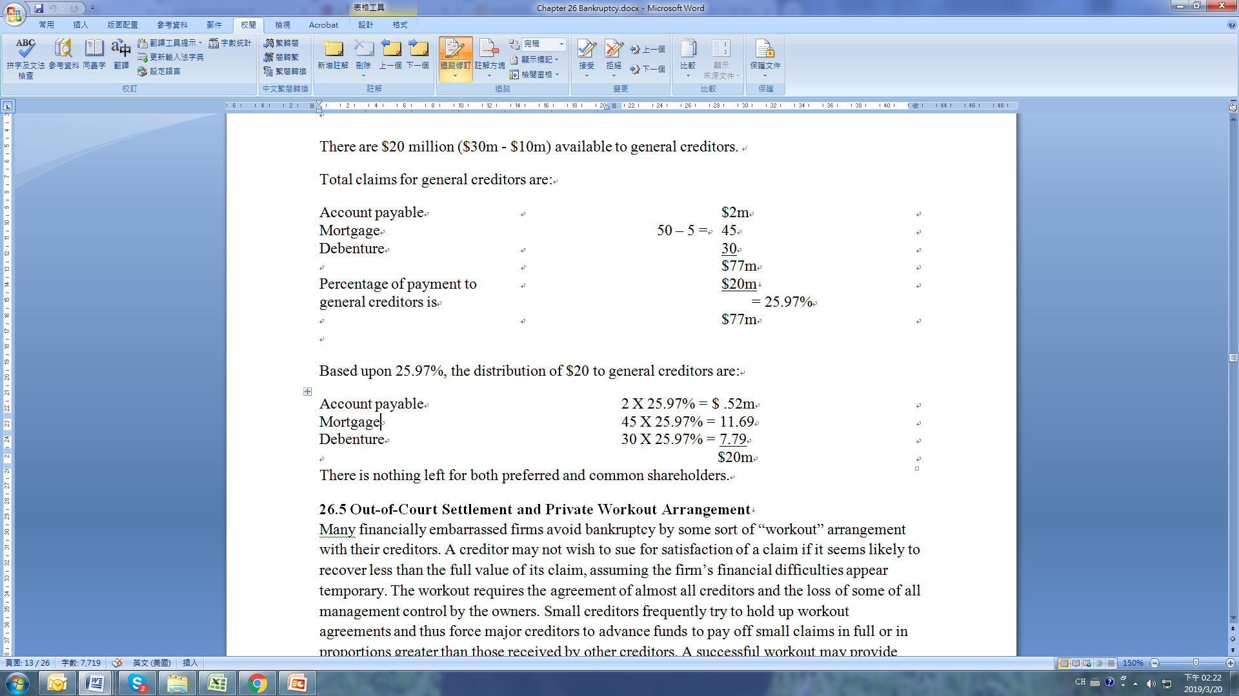
26.4 Bankruptcy
EXAMPLE 26.3 Absolute Priority of Claims
There are $20 million ($30m - $10m) available to general creditors.
Total claims for general creditors are:

Slide 47

26.4 Bankruptcy
EXAMPLE 26.3 Absolute Priority of Claims
Based upon 25.97%, the distribution of $20 to general creditors are:
There is nothing left for both preferred and common shareholders.

Slide 48
26.5 Out-of-Court Settlement and Private Workout Arrangement
Many financially embarrassed firms avoid bankruptcy by some sort of “workout” arrangement with their creditors. A creditor may not wish to sue for satisfaction of a claim if it seems likely to recover less than the full value of its claim, assuming the firm’s financial difficulties appear temporary. The workout requires the agreement of almost all creditors and the loss of some of all management control by the owners. Small creditors frequently try to hold up workout agreements and thus force major creditors to advance funds to pay off small claims in full or in proportions greater than those received by other creditors. A successful workout may provide major creditors full satisfaction of their claims, while avoiding bankruptcy proceedings and the attendant court costs.

Slide 49
26.5 Out-of-Court Settlement and Private Workout Arrangement
26.5.1 Extensions
Sometimes creditors will agree to extensions of the maturity dates of loans for which the principal payments currently are past due. Although this does not correct a fundamental disorder in a firm’s finances, it does give the firm more breathing room; it allows the firm to make other adjustments in its financial resources without the burden of immediate repayment of the principal of the loan. Creditors don’t give extensions without cost, however. They may impose restrictions on a firm’s dividends; ask major owners of a small firm to put up more money, or preclude future borrowing except through subordinated debt.

Slide 50
26.5 Out-of-Court Settlement and Private Workout Arrangement
26.5.2 Composition
Composition is another way a firm can adjust its capital sources. This method involves recomposing the debt of the firm in such a way that the creditors receive partial payment for their claims, say 60 cents for each dollar. Creditors may find it more expedient to follow this route than to take the troubled firm to court to seek full satisfaction. In court, they would run the risk of receiving less than they would through composition. Moreover, court appearances require various legal costs, which may more than offset the possible gains achieved by going to court.

Slide 51
26.5 Out-of-Court Settlement and Private Workout Arrangement
26.5.3 Creditors’ Committee
A third method of adjusting a capital structure without bankruptcy proceedings involves the operation of the enterprise by a group of creditors, called a creditors’ committee. These representatives manage the firm until it gathers sufficient liquid capital to satisfy existing claims or until an acceptable composition is found.
There is no legal compulsion for any creditor to accept an out-of-court adjustment. Any creditor can delay the process if it is dissatisfied with a proposal by the majority (or minority) of creditors to relieve the financial burden on the firm. The unhappy creditor can refuse the arrangement and insist that a claim be met in full; if it is not, the creditor can take the firm to court to be liquidated or reorganized.

Slide 52
26.5 Out-of-Court Settlement and Private Workout Arrangement
Example 26.4
The Absolute Priority of Claims Doctrine
XYZ Corporation has just completed the sale of all of its assets for $1 million. Following the absolute priority of claims doctrine, show how these proceeds should be distributed to the creditors and owners of XYZ Corporation.

Slide 53
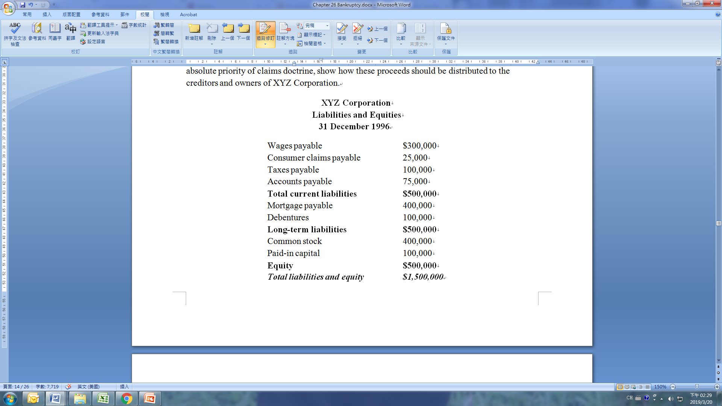
26.5 Out-of-Court Settlement and Private Workout Arrangement
Example 26.4

Slide 54
26.5 Out-of-Court Settlement and Private Workout Arrangement
Example 26.5
The Absolute Priority of Claims Doctrine
ABC Corporation has just completed the sale of all its assets for $1 million. Following the absolute priority of claims doctrine, show how the proceeds should be distributed to the creditors and owners of ABC Corporation.

Slide 55
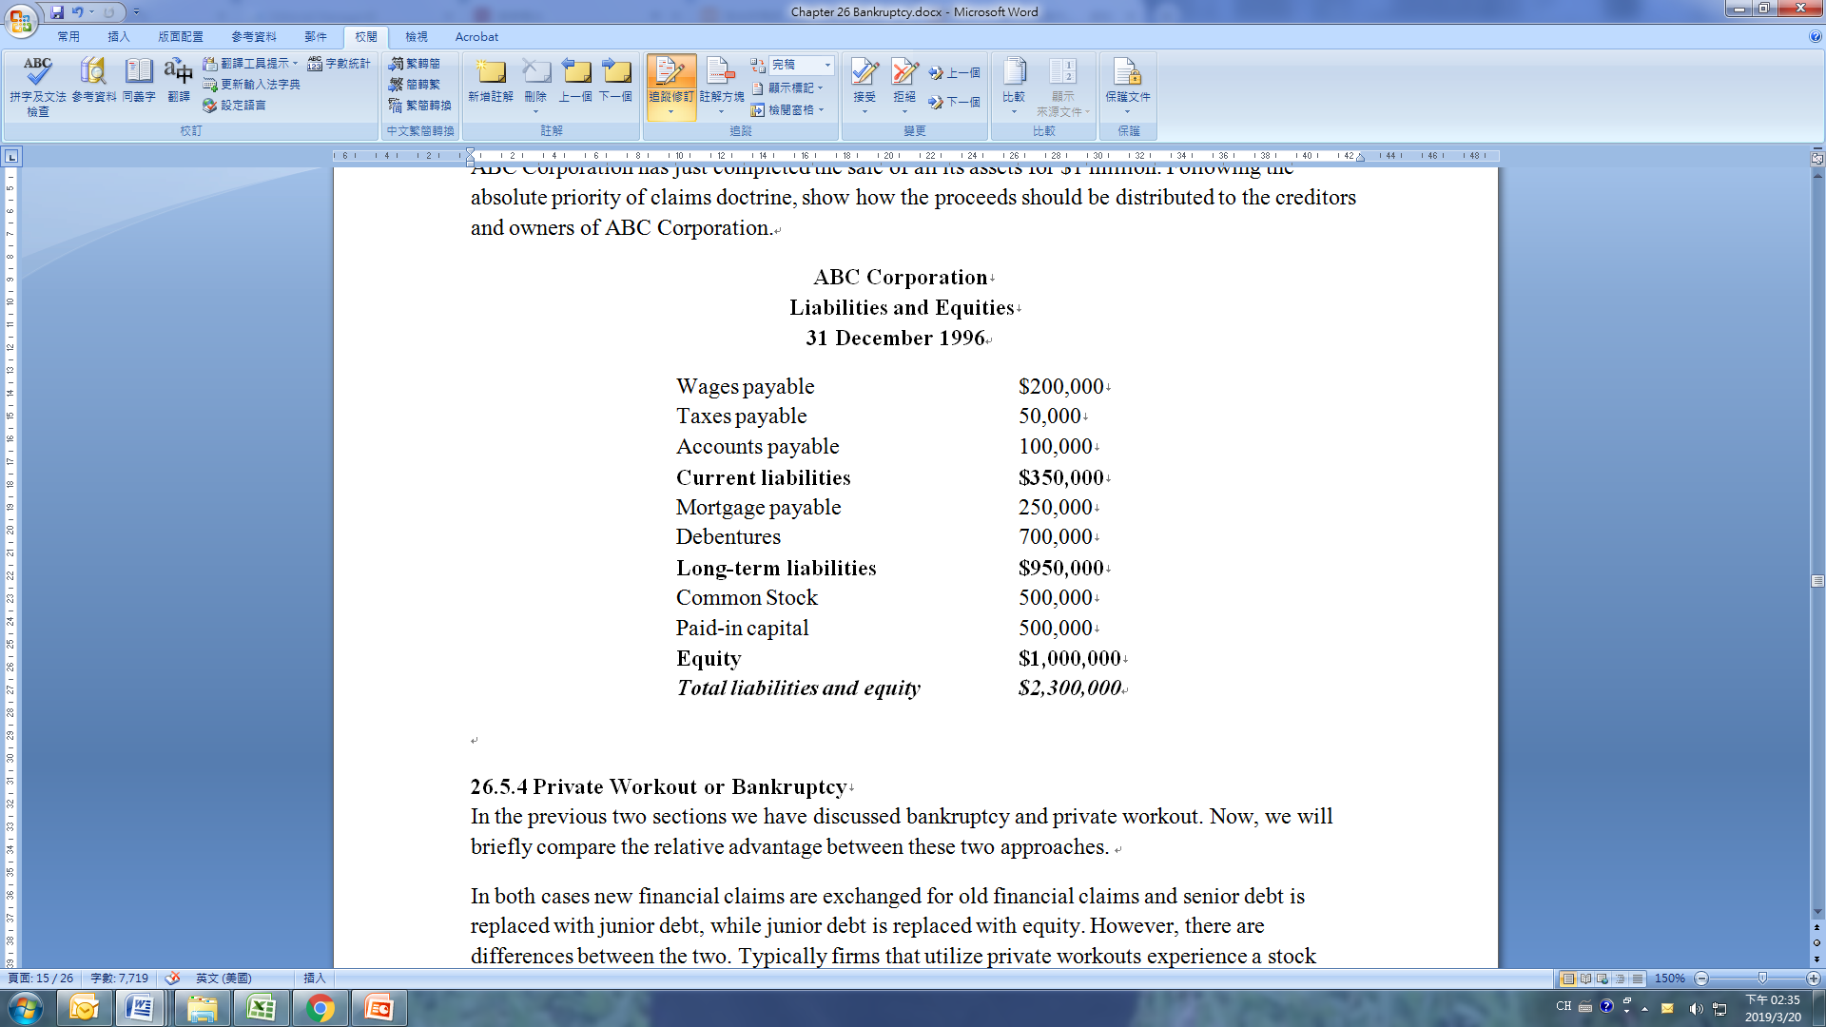
26.5 Out-of-Court Settlement and Private Workout Arrangement
Example 26.5

Slide 56
26.5 Out-of-Court Settlement and Private Workout Arrangement
26.5.4 Private Workout or Bankruptcy
In the previous two sections we have discussed bankruptcy and private workout. Now, we will briefly compare the relative advantage between these two approaches.
In both cases new financial claims are exchanged for old financial claims and senior debt is replaced with junior debt, while junior debt is replaced with equity. However, there are differences between the two. Typically firms that utilize private workouts experience a stock price increase. The direct cost of a private workout is also less for a firm when compared to the cost of bankruptcy. In terms of job security, top management can lose pay or their job when a firm chooses either a private workout or bankruptcy.

Slide 57
26.5 Out-of-Court Settlement and Private Workout Arrangement
26.5.4 Private Workout or Bankruptcy
Based on these facts private workout is better; however, bankruptcy is still used most of the time. Now, we will briefly discuss why bankruptcy is better than private workouts.
1. Tax Advantages Bankruptcy allows firms to issue debt, debtor in possession (DIP), that is considered senior to any previously incurred debt. Firms also experience some tax advantages in bankruptcy. They do not lose tax carryforwards and interest on pre-bankruptcy unsecured debt stops accruing.
2. Bankruptcy Is Better For The Equity Holder Than It Is For The Creditor Since DIP debt and the stoppage of pre-bankruptcy interest on unsecured debt favors stockholders, the equity investors are able to hold out and wait for a better deal in the bankruptcy. Absolute priority rule (APR), as indicated in Table 26.3, is generally violated in bankruptcies.

Slide 58
26.5 Out-of-Court Settlement and Private Workout Arrangement
26.5.4 Private Workout or Bankruptcy
3. Private Workout Is Too Complex If a firm's capital structure is too complex, for example if a firm has secured and trade creditors, it will be extremely difficult to reach a decision in a private workout with each different type of creditor.
4. Lack of Information When equity investors and creditors have incomplete information about a firm's financial troubles it can complicate the situation. For example, when a firm experiences its first shortage of cash flow it may not be able to tell if it's temporary or permanent. If the shortfall is permanent creditors will want a formal reorganization or liquidation; however, if it's only temporary equity investors will insist that reorganization or liquidation is not necessary.

Slide 59
26.5 Out-of-Court Settlement and Private Workout Arrangement
26.5.4 Private Workout or Bankruptcy
The complexity and lack of information play a major role in the cost of a firm's financial distress. If the complexity of the firm's capital structure is high and there is a lack of information than private workouts will be more expensive.

Slide 60
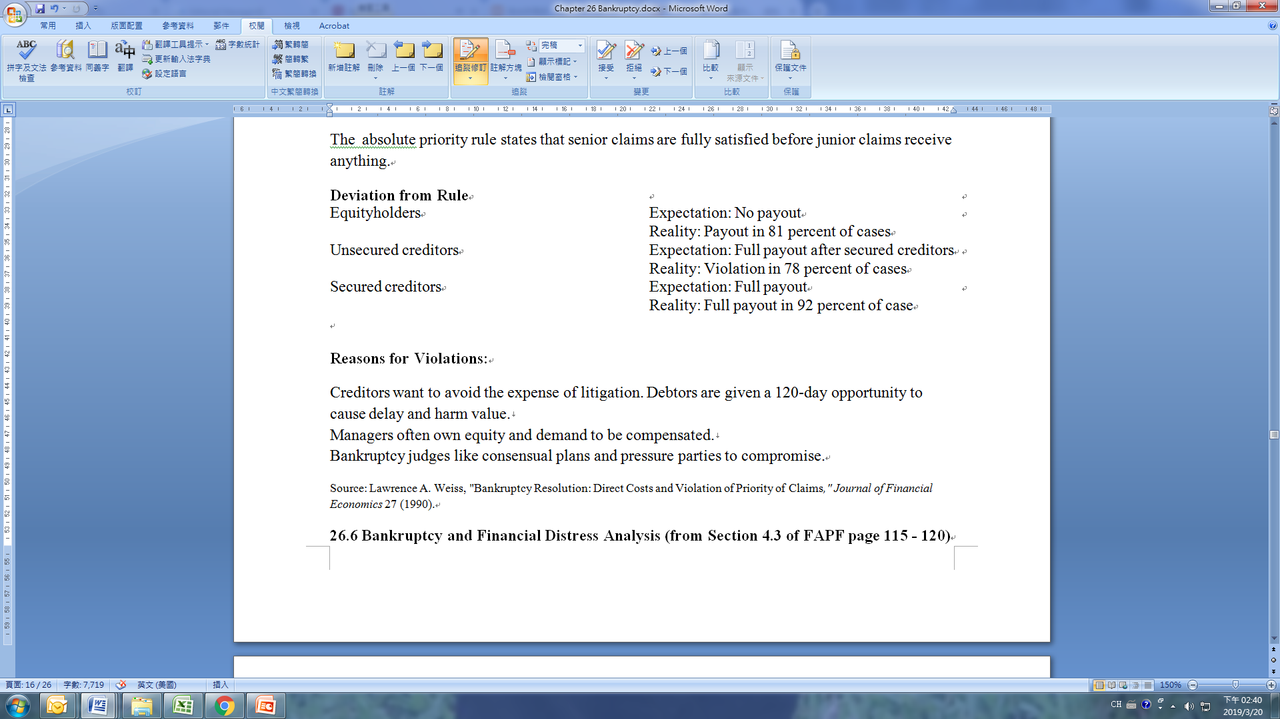
26.5 Out-of-Court Settlement and Private Workout Arrangement
26.5.4 Private Workout or Bankruptcy
Table 26.3 Absolute Priority Rule (APR)
The absolute priority rule states that senior claims are fully satisfied before junior claims receive anything.

Slide 61
26.5 Out-of-Court Settlement and Private Workout Arrangement
26.5.4 Private Workout or Bankruptcy
Reasons for Violations:
Creditors want to avoid the expense of litigation. Debtors are given a 120-day opportunity to cause delay and harm value.
Managers often own equity and demand to be compensated.
Bankruptcy judges like consensual plans and pressure parties to compromise.
Source: Lawrence A. Weiss, "Bankruptcy Resolution: Direct Costs and Violation of Priority of Claims," Journal of Financial Economics 27 (1990).

Slide 62
26.6 Bankruptcy and Financial Distress Analysis
For the past fifty years, academicians and practitioners have used the linear discriminant function to analyze bankruptcy and financial distress for both industrial and financial firms. In this section we will discuss Altman’s (1968) bankruptcy analysis for industrial firms. In Appendix 26A we will discuss Sinkey’s (1975) study of identifying problem banks from nonproblem banks.
Altman’s study included 33 manufacturers who filed bankruptcy petitions under Chapter X of the Bankruptcy Act during 1946-1965. These 33 firms were paired with 33 nonbankrupt firms on the basis of similar industry and asset size. Asset size ranged between $1 million and $25 million. For each firm, 22 variables were initially chosen for analysis on the basis of their popularity in the literature and their potential relevance to the study. These ratios were classified into five categories: liquidity, profitability, leverage, solvency, and activity. One ratio from each category was chosen for inclusion in the discriminant model.

Slide 63
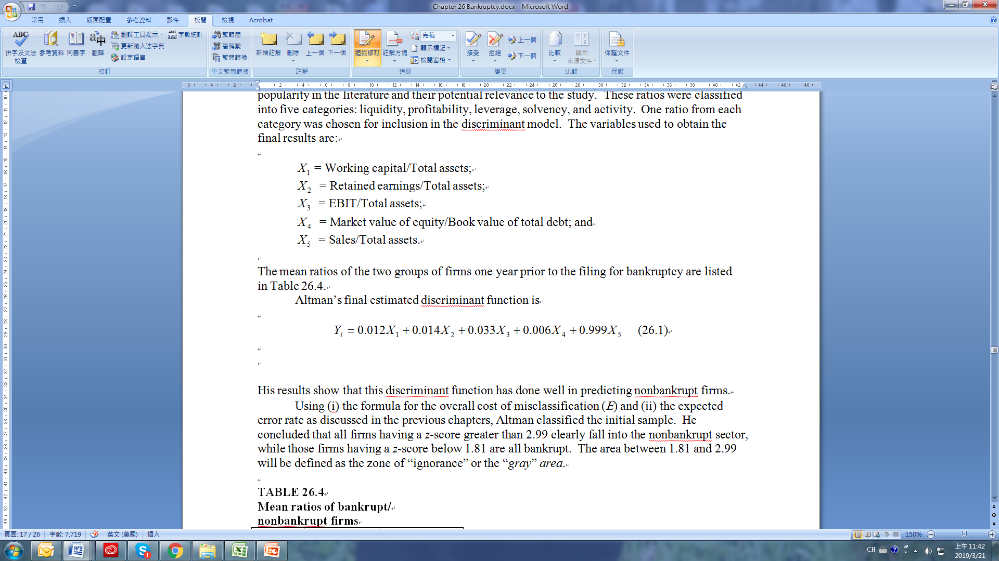
26.6 Bankruptcy and Financial Distress Analysis
The variables used to obtain the final results are:
The mean ratios of the two groups of firms one year prior to the filing for bankruptcy are listed in Table 26.4.
Altman’s final estimated discriminant function is
(26.1)

Slide 64
26.6 Bankruptcy and Financial Distress Analysis
His results show that this discriminant function has done well in predicting nonbankrupt firms.
Using (i) the formula for the overall cost of misclassification (E) and (ii) the expected error rate as discussed in the previous chapters, Altman classified the initial sample. He concluded that all firms having a z-score greater than 2.99 clearly fall into the nonbankrupt sector, while those firms having a z-score below 1.81 are all bankrupt. The area between 1.81 and 2.99 will be defined as the zone of “ignorance” or the “gray” area.

Slide 65
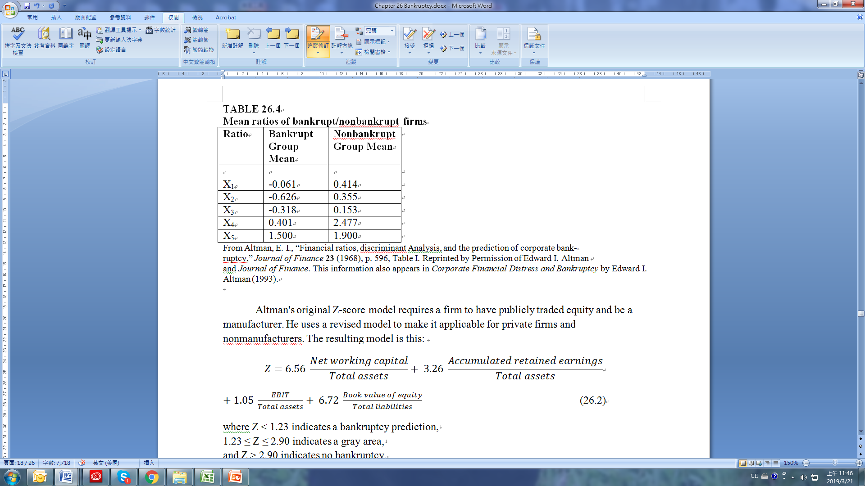
26.6 Bankruptcy and Financial Distress Analysis

Slide 66

26.6 Bankruptcy and Financial Distress Analysis
Altman's original Z-score model requires a firm to have publicly traded equity and be a manufacturer. He uses a revised model to make it applicable for private firms and nonmanufacturers. The resulting model is this:
(26.2)
where Z < 1.23 indicates a bankruptcy prediction, 1.23 ≤ Z ≤ 2.90 indicates a gray area, and Z > 2.90 indicates no bankruptcy.

Slide 67
26.6 Bankruptcy and Financial Distress Analysis
Now we will calculate the financial Z-score for Johnson & Johnson based upon their financial statement from 2016.
The balance sheet and income statement for Johnson & Johnson can be found in Tables 2.1 and 2.2 of Chapter 2.
The first step to determine the value of each of the financial statement variables and apply them in the Z-score value model as indicated in Equation 26.2.

Slide 68
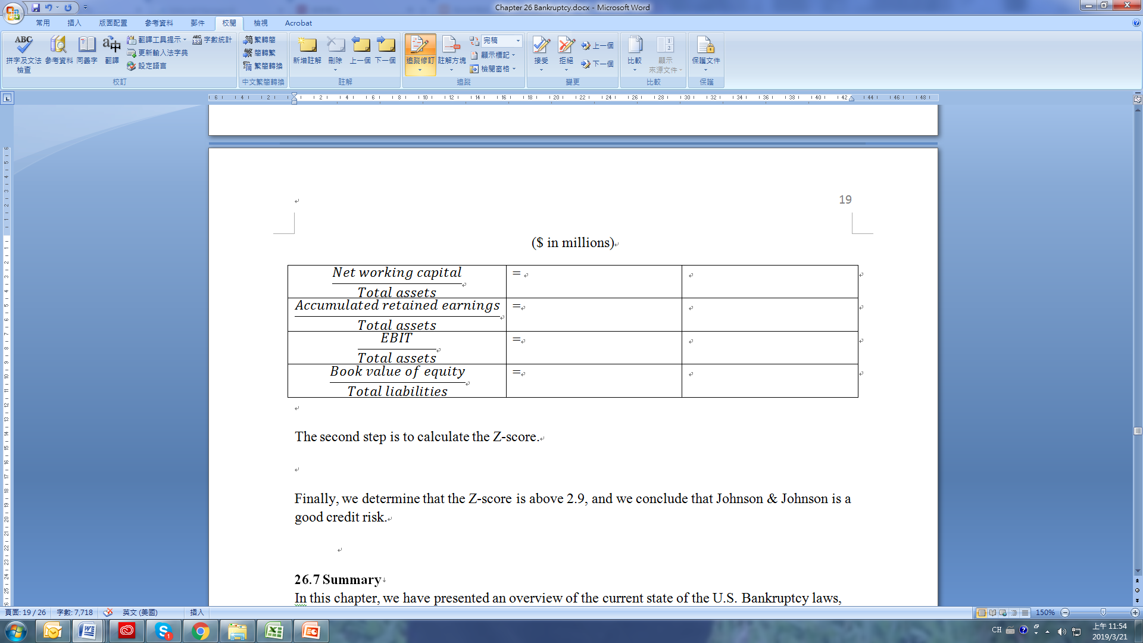
26.6 Bankruptcy and Financial Distress Analysis
The second step is to calculate the Z-score .
Finally, we determine that the Z-score is above 2.9, and we conclude that Johnson & Johnson is a good credit risk.

Slide 69
26.7 Summary
In this chapter, we have presented an overview of the current state of the U.S. Bankruptcy laws, especially Chapter 11 and Chapter 7 of the Federal Bankruptcy Reform Act of 1978. Debate continues as to whether or not this act is doing its job to strengthen the economy in the long term by providing the legal mechanism needed to liquidate or reorganize inefficient or failing firms. Critics of the current bankruptcy laws argue that:
1. The firm’s management is entrenched in its position. Most managers stay with the firm through bankruptcy proceedings. 2. Most companies that go through bankruptcy are liquidated. 3. There is no incentive for the bankruptcy process to be handled in a timely fashion.
In addition, we also have discussed how to calculate Altman's financial Z-score in terms of Johnson & Johnson's 2016 balance sheets and earnings statement data.

Slide 70
Appendix 26A: Financial Z-Score Analysis
BANKRUPTCY AND FINANCIAL DISTRESS ANALYSIS FOR FINANCIAL INSTITUTIONS
In Section 26.6 we discussed Altman's (1968) financial Z-score analysis for industrial firms. In this appendix we will discuss how Sinkey's (1975) study of problem banks is another example of the use of a discriminant function in financial analysis. Sinkey draws a profile of characteristics associated with banks that may be in danger of failing, in an attempt to develop an early warning system to help predict problem banks. The Federal Deposit Insurance Corporation wants to predict problem banks as early as possible in order to be able to advise banks of necessary financial-management changes in time for them to maintain solvent operations. “Problem” banks are categorized according to the likelihood of their needing financial assistance. The three classes of problem banks and the composition of the firms studied are presented below.

Slide 71
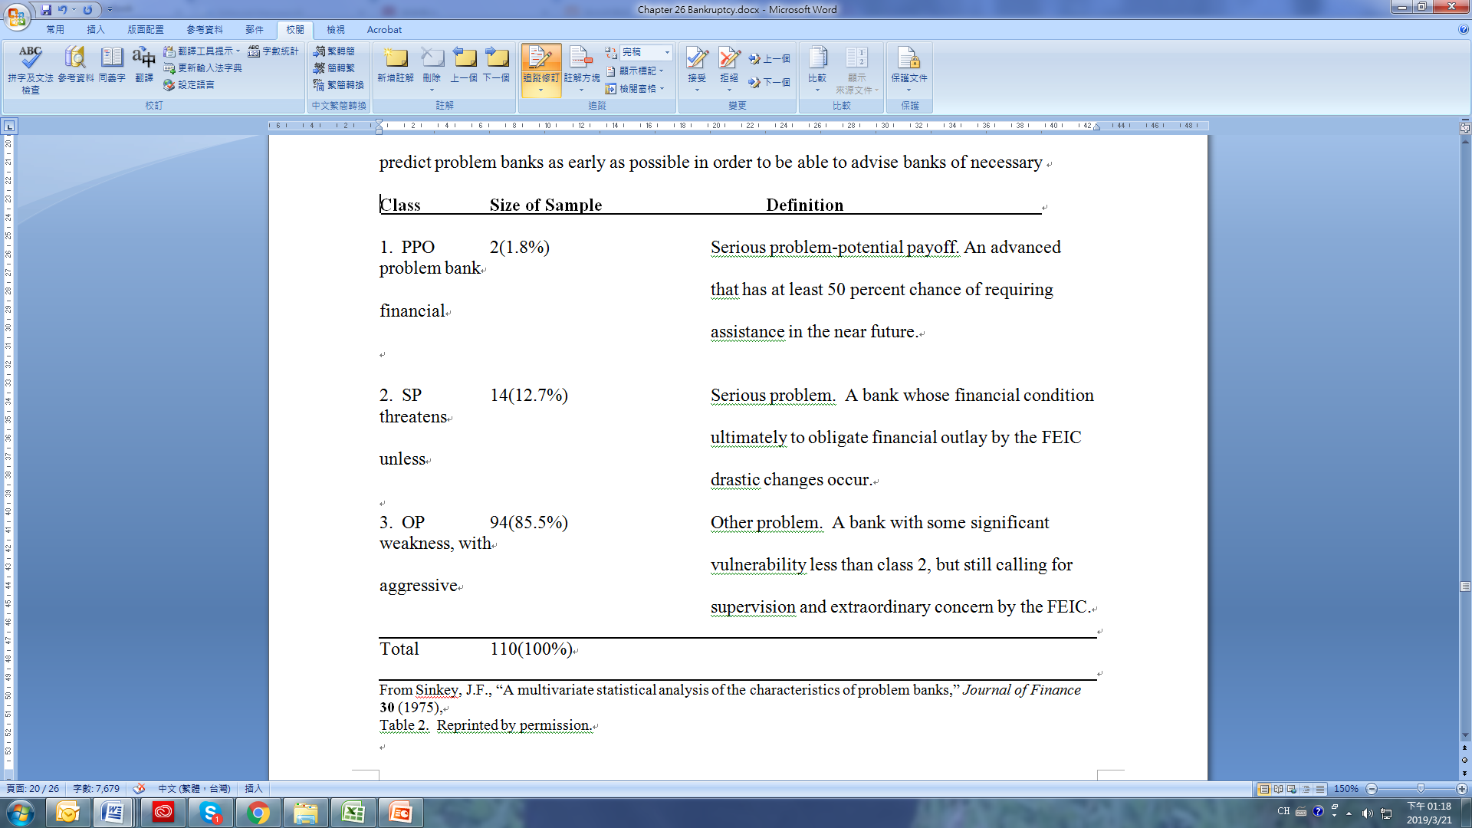
Appendix 26A: Financial Z-Score Analysis

Slide 72
Appendix 26A: Financial Z-Score Analysis
Of the 110 banks, analyzed, 90 were identified as “problems” in 1972 and 20 in 1973. Each problem bank was matched with a nonproblem bank similar to it by (1) geographic market area, (2) total deposits, (3) number of banking offices, and (4) Federal Reserve membership status.
Over 100 variables were initially examined to see if there was a significant difference between the ratios of problem and nonproblem banks on a univariate basis. Table 26A.1 presents a profile analysis (mean ratios for each group) of five ratios found to be highly significant over the 1969-72 period. These five variables represent the following dimensions of bank finances: (1) loan volume, represented by loans/assets; (2) capital adequacy, by loans/capital plus reserves; (3) efficiency, by operating expense/operating income; (4) sources of revenue, by loan revenue/total revenue; and 95) uses of revenue, by other expenses/total revenue.

Slide 73
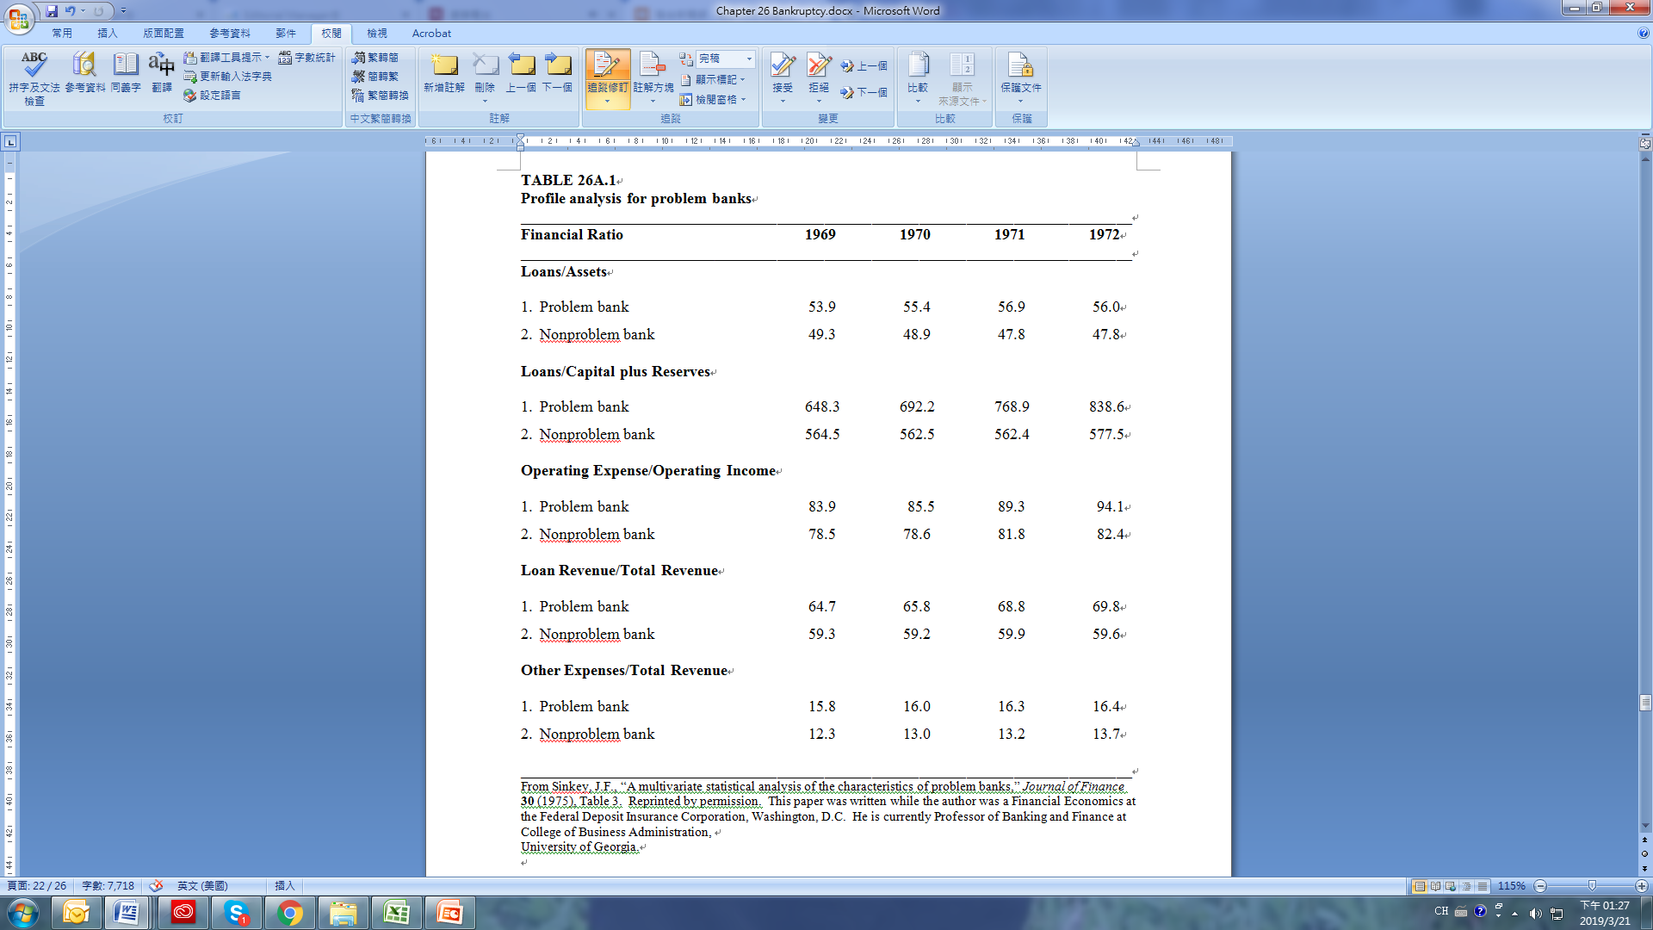
Appendix 26A: Financial Z-Score Analysis

Slide 74
Appendix 26A: Financial Z-Score Analysis
Sinkey then applied the multiple-discriminant-analysis technique to classify the banks on the basis of their financial ratios. Separate discriminant functions were estimated for each year from 1969 through 1972. In general, six or seven variables were included in each function. Recall that a type I error represents the prediction of a problem bank as a nonproblem one, and that a type II error represents the prediction of a nonproblem bank as a problem one. Obviously, from the viewpoint of financial outlay, a type I error is the more costly to the FDIC. The prediction results for each year are presented below.

Slide 75

Appendix 26A: Financial Z-Score Analysis
In the years closer to a bank’s classification as a problem bank, the discriminant model becomes better able to classify banks that were termed problems in 1971 and 1972. It is apparent that the potential exists for the banking agency to more efficiently allocate resources and analyze preexamination data through the implementation of an effective early warning system.

Slide 76
Discussion Questions
Explain in your own words the following terms: a. financial distress b. illiquidity c. insolvency d. bankruptcy
What is the difference between reorganization and liquidation?
What is a creditors’ committee? What type of power does a creditors’ committee have?
Identify the major difference between technical insolvency and legal insolvency.
According to Table 26.2, what are the major reasons for corporate failure? Do those reasons make sense to you? Can you find examples in The Wall Street Journal to illustrate those reasons?
Explain the difference between a cash flow view of bankruptcy and an accounting view of bankruptcy.
How are the rights of bondholders protected in the event of financial distress?

Slide 77
Discussion Questions
What are the basic arguments given for the need to reform Chapter 11?
What are some ways that a bankruptcy can be settled out of court?
Briefly explain how a bond indenture agreement can affect the solvency of a firm.
What actions can a firm that is in financial distress take to satisfy a bond indenture?
Provide some of the reasons for corporate failure.
What is composition?
If a firm is liquidated, what claim do stockholders have on the assets of the firm?
What effect does the conflict between stockholders and bondholders have on the probability of bankruptcy?
Should bankruptcy law favor creditors over owners, managers, or employees?
What problems might arise between stockholders and bondholders in a firm that is experiencing financial distress?
Please discuss how Altman's financial Z-score is developed.

Slide 78
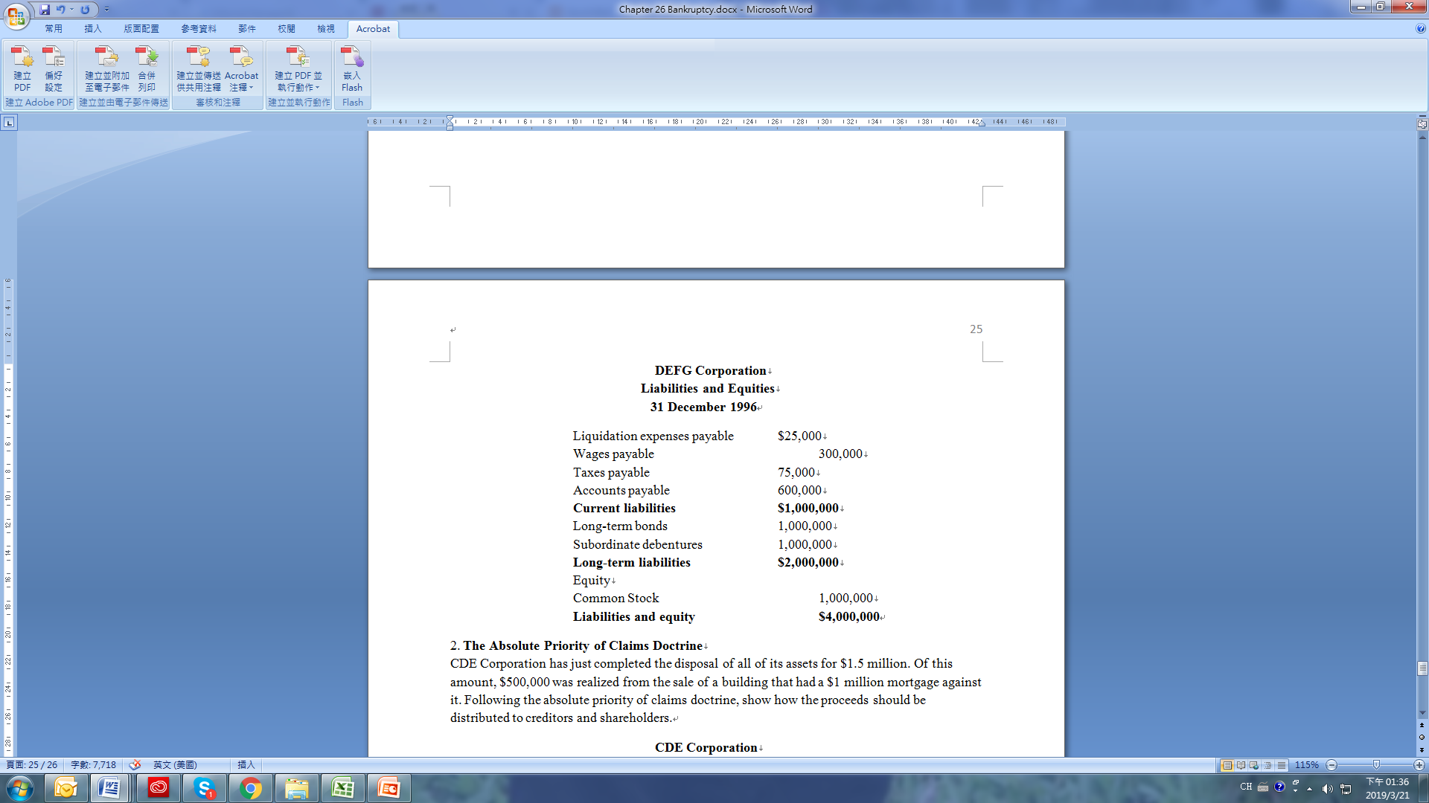
Problems
The Absolute Priority of Claims Doctrine
The DEFG Corporation has just completed the disposal of all of its assets for $2 million. Following the absolute priority of claims doctrine, show how the proceeds should be distributed to the creditors and shareholders.

Slide 79
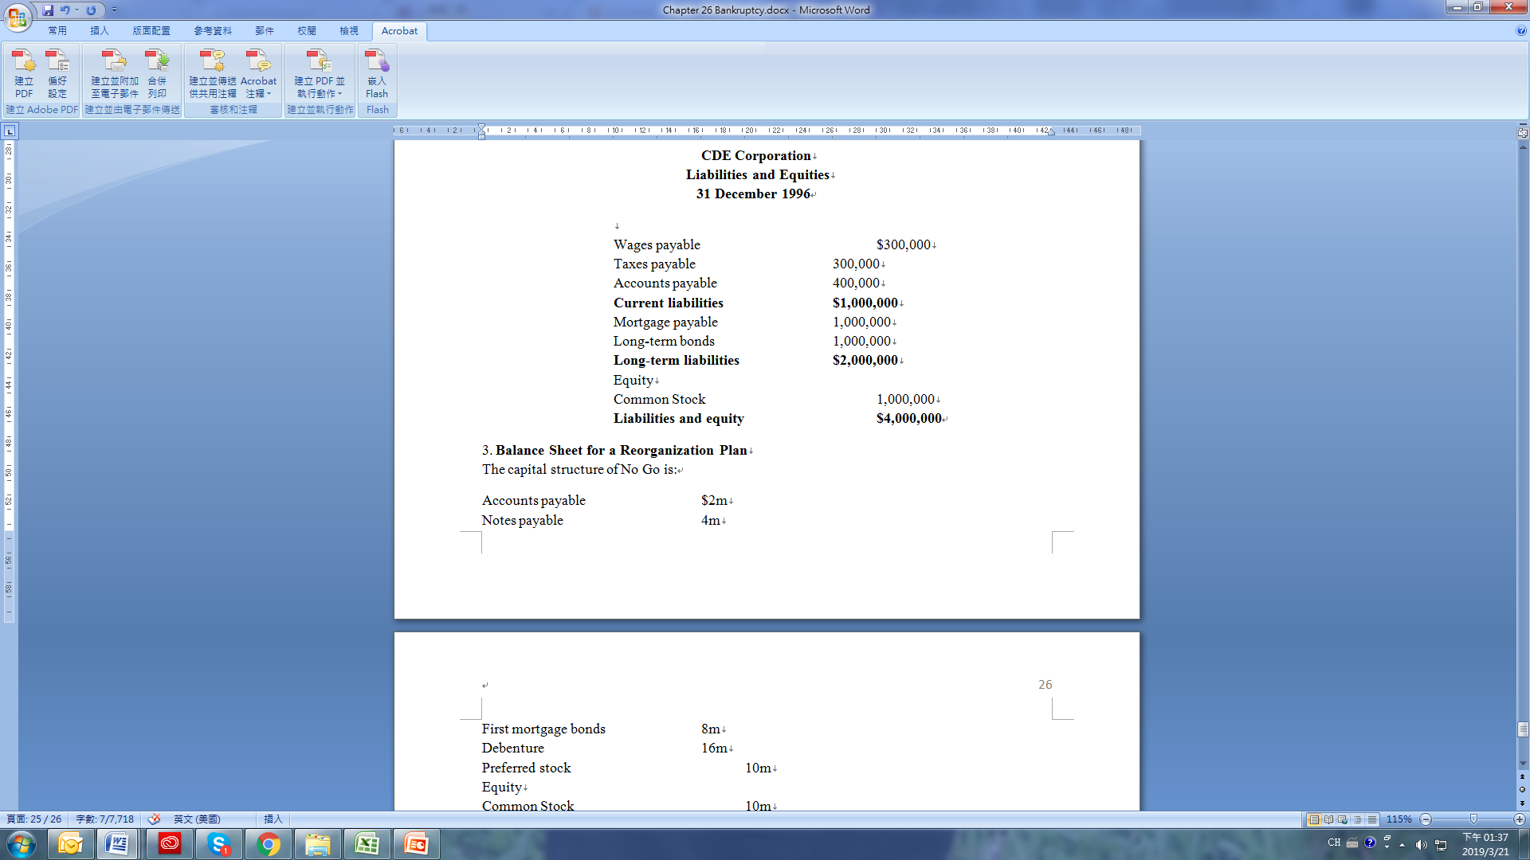
Problems
2. The Absolute Priority of Claims Doctrine
CDE Corporation has just completed the disposal of all of its assets for $1.5 million. Of this amount, $500,000 was realized from the sale of a building that had a $1 million mortgage against it. Following the absolute priority of claims doctrine, show how the proceeds should be distributed to creditors and shareholders.

Slide 80
Problems
3. Balance Sheet for a Reorganization Plan The capital structure of No Go is:
Accounts payable $2m Notes payable 4m First mortgage bonds 8m Debenture 16m Preferred stock 10m Equity Common Stock 10m Retained earnings (30m) Total liabilities and equity $20m
The firm’s assets are valued at $20 million. The first mortgage bonds are fully covered. The short-term creditors have agreed to share the loss at 50 percent. The debenture-holders will be residual and the preferred-holders will get nothing. Develop a reorganization plan for No Go. What is No Go’s balance sheet if your plan is accepted?
4. Please use Equation 26.1 to calculate Altman's financial Z-score in terms of balance sheets and earnings statement for 2018, 2019, 2020 and compare these three results.

