Slide 1
21 – FINANCIAL PLANNING AND STRATEGY

Slide 2
Chapter Outline
21.1 Introduction
21.2 Procedures For Financial Planning And Analysis
21.3 The Algebraic Simultaneous Equations Approach To Financial Planning And Analysis
21.4 The Linear Programming Approach To Financial Planning And Analysis
21.5 The Econometric Approach To Financial Planning And Analysis
21.5.1 A Dynamic Adjustment of the Capital Budgeting Model
21.5.2 Simplified Spies Model
21.6 Sensitivity Analysis
21.7 Summary
Appendix 21A: The Simplex Algorithm For Capital Rationing
Appendix 21B: Description Of Parameter Inputs Used To Forecast Johnson & Johnson’s Financial Statements And Share Price
Appendix 21C: Procedure of Using Excel to Implement the FinPlan Program

Slide 3
21.1 Introduction
Chapter 21 covers alternative financial planning models and their use in financial analysis and decision-making. The approach taken in this chapter gives the student an opportunity to combine information (accounting, market, and economic), theory, (classical, M & M, CAPM, and OPM), and methodology (regression and linear programming).
We begin by presenting the procedure for financial planning and analysis. This is followed by a discussion of the Warren and Shelton algebraic simultaneous equations planning model. The following sections cover the application of linear programming (LP) to financial planning and analysis, the application of econometric approaches to financial planning and analysis, and the importance of sensitivity analysis and its application to Warren and Shelton’s financial planning model. Appendix 21A shows how the simplex method is used in the capital rationing decision. Appendix 21B is a description of parameter inputs used to forecast Johnson & Johnson's financial statements and share price. Appendix 21C shows the procedure of how to use Excel to implement the FinPlan program.

Slide 4
21.2 PROCEDURES FOR FINANCIAL PLANNING AND ANALYSIS
Before discussing the various financial planning models, we must first be sure of our understanding of what the financial planning process is all about. Otherwise, we run the risk of too narrowly defining financial planning as simply data gathering and running computer programs. In reality, financial planning involves a process of analyzing alternative dividend, financing, and investment strategies, forecasting their outcome and impact within various economic environments, and then deciding how much risk to take on and which projects to pursue. Thus, financial planning models are merely tools to improve forecasting as well as to help managers better understand the interactions of dividend, financing, and investment decisions.

Slide 5
21.2 PROCEDURES FOR FINANCIAL PLANNING AND ANALYSIS
More formally, we can outline the financial planning process as follows:
Utilize the existing set of economic, legal, accounting, marketing, and company policy information.
Analyze the interactions of the dividend, financing, and investment choices open to the firm.
Forecast the future consequences of present decisions to avoid unexpected events as well as to aid in understanding the interaction of present and future decisions.
Decide which alternatives the firm should undertake, the explicit outline for which is contained in the financial plan.
Evaluate the subsequent outcome of these decisions once they are implemented against the objectives set forth in the financial plan.

Slide 6
21.2 PROCEDURES FOR FINANCIAL PLANNING AND ANALYSIS
So where does the financial planning model come in? To clarify its role in this process, look at Figure 21-1, which presents a flowchart of a financial planning model. The inputs to the model are economic and accounting information (discussed in Chapter 2) and market and policy information (discussed in Chapters 3-20). Three alternative financial planning, analysis, and forecasting models are (1) the algebraic simultaneous equations model, (2) the linear programming model, and (3) the econometric model. The outputs of the financial planning and forecasting model are pro forma financial statements, forecasted PPS, EPS, and DPS, new equity issued, and new debt issued. Essentially, the benefit of the model is to efficiently and effectively handle the analysis of information and its interactions with the forecasting of future consequences within the planning process. This chapter discusses three alternative financial planning models. The simultaneous equation model can be found in Lee and Lee's (2017) Chapter 24. The linear programming model can be found in chapters 22 and 23. Finally, the econometric type of financial planning model can be found in Chapter 26. This chapter has discussed the simultaneous equation model in detail; however, the other two models have only been briefly discussed. For further information on these two models, see Lee and Lee (2017).

Slide 7
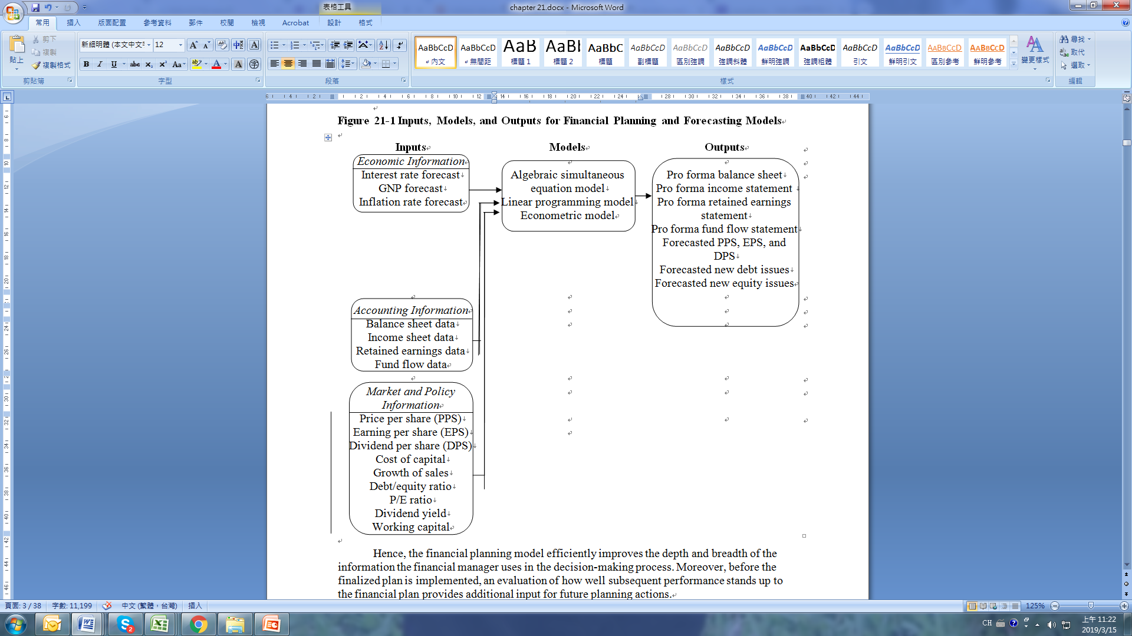
21.2 PROCEDURES FOR FINANCIAL PLANNING AND ANALYSIS
Figure 21-1 Inputs, Models, and Outputs for Financial Planning and Forecasting Models

Slide 8
21.2 PROCEDURES FOR FINANCIAL PLANNING AND ANALYSIS
Hence, the financial planning model efficiently improves the depth and breadth of the information the financial manager uses in the decision-making process. Moreover, before the finalized plan is implemented, an evaluation of how well subsequent performance stands up to the financial plan provides additional input for future planning actions.
A key to the value of any financial planning model is how it is formulated and constructed. That is, the credibility of the model’s output depends on the underlying assumptions and particular financial theory the model is based on, as well as its ease of use for the financial planner. Because of its potentially great impact on the financial planning process and, consequently, on the firm’s future, the particular financial planning model to be used must be chosen carefully.

Slide 9
21.2 PROCEDURES FOR FINANCIAL PLANNING AND ANALYSIS
Specifically, we can state that a useful financial planning model should have the following characteristics:
The model results and assumptions should be credible.
The model should be flexible so that it can be adapted and expanded to meet a variety of circumstances.
The model should improve on current practice in a technical or performance sense.
The model inputs and outputs should be comprehensible to the user without extensive additional knowledge or training.
The model should take into account the interrelated investment, financing, dividend, and production decisions and their effect on the firm’s market value.
The model should be fairly simple for the user to operate without extensive intervention of nonfinancial personnel and tedious formulation of the input.
On the basis of these guidelines, we now present and discuss the simultaneous equations, linear programming, and econometric financial planning models, which can be used for financial planning and analysis.

Slide 10
21.3 THE ALGEBRAIC SIMULTANEOUS EQUATIONS APPROACH TO FINANCIAL PLANNING AND ANALYSIS
In this section, we present the financial planning approach of Warren and Shelton (1971), which is based on a simultaneous equations concept. The model, called FINPLAN, deals with overall corporate financial planning as opposed to just some are of planning, such as capital budgeting. The objective of the FINPLAN model is not to optimize anything, but rather, to serve as a tool to provide relevant information to the decision-maker. One of the strengths of this planning model, in addition to its construction, is that it allows the user to simulate the financial impacts of changing assumptions regarding such variables as sales, operating ratios, price-to-earnings ratios, retention rates, and debt-to-equity ratios.

Slide 11
21.3 THE ALGEBRAIC SIMULTANEOUS EQUATIONS APPROACH TO FINANCIAL PLANNING AND ANALYSIS
The advantage of utilizing a simultaneous equation structure to represent a firm’s investment, financing, production, and dividend policies is the enhanced ability for the interaction of these decision-making areas. The Warren and Shelton (WS) model is a system of 20 equations which are listed in Table 21-1. These equations are segmented into distinct subgroups corresponding to sales, investment, financing, and per share (return to investors) data. The flowchart describing the interrelationships of the equations is shown in Figure 21-2.

Slide 12
21.3 THE ALGEBRAIC SIMULTANEOUS EQUATIONS APPROACH TO FINANCIAL PLANNING AND ANALYSIS
The key concepts of the interaction of investment, financing, and dividends, as explained in Chapter 13, are the basis of the FINPLAN model, which we now consider in some detail. First, we discuss the inputs to the model; second, we delve into the interaction of the equations in the model; and third, we look at the output of the FINPLAN model.

Slide 13
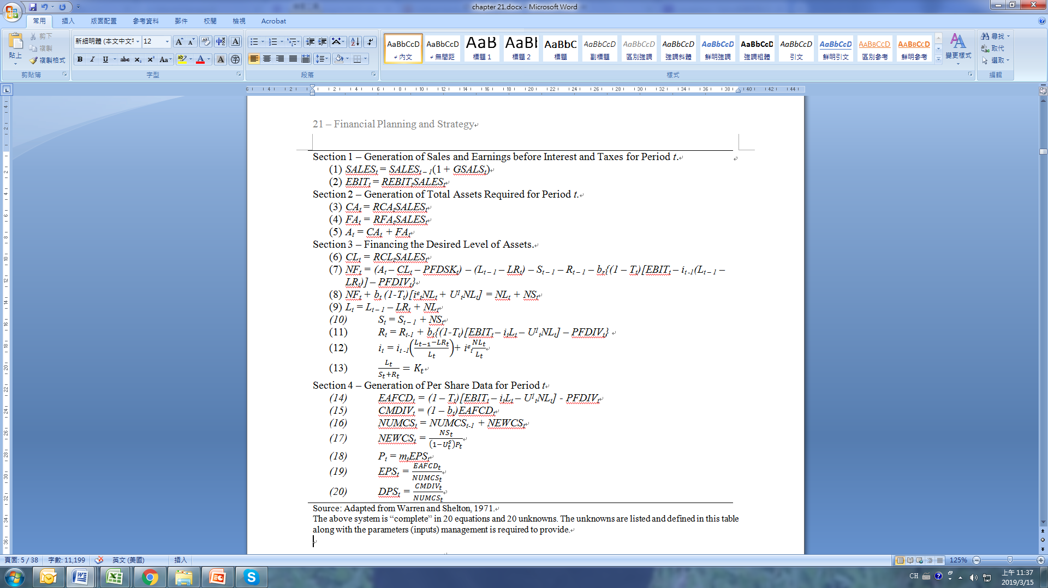
21.3 THE ALGEBRAIC SIMULTANEOUS EQUATIONS APPROACH TO FINANCIAL PLANNING AND ANALYSIS
Table 21-1 WS Model

Slide 14
21.3 THE ALGEBRAIC SIMULTANEOUS EQUATIONS APPROACH TO FINANCIAL PLANNING AND ANALYSIS
FIGURE 21-2 Flow Chart of a Simplified Financial Planning Model

Slide 15
21.3 THE ALGEBRAIC SIMULTANEOUS EQUATIONS APPROACH TO FINANCIAL PLANNING AND ANALYSIS
The inputs to the model are shown in Table 21-2B. The driving force of the WS model is the sales growth estimates (GSALS^{t}). Equation (1) in Table 21-1 shows that sales for period t is the product of sales in the prior period multiplied by the growth rate in sales for period t. EBIT is then derived, by expressing EBIT as a percentage of sales ratio, as in Equation (2) of Table 21-1. Current and fixed assets are then derived in Equations 3 and 4 of the table through use of the CA/SALES and FA/SALES ratios. The sum of CA and FA is total assets for the period.

Slide 16
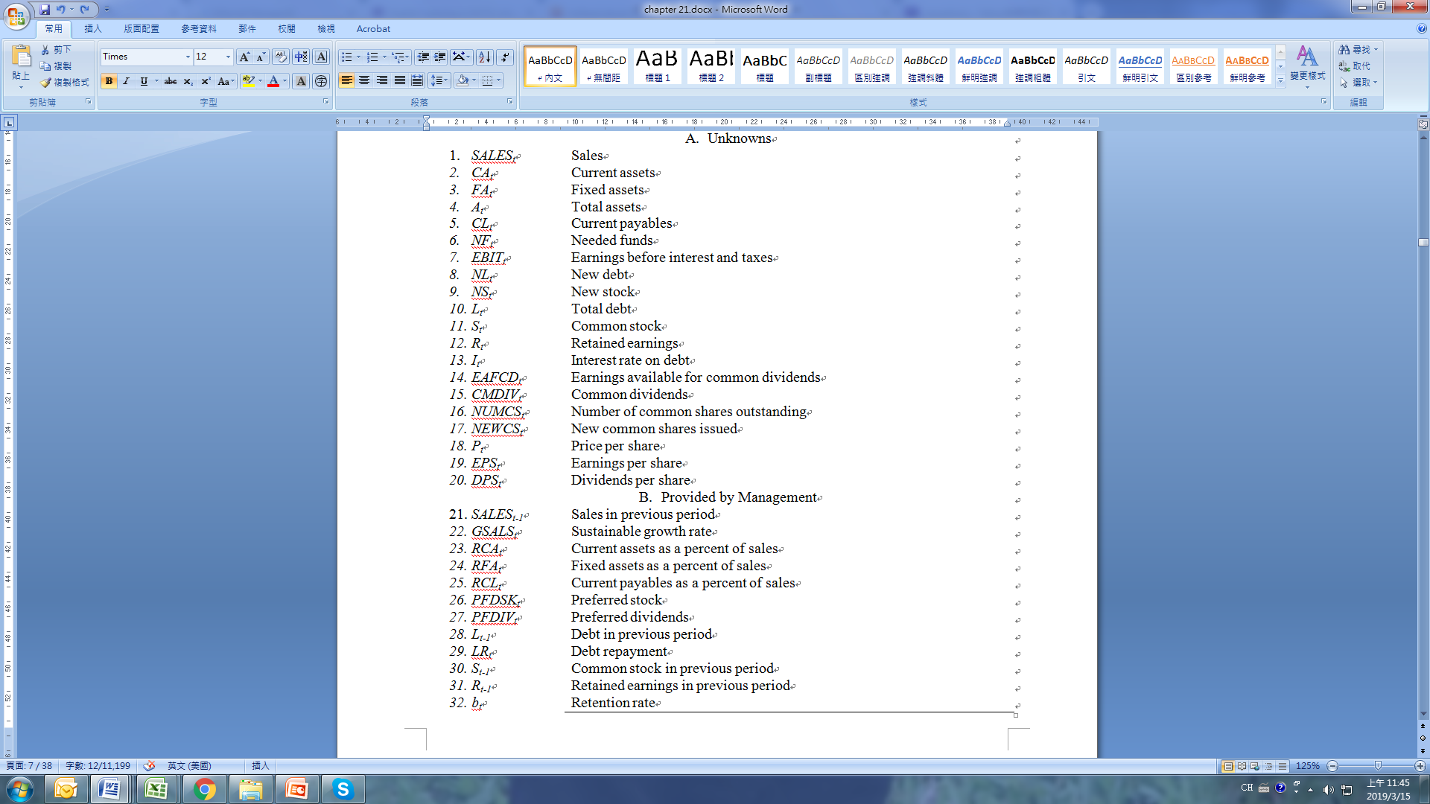
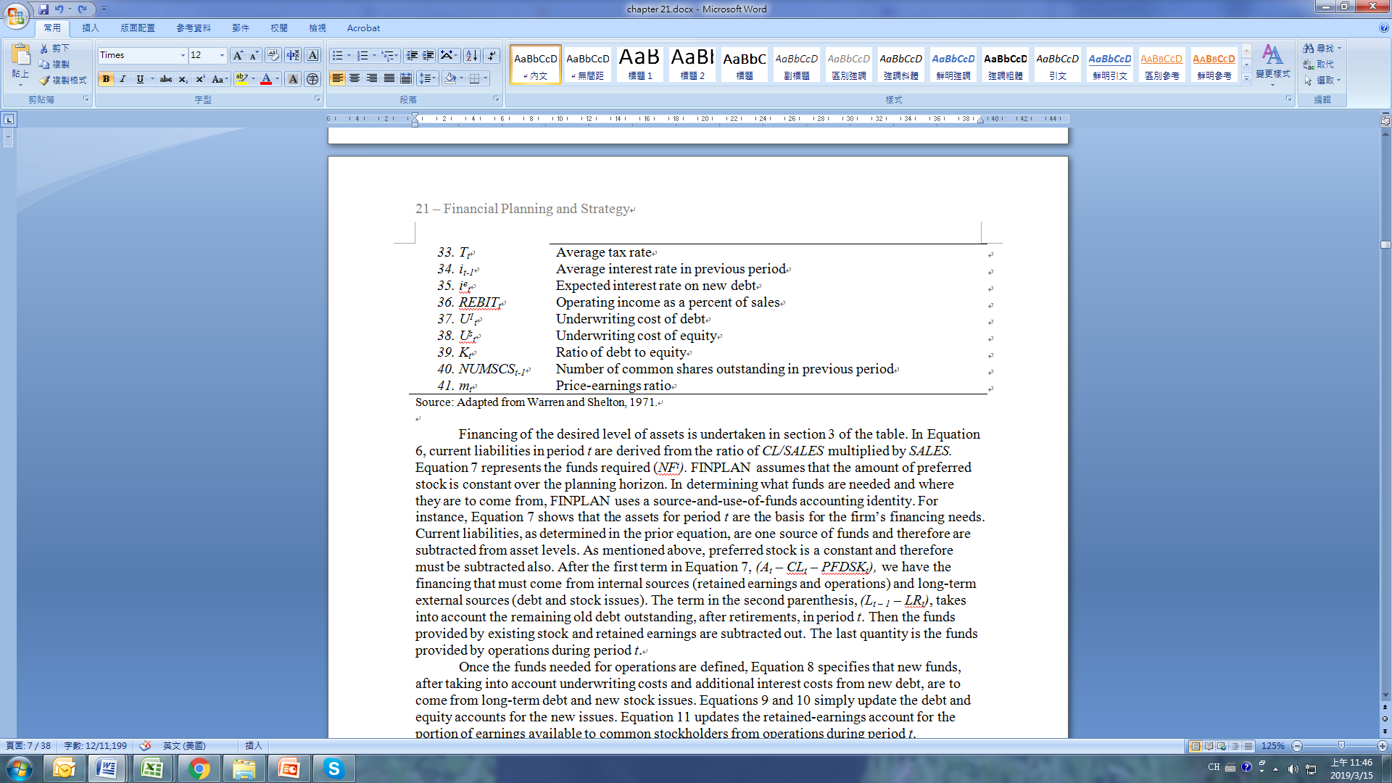
21.3 THE ALGEBRAIC SIMULTANEOUS EQUATIONS APPROACH TO FINANCIAL PLANNING AND ANALYSIS
Table 21-2 List of Unknowns and List of Parameters Provided by Management

Slide 17
21.3 THE ALGEBRAIC SIMULTANEOUS EQUATIONS APPROACH TO FINANCIAL PLANNING AND ANALYSIS
Financing of the desired level of assets is undertaken in section 3 of the table. In Equation 6, current liabilities in period t are derived from the ratio of CL/SALES multiplied by SALES. Equation 7 represents the funds required (NF^{t}). FINPLAN assumes that the amount of preferred stock is constant over the planning horizon. In determining what funds are needed and where they are to come from, FINPLAN uses a source-and-use-of-funds accounting identity. For instance, Equation 7 shows that the assets for period t are the basis for the firm’s financing needs. Current liabilities, as determined in the prior equation, are one source of funds and therefore are subtracted from asset levels.

Slide 18
21.3 THE ALGEBRAIC SIMULTANEOUS EQUATIONS APPROACH TO FINANCIAL PLANNING AND ANALYSIS
As mentioned above, preferred stock is a constant and therefore must be subtracted also. After the first term in Equation 7, (A_{t} – CL_{t} – PFDSK_{t}), we have the financing that must come from internal sources (retained earnings and operations) and long-term external sources (debt and stock issues). The term in the second parenthesis, (L_{t – 1} – LR_{t}), takes into account the remaining old debt outstanding, after retirements, in period t. Then the funds provided by existing stock and retained earnings are subtracted out. The last quantity is the funds provided by operations during period t.

Slide 19
21.3 THE ALGEBRAIC SIMULTANEOUS EQUATIONS APPROACH TO FINANCIAL PLANNING AND ANALYSIS
Once the funds needed for operations are defined, Equation 8 specifies that new funds, after taking into account underwriting costs and additional interest costs from new debt, are to come from long-term debt and new stock issues. Equations 9 and 10 simply update the debt and equity accounts for the new issues. Equation 11 updates the retained-earnings account for the portion of earnings available to common stockholders from operations during period t. Specifically, b^{t} is the retention rate in period t and (1 – T ^{t}) is the after-tax percentage, which is multiplied by the earnings from the period after netting out interest costs on both new and old debt. Since preferred stockholders must be paid before common stockholders, preferred dividends must be subtracted from funds available for common stockholders. Equation 12 calculates the new weighted-average interest rate for the firm’s debt. Equation 13 is the new debt-to-equity ratio for period t.

Slide 20
21.3 THE ALGEBRAIC SIMULTANEOUS EQUATIONS APPROACH TO FINANCIAL PLANNING AND ANALYSIS
Section 4 of Table 21-1 applies to the common stockholder; in particular, dividends and market value. Equation 14 represents the earnings available for common dividends and is simply the firm’s after-tax earnings. Correspondingly, Equation 15 computes the earnings to be paid to common stockholders. Equation 16 updates the number of common shares for new issues.
As Equation 17 shows, the number of new common shares is determined by the total new stock issue divided by the stock price after discounting for issuance costs. Equation 18 determines the price of the stock through the use of a price-earnings ratio (m^{t}) of the stock purchase. Equation 19 determines EPS, as usual, by dividing earnings available to common stockholders by the number of common shares outstanding. Equation 20 determines dividends in a similar manner.

Slide 21
21.3 THE ALGEBRAIC SIMULTANEOUS EQUATIONS APPROACH TO FINANCIAL PLANNING AND ANALYSIS
Tables 21-3, 21-4, and 21-5 illustrate the setup of the necessary input variables and the resulting output of the pro forma balance sheet and income statement for the Exxon Company. As mentioned, the WS equation system requires values for parameter inputs, which for this example are listed in Table 21-3. The first column represents the value of the input, while the second column corresponds to the variable number. The third and fourth columns pertain to beginning and ending periods for the desired planning horizon.
From Tables 21-4 and 21-5 you can see the type of information the FINPLAN model generates. With 2016 as a base year, planning information is forecasted for the firm over the period 2017-2020.

Slide 22
21.3 THE ALGEBRAIC SIMULTANEOUS EQUATIONS APPROACH TO FINANCIAL PLANNING AND ANALYSIS
Based on the model’s construction, its underlying assumptions, and the input data, the WS model reveals the following:
The amount of investment to be carried out
How this investment is to be financed
The amount of dividends to be paid
How alternative policies can affect the firm’s market value

Slide 23
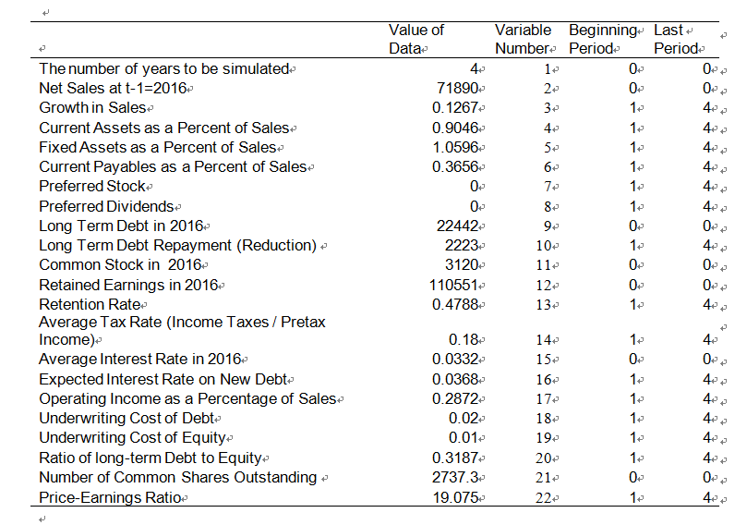
21.3 THE ALGEBRAIC SIMULTANEOUS EQUATIONS APPROACH TO FINANCIAL PLANNING AND ANALYSIS
Table 21-3 FINPLAN Inputs

Slide 24
21.3 THE ALGEBRAIC SIMULTANEOUS EQUATIONS APPROACH TO FINANCIAL PLANNING AND ANALYSIS
Even more important, as we will explore later in this chapter, this model’s greatest value (particularly for FINPLAN) arises from the sensitivity analysis that can be performed. That is, by varying one or several of the input parameters, the financial manager can better understand how his or her decisions interact and, consequently, how they will affect the company’s future. (Sensitivity analysis is discussed in greater detail later in this chapter.)

Slide 25
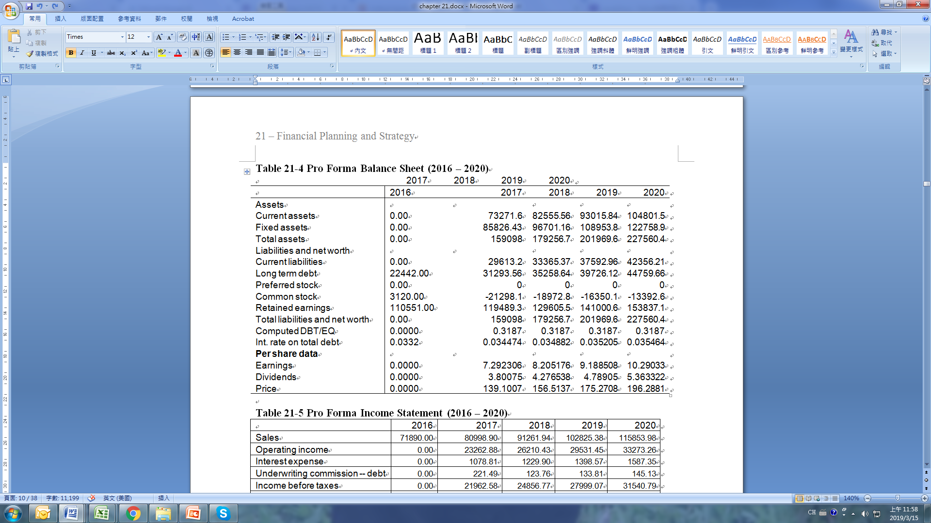
21.3 THE ALGEBRAIC SIMULTANEOUS EQUATIONS APPROACH TO FINANCIAL PLANNING AND ANALYSIS
Table 21-4 Pro Forma Balance Sheet (2016 – 2020)

Slide 26
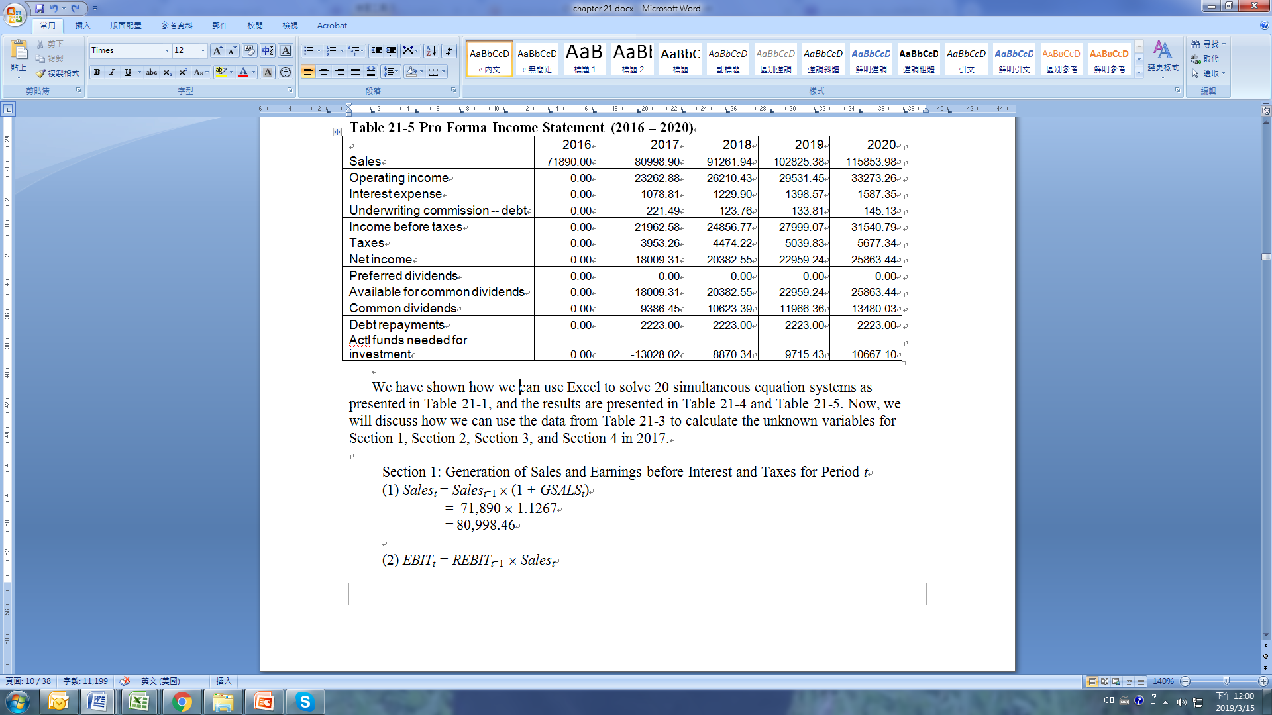
21.3 THE ALGEBRAIC SIMULTANEOUS EQUATIONS APPROACH TO FINANCIAL PLANNING AND ANALYSIS
Table 21-5 Pro Forma Income Statement (2016 – 2020)

Slide 27
21.3 THE ALGEBRAIC SIMULTANEOUS EQUATIONS APPROACH TO FINANCIAL PLANNING AND ANALYSIS
We have shown how we can use Excel to solve 20 simultaneous equation systems as presented in Table 21-1, and the results are presented in Table 21-4 and Table 21-5. Now, we will discuss how we can use the data from Table 21-3 to calculate the unknown variables for Section 1, Section 2, Section 3, and Section 4 in 2017.
Section 1: Generation of Sales and Earnings before Interest and Taxes for Period t
(1) Sales_{t} = Sales_{t}−₁ × (1 + GSALS_{t})
= 71,890 × 1.1267
= 80,998.46
(2) EBIT_{t} = REBIT_{t}−₁ × Sales_{t}
= 0.2872 × 80998.463
= 23,262.76

Slide 28
21.3 THE ALGEBRAIC SIMULTANEOUS EQUATIONS APPROACH TO FINANCIAL PLANNING AND ANALYSIS
Section 2: Generation of Total Assets Required for Period t
(3) CA_{t} = RCA_{t}−₁ × Sales_{t}
= 0.9046× 80998.463
= 73,271.21
(4) FA_{t} = RFA_{t}−₁ × Sales_{t}
= 1.0596 × 80998.463
= 85,825.97
(5) A_{t} = CA_{t} + FA_{t}
= 73271.21+ 85825.97
= 159,097.18
Section 3: Financing the Desired Level of Assets
(6) CL_{t} = RCL_{t}−₁ × Sales_{t}
= 0.3656 × 80998.463
= 29,613.00

Slide 29
21.3 THE ALGEBRAIC SIMULTANEOUS EQUATIONS APPROACH TO FINANCIAL PLANNING AND ANALYSIS
(7) NF_{t} = (A_{t} – CL_{t} – PFDSK_{t}) – (L_{t}−₁ – LR_{t}) – S_{t}−₁ – R_{t}−₁ – b_{t}×{(1 – T_{t})[EBIT_{t} –
i_{t}−₁(L_{t}−₁ – LR_{t})] – PFDIV_{t}}
= (159097.181–29,613.00– 0) − (22,442 – 2,223) – 3,120.0 – 110,551 – 0.4788×{(1−0.18)×[ 23262.76− 0.0332×(22,442-2,223)] – 0}
=-13,275.64
(12) i_{t}L_{t} = i_{t}−₁ (L_{t}−₁ – LR_{t}) + i^{e}_{t}−₁×NL_{t}
= 0.0332×(22,442 – 2,223) + 0.0368×NL_{t}
= 671.2708 + 0.0368×NL_{t}
(8) NF_{t} + b_{t}(1−T)[i_{t}−₁ ×NL_{t} + U^{L}_{t}×NL_{t}] = NL_{t} + NS_{t}
-13275.64 + 0.4788 ×(1−0.18) × (0.0332NL_{t} + 0.02×NL_{t}) = NL_{t} + NS_{t}
-13275.64+ 0.02089×NL_{t} = NL_{t} + NS_{t}
(a) NS_{t} +0.97911NL_{t} = −24,337.4104

Slide 30
21.3 THE ALGEBRAIC SIMULTANEOUS EQUATIONS APPROACH TO FINANCIAL PLANNING AND ANALYSIS
(9) L_{t} = L_{t}−₁ – LR_{t} + NL_{t}
(b) L_{t} = 22,442 – 2223+ NL_{t}
L_{t} – NL_{t} = 20,219
(10) S_{t} = S_{t}−₁ + NS_{t}
(c) −NS_{t} + S_{t} = 3,120.0
(11) R_{t} = R_{t}−₁ + b_{t}{(1 – T_{t})[EBIT_{t} – i_{t}L_{t} – U^{L}_{t}NL_{t}] – PFDIV_{t}}
= 110,551 + 0.4778×{(1−0.18)×[ 23,262.76– i_{t}L_{t} –0.02×NL_{t}] −0}

Slide 31
21.3 THE ALGEBRAIC SIMULTANEOUS EQUATIONS APPROACH TO FINANCIAL PLANNING AND ANALYSIS
Substitute (12) into (11)
R_{t} = 110,551 + 0.4778×{0.82× [23,262.76– (671.2708 + 0.0368×NL_{t})
–0.02×NL_{t}]}
= 119,420.7796 − 0.0223NL_{t}
(d) 119,420.7796 = R_{t} +0.0223NL_{t}
(13) L_{t} = (S_{t} + R_{t})K_{t}
L_{t} = 0.3187S_{t} + 0.3187R_{t}
(e) L_{t} – 0.3187S_{t} – 0.3187R_{t} = 0
(b) – (e) = (f)
20,219= 0.3187S_{t} + 0.3187R_{t} – NL_{t}

Slide 32
21.3 THE ALGEBRAIC SIMULTANEOUS EQUATIONS APPROACH TO FINANCIAL PLANNING AND ANALYSIS
(f) – 0.3187 (c) = (g)
19,224.656= 0.3187NS_{t} − NL_{t} + 0.3187R_{t}
(g) – 0.3187 (d) = (h)
- NL_{t}+0.3187 NS_{t}-0.0071 NL_{t}=-18834.74646
-18834.74646= 0.3187 NS_{t} –1.0071NL_{t}
(h) – 0.3187(a) = (i)
–1.0071NL_{t} –0.3120NL_{t}=-14603.81
NL_{t} =-14603.81/1.31915=11070.62
Substitute NL_{t} in (a)
NS_{t} =-24114.98745

Slide 33
21.3 THE ALGEBRAIC SIMULTANEOUS EQUATIONS APPROACH TO FINANCIAL PLANNING AND ANALYSIS
Substitute NL_{t} in (b)
L_{t} = 31289.62094
Substitute NS_{t} in (c)
S_{t} = -20994.98745
Substitute NL_{t} in (d)
R_{t} = 119173.9047
Substitute NL_{t}L_{t} in (12)…
i_{t} =0.03447
Section 4: Generation of Per Share Data for Period t
(14) EAFCD_{t} = (1 – T_{t})(EBIT_{t} – i_{t}L_{t} – U^{L}_{t}NL_{t}) − PFDIV_{t}
= (1-0.18)×[23,262.75857–0.03447×31289.62− 0.02× (11070.62)]-0
= 18009.49019

Slide 34
21.3 THE ALGEBRAIC SIMULTANEOUS EQUATIONS APPROACH TO FINANCIAL PLANNING AND ANALYSIS
(15) CMDIV_{t} = (1 – b_{t})EAFCD_{t}
= (1-0.4788)( 18009.49019)
= 9386.546287
(16) NUMCS_{t} = X₁ = NUMCS_{t}−₁ + NEWCS_{t}
X₁ = 2737.3 + NEWCS_{t}
(17) NEWCS_{t} = X₂ = NS_{t} / (1 – U^{E}_{t}) P_{t}
X₂ =-24114.98745/ (1 − 0.01)P_{t}
(18) P_{t} = X₃ = m_{t}EPS_{t}
X₃ = 19.075(EPS_{t})
(19) EPS_{t} = X₄ = EAFCD_{t} / NUMCS_{t}
X₄ = 18009.49019/ NUMCS_{t}
(20) DPS_{t} = X₅ = CMDIV_{t}/ NUMCS_{t}
X₅ =9386.546287/ NUMCS_{t}

Slide 35
21.3 THE ALGEBRAIC SIMULTANEOUS EQUATIONS APPROACH TO FINANCIAL PLANNING AND ANALYSIS
(A) = For (18) and (19), we obtain X₃ = 19.075(18009.49019)/ NUMCS_{t} =343,531.0254/X₁
Substitute (A) into Equation (17) to calculate (B)
(B)= X₂ = -24114.98745/[ (1 − 0.01) × 343,531.0254/X₁]
(B) =X₂ = -0.0709X₁
Substitute (B) into Equation (16) to calculate (C)
(C) = X₁ = 2,737.3 − 0.0709X₁
(C) = X₁ = 2556.058882=NUMCS_{t}
Substitute (C) into (B)…
(B) = X₂ = -181.2411175=NEWCS_{t}

Slide 36
21.3 THE ALGEBRAIC SIMULTANEOUS EQUATIONS APPROACH TO FINANCIAL PLANNING AND ANALYSIS
From Equation (19) and (20) we obtain X₄, X₅
X₄ = 7.04= EPS_{t}
X₅ =3.67= DPS_{t}
From Equation (18) we obtain X₃
X₃ = 134.40= P_{t}
Now we summarize the forecasted variables for 2017 as follows:
Sales = $80,998.46
Current Assets = $73,271.21
Fixed Assets = $85,825.97
Total Assets = $159,097.18
Current Payables = $29,613.00

Slide 37
21.3 THE ALGEBRAIC SIMULTANEOUS EQUATIONS APPROACH TO FINANCIAL PLANNING AND ANALYSIS
Needed Funds = ($13,275.64)
Earnings before Interest and Taxes = $23,262.76
New Debt = $8393.78
New Stock = ($24,114.99)
Total Debt = $31,289.62094
Common Stock = ($20,994.98745)
Retained Earnings = $119,173.9047
Interest Rate on Debt = 3.43%
Earnings Available for Common Dividends = $18009.49019
Common Dividends = $9386.546287
Number of Common Shares Outstanding = 2556.058882
New Common Shares Issued = (181.2411175)
Price per Share = $134.40
Earnings per Share = $7.04
Dividends per Share = $3.67
The above forecasted variables are almost identical to the numbers for 2017 presented in Table 21-4 and Table 21-5.

Slide 38
21.4 THE LINEAR PROGRAMMING APPROACH TO FINANCIAL PLANNING AND ANALYSIS
In this section, we will discuss how linear programming techniques can be used to i) solve profit maximization problems, ii) to perform capital rationing problems, and iii) to perform financial planning and forecasting.
An alternative approach to financial planning is based on using the optimization technique of linear programming. Using linear programming to do financial planning, the decision-maker sets up an objective function, such as to maximize firm value based on some financial theory. Hence, the model optimizes this objective function subject to certain constraints, such as maximum allowable debt/equity and payout ratios.

Slide 39
21.4 THE LINEAR PROGRAMMING APPROACH TO FINANCIAL PLANNING AND ANALYSIS
To use the linear programming approach for financial decisions, the problem must be formulated using the following three steps:
Identify the controllable decision variable of the problem.
Define the objective to be maximized or minimized, and define this function in terms of the controllable decision variables. In general, the objective is usually to maximize profit or minimize cost.
Define the constraints, either as linear equations or inequalities of the decision variables.
Several points need to be noted concerning the linear programming model. The variables representing the decision variables are divisible; that is, a workable solution would permit the variable to have a value of ½, ¾, etc. If such a fractional value is not realistic (that is, you cannot produce ½ of a product), then a related technique called integer programming can be used. Both linear programming and integer programming are generally taught in the MBA or undergraduate operation-analysis course. See Hillier and Lieberman, Introduction to Operation Research, for discussion of these methods.
In this section, we apply linear programming to profit maximization, capital rationing, and financial planning and forecasting.

Slide 40
21.4 THE LINEAR PROGRAMMING APPROACH TO FINANCIAL PLANNING AND ANALYSIS
21.4.1 Profit Maximization
XYZ, a toy manufacturer, produces three types of toys: King Kobra (KK), Pistol Pete (PP), and Rock Coolies (RC). To produce each toy, the plastic parts must be molded by machine and then assembled. The machine and assembly times for each type of toy are shown in Table 21-6.
Variable cost, selling prices, and profit contributions for each type of toy are presented in Table 21-7.
XYZ finances its operations through bank loans. The covenants of the loans require that XYZ maintain a current ratio of 1 or more; otherwise the full amount of the loan must be immediately repaid. The balance sheet of XYZ is presented in Table 21-8

Slide 41
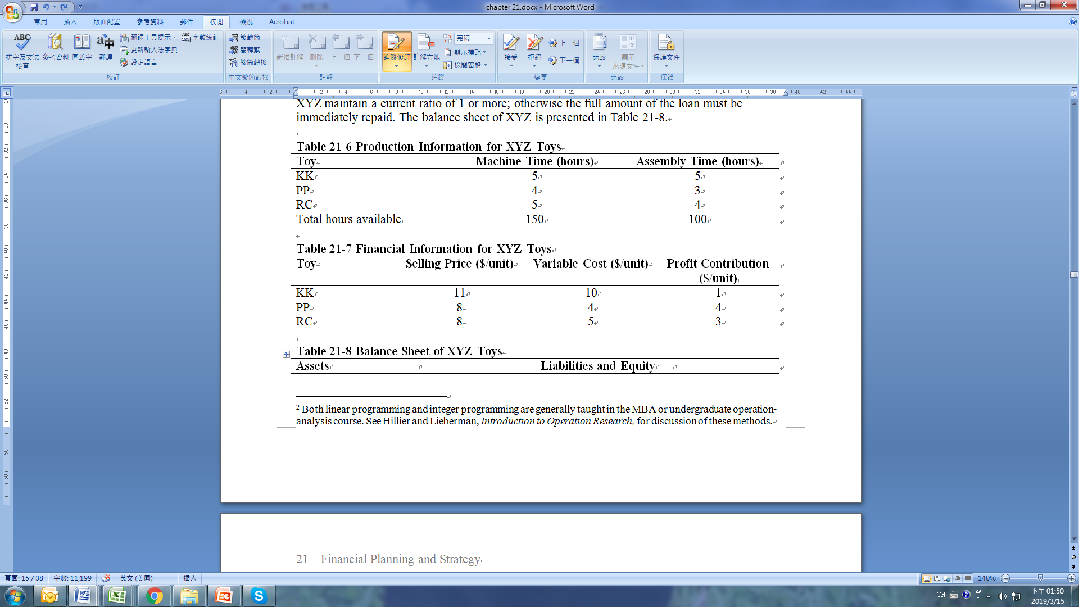
21.4 THE LINEAR PROGRAMMING APPROACH TO FINANCIAL PLANNING AND ANALYSIS
21.4.1 Profit Maximization

Slide 42
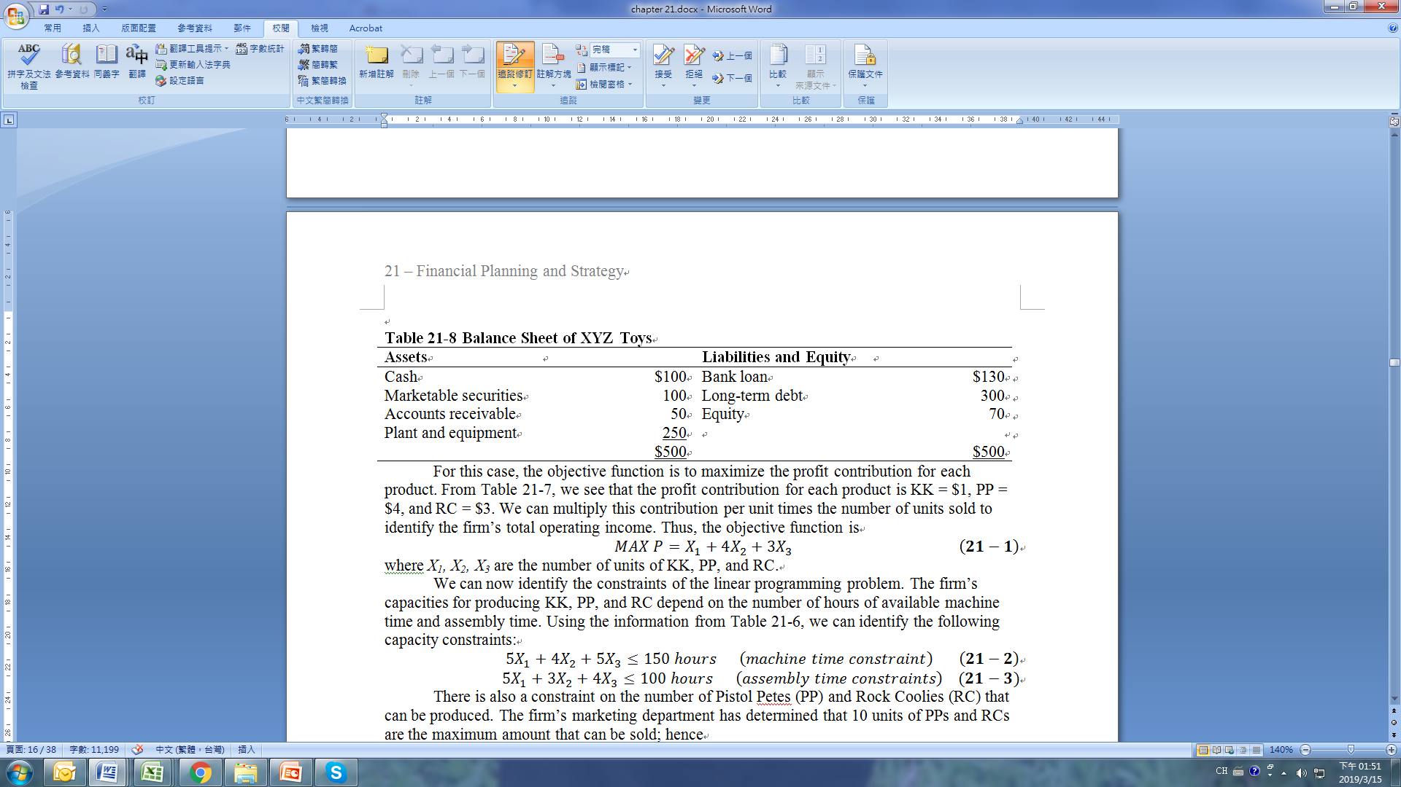
21.4 THE LINEAR PROGRAMMING APPROACH TO FINANCIAL PLANNING AND ANALYSIS
21.4.1 Profit Maximization
For this case, the objective function is to maximize the profit contribution for each product. From Table 21-7, we see that the profit contribution for each product is KK = $1, PP = $4, and RC = $3. We can multiply this contribution per unit times the number of units sold to identify the firm’s total operating income. Thus, the objective function is

Slide 43
21.4 THE LINEAR PROGRAMMING APPROACH TO FINANCIAL PLANNING AND ANALYSIS
21.4.1 Profit Maximization
where X₁, X₂, X₃ are the number of units of KK, PP, and RC.
We can now identify the constraints of the linear programming problem. The firm’s capacities for producing KK, PP, and RC depend on the number of hours of available machine time and assembly time. Using the information from Table 21-6, we can identify the following capacity constraints:

Slide 44
21.4 THE LINEAR PROGRAMMING APPROACH TO FINANCIAL PLANNING AND ANALYSIS
21.4.1 Profit Maximization
There is also a constraint on the number of Pistol Petes (PP) and Rock Coolies (RC) that can be produced. The firm’s marketing department has determined that 10 units of PPs and RCs are the maximum amount that can be sold; hence
Finally, the bank covenant requiring a current ratio greater than 1 must be met. Thus,

Slide 45

21.4 THE LINEAR PROGRAMMING APPROACH TO FINANCIAL PLANNING AND ANALYSIS
21.4.1 Profit Maximization
Since production of each toy must, at minimum, be 0, three nonnegative constraints complete the formulation of the problem:
Combining the objective functions and constraints yields
subject to 5X_{t} + 4X₂ + 5X₃ 150; 5X₁ + 3X₂ + 4X₃ 100; X₂ + X₃ 10; 10X₁ + 4X₂ + 5X₃ 120; and X₁ 0, X₂ 0, X₃ 0.

Slide 46
21.4 THE LINEAR PROGRAMMING APPROACH TO FINANCIAL PLANNING AND ANALYSIS
21.4.1 Profit Maximization
Using the simplex method to solve this linear programming problem, we derive the three simplex method tableaus in Table 21-9. Tableau 1 presents the information of objective function and constraints as derived in Equation 21-7. Since there are constraints for four resources, there are four slack variables: S₁, S₂, S₃, and S₄. The initial tableau implies that we produce neither KK, PP, or RC. Therefore, the total profit is 0, a result that is not optimal because all objective coefficients are positive. In the second tableau, the firm produces ten units of PP and generates a $40 profit. But this result also is not optimal because one of the objective function coefficients is positive. Tableau 3 presents the optimal situation because none of the objective function coefficients is positive. (Appendix 21A presents the method and procedure for specifying tableau 1 and solving tableaus 2, and 3 in terms of a capital rationing example.)

Slide 47
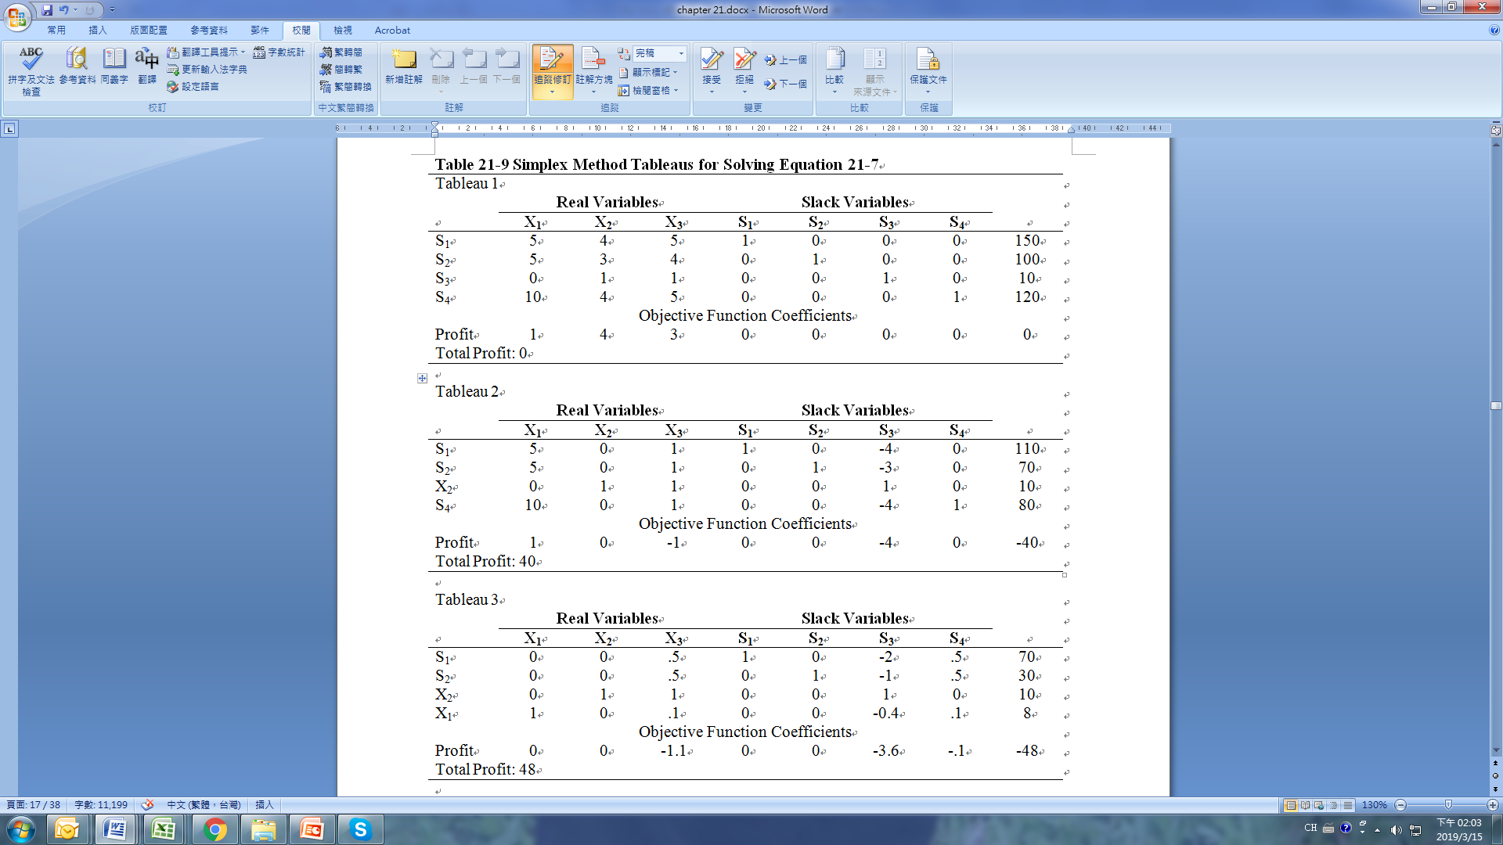
21.4 THE LINEAR PROGRAMMING APPROACH TO FINANCIAL PLANNING AND ANALYSIS
21.4.1 Profit Maximization

Slide 48
21.4 THE LINEAR PROGRAMMING APPROACH TO FINANCIAL PLANNING AND ANALYSIS
21.4.1 Profit Maximization
In tableau 3, the solution values for variables X₁ and X₂ are found in the right-hand column. Thus, X₁ = 8 units and X₂ = 10 units. Since X₃ doesn’t appear in the final solution, it has a value of 0. The slack variables indicate the amount of XYZ’s unused resources. For example, S₁ = 70 indicates that the firm has 70 hours of unused machine time. To produce 8 units of X₁ requires 40 hours, and to produce 10 units of X₂ requires 40 hours, so our total usage of machine time is 80 hours. This is 70 hours less than the total hours of machine time the firm has available. S₂ = 30 indicates that there are additional assembly hours available. S₃ = 0 (it is not in the solution) implies that the constraint to make 10 units of X₂ + X₃ is satisfied. S₄ = 0 implies that the current ratio constraint is also satisfied and that financing, or, more precisely, the lack of financing, is limiting the amount of production. If the firm can change the bank loan covenant or increase the amount of available funds, it will be able to produce more. The maximum total profit contribution is $48 given the current production level.

Slide 49
21.4 THE LINEAR PROGRAMMING APPROACH TO FINANCIAL PLANNING AND ANALYSIS
21.4.2 Linear Programming and Capital Rationing
Linear programming is a mathematical technique that can be used to find the optimal solution to problems involving the allocation of scarce resources among competing activities. Mathematically, linear programming can best solve problems in which both the firm’s objective is to be maximized and the constraints limiting the firm’s actions are linear functions of the decision variables involved. Thus, the first step in using linear programming as a tool for financial decision-making is to model the problem facing the firm into a linear-programming form. To construct the programming model involves the following steps.

Slide 50
21.4 THE LINEAR PROGRAMMING APPROACH TO FINANCIAL PLANNING AND ANALYSIS
21.4.2 Linear Programming and Capital Rationing
First, identify the controllable decision variables. Second, define the objective to be maximized or minimized and formulate that objective into a linear function with controllable decision variables. In finance, the objective generally is to maximize profit and market value or to minimize production costs. Third, the constraints must be defined and expressed as linear equations (equalities or inequalities) of the decision variables. This usually involves determining the capacities of the scarce resources involved in the constraints and then deriving a linear relationship between these capacities and the decision variables.

Slide 51
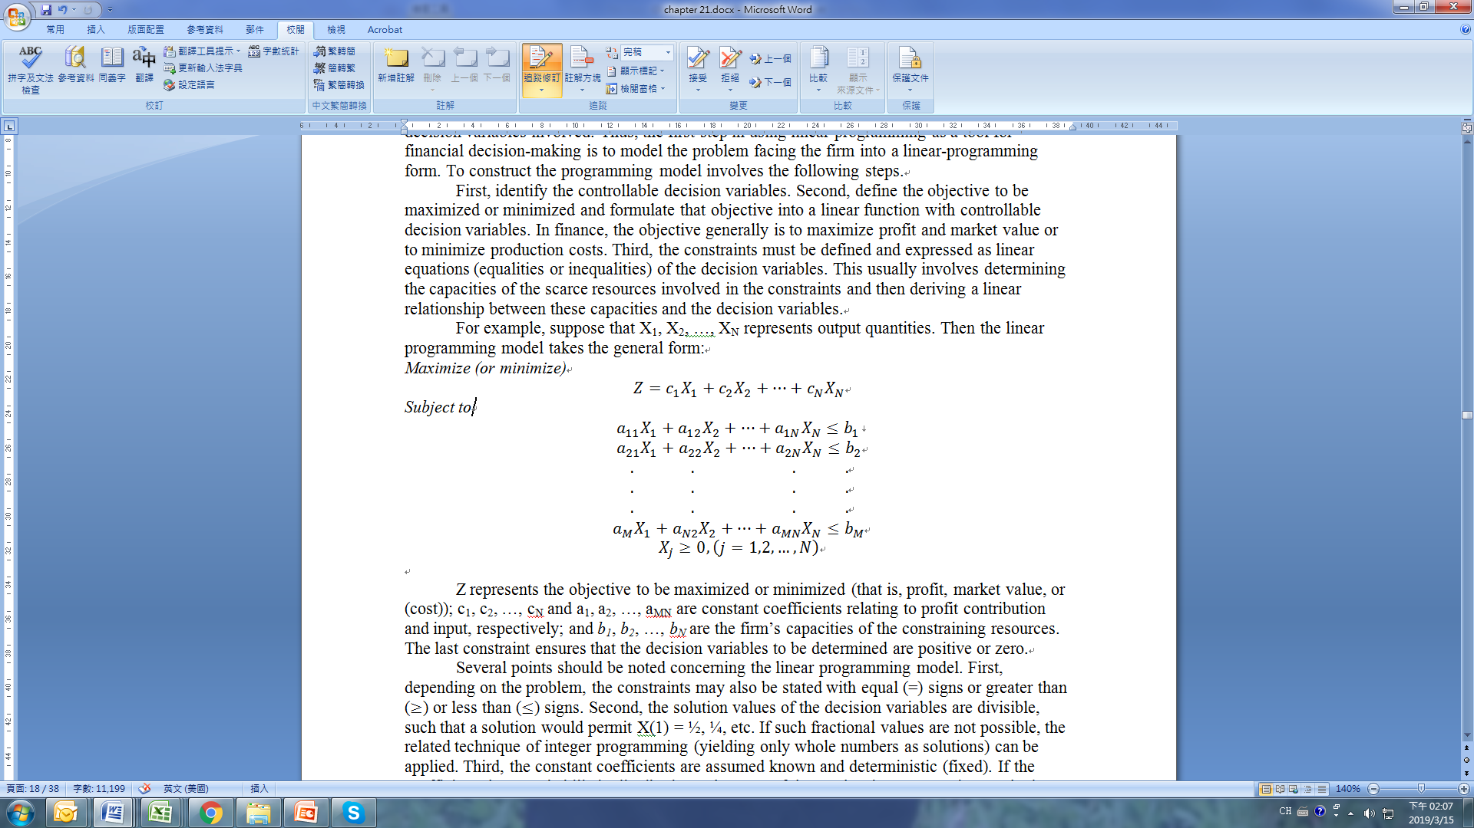
21.4 THE LINEAR PROGRAMMING APPROACH TO FINANCIAL PLANNING AND ANALYSIS
21.4.2 Linear Programming and Capital Rationing
For example, suppose that X₁, X₂, …, X_{N} represents output quantities. Then the linear programming model takes the general form:
Maximize (or minimize)

Slide 52
21.4 THE LINEAR PROGRAMMING APPROACH TO FINANCIAL PLANNING AND ANALYSIS
21.4.2 Linear Programming and Capital Rationing
Z represents the objective to be maximized or minimized (that is, profit, market value, or (cost)); c₁, c₂, …, c_{N} and a₁, a₂, …, a_{MN} are constant coefficients relating to profit contribution and input, respectively; and b₁, b₂, …, b_{N} are the firm’s capacities of the constraining resources. The last constraint ensures that the decision variables to be determined are positive or zero.
Several points should be noted concerning the linear programming model. First, depending on the problem, the constraints may also be stated with equal (=) signs or greater than () or less than () signs. Second, the solution values of the decision variables are divisible, such that a solution would permit X(1) = ½, ¼, etc. If such fractional values are not possible, the related technique of integer programming (yielding only whole numbers as solutions) can be applied. Third, the constant coefficients are assumed known and deterministic (fixed). If the coefficients have probabilistic distributions, then one of the stochastic programming methods must be used.

Slide 53
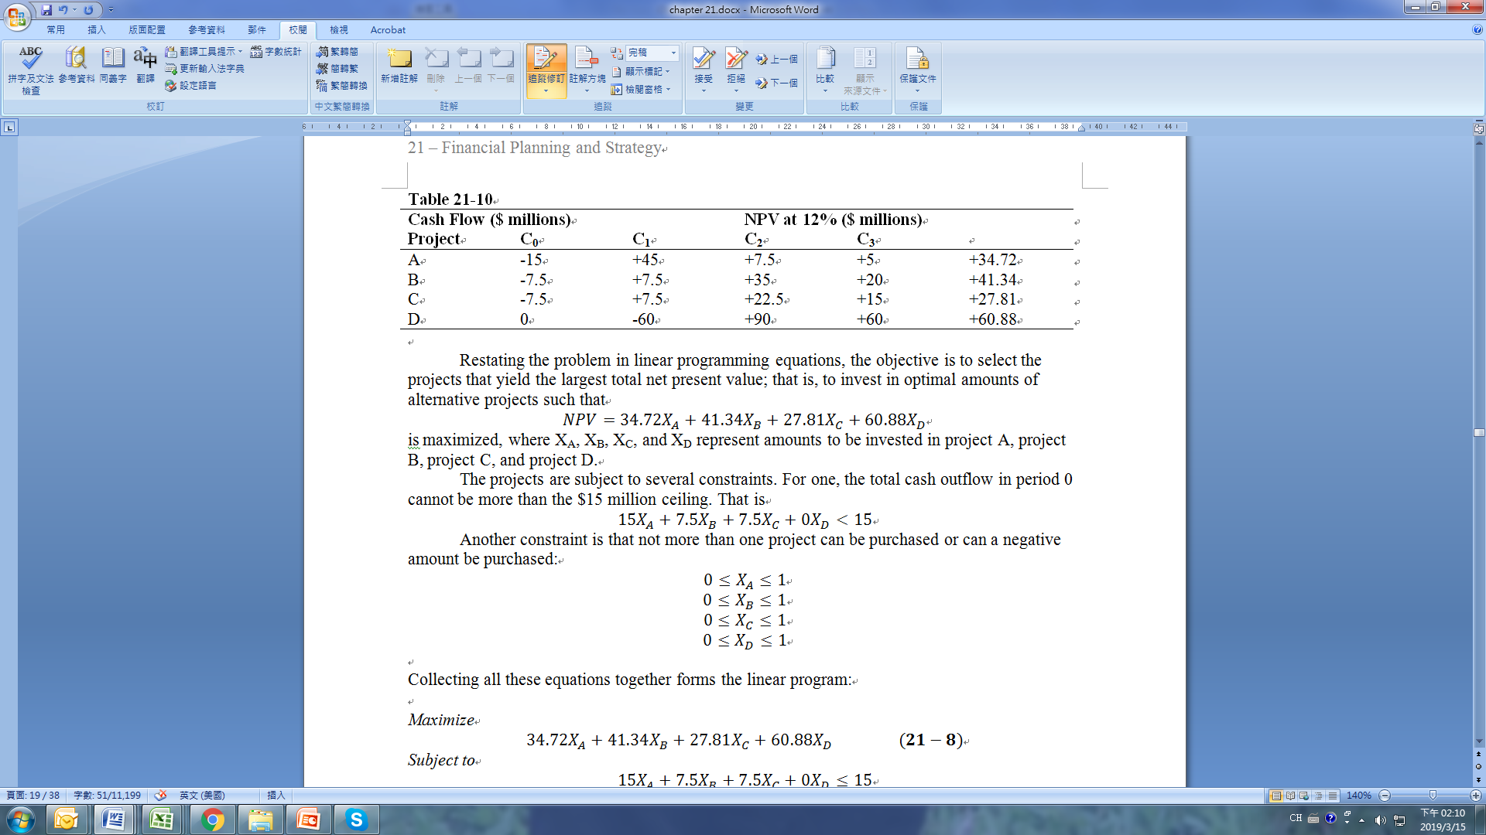
21.4 THE LINEAR PROGRAMMING APPROACH TO FINANCIAL PLANNING AND ANALYSIS
21.4.2 Linear Programming and Capital Rationing
As an example of the application of linear programming to the areas of capital rationing and capital budgeting, assume that a firm has a 12 percent cost of capital and $15 million in resources for investment opportunities. Management is considering four investment projects, with financial information as listen in Table 21-10.

Slide 54
21.4 THE LINEAR PROGRAMMING APPROACH TO FINANCIAL PLANNING AND ANALYSIS
21.4.2 Linear Programming and Capital Rationing
Restating the problem in linear programming equations, the objective is to select the projects that yield the largest total net present value; that is, to invest in optimal amounts of alternative projects such that
is maximized, where X_{A}, X_{B}, X_{C}, and X_{D} represent amounts to be invested in project A, project B, project C, and project D.
The projects are subject to several constraints. For one, the total cash outflow in period 0 cannot be more than the $15 million ceiling. That is

Slide 55
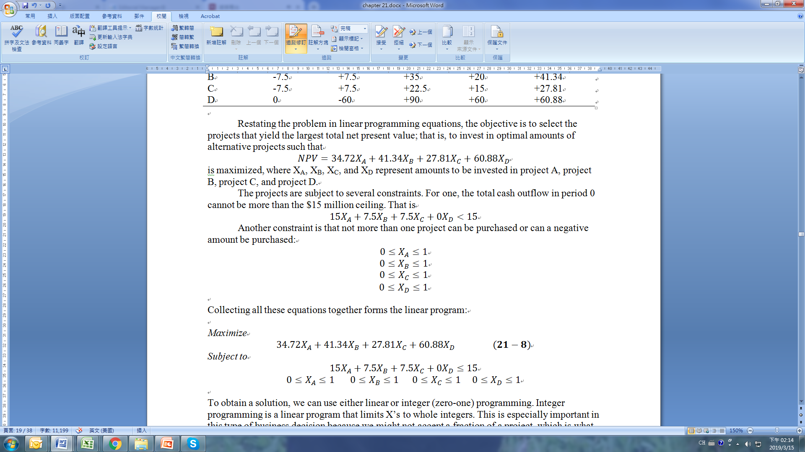
21.4 THE LINEAR PROGRAMMING APPROACH TO FINANCIAL PLANNING AND ANALYSIS
21.4.2 Linear Programming and Capital Rationing
Another constraint is that not more than one project can be purchased or can a negative amount be purchased:
Collecting all these equations together forms the linear program:
Maximize
Subject to

Slide 56
21.4 THE LINEAR PROGRAMMING APPROACH TO FINANCIAL PLANNING AND ANALYSIS
21.4.2 Linear Programming and Capital Rationing
To obtain a solution, we can use either linear or integer (zero-one) programming. Integer programming is a linear program that limits X’s to whole integers. This is especially important in this type of business decision because we might not accept a fraction of a project, which is what the constraint is likely to produce.
The best integer solution is to accept projects B and C (X_{B} = 1 and X_{C} = 1), which yields the maximum NPV of $69.15.

Slide 57

21.4 THE LINEAR PROGRAMMING APPROACH TO FINANCIAL PLANNING AND ANALYSIS
21.4.3 Linear Programming Approach to Financial Planning
Carleton (1970) and Carleton, Dick, and Downes (CDD, 1973) have formulated a financial planning model within a linear programming framework. Their objective function is based on the dividend stream model as expressed in Equation 21-9:
where N₀ = total common shares in period 0; P₀ = total equity value in period 0; P_{T} = aggregate market value of the firm’s equity at the end of period T; N_{t} = number of common shares outstanding at the beginning of period t; D_{t} = total dividends paid by the firm in period t; k = cost of equity capital, assuming constant risk and a constant k; and N_{T} = number of common shares outstanding in period T.

Slide 58
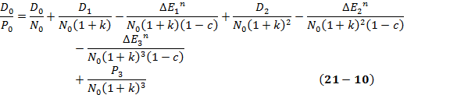
21.4 THE LINEAR PROGRAMMING APPROACH TO FINANCIAL PLANNING AND ANALYSIS
21.4.3 Linear Programming Approach to Financial Planning
This objective function attempts to maximize the present value of the owners’ equity, which includes all future dividends and long-term growth opportunities. (This model formulation is simply a rearranged version of the Gordon theory discussed in Chapter 4.)
Equation 21-9 is a nonlinear function in terms of N_{t}. To apply the linear programming method to this objective function, the function should be linearized. Following Lee (1985), a three-period linearized objective function for Equation 21-9 can be defined as

Slide 59
21.4 THE LINEAR PROGRAMMING APPROACH TO FINANCIAL PLANNING AND ANALYSIS
21.4.3 Linear Programming Approach to Financial Planning
where D₀, P₀, N₀, and k are as defined in Equation 21-9; , , represent the new equity issued in periods 1, 2, and 3; D₁ and D₂ represent dividend payments in periods 1 and 2; c is an estimate of the portion of equity lost to underpricing and transaction costs; and P₃ is the total market value of equity in the third period. To use this model, P₃ should be forecast first. Since both D₀/N₀ and P₃ are predetermined, they can be omitted from the objective function without affecting the optimization results. If N₀ = 49.69, c = .10, and k = 16.5 percent, then the objective function without D₀//N₀ and P₃ can be written as

Slide 60
21.4 THE LINEAR PROGRAMMING APPROACH TO FINANCIAL PLANNING AND ANALYSIS
21.4.3 Linear Programming Approach to Financial Planning
Using this objective function and the constraints listed in Table 21-11, this model can be used to forecast important variables related to key pro forma financial statements. In Table 21-11, the constraint of available earnings for the common equity holders pertains to the amount of net income available to common equity holders. The constraint of sources and uses of funds involves the relationship among the investments, dividend payments, new equity issued, and new debt issued.
Policy constraints pertain to financing policy and dividend policy as described in Chapters 3, 9, 12, and 13. Financing policy can be classified into interest coverage and maximum leverage limitation. The dividend-related constraints can be classified into prefinancing limitations to avoid accumulating excess cash, minimum dividend growth, and payout restrictions. (More detailed discussion of these constraints can be found in Lee (1985, Chapter 16).

Slide 61
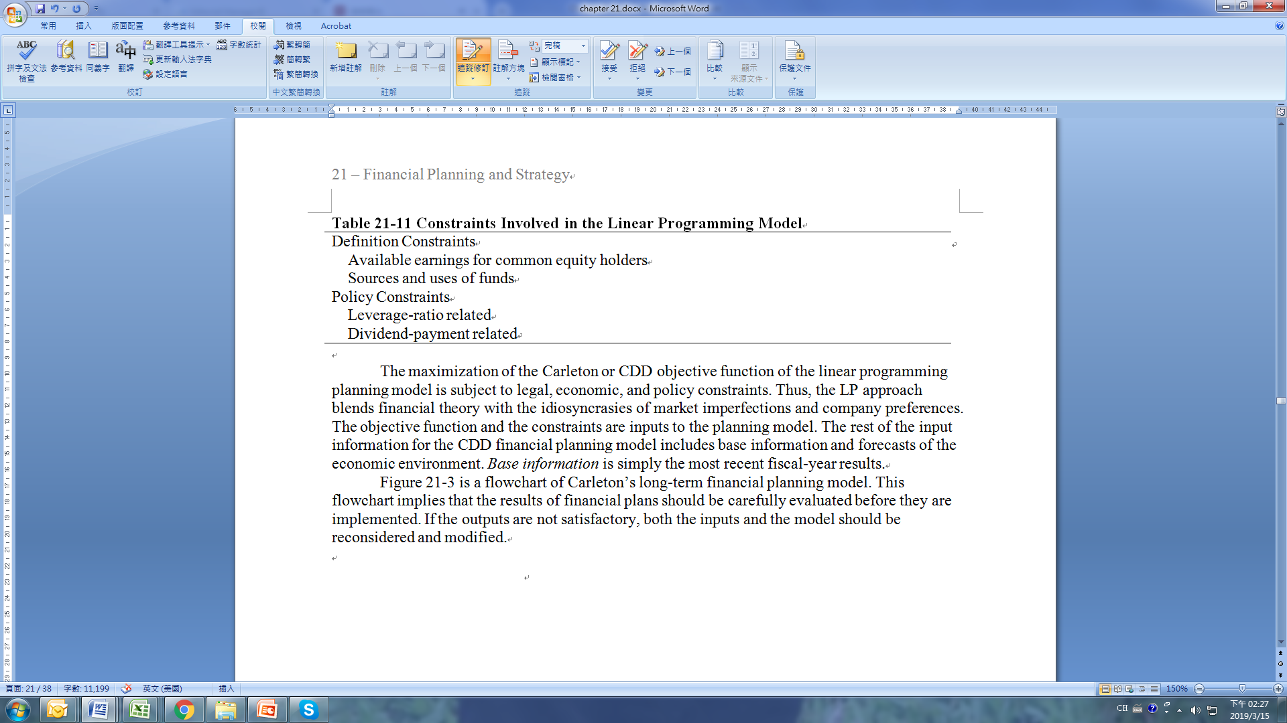
21.4 THE LINEAR PROGRAMMING APPROACH TO FINANCIAL PLANNING AND ANALYSIS
21.4.3 Linear Programming Approach to Financial Planning
The maximization of the Carleton or CDD objective function of the linear programming planning model is subject to legal, economic, and policy constraints. Thus, the LP approach blends financial theory with the idiosyncrasies of market imperfections and company preferences. The objective function and the constraints are inputs to the planning model. The rest of the input information for the CDD financial planning model includes base information and forecasts of the economic environment. Base information is simply the most recent fiscal-year results.

Slide 62
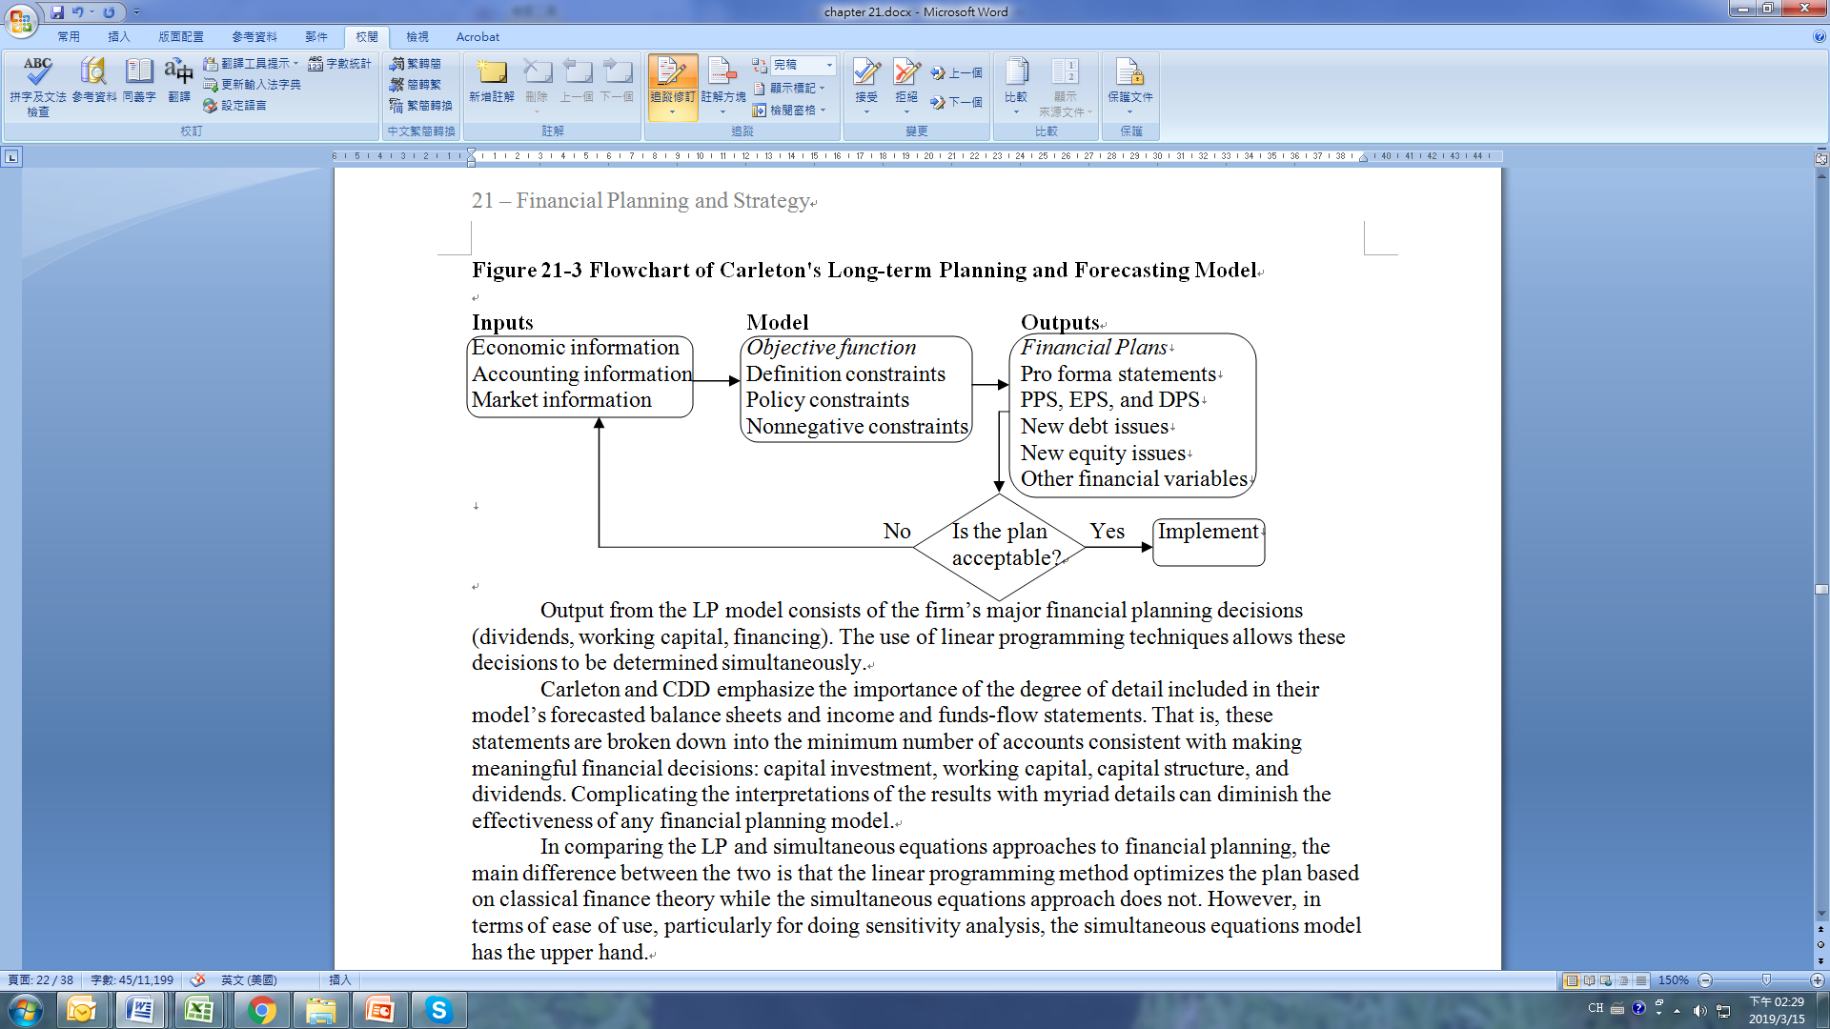
21.4 THE LINEAR PROGRAMMING APPROACH TO FINANCIAL PLANNING AND ANALYSIS
21.4.3 Linear Programming Approach to Financial Planning
Figure 21-3 is a flowchart of Carleton’s long-term financial planning model. This flowchart implies that the results of financial plans should be carefully evaluated before they are implemented. If the outputs are not satisfactory, both the inputs and the model should be reconsidered and modified.

Slide 63
21.4 THE LINEAR PROGRAMMING APPROACH TO FINANCIAL PLANNING AND ANALYSIS
21.4.3 Linear Programming Approach to Financial Planning
Output from the LP model consists of the firm’s major financial planning decisions (dividends, working capital, financing). The use of linear programming techniques allows these decisions to be determined simultaneously.
Carleton and CDD emphasize the importance of the degree of detail included in their model’s forecasted balance sheets and income and funds-flow statements. That is, these statements are broken down into the minimum number of accounts consistent with making meaningful financial decisions: capital investment, working capital, capital structure, and dividends. Complicating the interpretations of the results with myriad details can diminish the effectiveness of any financial planning model.
In comparing the LP and simultaneous equations approaches to financial planning, the main difference between the two is that the linear programming method optimizes the plan based on classical finance theory while the simultaneous equations approach does not. However, in terms of ease of use, particularly for doing sensitivity analysis, the simultaneous equations model has the upper hand.

Slide 64
21.5 THE ECONOMETRIC APPROACH TO FINANCIAL PLANNING AND ANALYSIS
The econometric approach to financial planning and analysis combines the simultaneous equations technique with regression analysis. The econometric approach models the firm in terms of a series of predictive regression equations and then proceeds to estimate the model parameters simultaneously, thereby taking account of the interactions among various policies and decisions.
To investigate the interrelationship between investment, financing, and dividend decisions, Spies (1974) developed five multiple regressions to describe the behavior of five alternative financial management decisions. Spies used a simultaneous equations technique to estimate all the equations at once. He then used this model to demonstrate that investment, financing, and dividend policies generally are jointly determined within an individual industry. This technique takes into account the interaction relationship among investment, financing, and dividend policies (discussed in Chapter 13).

Slide 65
21.5 THE ECONOMETRIC APPROACH TO FINANCIAL PLANNING AND ANALYSIS
Through the partial-adjustment model, the five endogenous variables (dividend payments, net short-term investment, gross long-term investment, new debt issued, and new equity issued), as defined in Table 21-12, are determined simultaneously through the use of the “uses equals sources” accounting identity. This identity ensures that the adjustment of each component of the budgeting process (the endogenous variables) depends not only on the component’s distance from its target, but also on the simultaneous adjustment of the other four decision variables.

Slide 66
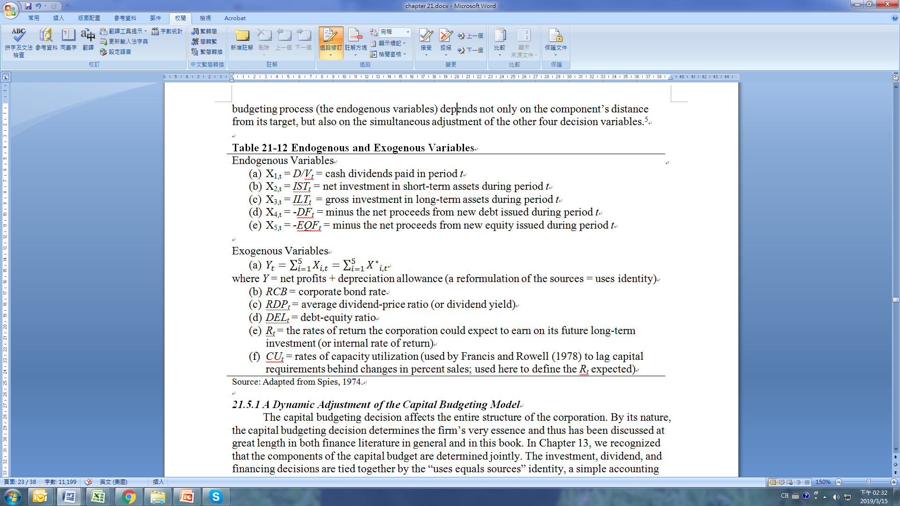
21.5 THE ECONOMETRIC APPROACH TO FINANCIAL PLANNING AND ANALYSIS

Slide 67
21.5 THE ECONOMETRIC APPROACH TO FINANCIAL PLANNING AND ANALYSIS
21.5.1 A Dynamic Adjustment of the Capital Budgeting Model
The capital budgeting decision affects the entire structure of the corporation. By its nature, the capital budgeting decision determines the firm’s very essence and thus has been discussed at great length in both finance literature in general and in this book. In Chapter 13, we recognized that the components of the capital budget are determined jointly. The investment, dividend, and financing decisions are tied together by the “uses equals sources” identity, a simple accounting identity that requires all capital invested or distributed to stockholders be accounted for. However, despite the obviousness of this relationship, few attempts have been made to incorporate it into an econometric model. In this section, we describe Spies’ (1974) econometric capital budgeting model, which explicitly recognizes the “uses equals sources” identity. This constraint also plays an important role in both Warren and Shelton’s model and Carleton’s model, as discussed previously.

Slide 68
21.5 THE ECONOMETRIC APPROACH TO FINANCIAL PLANNING AND ANALYSIS
21.5.1 A Dynamic Adjustment of the Capital Budgeting Model
In his empirical work, Spies divided the capital budgeting decision into five basic components: dividends, net short-term investment, gross long-term investment, new debt financing, and new equity financing. The first three components are uses of funds, while the latter two components are sources of funds. The dividends component includes all cash payments to stockholders and must be nonnegative. Net short-term investment is the net change in the corporation’s holdings of short-term financial assets, such as cash, government securities, and accounts receivable. This component of the capital budget can be either positive or negative. Gross long-term investment is the change in gross long-term assets during the period. For example, the replacement of old equipment is considered a positive long-term investment. Long-term investment can be negative, but only if the sale of long-term assets exceeds replacement plus new investment.

Slide 69
21.5 THE ECONOMETRIC APPROACH TO FINANCIAL PLANNING AND ANALYSIS
21.5.1 A Dynamic Adjustment of the Capital Budgeting Model
As for sources of funds, the debt-financing component is simply the net change in the corporation’s liabilities, such as corporate bonds, bank loans, taxes owed, and other accounts payable. Since a corporation can either increase its liabilities or retire existing liabilities, this variable can be either positive or negative. Finally, new equity financing is the change in stockholder equity minus the amount due to retained earnings. This should represent the capital raised by the sale of new shares of common stock. Although corporations frequently repurchase stock already sold, this variable is almost always positive when aggregated.

Slide 70

21.5 THE ECONOMETRIC APPROACH TO FINANCIAL PLANNING AND ANALYSIS
21.5.1 A Dynamic Adjustment of the Capital Budgeting Model
The first step is to develop a theoretical model that describes the optimal capital budget as a set of predetermined economic and financial variables. The first of these variables is a measure of cash flow: net profits plus depreciation allowances. This variable, denoted by Y, is exogenous as long as the policies determining production, pricing, advertising, taxes, and the like cannot be changed quickly enough to affect the current period’s earnings. Since quarterly data are used in this work, this seems a reasonable assumption. It should also be noted that the “uses equals sources” identity ensures the following:

Slide 71
21.5 THE ECONOMETRIC APPROACH TO FINANCIAL PLANNING AND ANALYSIS
21.5.1 A Dynamic Adjustment of the Capital Budgeting Model
where X_{1,t}, X_{2,t}, X_{3,t}, X_{4,t}, X_{5,t}, X*_{1,t}, and Y_{t} are defined in Table 21-12.
The second exogenous variable in the model is the corporate bond rate, RCD_{t}, which was used as a measure of the corporations’ borrowing rate. In addition, the debt-equity ratio at the start of the period, DEL_{t}, was included to allow for the increase in the cost of financing due to leverage. The average dividend-price ratio for all stocks, RDP_{t}, was used as a measure of the rate of return demanded by investors in a no-growth, unlevered corporation for the average-risk class. The last two exogenous variables, R and CU_{t}, describe the rate of return the corporation could expect to earn on its future long-term investment. The ratio of the change in earnings to investment in the previous quarter should provide a rough measure of the rate of return to that investment. Spies used a four-quarter average of that ratio, R_{t}, to smooth out the normal fluctuations in earnings. The rate of capacity utilization, CU_{t}, was also included to improve this measure of expected rate of return. Finally, a constant and three seasonal dummy variables were included. The exogenous variables are summarized in Table 21-12

Slide 72
21.5 THE ECONOMETRIC APPROACH TO FINANCIAL PLANNING AND ANALYSIS
21.5.2 Simplified Spies Model
The simplified Spies model for dividend payments (X_{1, t}), net short-term investments (X_{2, t}), gross long-term investments (X_{3, t}), new debt issues (X_{4, t}) and new equity issues (X_{5, t}) is defined as
where i = 1, 2, 3, 4, 5, etc. Equation 21-12 implies that dividend payments, net short-term investments, gross long-term investments, new debt issues, and new equity issues all can be affected by new cash inflow (Y_{t}), the corporate bond rate (RCB_{t}), average dividend yield (RDP_{t}), debt-equity ratio (DEL_{t}), rates of return on long-term investment (R_{t}), rates of capacity utilization (CU_{t}), and X_{i, t-1} (the last period’s dividend payment, net short-term investment, etc.). These empirical models simultaneously take into account theory, information, and methodologies, and they can be used to forecast cash payments, net short-term investment, gross long-term investment, new debt issues, and new equity issues.

Slide 73
21.6 SENSITIVITY ANALYSIS
So far, we have covered three types of financial planning models and discussed their strengths, weaknesses, and functional procedures. The efficiency of these models will depend solely on how they are employed. This section looks at alternative uses of financial planning models to improve their information dissemination. One of the most advantageous ways to use these financial planning models is to perform sensitivity analysis. The purpose of sensitivity analysis is to hold all but one or perhaps a couple of variables constant and then analyze the impact of their change on the predicted outcome.
As mentioned earlier, financial planning models are merely forecasting tools to help the financial manager analyze the interactions of important company decisions with uncertain economic elements. Since we can never be precisely sure what the future holds, sensitivity analysis stands out as a desirable manner of examining the impact of the unexpected as well as of the expected.

Slide 74
21.6 SENSITIVITY ANALYSIS
Of the three types of financial planning models presented in this chapter, the simultaneous equations approach, as embodied in Warren and Shelton’s FINPLAN, offers the best method for performing sensitivity analysis. By changing the parameter values, we can compare new outputs of the financial statements with those such as in Tables 21-4 and 21-5. The difference between the new statement and the statements in Tables 21-4 and 21-5 reflects the impact of potential changes in such areas as economic conditions (reflected in the interest rate, tax rate, and sales growth estimates) and company policy decisions (reflected in the maximum and minimum limits specified for the maturity and amount of debt and in the dividend policy as reflected in the specified payout ratio).

Slide 75
21.6 SENSITIVITY ANALYSIS
To perform sensitivity analysis, we change growth in sales (variable 3), operating income as a percentage of sales (variable 17), the P/E ratio (variable 22), the expected interest rate on new debt (variable 16), and long-term debt-to-equity ratio (variable 20). The new parameters are listed in Table 21-13. Summary results of the alternative sensitivity analyses for EPS, DPS and price per share (PPS) are listed in Table 21-14. The results indicate that changes of key financial decision variables will generally affect EPS, DPS, and PPS.

Slide 76
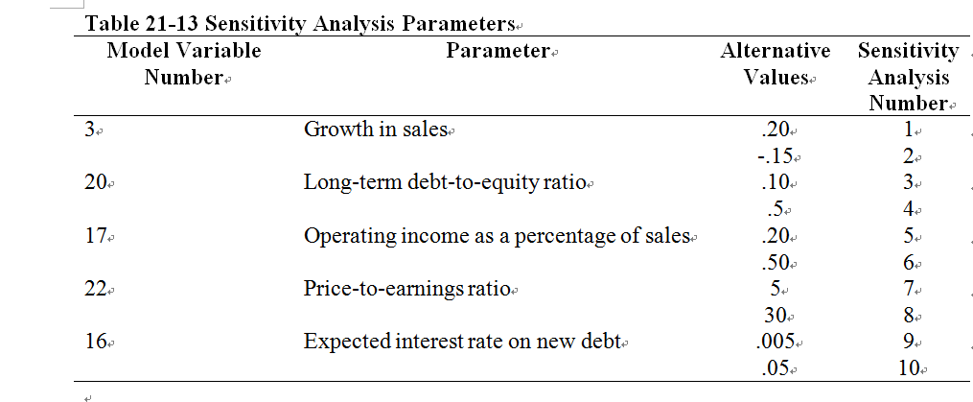
21.6 SENSITIVITY ANALYSIS

Slide 77
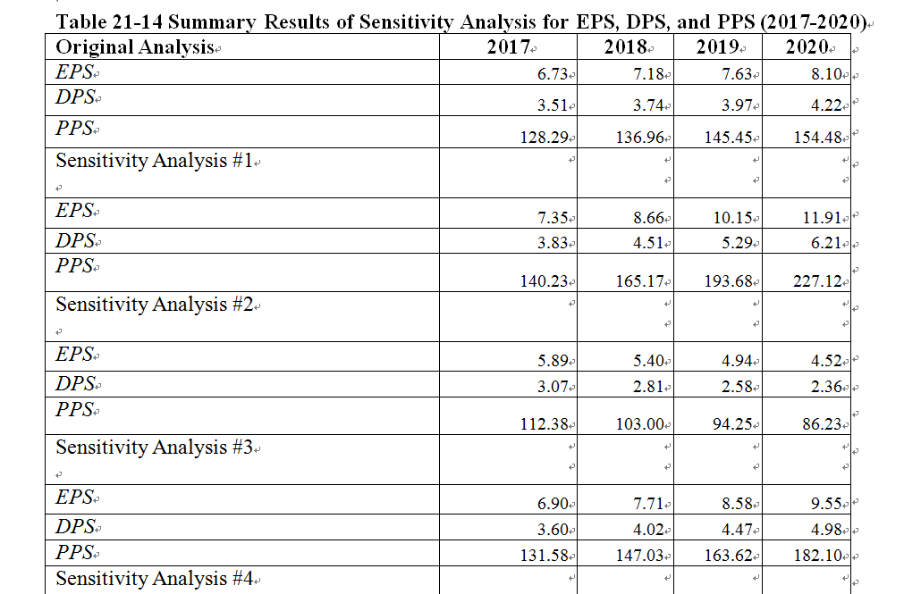
21.6 SENSITIVITY ANALYSIS

Slide 78
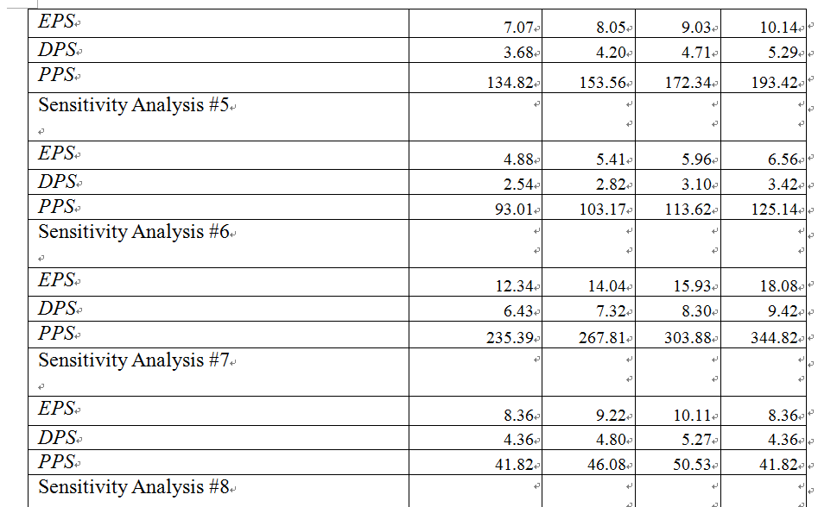
21.6 SENSITIVITY ANALYSIS

Slide 79
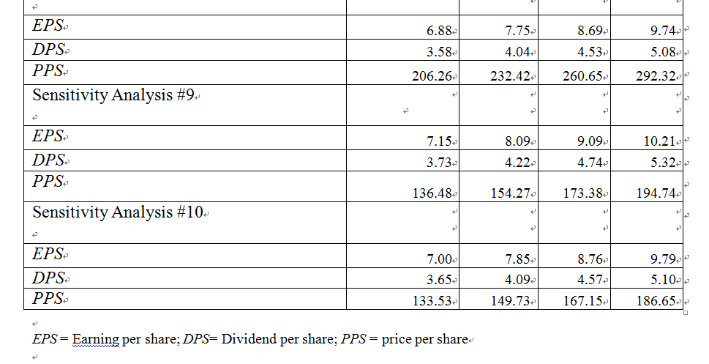
21.6 SENSITIVITY ANALYSIS

Slide 80
21.7 SUMMARY
Chapter 21 has examined three types of financial planning models available to the financial manager for use in analyzing the interactions of company decisions: the algebraic simultaneous equations model, the linear programming model, and the econometric model. We also have discussed the benefits of sensitivity analysis for determining the impact on the company from changes (expected and unexpected) in economic conditions.
The student should understand the basic functioning of all three models, along with the underlying financial theory. Moreover, it is essential to understand that a financial planning model is an aid or tool to be used in the decision-making process and is not an end in and of itself.
The computer-based financial modeling discussed in this chapter can be performed on either a mainframe computer or a PC. An additional dimension is the development of electronic spreadsheets. These programs simulate the matrix or spreadsheet format used in accounting and financial statements. Their growing acceptance and popularity is due to the ease with which users can make changes in the spreadsheet. This flexibility greatly facilitates the use of these programs for sensitivity analysis.

Slide 81
APPENDIX 21A – THE SIMPLEX ALGORITHM FOR CAPITAL RATIONING
The procedure of using the simplex method in capital rationing to solve Equation 21-8 is as follows:
Step 1: Convert equality constraints into a system of equalities through the introduction of slack variables S₁ and S₂, as follows:
where X₁ = X_{A}; X₂ = X_{B}; X₃ = X_{C}; and X₄ = X_{D} (each of these is a separate investment project)
Step 2: Construct a tableau or tableaus for representing the objective function and equality constraints. This has been done for four tableaus in Table 21A-1. In tableau 1, the figures in columns 2 through 6 are the coefficients of X₁, X₂, X₃, X₄, S₁, and S₂, as specified in the two equalities in Equation 21A-1. Below these figures are the objective function coefficients. Note that only S₁ and S₂ are listed in the first column of tableau 1. This indicates that S₁ and S₂ are basic variables in tableau 1 and that remaining variables X₁, X₂, X₃, and X₄ have been arbitrarily set equal to 0.

Slide 82
APPENDIX 21A – THE SIMPLEX ALGORITHM FOR CAPITAL RATIONING
With X₁, X₂, X₃, and X₄ all equal to 0, the remaining variables assume the values in the last column of the tableau; that is, S₁ = 15 and S₂ = 20. The numbers in the last column represent the values of basic variables in a particular basic-feasible solution.
Step 3: Obtain a new feasible solution. The basic-feasible solution of tableau 1 indicates zero profits for the firm. Clearly, this basic-feasible solution can be bettered because it shows no profit, and profit should be expected from the adoption of any project.
The fact that X₄ has the largest incremental NPV indicates that the value of X₄ should be increased from its present level of 0. If we divide the column of figures under X₄ into the corresponding figures in the last column, we obtain quotients and 1/3. Since the smallest positive quotient is associated with S₂, then S₂ should be replaced by X₄ in tableau 2.

Slide 83

APPENDIX 21A – THE SIMPLEX ALGORITHM FOR CAPITAL RATIONING
The figures in tableau 2 are computed by setting the value of S₁ to 0, S₂ to 1, and NPV to 0. The steps in the derivation are as follows: To eliminate the nonzero terms, we first divide the second row in tableau 1 by 60 and thus obtain the coefficients indicated in the second row of tableau 2. We then multiply this row by -60.88 and combine this result with the third row, as follows:

Slide 84
APPENDIX 21A – THE SIMPLEX ALGORITHM FOR CAPITAL RATIONING
The objective function coefficients of Equation 21A-2 are listed in the third row of tableau 2. Tableau 2 implies that the company will undertake 1/3 units of project 4 (X₄) and that the total NPV of X₄ is $20.2933. All coefficients associated with objective function are positive, which implies that the NPV can be improved by replacing S₁ with either X₁, X₂, X₃, X₄.
Using the same procedure mentioned above, we can now obtain tableau 3. In tableau 3, the only positive objective function coefficient is X₂. Therefore, X₂ can replace either X₁ or X₄ to increase the NPV.
Once again, using the procedure discussed above, we now obtain tableau 4. In tableau 4, none of the coefficients associated with objective function are positive. Therefore, the solution in this tableau is optimal. Tableau 4 implies that the company will undertake 2 units of project 2 (X₂) and .583 units of project 4 (X₄) to maximize its total NPV.

Slide 85
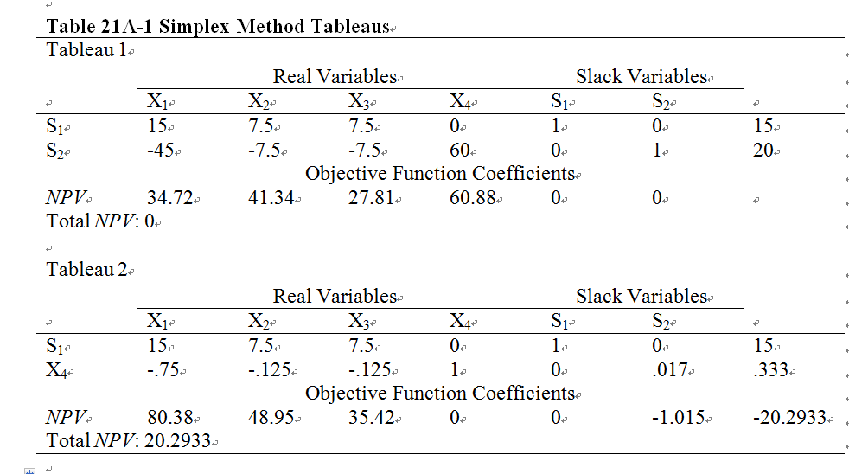
APPENDIX 21A – THE SIMPLEX ALGORITHM FOR CAPITAL RATIONING

Slide 86
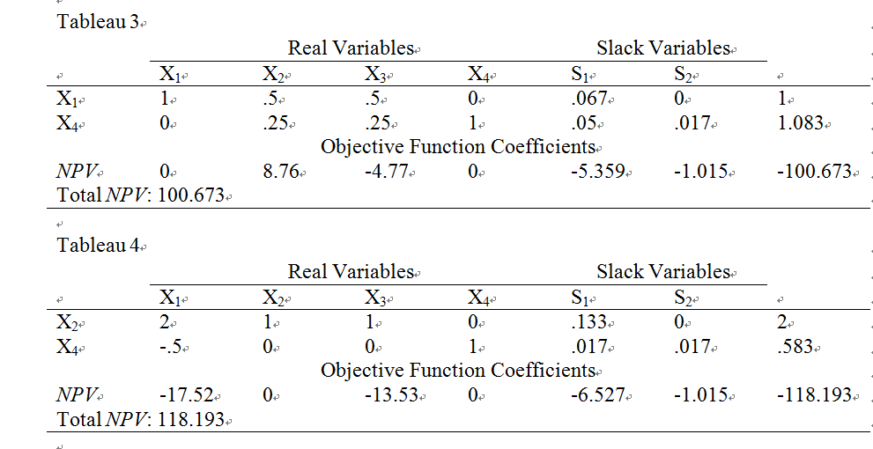
APPENDIX 21A – THE SIMPLEX ALGORITHM FOR CAPITAL RATIONING

Slide 87
APPENDIX 21A – THE SIMPLEX ALGORITHM FOR CAPITAL RATIONING
From tableau 4, we obtain the best feasible solution:
Total NPV is now equal to (2)(41.34) + (60.88)(.583) = $118.193.
Although there are computer packages that can be used for linear programming, we can use the simplex method to hand-calculate the optimal number of projects and the maximum NPV in order to understand and appreciate the basic technique of derivation.

Slide 88


Appendix 21B - Description of Parameter Inputs Used to Forecast Johnson & Johnson’s Financial Statements and Share Price
In our financial planning plan program, there are 20 equations and 20 unknowns. To use this program, we need to input 21 parameters. These 20 unknowns and 21 parameters can be found in table 21.2.
We use 2016 as the initial reference year and input the 21 parameters, the bulk of which can be obtained or derived from the historical financial statements of JNJ. The first input is SALE t-1 ($71,890), defined as fiscal 2016 net sales and can be obtained from the income statement of JNJ. The second input is GCALSt-1. This parameter can be calculated by either the percentage change method:
or sustainability growth rate:

Slide 89
Appendix 21B - Description of Parameter Inputs Used to Forecast Johnson & Johnson’s Financial Statements and Share Price
The third input is RCAt-1 (90.46%), defined as current assets divided by total sales, and the fourth input is RLA t-1 (1.0596), defined as total asset minus current asset divided by net sales. The next parameter is RCLt-1 (36.57%), defined as current liabilities as a percentage of net sales. The sixth parameter is preferred stock issued (PKV), with a value of 0, as JNJ does not currently have any preferred stock outstanding. The inputs for the aforementioned three parameters are all obtained from the JNJ’s fiscal 2016 balance sheet. The seventh input is JNJ’s preferred stock dividends, and since there is no preferred stock outstanding, it is correspondingly 0. The eighth input is LR t-1 ($22,442), defined as long-term debt, coming from the balance sheet of JNJ for the fiscal year 2016, and the ninth input is LR t-1 ($-2,223), defined as long-term debt retirement, from the 2016 statement of cash flows.

Slide 90

Appendix 21B - Description of Parameter Inputs Used to Forecast Johnson & Johnson’s Financial Statements and Share Price
The tenth input is St-1 ($3,120), which represents common stock issued, and the eleventh input is retained earnings (Rt-1=$110,551). Both of these two variables can be found in the balance sheet for JNJ’s fiscal year 2016. The twelfth input is the retention rate (bt-1= 47.88%), defined as
The thirteenth input, the average tax rate (Tt-1), is assumed to be 15%. The fourteenth input is the weighted average effective interest rate (It-1=3.33%), which JNJ provides in its annual report (page 53 of the respective 10-K filing). The fifteenth input is expected interest on new debt (iet-1=3.68%), calculated as the average of the weighted average interest rates in previous two periods.

Slide 91
Appendix 21B - Description of Parameter Inputs Used to Forecast Johnson & Johnson’s Financial Statements and Share Price
The next input is REBITt-1 (28.71%), defined as operating income as a percentage of sales. However, JNJ does not list explicitly list operating income in its income statements. Thus, we defined operating income as JNJ’s earnings before provision for taxes on income, with interest expense added back and interest income subtracted out. We also adjusted for non-recurring expenses and added back other income/losses (related primarily to hedging activities, write-downs, and restructuring charges) to get to an adjusted and normalized operating income figure.

Slide 92
Appendix 21B - Description of Parameter Inputs Used to Forecast Johnson & Johnson’s Financial Statements and Share Price
The seventeenth input is the underwriting cost of debt (UL) that we assume to be 2%, and the eighteenth parameter is the underwriting cost of equity (UE=1%). The nineteen input is the ratio of long-term debt to equity (K t-1=31.87%), defined as long term debt divided by total equity. The twentieth input is the number of common shares outstanding (NUMCSt-1=2,737.3) listed in the JNJ’s Balance Sheet for fiscal year 2016.The last input is P/E ratio(mt-1=19.075) which is calculated as JNJ’s closing share price on the last trading day of 2016 divided by fiscal 2016 net income.

Slide 93
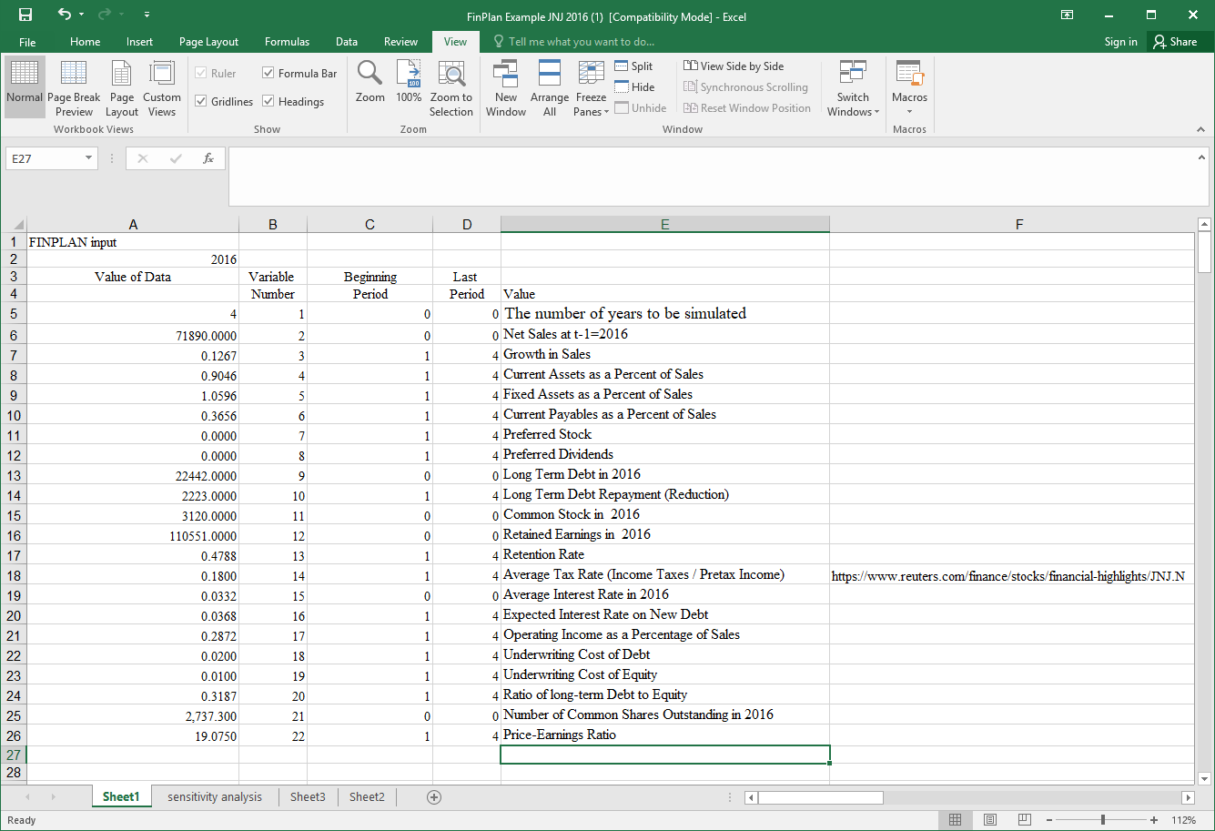
Appendix 21C - Procedure of Using Excel to Implement the FinPlan Program
This appendix describes the detailed procedure of using Excel to implement the FinPlan program. There are four steps to use the FinPlan program.
Step 1.Open the Excel file of FinPlan Example.

Slide 94
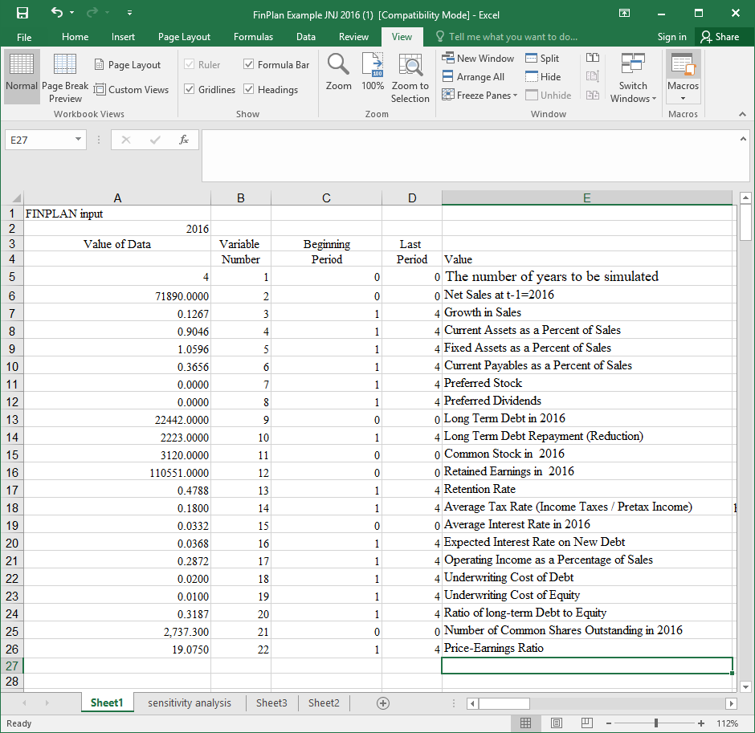
Appendix 21C - Procedure of Using Excel to Implement the FinPlan Program
Step 2. Click the “View” and see “Macros” in the right hand side.

Slide 95
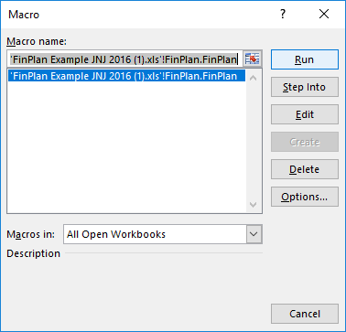
Appendix 21C - Procedure of Using Excel to Implement the FinPlan Program
Step 3. Choose “Macros” and then click “Run”.

Slide 96
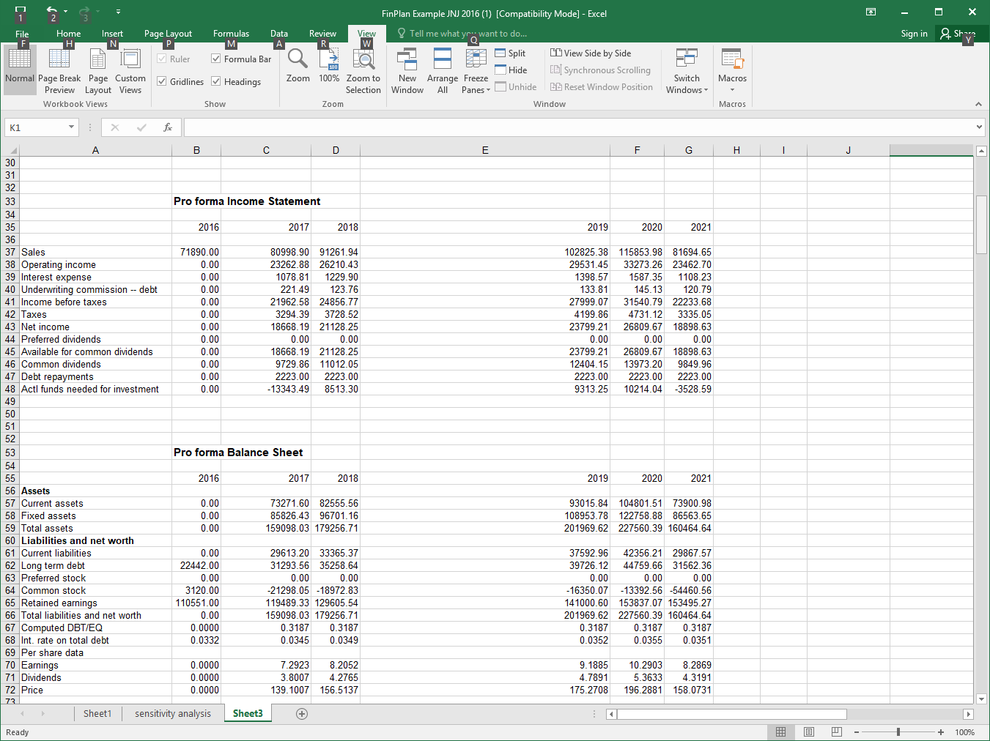
Appendix 21C - Procedure of Using Excel to Implement the FinPlan Program
Step 4. Excel will show the solutions of the simultaneous equations.

Slide 97
Appendix 21C - Procedure of Using Excel to Implement the FinPlan Program
After we obtain the forecasted values from the model, we compare them with the actual data of JNJ in 2017 via calculating the absolute percentage change of error. The following table shows results.

Slide 98
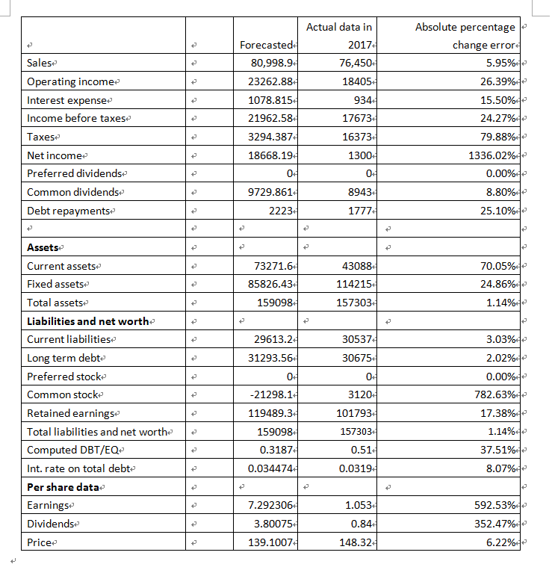
Appendix 21C - Procedure of Using Excel to Implement the FinPlan Program

