Slide 1
Chapter 18 Accounting for Leases

Slide 2
LEARNING OBJECTIVES
Understand the basic concepts of lease accounting and identify
the advantages and disadvantages of leasing.
Understand lease contracts and determine how to separate
lease and nonlease components and how to allocate contract
consideration to the various components.
Classify leases as operating, finance, direct financing, and
sales-type.
Demonstrate the accounting for an operating lease for both
the lessee and the lessor.
Demonstrate lessee accounting for a finance lease.
Illustrate lessor accounting for sales-type leases.
Illustrate lessor accounting for direct financing leases.
Detail the required lease disclosures.

Slide 3
Introduction
A LEASE IS ONE OF THE most common means by which companies obtain the use of long-term operating assets. In a lease, a company acquires the use of an asset—such as a copy machine, office space, or even an airplane—by financing it directly through the asset’s owner. In the airline industry, about one-third of airplanes are leased.1 Airlines decide to lease versus buy assets for a variety of reasons, including the ability to obtain financing, reduced risk of obsolescence, or operating flexibility. For example, small, recently established airlines, which may have difficulty obtaining capital to buy large airplanes, lease planes to exploit new routes. At the end of fiscal 2016, the operating fleet of Spirit Airlines consisted of 95 airplanes of which 38% were owned and 62% were leased. Spirit also leases most of its land and buildings that it occupies, such as its aircraft maintenance base as well as various computers, cargo, flight kitchens, and training facilities. On your next trip to the airport, consider that airlines lease the ticket counter and other terminal space, operating areas, and air cargo facilities in most of the airports that they serve.

Slide 4
Introduction
Is there a difference in the economic substance of acquiring a long-term operating asset (such as an airplane) by issuing long-term debt or acquiring the use of an asset by signing a lease contract? In most cases, there is no real substantial difference in leasing and purchasing. The form of the contract is different, but the substance of these transactions is the same.
A lease typically results in obtaining the use and control of a long-term asset and the recognition of a long-term financing liability. Accounting for the liability requires similar accounting procedures as used in accounting for a long-term debt instrument. Because the lease will involve the use and control of an asset, we also discuss accounting for long-term operating assets.

Slide 5
Introduction
We begin the chapter with an overview of leases and their advantages and disadvantages. Then, we discuss how to determine whether a lease exists, how to separate lease and nonlease components, and how to allocate consideration among these components. We then consider the proper classification of leases and illustrate lease accounting from the perspective of both parties: the company obtaining the use of the asset (the lessee) and the company providing the asset for use (the lessor). Finally, we review required lease disclosures and then explore the possible financial statement effects of the lease accounting alternatives.

Slide 6
Leases: Overview
A lease gives the lessee the right to control and use the property, plant, or equipment legally owned by the lessor for a specified period of time in return for periodic payments or rentals made by the lessee. The owner of the asset is called the lessor. The party acquiring the use of the asset is the lessee. The lease contract conveys only the right to use the asset—it typically does not result in a transfer of ownership of the asset. This property right has economic value to the lessee and, in substance, represents the purchase of an asset with a corresponding obligation.
Advantages of Leasing for the Lessee
What accounts for the popularity of leasing? Leasing provides multiple Advantages over buying.
Complete Financing. Many leases allow the lessee to enter into a lease agreement with little or no money down and with no security deposit. The lessee maintains its cash and other assets, resulting in 100% financing for the leased asset.

Slide 7
Lessor Bears the Risk of Obsolescence. The risk of obsolescence is borne by the owner of the asset, the lessor, and is reflected in high lessee monthly rental payments. However, the lessee is willing to pay this premium when leasing an asset that is subject to rapid technological obsolescence. A lessee company upgrading to the latest technology maintains its competitive advantage. For example, consider leased photocopy equipment, which is one of the most common types of leased assets. Over time, technology has improved the features in photocopiers with options such as scanning, emailing, and remote copying. A company that owns its copier would need to buy a new copy machine to obtain these features. A company that leases a photocopier can easily upgrade when new features become available.
Business and Financial Flexibility. Leases can offer many business options for the lessee. For example, the lessee can upgrade the asset, return the asset, continue the lease with extended terms, modify rental amounts, or exercise a purchase option. The lease may also provide financial flexibility by permitting the lessee to obtain an additional source of financing without affecting existing lines of credit.

Slide 8
Tax Benefits. When a company purchases equipment by issuing a long-term note, the interest element of the payment is tax deductible. However, if the company leases equipment, the entire lease payment may be tax deductible. In addition, in a purchase of real estate, only the building but not the land is depreciable. If a company leases a building (on the land), the total lease payment may be fully tax deductible as rent expense.
Disadvantages of Leasing for the Lessee
Although there are multiple advantages to leasing, there are a few disadvantages.
Overall Cost of the Asset. In general, the costs of the asset over the life of the lease are higher than had the lessee purchased the asset. The lease payments must compensate the lessor for the use of the asset, financing costs, and the risk of ownership.
Lack of Ownership. Unless the lease arrangement includes a transfer of ownership or a purchase option that is exercised, the asset does not belong to the lessee at the end of the lease.

Slide 9
Understanding the Basics of Lease Accounting
Lease accounting is complex and detailed. However, the basic concepts behind lease accounting are straightforward. Let’s start with these basic concepts before examining the details of lease accounting.
An important concept to understand is that the substance of a typical lease transaction is similar to the purchase of an asset on credit. In a lease transaction, the lessor obtains the right to use the leased asset in return for payments made to the lessor. So, this is similar to the lessee purchasing an asset from the lessor with the lessor providing the financing. Although there are some differences in a lease transaction and a purchase financed by the seller, there are more similarities than differences.
Thus, the accounting treatment follows the substance of the transaction. As in the case of a purchase financed by the seller, a lease transaction typically results in the leased asset on the lessee’s balance sheet. In addition, the lessee reports a long-term obligation. Consistent with accounting for long-term debt and long-term operating assets, the lessee records both interest expense and amortization on its income statement.2
The lessor often (although not always) removes the leased asset from its balance sheet and instead recognizes a financial asset that represents the amounts that are receivable from the lessee. The lessor also records interest revenue on its income statement related to the financing component of the transaction. In addition, the lessor may report revenue and cost of goods sold related to what is, in substance, a sales transaction.

Slide 10
2016 Lease Standards. This chapter is based on the lease standards issued by FASB and the IASB in 2016, which are effective beginning in 2019. Prior to the release of these standards, lessees did not report all leases on the balance sheet. These new standards accomplish the standard setters’ primary goal of requiring lessees to report the leased asset and lease liability on their balance sheets.
Key Steps in Lease Transactions. This chapter addresses the key steps in the flow of a lease transaction.
Step 1. Identify a lease contract.
Step 2. Identify lease and nonlease components and allocate costs to each component.
Step 3. Classify the lease.
Step 4. Recognize and initially measure the lease transaction.
Step 5. Determine subsequent measurement of the lease transaction.
Within each step, lessees and lessors make many judgments in applying lease accounting. Exhibit 18.1 presents these steps.

Slide 11
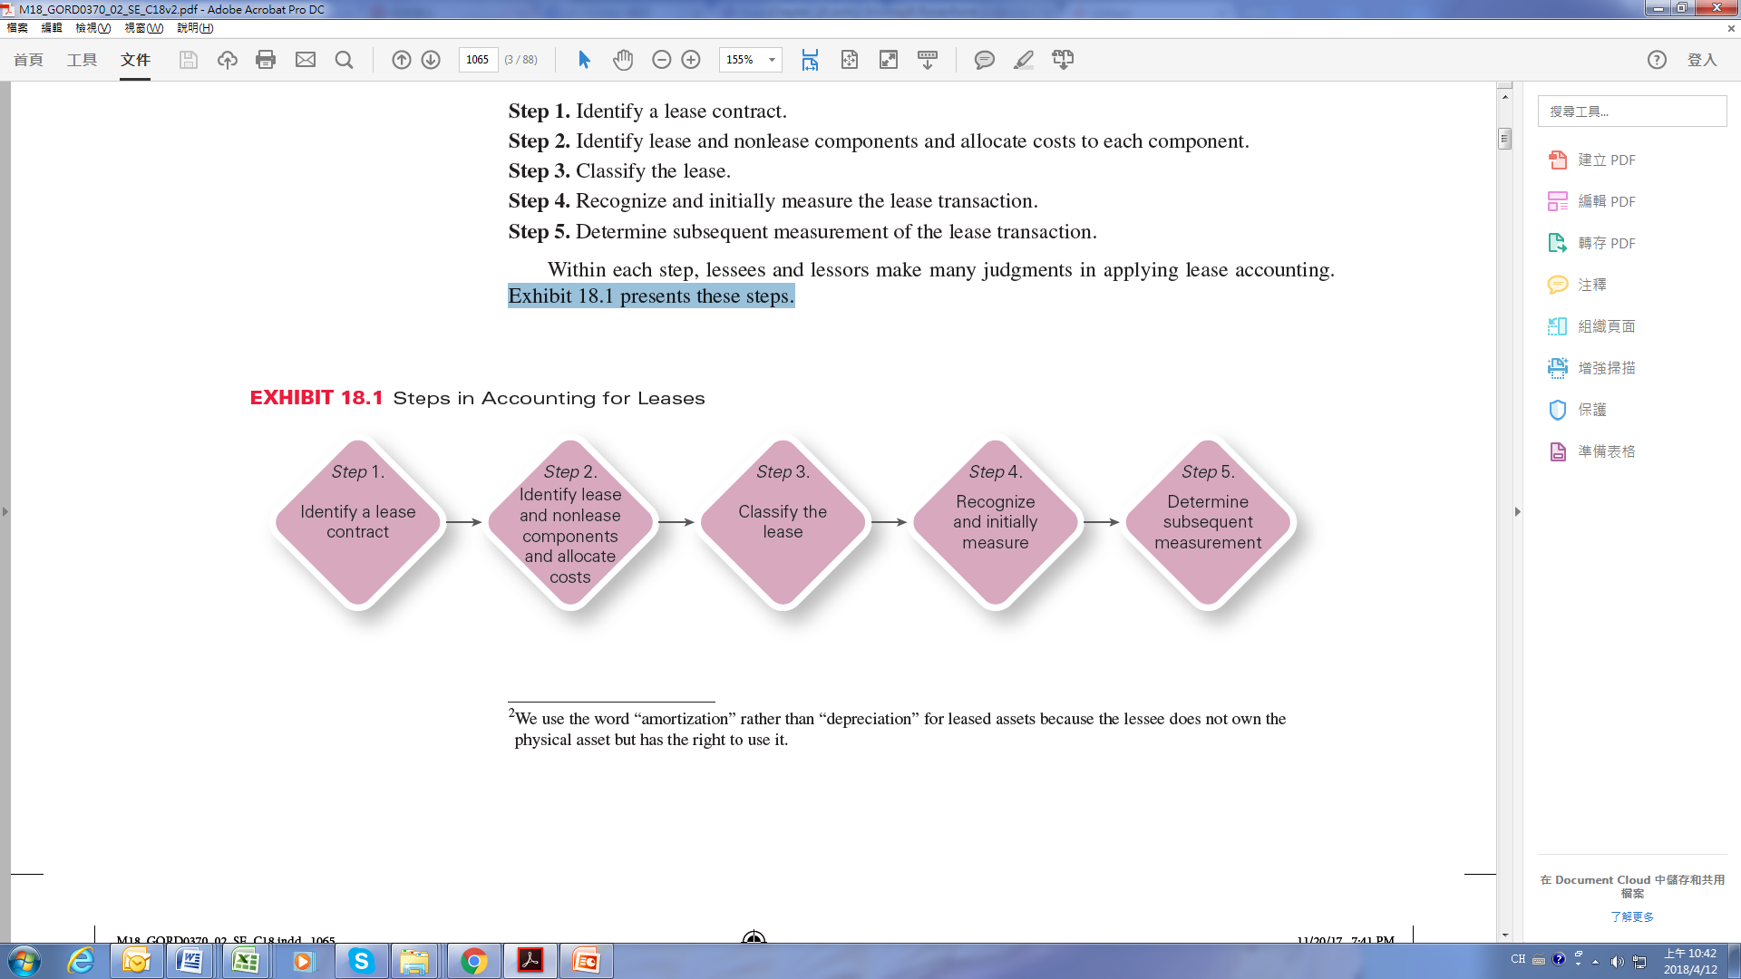

Slide 12
Lease Contracts, Lease Components, and Contract Consideration
The first step in lease accounting for both the lessee and the lessor is to determine whether a contract contains a lease. A company makes this determination at the inception of a contract. An agreement could be a separate lease contract, or a lease contract could be embedded in another agreement, such as a contract for services. The determination of whether a contract contains a lease is generally clear, but there can be cases in which it is much more complex.³
Lease contracts often contain multiple components that may be lease or nonlease components. A component of a contract is an item or activity that transfers a good or service to the lessee. Both the lessee and lessor are required to identify and separate the various lease and nonlease components. After identifying the lease and nonlease components, the lessor and lessee will be
able to allocate consideration to these components.
Companies include only lease components when accounting for the lease transaction. Any nonlease components are accounted for under other areas of the authoritative literature as appropriate. Examples of nonlease components in a lease agreement include goods or services such as maintenance services or supplies.

Slide 13
Separating Components in a Lease Contract
Prior to allocating any consideration, a company has to identify the components in the contract.
Lease Components. When lease contracts contain the right to use several assets, the company must identify each right-of-use asset. For example, a company that leases a building can also have the right to use the building’s adjacent parking lot. Typically, the right to use these multiple assets is considered a single lease component. However, if both of the following criteria are met, the right to use an asset is considered a separate lease component:
1. The lessee can benefit from the right of use of the asset either on its own or together with other resources that are readily available to the lessee.
2. The right of use is neither highly dependent on nor highly interrelated with the other rights underlying assets in the contract.
In the case of the building and parking lot, the parking lot is highly interrelated to the building. The lessee would have no use for the parking lot if it were not also leasing the building.
Land. The right to use land is considered a separate lease component unless the impact on the financial statements of not separating the land from the other asset(s) is insignificant.
Example 18.1 illustrates identifying lease and nonlease components.

Slide 14
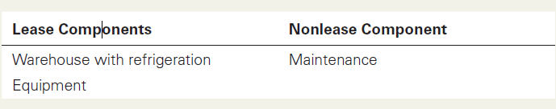
EXAMPLE 18.1 Identification of Lease and Nonlease Components
PROBLEM: Bassey Seafood Company leased a warehouse from the Gilli Group for a term of 10 years to store its products. The warehouse includes refrigeration units. The warehouse lease includes the use of forklifts, pallets, and conveyer belts. In addition, Gilli provides maintenance of all items of equipment included in the agreement. The maintenance is included in the annual lease payments.
What are the lease and nonlease components of the contract? How many lease and nonlease components are included in the contract?
SOLUTION: Bassey receives the use of warehouse storage, refrigeration units, and warehouse equipment. It also gets the use of maintenance services. The warehouse and the refrigeration units cannot be separated because they are interdependent. That is, the warehouse cannot be used to store seafood without proper refrigeration. However, the warehouse equipment (forklifts, pallets, and conveyer belts) function independently and can be used separately in any warehouse. Therefore, this contract contains two lease components: the warehouse (with refrigeration) and the equipment. Maintenance is an additional nonlease component of the contract.
In total, the contract contains three components: two lease and one nonlease.

Slide 15
Allocating Consideration in a Lease Contract
After identifying the lease and nonlease components of the contract, lessees and lessors must then allocate the total contract consideration to the components. Although the approach to allocating consideration across the components is similar for lessees and lessors, there are some differences. Let’s examine the lessee and lessor requirements separately.
Lessee Allocation Procedures. To separate the lease and nonlease components, the lessee allocates the contract consideration on a relative standalone price basis. The lessee first determines the standalone price of each component, which is the price at which it would purchase a component of a contract separately. The lessee then computes for each component the percentage of the component’s standalone price to the sum of the standalone prices for all components. Then, to determine the amount of consideration allocated to a particular component, the lessee multiplies the percentage by the total consideration.
Ideally, the lessee uses the observable standalone prices. However, if observable prices are not available, the lessee can estimate the standalone prices. When estimating standalone prices, the lessee should maximize the use of observable inputs.

Slide 16
In cases in which the standalone price is highly variable or uncertain, the lessee may use a residual method of determining the standalone price. The residual method subtracts the other standalone prices from the total contract consideration and assigns the remaining amount as the estimated standalone price of the remaining component.⁴
Initial direct costs are incremental costs that the lessee would not have incurred if he had not obtained the lease, such as commissions, legal fees resulting from the execution of the lease, costs to prepare documents after the execution of the lease, and payments to existing tenants to move out of a facility. The lessee allocates initial direct costs to the separate lease components on the same basis as the lease payments. We discuss the accounting treatment for initial direct costs
in more detail later in the chapter.

Slide 17
Lessor Allocation Procedures. The lessor allocates the lease transaction price to the separate components in accordance with the revenue recognition guidance discussed in Chapter 8. The lessor allocates the total consideration in the contract to each individual lease and nonlease component using the relative standalone selling price allocation. If there is not an observable standalone selling price, the lessor must use an estimate of the standalone selling price and allocate it based on any of the following methods:
1. Adjusted market assessment approach
2. Expected-cost-plus-a-margin approach
3. Residual approach⁵
In all cases, the lessor must use observable data when possible. The lessor allocates any initial direct costs to the separate lease and nonlease components to which the costs relate. Example 18.2 illustrates the allocation of consideration to separate lease and nonlease components.

Slide 18
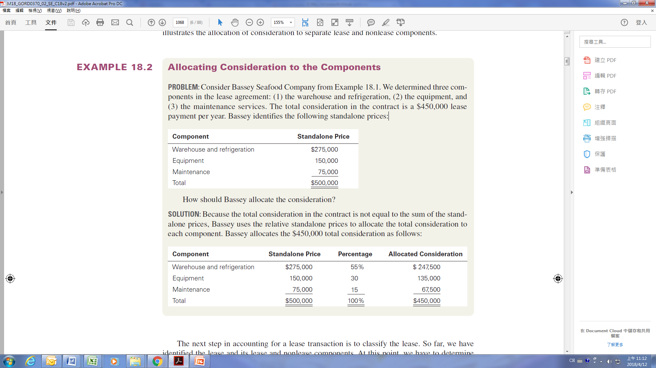
EXAMPLE 18.2 Allocating Consideration to the Components
PROBLEM: Consider Bassey Seafood Company from Example 18.1. We determined three components in the lease agreement: (1) the warehouse and refrigeration, (2) the equipment, and (3) the maintenance services. The total consideration in the contract is a $450,000 lease payment per year. Bassey identifies the following standalone prices:
How should Bassey allocate the consideration?
SOLUTION: Because the total consideration in the contract is not equal to the sum of the standalone prices, Bassey uses the relative standalone prices to allocate the total consideration to each component. Bassey allocates the $450,000 total consideration as follows:

Slide 19
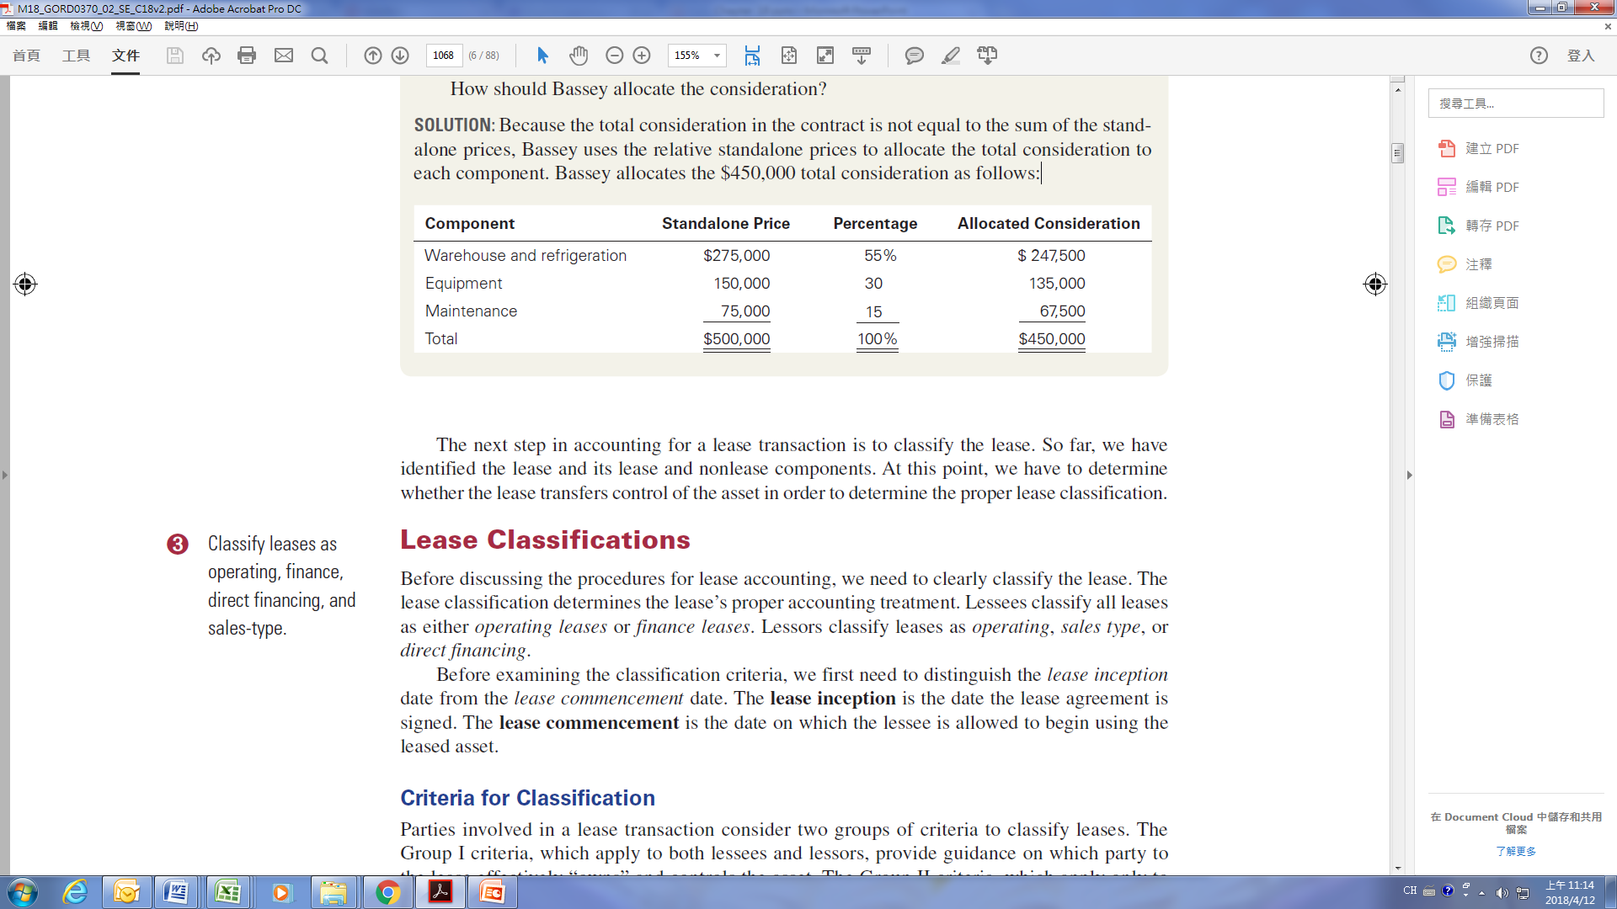
The next step in accounting for a lease transaction is to classify the lease. So far, we have identified the lease and its lease and nonlease components. At this point, we have to determine whether the lease transfers control of the asset in order to determine the proper lease classification.

Slide 20
Lease Classifications
Before discussing the procedures for lease accounting, we need to clearly classify the lease. The lease classification determines the lease’s proper accounting treatment. Lessees classify all leases as either operating leases or finance leases. Lessors classify leases as operating, sales type, or direct financing.
Before examining the classification criteria, we first need to distinguish the lease inception date from the lease commencement date. The lease inception is the date the lease agreement is signed. The lease commencement is the date on which the lessee is allowed to begin using the leased asset.
Criteria for Classification
Parties involved in a lease transaction consider two groups of criteria to classify leases. The Group I criteria, which apply to both lessees and lessors, provide guidance on which party to the lease effectively “owns” and controls the asset. The Group II criteria, which apply only to lessors, determine the extent to which the lessor will absorb the credit risk related to the lease contract.

Slide 21
Group I Criteria. Group I criteria provide guidance to operationalize the concept of ownership and control of an asset. Both the lessor and lessee use the Group I criteria. To meet the Group I conditions, a transaction needs only to meet one of the five criteria:
1. The lease transfers ownership of the leased asset to the lessee at the end of the lease term. If the lease transfers ownership, the lessee firm has in essence purchased the asset.
2. The lessee is given an option to purchase the asset that the lessee is reasonably certain to exercise. For example, it might be reasonably certain that the lessee would exercise a purchase option if the specified purchase price is well lower than the expected value of the leased asset at the completion of the lease term.
3. The lease term is for a major part of the economic life of the asset.6 If the lease term provides the lessee the use and control over substantially all of the asset’s useful life, the agreement should be considered equivalent to purchasing the asset.
The lease term begins at the lease commencement date and includes the noncancellable period for which a lessee has the right to use the leased asset. The lease term also includes periods covered by an option to renew the lease if the lessee is reasonably certain to renew. The lessee is likely to renew if the lease payments over the renewal period are substantially lower than the fair value rental amount. If the lessor controls the option to renew the lease,

Slide 22
the renewal period is included in the lease term.
If a lease agreement contains an option to terminate and the lessee is reasonably likely to exercise that option, the lease term ends on the earliest date that the lease can be terminated. If the lessor has the option not to terminate the lease then, the lease term is the total lease period and will not terminate early.
4. The present value of the sum of the lease payments and any residual value the lessee guarantees to pay (that is not otherwise included in the lease payments) is equal to substantially all of the asset’s fair value. In this case, the lessor is able to recover the cost of the asset. The present value computation includes lease payments in the renewal periods, if any. Meeting this criterion implies that the lessee is providing the lessor compensation that is equivalent to the purchase of the asset.
5. The leased asset is of a specialized nature. An asset with a specialized nature has no alternative use to the lessor at the end of the lease term. Because the asset has no alternative use to the lessor, its specialized nature implies that the lessor must have transferred control over the asset to the lessee.

Slide 23
Group II Criteria. Group II criteria apply to the lessor only. To meet the Group II criteria, a transaction must meet both criteria.
1. The present value of the sum of the lease payments and any residual value the lessee or a third party guarantees to pay (that is not otherwise included in the lease payments) is equal to substantially all of the asset’s fair value.
2. It is probable that the lessor will collect the lease payments plus any amount necessary to satisfy a residual value guarantee.
Many of the Group I and Group II criteria depend highly on judgment. FASB does give some implementation guidance, and we discuss that in the judgment section later in the chapter. However, even with this limited guidance, much judgment is needed.

Slide 24
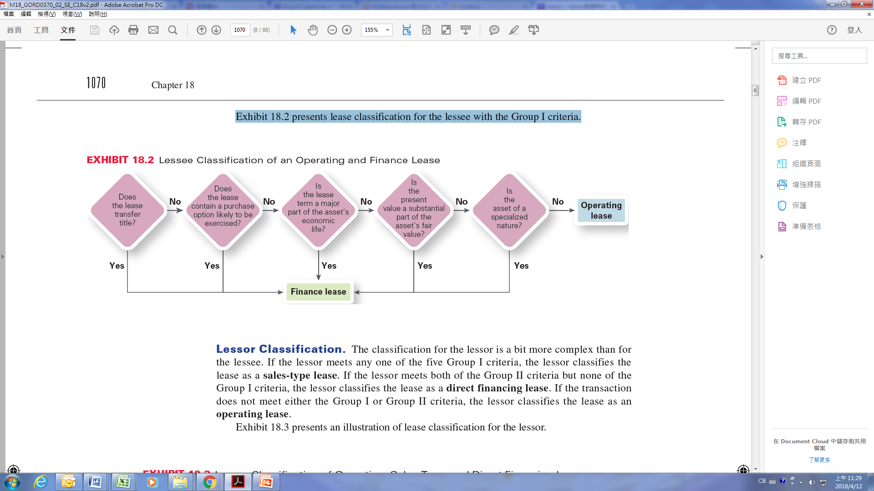
Lessee Classification. The classification is fairly straightforward for lessees. If the lease transaction meets any one of the five Group I criteria, the lessee classifies the lease as a finance lease. If none of the Group I criteria is met, the lessee classifies the lease as an operating lease. The Group II criteria are not used by the lessee.
Exhibit 18.2 presents lease classification for the lessee with the Group I criteria.

Slide 25
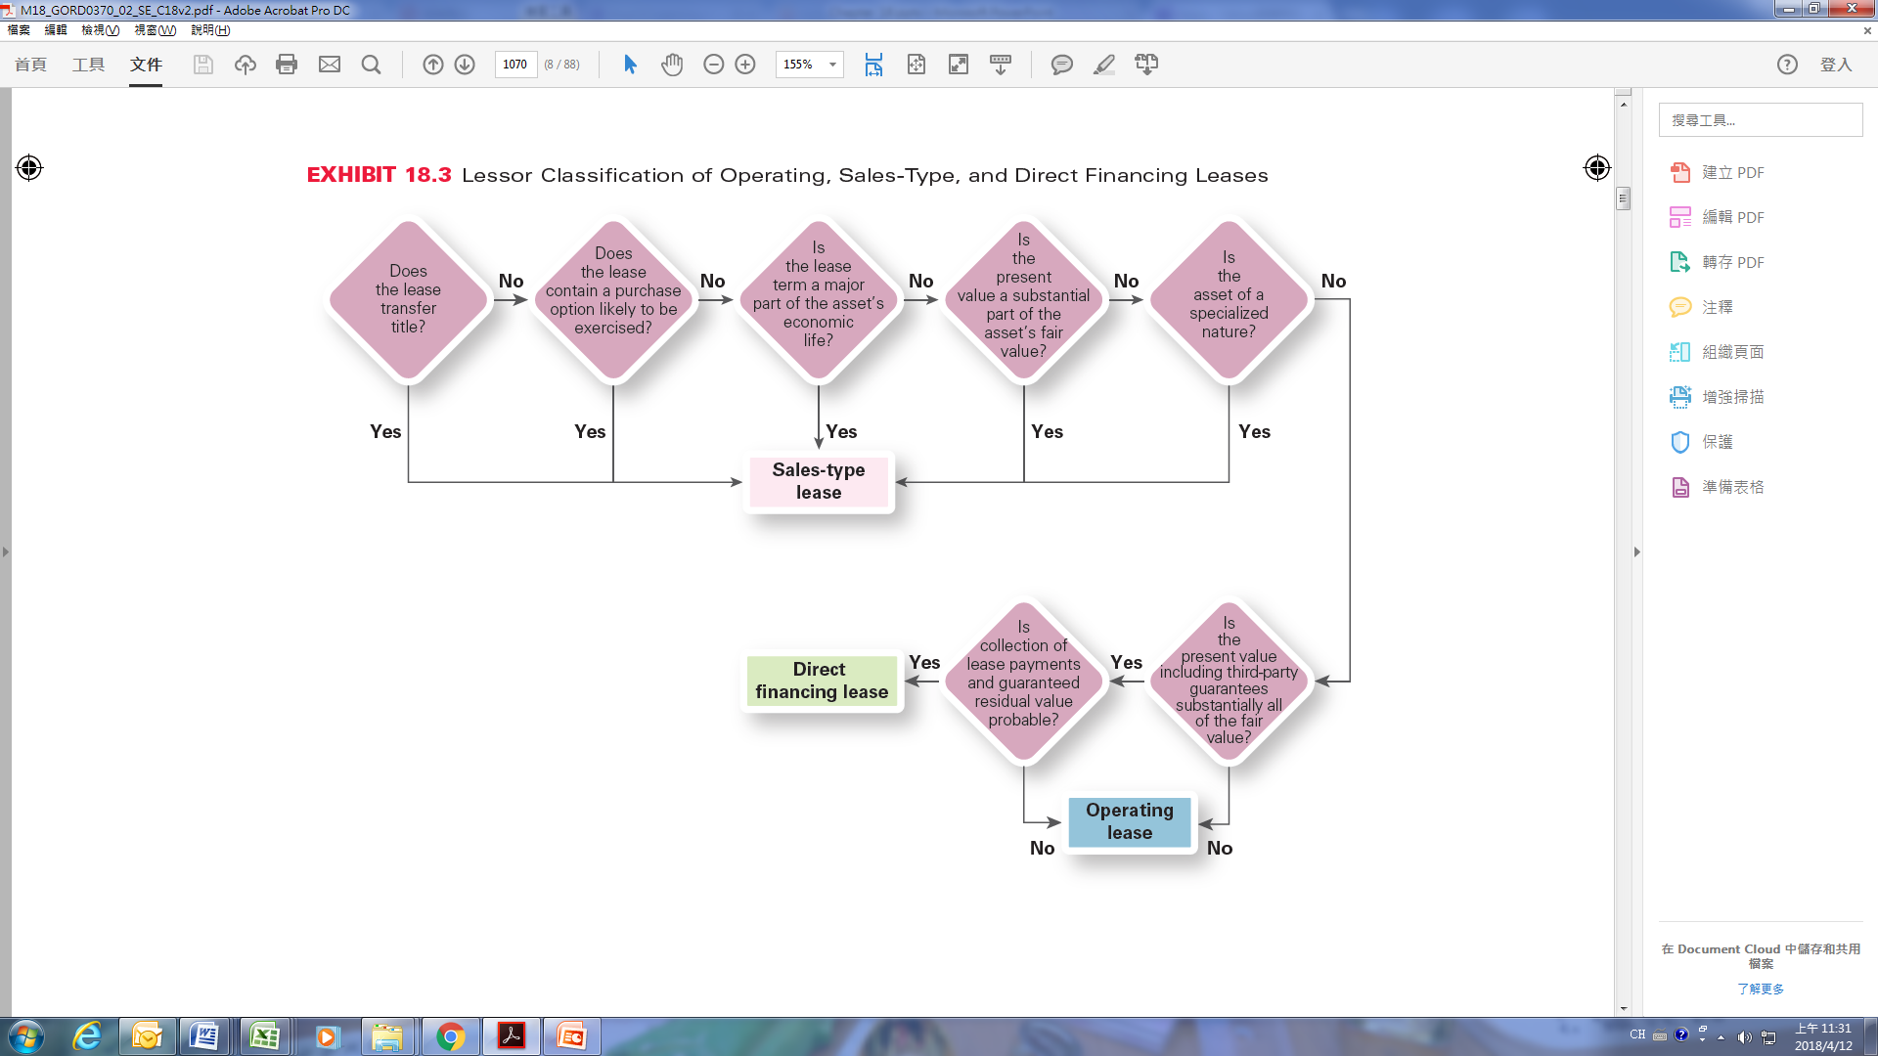
Lessor Classification. The classification for the lessor is a bit more complex than for
the lessee. If the lessor meets any one of the five Group I criteria, the lessor classifies the lease as a sales-type lease. If the lessor meets both of the Group II criteria but none of the Group I criteria, the lessor classifies the lease as a direct financing lease. If the transaction does not meet either the Group I or Group II criteria, the lessor classifies the lease as an operating lease.
Exhibit 18.3 presents an illustration of lease classification for the lessor.

Slide 26
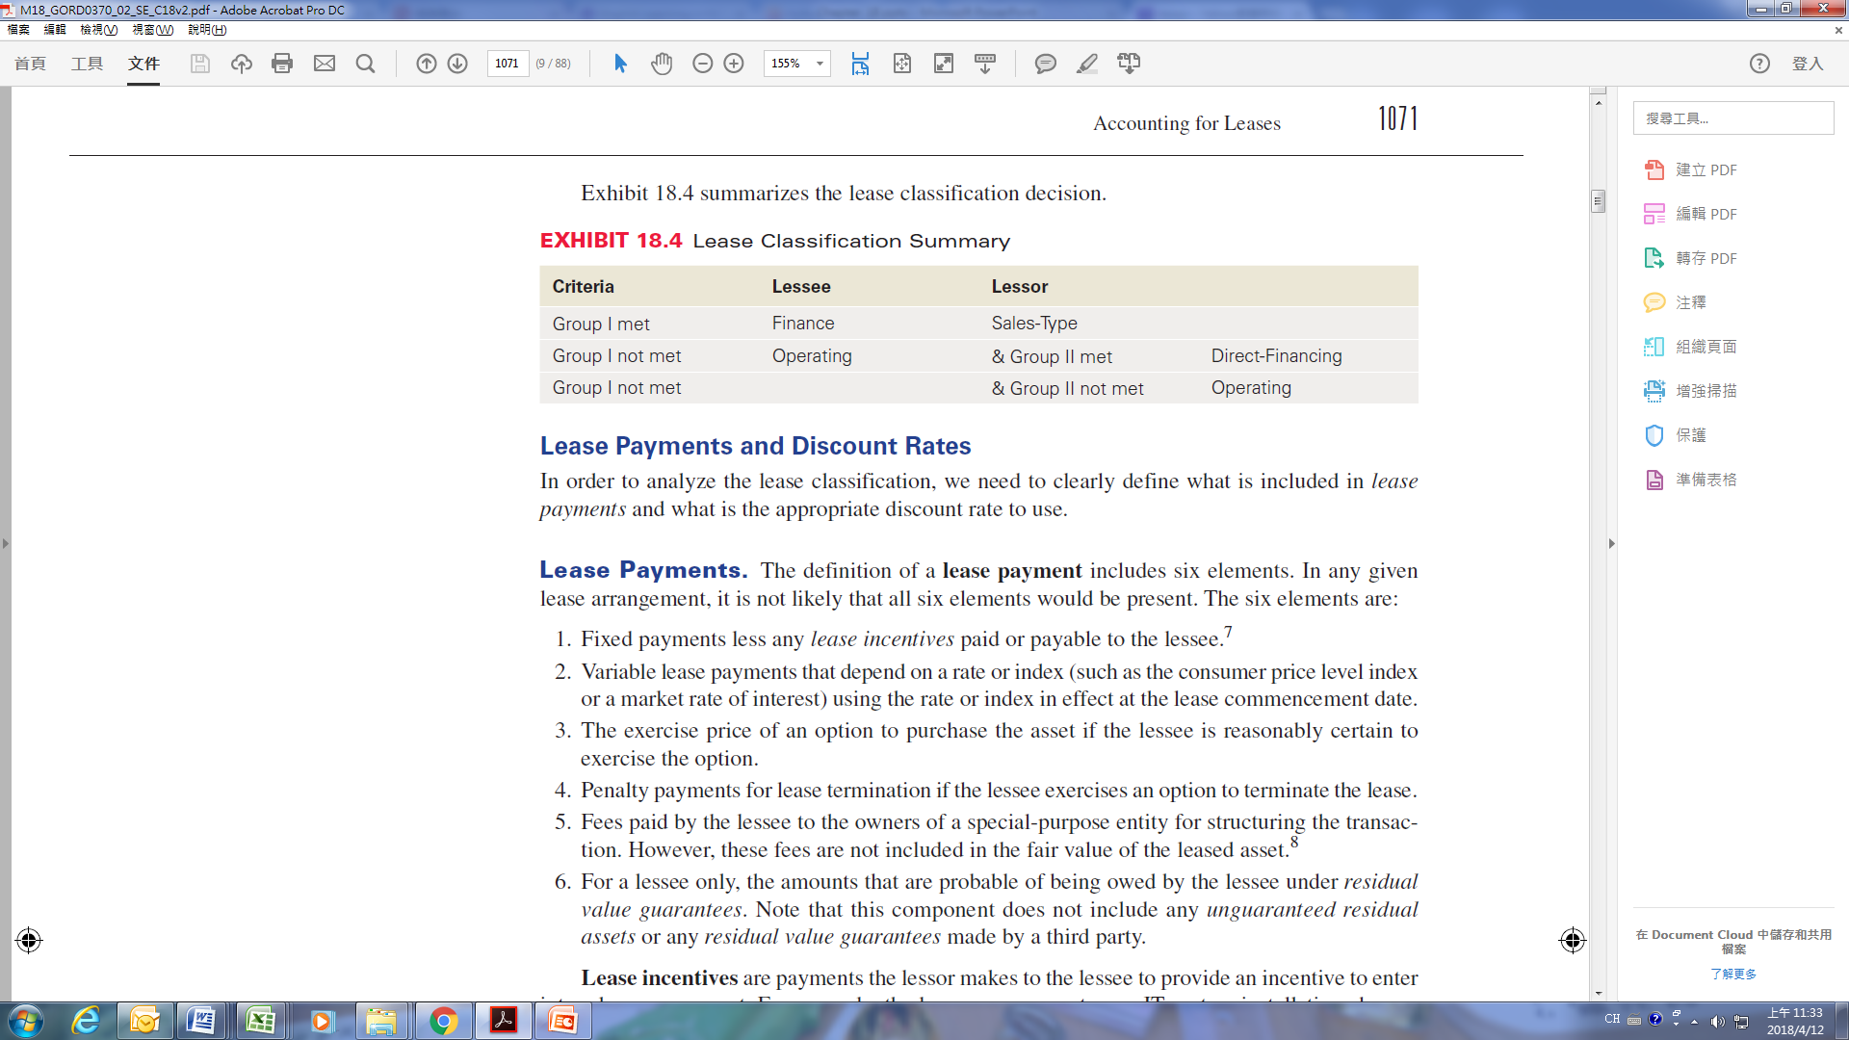
Exhibit 18.4 summarizes the lease classification decision.
Lease Payments and Discount Rates
In order to analyze the lease classification, we need to clearly define what is included in lease payments and what is the appropriate discount rate to use.

Slide 27
Lease Payments. The definition of a lease payment includes six elements. In any given lease arrangement, it is not likely that all six elements would be present. The six elements are:
1. Fixed payments less any lease incentives paid or payable to the lessee.⁷
2. Variable lease payments that depend on a rate or index (such as the consumer price level index or a market rate of interest) using the rate or index in effect at the lease commencement date.
3. The exercise price of an option to purchase the asset if the lessee is reasonably certain to exercise the option.
4. Penalty payments for lease termination if the lessee exercises an option to terminate the lease.
5. Fees paid by the lessee to the owners of a special-purpose entity for structuring the transaction. However, these fees are not included in the fair value of the leased asset.⁸
6. For a lessee only, the amounts that are probable of being owed by the lessee under residual value guarantees. Note that this component does not include any unguaranteed residual assets or any residual value guarantees made by a third party.

Slide 28
Lease incentives are payments the lessor makes to the lessee to provide an incentive to enter into a lease agreement. For example, the lessor may agree to pay IT system installation charges at a new location to give the lessee incentive to lease the new facility. As another example, the lessor may agree to pay the lessee’s remaining rentals on another lease so the lessee can terminate
that lease.
A residual value guarantee is a guarantee or assurance made to the lessor that he will receive a fixed dollar amount for the leased asset at the end of the lease. The lessee or a third party may provide this guarantee. If the fair value of the asset at the end of the lease is less than the residual value guarantee, the guarantor will make a payment to the lessor for the difference in the residual value guarantee and the fair value of the asset.
An unguaranteed residual asset is an amount the lessor expects to derive from the leased asset at the end of the lease term. This amount is simply the lessor’s expectation; the lessee or a third party does not guarantee the residual value.

Slide 29
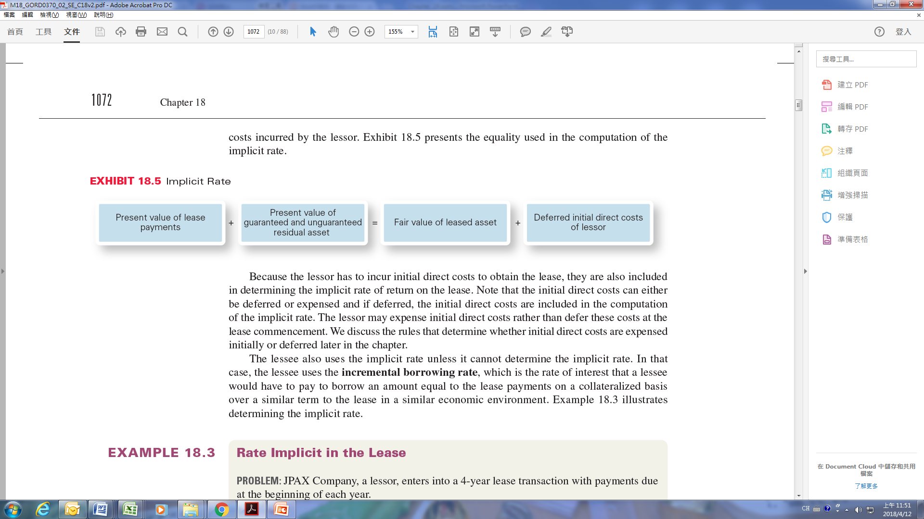
Discount Rates. Now that we have established the elements of lease payments, we discuss the determination of the appropriate discount rate to use in our lease computations. To compute the present value of the lease payments, both the lessor and the lessee have to determine the appropriate discount rate at the commencement of the lease. The lessor uses the implicit rate, which is a rate that is determined implicitly based on the equation in Exhibit 18.5.
The implicit rate is the rate of interest that sets the present value of the lease payments plus the present value of the amount that a lessor expects to obtain from the leased asset at the end of the lease term equal to the sum of the fair value of the leased asset and any deferred initial direct costs incurred by the lessor. Exhibit 18.5 presents the equality used in the computation of the
implicit rate.

Slide 30
Because the lessor has to incur initial direct costs to obtain the lease, they are also included in determining the implicit rate of return on the lease. Note that the initial direct costs can either be deferred or expensed and if deferred, the initial direct costs are included in the computation of the implicit rate. The lessor may expense initial direct costs rather than defer these costs at the lease commencement. We discuss the rules that determine whether initial direct costs are expensed initially or deferred later in the chapter.
The lessee also uses the implicit rate unless it cannot determine the implicit rate. In that case, the lessee uses the incremental borrowing rate, which is the rate of interest that a lessee would have to pay to borrow an amount equal to the lease payments on a collateralized basis over a similar term to the lease in a similar economic environment. Example 18.3 illustrates determining the implicit rate.

Slide 31
EXAMPLE 18.3 Rate Implicit in the Lease
PROBLEM: JPAX Company, a lessor, enters into a 4-year lease transaction with payments due at the beginning of each year.
• The lease payments are $48,000 per year.
• The fair value of the leased asset is $260,000.
• The lessor’s deferred initial direct costs are equal to $12,000.
• The lessor’s estimate of the unguaranteed residual asset is $115,000.
What is the implicit rate in the lease for the lessor?
SOLUTION: JPAX solves for the implicit rate using the following equality:
Present Value of Lease Payments + Present Value of Estimated Residual Value
= Fair Value of Asset + Deferred Initial Direct Costs

Slide 32
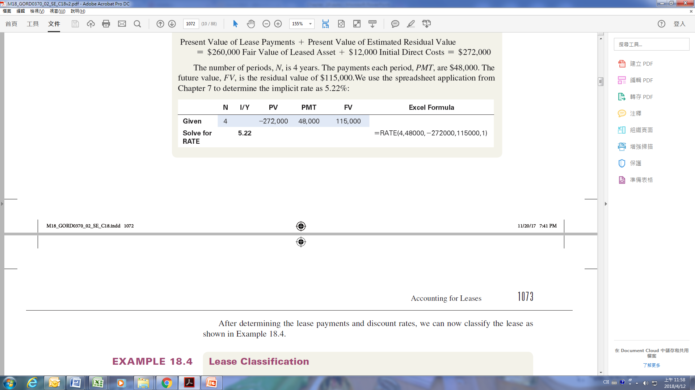
JPAX applies time value of money concepts to identify the terms needed to solve for the implicit rate: the present value, PV; the number of periods, N; the payments per period, PMT; and the future value, FV. Because the payments are due at the beginning of the period, this is
a present value of an annuity due problem. The present value, PV, is the present value of the lease payments plus the expected residual value which equals the fair value of the leased asset plus the deferred initial direct costs:
Present Value of Lease Payments + Present Value of Estimated Residual Value
= $260,000 Fair Value of Leased Asset + $12,000 Initial Direct Costs = $272,000
The number of periods, N, is 4 years. The payments each period, PMT, are $48,000. The future value, FV, is the residual value of $115,000. We use the spreadsheet application from Chapter 7 to determine the implicit rate as 5.22%:
After determining the lease payments and discount rates, we can now classify the lease as shown in Example 18.4.

Slide 33
EXAMPLE 18.4 Lease Classification
PROBLEM: On January 1, 2019, Sturge Manufacturing leased a piece of machinery for use in its North American operations from Borko Bank. The machinery is not specialized and, therefore, could also be leased to other parties. The 9-year, noncancellable lease requires lease payments of $13,000 due at the beginning of each year. The present value of the lease payments is $77,579. The lease agreement does not transfer ownership of the machinery and it does not contain a purchase option. Sturge has not guaranteed a residual value, but a third party has provided a guarantee with a present value of $18,031. The machinery has a fair value of $95,455 and an estimated life of 10 years. Borko views it highly probable that the bank will collect the lease payments from Sturge and the third-party residual value guarantor. Determine whether Sturge should report the lease as an operating or finance lease. Determine whether Borko should classify the lease as operating, direct financing, or sales type.

Slide 34
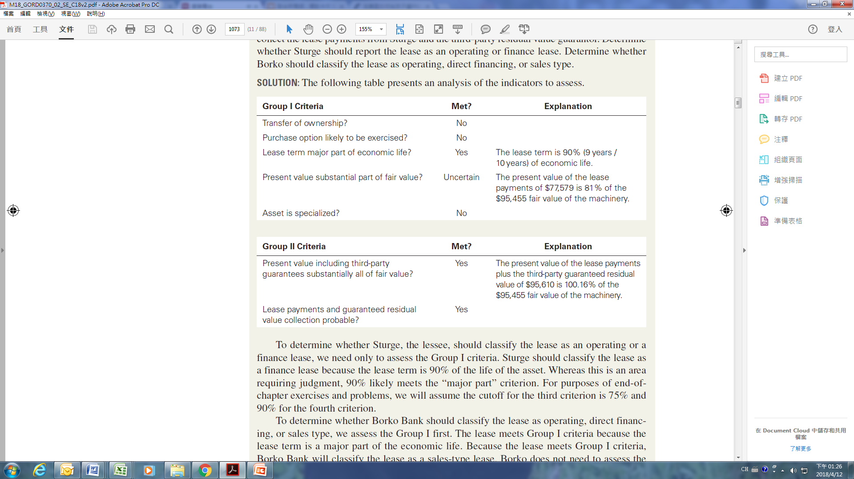
SOLUTION: The following table presents an analysis of the indicators to assess.

Slide 35
To determine whether Sturge, the lessee, should classify the lease as an operating or a finance lease, we need only to assess the Group I criteria. Sturge should classify the lease as a finance lease because the lease term is 90% of the life of the asset. Whereas this is an area requiring judgment, 90% likely meets the “major part” criterion. For purposes of end-of-chapter exercises and problems, we will assume the cutoff for the third criterion is 75% and 90% for the fourth criterion.
To determine whether Borko Bank should classify the lease as operating, direct financing, or sales type, we assess the Group I first. The lease meets Group I criteria because the lease term is a major part of the economic life. Because the lease meets Group I criteria, Borko Bank will classify the lease as a sales-type lease. Borko does not need to assess the Group II criteria, but include them here to demonstrate the calculations involved.

Slide 36
IFRS Lease Classification
Lease classification is different under U.S. GAAP and IFRS.
In the case of the lessee, IFRS does not classify leases as operating and financing and does not distinguish two types of leases. Rather, lessee accounting treatment is the same for all leases under IFRS. All leases are recorded with leased assets and lease liabilities.
In the case of the lessor, IFRS includes only one group of criteria. If the criteria are met, the lease is classified as a finance lease; otherwise, the lease is classified as an operating lease. The goal of the IFRS classification standards for lessors is to determine whether the risks and rewards of ownership have been transferred to the lessee. IFRS does not distinguish between sales-type and direct financing leases.
The first five IFRS criteria are the same as U.S. GAAP Group I criteria for the lessor. However, IFRS does not specify that if one of the criteria is met, the lease is a finance lease. Rather, IFRS takes the approach that these scenarios are indicators that the lease is a finance lease for the lessor.

Slide 37
IFRS also identifies three additional indicators that individually or in combination could lead to classifying a lease as a finance lease. The terms of the lease imply a finance lease if:
1. The lessee bears the lessor’s losses if the lessee cancels the lease.
2. The lessee absorbs the gains or losses from fluctuations in the fair value of the residual value of the asset.
3. The lessee may extend the lease for a secondary period at a rent substantially below the market rent in a renewal option.
An example of lease classification under IFRS is presented in Example 18.5.

Slide 38
EXAMPLE 18.5 IFRS Finance Lease: Lessor
PROBLEM: On January 1, 2019, Sturge Manufacturing, an IFRS reporter, leased a piece of machinery for use in its North American operations from Borko Bank. The 9-year, noncancellable lease requires lease payments of $14,000 due at the beginning of each year. The machinery built to Sturge’s specifications would require significant modifications for another manufacturer to use it. The present value of the lease payments, including payments during the renewal period, is $77,519. The lease agreement does not transfer ownership of the machinery,
and it does not contain a purchase option. Sturge can renew the lease for $500 a year for 10 additional years and expects these terms to be lower than the market rent on the renewal date. The machinery has a fair value of $95,455 and an estimated life of 20 years. Determine whether Borko Bank should report the lease as an operating or finance lease under IFRS.

Slide 39
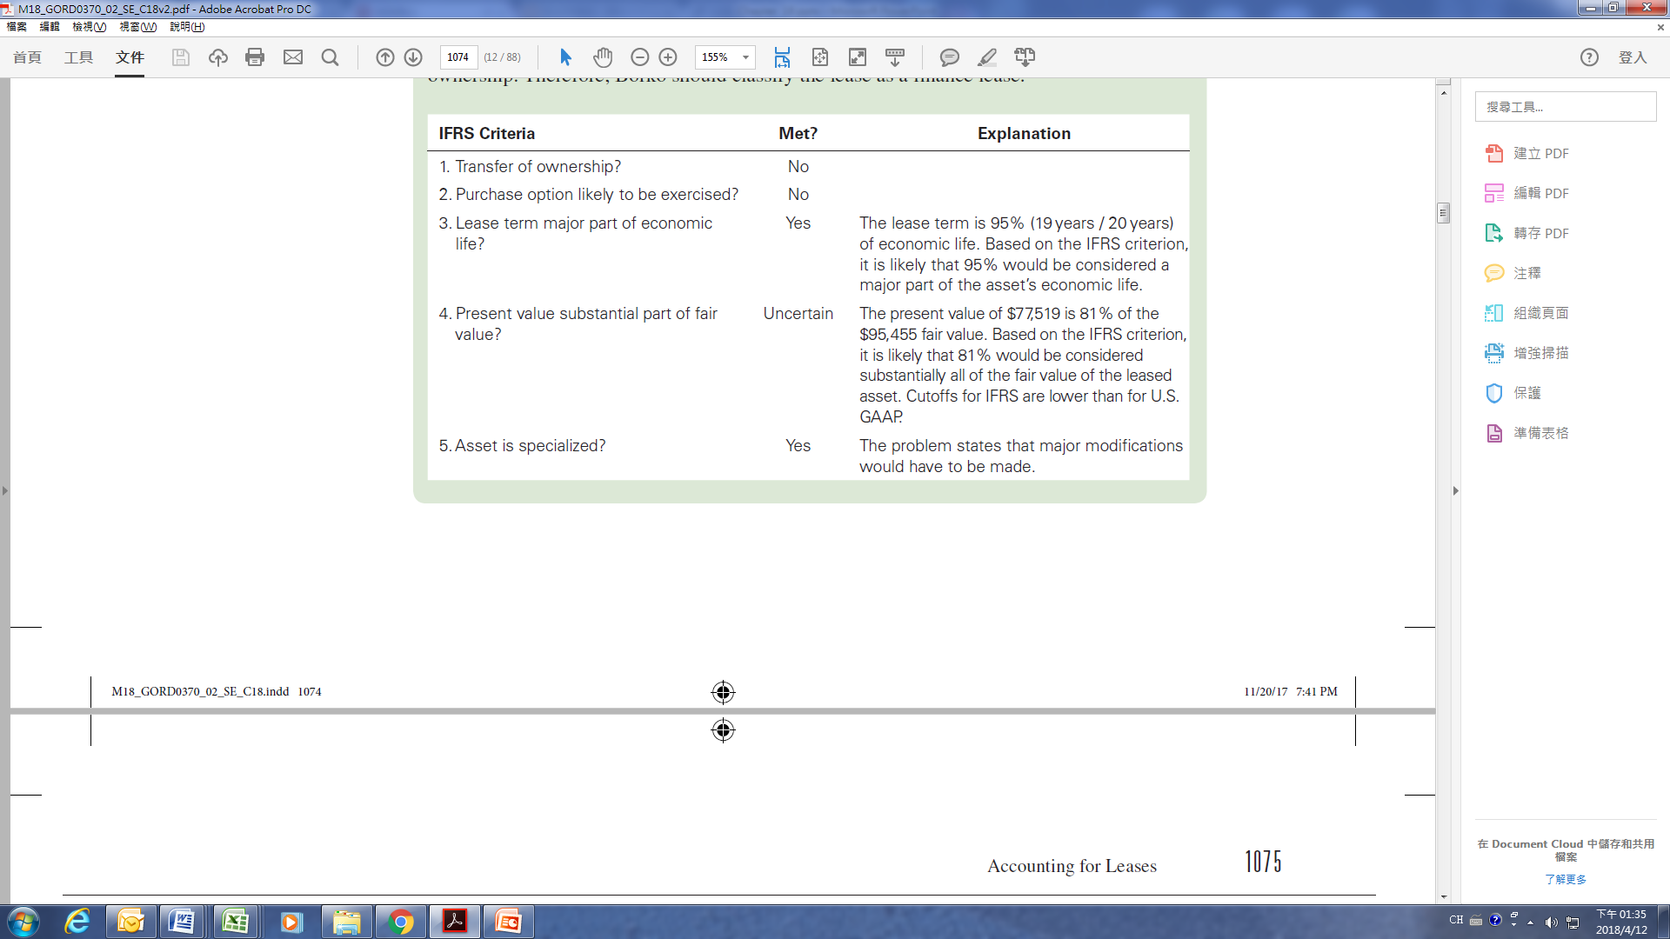
SOLUTION: Borko Bank classifies this as a finance lease because the lease is for the major part of the machinery’s economic life and at an amount representing a substantial portion of its fair value. Because the lease is noncancellable and the machinery is specialized, Sturge assumes the risks of ownership. The following table analyzes the situations and indicators of situations that Borko must assess. This analysis suggests that the lease transfers the risks and rewards of ownership. Therefore, Borko should classify the lease as a finance lease.

Slide 40
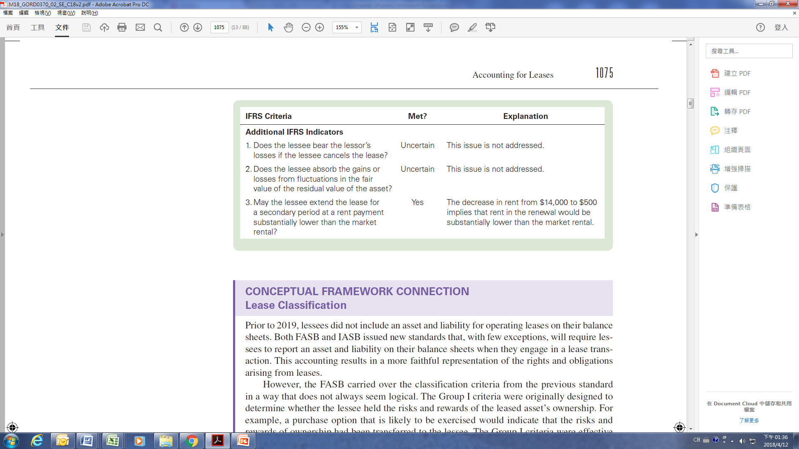

Slide 41
CONCEPTUAL FRAMEWORK CONNECTION
Lease Classification
Prior to 2019, lessees did not include an asset and liability for operating leases on their balance sheets. Both FASB and IASB issued new standards that, with few exceptions, will require lessees to report an asset and liability on their balance sheets when they engage in a lease transaction. This accounting results in a more faithful representation of the rights and obligations arising from leases.
However, the FASB carried over the classification criteria from the previous standard in a way that does not always seem logical. The Group I criteria were originally designed to determine whether the lessee held the risks and rewards of the leased asset’s ownership. For example, a purchase option that is likely to be exercised would indicate that the risks and rewards of ownership had been transferred to the lessee. The Group I criteria were effective in evaluating the transfer of risk and rewards. Because all leased assets and lease liabilities are
now on the balance sheet, the current Group I criteria are no longer logical; that is, requiring the lessee to report all leased assets and lease liabilities on the balance sheet seems to answer the question of who holds the risks and rewards—the lessee.

Slide 42
In reality, the Group I criteria are now used to determine the subsequent accounting for operating and finance leases for the lessee. As we discuss later in the chapter, when the amount the expenses are reported and where on the income statement they are reported differs for an operating lease and a finance lease. Yet, the Group I criteria are not related to the leased asset’s subsequent use and cannot be used to explain the differences in expense reporting. Whereas the U.S. GAAP standard initially results in a faithful representation of the leased asset and liability on the balance sheet, the subsequent treatment on the income statement is more difficult to justify from a conceptual standpoint. The IFRS model—for which there is no distinction in operating and finance leases for a lessee—is much more conceptually sound.
Likewise, it is challenging to understand the objective of the Group II criteria. Under the prior standards, U.S. GAAP distinguished a sales-type lease from a direct financing lease based on whether a profit existed. Now the distinction is based on whether there is a third-party guaranteed residual value. Presumably, FASB did not want lessors to recognize a profit at lease commencement from non-operating lease treatment due solely to a third-party residual value guarantee. But the Group II criteria seem like a highly complex way to achieve this reporting outcome.

Slide 43
Finally, there is a disconnect for lessee and lessor accounting under both U.S. GAAP and IFRS. Under both standards, the lessee always recognizes the leased asset and the lease liability (unless he meets one of the limited exceptions that we discuss later in the chapter). However, in the case of the operating lease, the lessor continues to recognize the asset on its balance sheet. If the risks and returns of ownership have truly passed to the lessee, causing the lessee to recognize the leased asset and lease liability on the balance sheet, then why wouldn’t the lessor derecognize the asset? This is a question that the current standards do not answer.

