Slide 1
APPENDIX 3.A. FOUR ALTERNATIVE METHODS TO SOLVE SYSTEM OF LINEAR EQUATIONS

Slide 2
Method 1: Substitution methods
(Reference: Wikipedia)
The simplest method for solving a system of linear equations is to repeatedly eliminate variables. This method can be described as follows:
In the first equation, solve for one of the variables in terms of the others.
Substitute this expression into the remaining equations. This yields a system of equations with one fewer equation and one fewer unknown.
Continue until you have reduced the system to a single linear equation.
4.Solve this equation and then back-substitute until the entire solution is found.

Slide 3


For example, consider the following system:
(3.A.1)
Solving the first equation for x gives x = 5 + 2z − 3y, and plugging this into the second and third equation yields
(3.A.2)

Slide 4

Solving the first of these equations for y yields y = 2 + 3z, and plugging this into the second equation yields z = 2. We now have:
(3.A.3)
Substituting z = 2 into the second equation gives y = 8, and substituting z = 2 and y = 8 into the first equation yields x = −15. Therefore, the solution set is the single point (x, y, z) = (−15, 8, 2).

Slide 5


Method 2: Cramer’s rule
Explicit formulas for small systems (Reference: Wikipedia)
Consider the linear system
(3.A.4)
which in matrix format is
(3.A.5)

Slide 6


Assume a₁b₂ − b₁a₂ nonzero. Then, x and y can be found with Cramer's rule as
(3.A.6)
and
(3.A.7)

Slide 7


The rules for 3 × 3 matrices are similar. Given
(3.C.8)
which in matrix format is
(3.A.8)

Slide 8
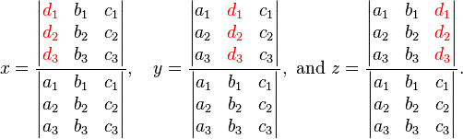
Then the values of x, y and z can be found as follows:
(3.A.9)
And then you need to use determinant calculation, which will be discussed in next session.

Slide 9
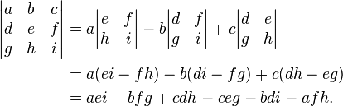
Determinant Calculation
3 × 3 matrices
The determinant of a 3×3 matrix is defined by
(3.A.10)

Slide 10
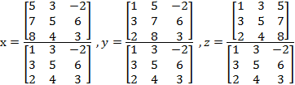
We use the same example as we did in the first method:
(3.A.11)

Slide 11


(3.C.12)
(3.C.13)

Slide 12

Method 3: Matrix Method
Using the example above, we can derive the following matrix equation:
(3.A.14)
The inversion of matrix A is, by the definition
(3.A.15)
The Adjoint A is defined by the transpose of the cofactor matrix. First we need to calculate the cofactor matrix of A. Suppose the cofactor matrix is:

Slide 13

Therefore,

Slide 14


(3.A.16)
Then, we can get the Adjoint A:
(3.A.17)

Slide 15

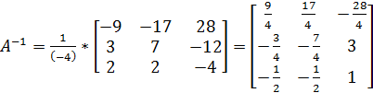
The determinant of A we have calculated in Cramer’s rule:
(3.A.18)

Slide 16
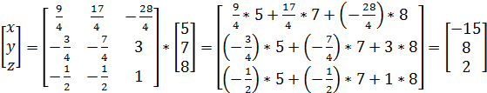
Therefore,
(3.A.19)

Slide 17
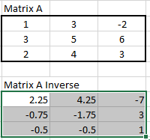
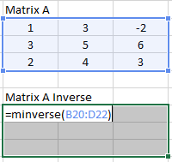
Method 4: Excel Matrix Inversion and
Multiplication
1.Using minverse () function to get the A inverse. Type “Ctrl + Shift + Enter” together you will get the inverse of A.

Slide 18


2.Using mmult () function to do the matrix multiplication and type “Ctrl + Shift + Enter” together, you will get the answers for x, y, and z.

