Slide 1
Financial Analysis, Planning and Forecasting Theory and Application
Chapter 16
Mergers: Theory and Evidence
By
Cheng F. Lee
Rutgers University, USA
John Lee
Center for PBBEF Research, USA

Slide 2
Outline
16.1 Introduction
16.2 Overview of Mergers
16.3 Classification of Business Combination
16.4 Methods of Business Combination
16.5 Merger Accounting and Tax Effects
Tax Implications
Accounting Treatment of Business Combination
16.6 Economic Theories and Evidence
Economic Theories
Market Power
16.7 Financial Theories and Evidence
Diversification and Debt Capacity
16.8 Summary

Slide 3
16.3 Classification of Business Combination
Table 16.1 Largest Mergers, Acquisitions and LBOs: 1980-1995
 | Acquiring Company | Acquired Company | Price ($ Billions) | Year
1 | Kohlberg Kravis Roberts (LBO) | RJR Nabisco | $25.1 | 1988
2 | AT&T | McCaw Cellular Comm. Inc. | 18.9 | 1994
3 | Air Touch Communications (merger) | US West Inc. | 13.5 | 1995
4 | Chevron | Gulf Oil | 13.3 | 1984
5 | Philip Morris | Kraft | 13.1 | 1988
6 | Bell Atlantic Corp. (merger) (cellular phone business) | NYNEX Corp. (cellular phone business) | 13.0 | 1995
7 | Time Inc. | Warner Communications | 12.6 | 1990
8 | Bristol-Myers | Squibb | 12.5 | 1989
9 | Texaco | Getty Oil | 10.1 | 1984
10 | Martin Mirietta Corp. (merger) | Lockheed Martin Corp. | 10.0 | 1995
11 | Viacom Inc. | Paramount Communication Inc. | 9.6 | 1994
12 | American home Products Corp. | American Cyanmid Co. | 9.6 | 1989
13 | Beecham Group | Smith Kline Beckman | 8.3 | 1989

Slide 4
16.3 Classification of Business Combination
Table 16.1 Largest Mergers, Acquisitions and LBOs: 1980-1995 (Cont’d)
Source: Mergers & Acquisitions, IDD Inc., Philadelphia, Reprinted with permission.
 | Acquiring Company | Acquired Company | Price ($ Billions) | Year
14 | DuPont | Conoco | 8.0 | 1981
15 | Viacom Inc. | blockbuster Entertainment Corp. | 8.0 | 1994
16 | British Petroleum | Standard Oil Ohio (remaining 45% interest) | 7.8 | 1987
17 | AT&T | NCR | 7.5 | 1991
18 | Hoechst AG | Marion Merrell Dow Inc. | 7.1 | 1995
19 | Upjohn co. | Phamacia AB | 7.0 | 1995
20 | Matsushita Electric Industrial Co. Ltd. | MCA, Inc. | 6.9 | 1991
21 | GTE | Contel | 6.8 | 1991
22 | Kimberly-Clerk Corp. | Scott Paper Co. | 6.8 | 1995
23 | Bankers Trust New York Corp. | Cheska Sporitela Savings Banks (40% of Cesky Investichi Fond and Vynosovy Investichi Fond | 6.7 | 1995
24 | Campeau | Federated Department Stores | 6.5 | 1988
25 | Kohlberg Kravis Roberts (LBO) | Beatrice | 6.2 | 1983
26 | Merck & Co. | Medco Containment Services Inc. | 6.2 | 1993

Slide 5
16.3 Classification of Business Combination
Classification by corporate structure. Assume there are originally two firms, A and B. One possible business combination might result in only B surviving. This type of combination is known as a merger, and B is called the acquiring firm and A the acquired firm or target firm. Another type of business combination might result in the formation of a new firm C, which has the assets of both A and B. This type of combination is known as a consolidation. Finally, consider a combination in which A exchanges some of its shares for some of the shares of B. This is called an acquisition; B is the parent and A is the subsidiary. Note that one, both, or neither of the original firms may survive after a business combination. The terms merger, consolidation, and acquisition are often used interchangeably.
Classification by economic relationship. Another useful way of classifying business combinations is by the economic relationship of the firms before the combination. If the two firms had performed a similar function in the production or sale of goods and services, then the combination is said to be horizontal. Before a horizontal combination the firms were, or at least had the potential to be, competitors. Another type of combination may involve two firms that are in a supplier-customer relationship. Such a combination is said to be vertical. Finally, a third type of combination may involve firms which have little, if any, product market similarities. These are known as conglomerate combinations. The term conglomerate, however, is generally reserved for firms that have engaged in several conglomerate combinations.

Slide 6
16.4 Methods of Business Combination
Table 16.2
Firm | Net Income | Shares | EPS | Price | P/E
A | $1,000,000 | 1,000,000 | $1.00 | $10 | 10
B | 4,000,000 | 2,000,000 | 2.00 | 40 | 20

Slide 7
16.4 Methods of Business Combination

Slide 8
16.4 Methods of Business Combination

Slide 9
16.4 Methods of Business Combination
FIGURE 16.1 The relation between ER and P/E

Slide 10
16.4 Methods of Business Combination
 | Successful | Unsuccessful
Bidding Firm | 124 | 48
Target Firm | 136 | 36
R_{jt} = α_{j} + ß_{j}R_{mt} + ε_{jt} (16.1)
where
R_{jt} = Rate-of-return on security j over period t,
R_{mt} = Rate-of-return on a value-weighted market index,
ε_{jt} = Disturbance term with E(ε_{jt}) = 0,
ß_{j} = Measure of the systematic risk of security j, and
α_{j} = Intercept of the market model for security j.

Slide 11
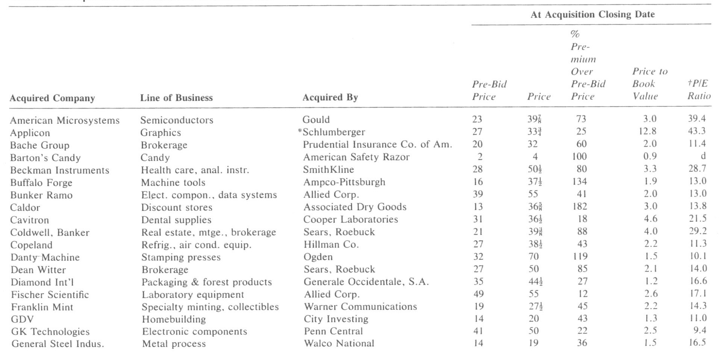
16.4 Methods of Business Combination
TABLE 16.3 Selected companies that received offers in 1981

Slide 12
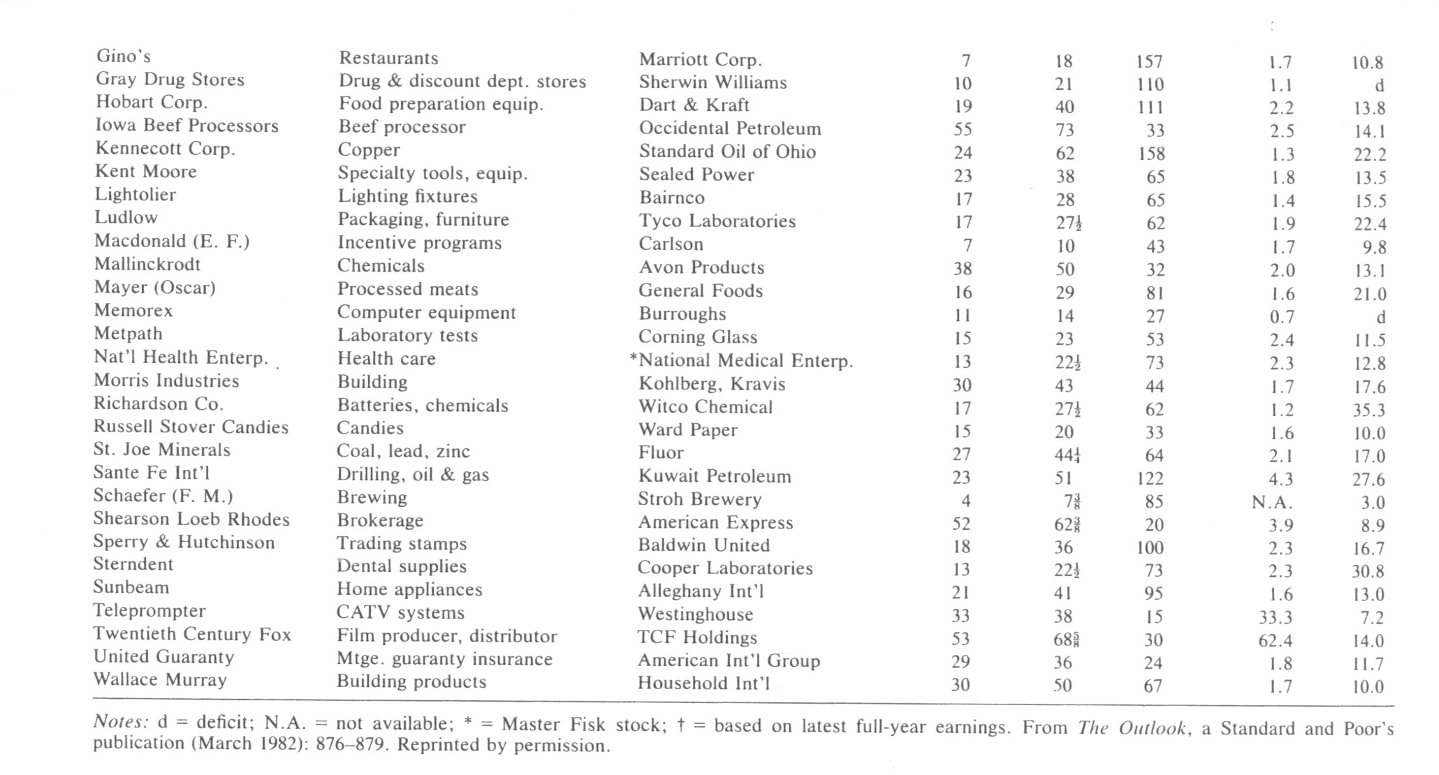
16.4 Methods of Business Combination
TABLE 16.3 Selected companies that received offers in 1981 (Cont’d)

Slide 13
16.5 Merger accounting and tax effects
Tax implications
Taxable Mergers and Acquisitions
Nontaxable Mergers and Acquisitions
Accounting treatment of business combinations
Pooling of Interest
Purchase Method

Slide 14
16.5 Merger accounting and tax effects
Tax implications
Taxable Mergers and Acquisitions
On taxable acquisitions, the acquiring company’s tax basis in the stock or assets acquired is equal to the amount paid. For the selling firm, the entire gain (or loss) is recognized immediately and is taxable.
Nontaxable Mergers and Acquisitions
On nontaxable combinations, the seller defers recognition of the gain and the acquiring company obtains the seller’s basis for the stock or assets acquired.

Slide 15
16.5 Merger accounting and tax effects
Accounting treatment of business combinations
Pooling of Interest
Purchase Method
Firm B
Working Capital 100 Net Plant 300 | Long-term Debt 50 Equity 350
Firm A
Working Capital 50 Net Plant 150 | Long-term Debt 20 Equity 180

Slide 16
16.5 Merger accounting and tax effects
Firm B-A
Working Capital 150 Net Plant 450 | Long-term Debt 70 Equity 530
Firm B-A
Working Capital (100 -50 + 50) 100 Net Plant (300+150) 450 Goodwill 20 | Long-term Debt (50 +20 +150) 220 Equity 350

Slide 17
16.6 Economic theories and evidence
Economic theories
The literature of economics and finance has advanced many theories to justify business combinations. However, it is unlikely that any business combination occurs because of a single reason -- several objectives may act together to motivate the activity.
Market power
Another economic justification for mergers involves the issue of market power and market share. These issues are the crux of the arguments that the Justice Department advances against mergers. The basic defense is that mergers do not result in an increase in the level of competition; but that they are only organizational changes and should leave competing forces the same.

Slide 18
16.7 Financial Theories and Evidence
Diversification and debt capacity
V_{AB} = V_{A} + V_{B},
Z = 0.012x₁ + 0.014x₂ + 0.033x₃ + 0.006x₄ + 0.99x₅,
where

Slide 19
16.7 Financial theories and evidence

Slide 20
16.7 Financial theories and evidence
R_{It} - R_{ft} = α_{I} + B_{I} (R_{mt} - R_{ft}) + E_{It}. (16.6)

Slide 21
16.7 Financial theories and evidence
E_{it} = C_{i}E_{It} + μ_{it}. (16.7)
R_{it} - R_{ft} = α_{i} + ß_{i}(R_{mt} - R_{ft}) + ε_{it}
= α′_{i} + ß_{i}(R_{mt} - R_{ft}) + C_{i}(ε_{It} - α_{I}) + μ_{it}. (16.8)
E_{it} = α′_{i} + μ_{it}. (16.9)

Slide 22
16.7 Financial theories and evidence
ln P = B₀ + B₁ ln D + B₂ ln (g_{s}/g₁)
+ B₃ ln g₁ + B₄ ln h
+ B₅ ln V + B₆ ln A + B₇ ln F + ε
(16.11)
In order to determine the hypothetical dividends and stock price, Shick and Jen use a common-stock valuation model (see Shick (1972) and Bower and Bower (1969)) based on Gordon’s model:

Slide 23
16.8 Summary
Summary
In this chapter, we have reviewed historical merger and
acquisition activities in United States and other countries.
Then, we have discussed accounting treatment of merger and
acquisition. In addition, we also discussed the method to
evaluate and forecast merger and acquisition activities.
There are many reasons why firms engage in business
combinations and there is much we can learn from empirical
research. Mergers and acquisitions provide a rich area for
study of the firm because they allow specific events to be
analyzed in light of their capital-market effects. An
integration of accounting, microeconomics, and financial
theory has the potential to provide a more complete theory of
the firm.

Slide 24
Appendix 16A. Effects of divestiture on firm valuation
（16.A.1）
where

Slide 25
Appendix 16A. Effects of divestiture on firm valuation
（16.A.2）
（16.A.3）
Where

Slide 26
Appendix 16A. Effects of divestiture on firm valuation
（16.A.4）
where

Slide 27
Appendix 16B. Exchange Ratio
One of the more common results of negotiation is the agreement to exchange shares of common stock. In these cases, the determination of the price paid for the acquired firm is actually the determination of an exchange ratio. Larson and Gonedes (1969) presented a model for exchange ratio determination. Their analysis of exchange ratios involves making assumptions about the pre- and post-combination earnings streams and P/E (price-earnings) ratios. For example, assume the information of net income, shares, earnings per share (EPS), price per share (PPS) and P/E ratio about firms A and B as shown in Table 25-1. Let ER be the exchange ratio, which is defined as the number of traded shares of firm B divided by the number of traded shares of firm A. The earnings per share after the combination is given by

Slide 28


Appendix 16B. Exchange Ratio
and the post-combination price is
where P/E* is the post-combination P/E ratio.
Table 25-1
Firm | Net Income | Shares | EPS | PPS | P/E Ratio
A | $1,000,000 | 1,000,000 | $1 | $10 | 10
B | 4,000,000 | 2,000,000 | 2 | 40 | 20

Slide 29


Appendix 16B. Exchange Ratio
For the shareholders of firm B to be as well off after the negotiation as before, then P* P_{B}; that is,
This will occur when
Assume that P/E* is 18, then the exchange ratio is .25 or 1/4. In other words, each share of A’s stock is exchanged for 1/4th of B’s stock.

Slide 30


Appendix 16B. Exchange Ratio
And for the shareholders of firm A to be as well off, then P*
P_{A}/ER, or
which will occur when

Slide 31
Appendix 16B. Exchange Ratio
Hence, the acceptance of the negotiated exchange ratio depends on expectations about the post-combination P/E ratio. Graphically, these requirements imply that the range of negotiation lies in the area labeled I in Figure 25-2. The agreed-on exchange ratio will depend on the relative bargaining positions of the two firms.^{[1]}
Hence, the acceptance of the negotiated exchange ratio depends on expectations about the post-combination P/E ratio. Graphically, these requirements imply that the range of negotiation lies in the area labeled I in Figure 25-2. The agreed-on exchange ratio will depend on the relative bargaining positions of the two firms¹.
^{[1]} An empirical test of the exchange ratio model has been conducted by Conn and Nielson (1977) on a sample of 131 combinations over the period from 1960 through 1969. They found that the exchange ratio model was supported by the tests, but that there were cases when the shareholders of the acquired firm benefited at the expense of the shareholders of the acquitting firm.

Slide 32

Appendix 16B. Exchange Ratio
Now we will define general equations for the example discussed in the previous section.
Assume Firm A and Firm B are the acquired firm and the acquiring firm, respectively. Let the exchange ratio (ER) be defined as the number of traded shares of Firm B to be exchanged for the one traded share of Firm A. LG defined the post-combination price (p*) as:
(16B-1)

Slide 33
Appendix 16B. Exchange Ratio
where NI_{A} and NI_{B} represent net income for Firm A and Firm B, respectively, and N_{A} and N_{B} are the number of shares outstanding for Firm A and Firm B, respectively. PE* is the post-combination price/earnings ratio. By comparing p* with price per share before the combination of Firm A (P_{A}) and Firm B (P_{B}), we find the following exchange ratio will affect the shareholders of both Firm A and Firm B as follows:

Slide 34


Appendix 16B. Exchange Ratio
(i) The shareholder of Firm A are as well off after the combination as before if:
(16B-2)
(ii) The shareholder of Firm B are as well off after the combination as before if:
(16B-3)

Slide 35
Appendix 16B. Exchange Ratio
EXAMPLE 25.1 Exchange Ratio Determination
Q: Related financial information prior to a business combination presented as follows:
Firm | Net Income | Shares | EPS | Price | P/E
A | $1,000,000 | 1,000,000 | $1.00 | $10 | 10
B | 4,000,000 | 2,000,000 | 2.00 | 40 | 20
If the P/E ratio after the business combination is 18, what is the exchange ratio that will make the shareholders of Firm B as well off after the combination as before?
For any P/E greater than or equal to 10, the shareholders of Firm B will always be better off. Therefore, the only P/Es of interest are those less than 20.

Slide 36

Appendix 16B. Exchange Ratio
EXAMPLE 25.1 Exchange Ratio Determination
A: Substituting the above information in Equation 25-3, we obtain:
= 2.25-2 = .25, or ¼
If the exchange ratio is 1/4 , then the shareholders of Firm B will be as well off after the combination as they were before. This result is consistent with the result presented before.

Slide 37
Appendix 16C. The Tender Offer
Another method used in business combinations is the tender offer, in which the acquiring firm makes its offer directly to the shareholders of the firm it wishes to acquire. Tender offers are usually made through the financial press. The acquiring firm offers to pay a fixed amount per share to each shareholder who then “tenders” his or her shares. The amount per share is usually set far enough above the current market price to entice the shareholders of the target firm.
Tender offers are often made when negotiations break down or as a surprise move by the acquiring firm to catch the management of the target firm off guard. Tender offers may take the form of either a cash or stock bid for a block of shares of the target firm. In many large corporations, effective control can be gained with ownership of less than 50 percent of the shares.

Slide 38
Appendix 16C. The Tender Offer
Hence, an acquiring firm can make a tender offer, gain control, and then proceed with negotiation for the remainder of the shares.
Tender offers have generated a new vernacular. Some of the frequently encountered terms are as follows:
White knights. In 1982, 29 major firms were targets of hostile takeover bids, and only 12 of these firms were able to resist the unwelcome bids. Of these 12 firms, only 2 were “saved” by white knights, which are firms that offer friendly takeover terms.
Shark repellents. These are antitakeover amendments firms use in their corporate charters to protect themselves from unfavorable takeovers. Two such strategies are (1) supermajority rules, which generally require 95 percent approval for tender offers, and (2) fair-price amendments,

Slide 39
Appendix 16C. The Tender Offer
which require that the stock be acquired at essentially one price. Fair-price amendments help shareholders to protect against two-tier acquisitions in which the acquiring firm buys one block of stock at a high price and then the remaining shares at a substantially lower price.
Pac-man strategy. In this strategy, the target firm tries to take over the hostile bidder.
Golden parachutes. Companies often provide their top executives with substantial severance benefits, or golden parachutes, in the event of a hostile takeover. Arguably, these benefits may have some economic justification because top management faces a dilemma in light of a hostile threat. If management resists the takeover attempt, even if it believes such resistance is in the shareholders’

Slide 40
Appendix 16C. The Tender Offer
best interests, the top managers are likely to be dismissed if the attempt is successful. Hence, with the golden parachute there is some incentive to acquiesce to hostile but strong suitors.
State and federal laws place several legal requirements on tender offers. The bids for shares must remain open for at least 20 days. Moreover, shares that are tendered during this period may be withdrawn during the period. And if the original offer price is raised, shares tendered under the original offer are also entitled to the higher price. Also, after one firm makes a tender offer, other firms may also enter the battle for a target firm.

