Slide 1
Financial Analysis, Planning and Forecasting Theory and Application Chapter 1. Introduction
By
Cheng F. Lee
Rutgers University, USA
John Lee
Center for PBBEF Research, USA

Slide 2
Table contents
1.1. Introduction
1.2. FinancialManagement:Analysis And Planning
1.2.1. BasicDefinitions
1.2.2. Objectives of FinancialManagement
1.2.3. Planning Horizon Classification
1.3. Objectives and Philosophy of the Book
1.4. Structure of the Book

Slide 3
1.1. Introduction
In this chapter, we shall (i) discuss the fundamental concepts of financial analysis and planning, (ii) explain the basic objectives and philosophy of the book, and (iii) lay out the structure of the book.
First, the basic definition of financial management is used as a background for discussing financial analysis and planning. Secondly, the objectives and the philosophy of the book are given in order to specify its unique nature. Finally, the structure of the book is presented to show how these objectives and this philosophy are expanded on in the later chapters.

Slide 4
1.2. Financial Management: Analysis And Planning
1.2.2. Objectives of Financial Management
1.2.3. Planning Horizon Classification

Slide 5
1.2.2. Objectives of Financial Management
The main objective of a firm is to maximize the wealth of its shareholders. Consequently, there are two basic objectives of financial management: to determine a firm’s present market value and to delineate ways of improving its future market value. The investment, financing, and dividend policies discussed earlier determine the market value of the firm to its shareholders. From the analysis of these policies, a financial manager can go one step further to suggest desired investment, financing, and dividend policies that will improve the market value of the firm. To do this, it is necessary to have a working understanding of realistic financial theory as well as some practical operational experience.

Slide 6
1.2.3. Planning Horizon Classification
Financial management is generally described by the time horizon with which the manager is concerned: short-term or long-term. Short-term planning and analysis covers periods of less than 1 year. Short-term management might be described more properly as working capital management, because it involves the determination of an optimal mixture of current assets and current liabilities. Working-capital management includes cash management, inventory management, accounts receivable management, and the like. Although at first glance short-term planning and analysis may seem of lesser importance, it can be quite difficult and important because of the volatility of capital markets during periods of high inflation. Long-term financial management encompasses essentially all decision making that has an impact over a period of 1 year or more. This includes the determination of a firm’s long-term investment, financing, and dividend policies. Although working-capital management is discussed intermittently, this book is primarily concerned with the long-term aspects of financial management. Four mathematical techniques, simultaneous equations, linear programming, goal programming, and the econometric method, are popular approaches to financial planning that we will investigate in detail.

Slide 7
1.3. Objectives and Philosophy of the Book
The motivation for writing this book derived from the belief that many texts available for use in upper-level undergraduate and graduate-level corporate finance courses seem to have either a theoretical or a practical approach. These two divergent approaches need to be integrated, and that is what we attempt to do in this book. We offer a solid integration of theory and practitioner-oriented procedures for attacking the various problems confronted in the current business environment.

Slide 8
1.4. Structure of the Book
In Part I, readers will learn: (i) how statistical distributions, both normal and lognormal, can be used to analyze accounting information, (ii) how regression analysis, factor analysis, and discriminant analysis can make financial ratios more useful in financial planning and analysis, and (iii) how mathematics, statistical methods, and regression analysis techniques can be used in interest-rate determination and the use of these interest rates.

Slide 9
1.4. Structure of the Book (cont’)
In Chapter 2, Accounting Information and Financial Management, statistical methods, regression analysis, and related econometric methodology are used in static and dynamic ratio analysis, and to do break-even analysis. Here important accounting information and basic quantitative methods are reviewed and generalized.
In Chapter 3, Factor Analysis and Discriminant Analysis: Theory and Methods, linear algebra, matrix algebra, and basic multivariate statistical distribution concepts are introduced. Detailed understanding of this chapter is not necessary for an overall understanding of this book.
Chapter 4, Applications of Factor Analysis and Discriminant Analysis in Financial Management, shows how factor analysis can be used to identify important financial ratios and how discriminant analysis can be used for: (i) credit analysis, (ii) bankruptcy prediction, and (iii) bond rating. In addition, methods for estimating default probability are also discussed in some detail.

Slide 10
1.4. Structure of the Book (cont’)
Chapter 5, Interest Rate, Rate-of-Return, and Growth Rate, shows the arithmetic, algebraic, and statistical methods used in deterministic and stochastic interest-rate determination and analysis. The concept and effects of inflation on interest rates and equity rates-of-return are also discussed here.
In summary, Chapters 2 through 5 give the reader an important foundation in the information and methodology for performing sound financial analysis and planning.

Slide 11
1.4. Structure of the Book (cont’)
Part II, Alternative Finance Theories and the Cost of Capital, discusses how finance theory can make financial planning and analysis more general and useful. Classical theory, the new classical theory, capital asset pricing theory, and option-pricing theory are the four theoretical bases used here.
These four theories are interrelated, and therefore are presented together.
Chapter 6, Valuation of Bonds and Stocks, discusses the basic concepts and methods to evaluate stocks and bonds. Furthermore, the chapter explains risk, return, and market efficiency and exchange rates and investing overseas. The chapter ends with the Appendix, which addresses the relationship between exchange rates and interest rates.

Slide 12
1.4. Structure of the Book (cont’)
Chapter 7, Valuation, Capital Structure, and Risk Premiums, discusses the classical and the new classical theories and other related issues.
Chapter 8, 9, 10, and 11, Capital Asset Pricing Model (CAPM), Arbitrage Pricing Model, and Option-Pricing Model, shows the use of portfolio theory to derive new finance theories for financial management.
In the first seven chapters, some of the empirical results are obtained by using the information and methods discussed in Part I. Most of the important knowledge needed for practical financial analysis is reinforced by the action taken and learning-by-doing approach.

Slide 13
1.4. Structure of the Book (cont’)
Part III, Capital Budgeting and Leasing Decisions, shows the use of the cost of capital and cash flow information in capital budgeting and leasing decisions.
Chapter 12, Alternative Cost of Capital Analysis and Estimation, shows the empirical uses of four theories in the determination of the cost of capital.
Chapter 13, Capital Budgeting under Certainty, and Chapter 14, Capital Budgeting under Uncertainty, introduce a major area of financial decision making, that of capital budgeting. In these two chapters, information, theory, and methodologies from Parts I and II are used in making investment decisions. A linear programming technique is introduced in
Chapter 10 in performing capital rationing analysis. Issues related to multiperiod capital budgeting and the impact of inflation are also discussed.

Slide 14
1.4. Structure of the Book (cont’)
Chapter 15 is devoted to an extension of capital budgeting to the lease buy decisions that a firm faces. Examples are used to illustrate the various methods that can be employed in making these decisions. This chapter also discusses the basic types of leasing arrangement that are available and their implications. In addition, finance theories discussed in Part II are used to show the accounting approach to leasing decisions can be different from an economic approach.

Slide 15
1.4. Structure of the Book (cont’)
Part IV, Corporate Policies an Their Interrelationships, explores mergers, dividend policy, the interaction between investment, financing, and dividend policy, and the use of stochastic dominance in the capital structure analysis with risky debt.
Chapter 16, Mergers: Theory and Evidence, discusses problems related to firm mergers. Two different types of mergers available are defined and contrasted. The theory underlying mergers is observed from an economic and a finance viewpoint. The various accounting treatments of merged firms and detailed, are the effect of these treatments on earnings, earnings per share, and other financial ratios. Finally, empirical evidence concerning mergers is examined from a traditional and CAPM viewpoints.

Slide 16
1.4. Structure of the Book (cont’)
In Chapter 17, Dividend Policy and Empirical Evidence, we discuss an area in financial management that has been the subject of much debate. Dividend Policy is first looked at in a theoretical framework. Modigliani and Miller’s arguments concerning firm valuation and its relation to dividend payouts and changes in these payouts are discussed. Gordon and Lintner’s high-dividend-high-valuation theory is explained and contrasted with the approach of Modigliani and Miller. The information content of dividends is also examined in this chapter. In addition, the residual theory approach to dividends and its relation to investment financing are explained. The CAPM framework is applied to dividends, and various forms are discussed in detail. Finally, empirical evidence is shown.

Slide 17
1.4. Structure of the Book (cont’)
Chapter 18, Interaction of Financing, Investment, and Dividend Policies, discusses the subject of the interrelation of the three major activities of financial management. Also, debt capacity and optimal capital structure are discussed in the context of these interrelationships. In the Appendix to Chapter 18, stochastic dominance and its applications to optimal capital structure analysis are briefly discussed. This method of analysis is applied to analyze the impacts of risky debt on optimal capital structure determination. This appendix is not required for the understanding of later chapters.

Slide 18
1.4. Structure of the Book (cont’)
Part V discusses the issue of Short-term Financial Decision. Chapter 19 discusses short-term financial analysis and planning. Chapter 20 discusses credit, cash, marketable securities, and inventory management. Chapter 21, discusses short term financing. Finally, Chapter 22 discusses Elementary Applications of Programming Techniques inWorking-CapitalManagement, introduces the use of linear and goal programming in working-capital management.
Part VI, Financial Planning and Forecasting, covers alternative methods to perform financial planning and forecasting.

Slide 19
1.4. Structure of the Book (cont’)
Part VI, Financial Planning and Forecasting, covers alternative methods to perform financial planning and forecasting. Three alternative long-term financial planning and forecasting methods are discussed in Part VI. In Chapter 23, Long-Range Financial Planning — A Linear Programming Modeling Approach, we show how Carleton’s model can be incorporated with information and theory to carry out, theoretically and empirically, financial planning and forecasting. Chapter 24, Simultaneous-Equation Models for Financial Planning, shows how simultaneous-equation models can be used in financial planning and forecasting. Johnson & Johnson is used in an empirical example of this technique. Chapter 25, discusses how to use time-series analysis to do analysis, model, and forecasting. Chapter 26, Econometric Approaches to Financial Planning and Forecasting, discusses how econometric specification and modeling techniques can be used to empirically analyze financial planning and forecasting decisions.
In summary, Parts I and II give the reader knowledge of the information, theories and methodologies needed for financial planning and analysis. Parts III, IV, V, and VI show how financial planning and analysis can be accomplished analytically and empirically.

Slide 20
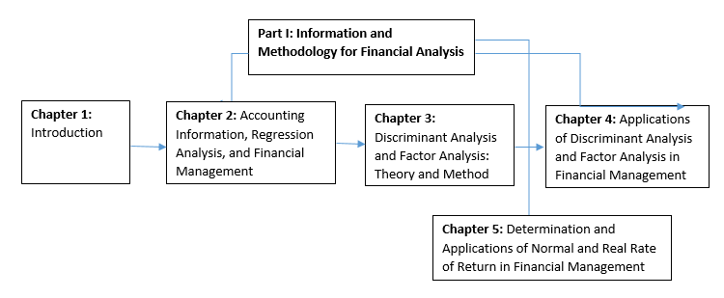
Part I of the book

Slide 21
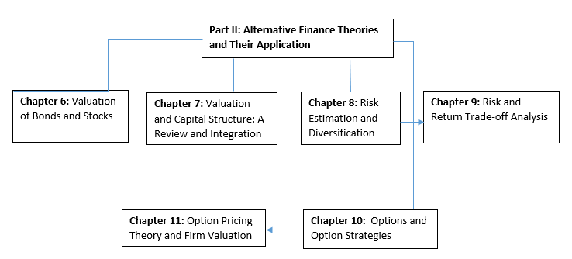
Part II of the book

Slide 22
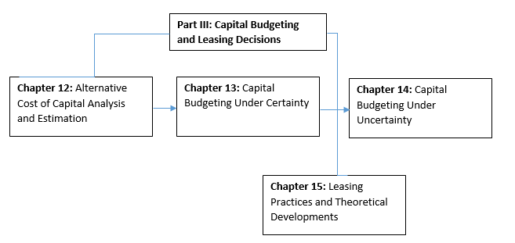
Part III of the book

Slide 23
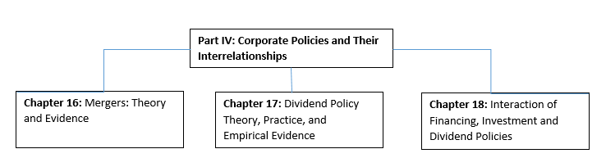
Part IV of the book

Slide 24
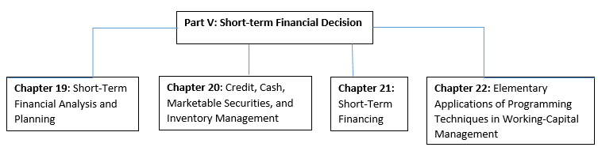
Part V of the book

Slide 25
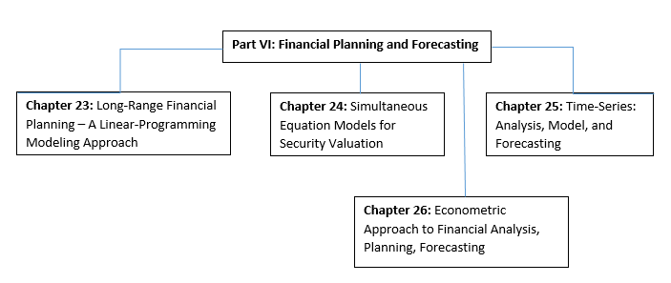
Part V of the book

