Slide 1
Financial Analysis, Planning and Forecasting Theory and Application Chapter 6 Valuation of Bonds and Stocks
By
Cheng F. Lee
Rutgers University, USA
John Lee
Center for PBBEF Research, USA

Slide 2
Outline
6.1. Introduction
6.2. Bond Valuation
6.3. Stock Valuation
6.4. Growth Rate Estimation and Its Application
6.5. Preferred Stock Valuation
6.6. Risk, Return, and Market Efficiency
6.7. Exchange Rates and Investing Overseas
6.8. Application Examples
6.9. Summary
Appendix 6.A. The Relationship between Exchange Rates
and Interest Rates
Appendix 6.B.Derivation of Dividend Discount Model
Appendix 6.C.Duration Analysis

Slide 3
6.1. Introduction
The main purpose of this chapter is to discuss how to use time value of money concepts and methods to determine the valuation of bonds and stocks. Some bonds pay coupon interest annually, some semiannually, and some pay no coupon interest at all. Some stocks pay no dividends, others pay the same dollar amount each year as a dividend, and some pay dividends that change every year. How much should investors be willing to pay for these securities? And what price can issuing corporations expect to receive in selling them? Fortunately, basic techniques exist to help us to value, or determine a price on these assets. In the next chapter, we will use the valuation of bonds and stocks to discuss capital structure and other related issues.

Slide 4
6.2. Bond Valuation
A bond represents a liability of a firm or government entity that arises from borrowing money. A typical bond pays a set amount of interest each year and repays the principal amount of the loan at maturity. The valuation principle states that the bond’s value equals the present value of these expected future cash flows.
Four factors affect bond valuation: The YTM is the effective annual rate-of-return demanded by investors on bonds of a given maturity and risk. The face value of a bond is called the par value. In general, this is the amount of money that the issuer has initially borrowed and promised to repay at a future maturity date. Most U.S. corporate bonds have a par value of $1,000 per bond. The coupon interest rate is the percentage of the par value to be paid annually, as interest, to the bond holder.

Slide 5
6.2. Bond Valuation
Most U.S. corporate bonds make interest payments semiannually, that is, every 6 months. Eurobonds, which are bonds denominated in U.S. dollars issued by firms in financial markets outside the United States, typically pay interest annually. A bond’s maturity date, par value, and coupon rate are all disclosed to investors prior to purchase; for the most part, these items are fixed and do not change over the life of a bond issue. The YTM changes, however, depending upon economic and financial trends, market expectations, and firm-specific information affecting risk.

Slide 6

6.2. Bond Valuation
Suppose that a bond with par (face) value F is purchased today and that the bond matures in N years. Let us assume that interest payments of dollar amount I are to be made at the end of each of the next N years. The bondholder will then receive a stream of N annual payments of I dollars, plus a payment of F dollars at the end of the Nth year. Using the rate of interest k to discount future receipts, the present value of the bond is
The first term on the right-hand side of Eq. (6.1) is the present value of the stream of interest payments, while the second term is the present value of the future receipt of the par amount.

Slide 7
6.2.1. Present Value of Future Cash Flows
Cash flows arise from the receipt of coupon interest every 6 months and from the par value at maturity. Thus, cash flows from a bond have two components. First, the coupon interest payments resemble an annuity that occurs every 6 months over the bond’s life. Second, the par value payment is a lump sum or single payment made when the bond matures.
The annual interest payments on a bond equal the coupon rate multiplied by the par value. Thus, the amount of each semiannual coupon payment is half of this amount. For example, a 10% coupon bond pays annual interest of 0.10 times $1,000, or $100; each semiannual coupon payment is half of $100, or $50.

Slide 8
6.2.1. Present Value of Future Cash Flows
The easiest way to compute the present value, or price, of a bond is to divide the analysis into two simpler present value problems that we already know how to solve. The complex cash flow pattern shown can be separated into two familiar cash flow patterns: (1) an annuity (the coupon payments), and (2) a lump sum (the principal payment). Compute the present value of the coupon annuity; the second part of the analysis involves computing the present value of the par value. The price of the bond will be the sum of these two present value calculations, as shown in Eq. (6.2):

Slide 9

EXAMPLE 6.1 - Eurobonds–Annual Coupons
Q: A Eurobond with a coupon rate of 8% pays interest annually, has a par value of $1,000, and matures 7 years from now. What current market price would we expect for this bond, assuming that bonds of similar risk and maturity have a 10% YTM?
A: To find the price of the bond, first find the present value of the coupon annuity and add it to the present value of the par value. With an 8% coupon rate, annual interest payments for the bond are 0.08 times $1,000, or $80; with interest paid annually, the size of the coupon annuity is $80 per year. With 7 years until maturity and a 10% YTM, the present value of the coupon annuity is:

Slide 10

EXAMPLE 6.1 - Eurobonds–Annual Coupons (cont’d)
The present value of the par value is:
Thus, the current market price of the bond should be $389.47 plus 513.16, or $902.63.

Slide 11
6.2.1.1. Semiannual coupon payments
Semiannual coupon payments would change our analysis in Example 6.1. We know that when cash flows occur more frequently than once a year, adjustments must be made to n, the number of periods, and to r, the discount rate. The number of periods, n, becomes the number of years multiplied by the number of cash flows per year. The interest rate also will need to be adjusted to determine the appropriate periodic interest rate. The method by which we compute the periodic interest rate depends, however, upon which type of annual interest rate is quoted. Bonds can have two interest rates that reflect their annual returns: they can be based on the effective annual rate (EAR), or they can be quoted based upon the annual percentage rate (APR) concept. We discuss each of these in turn.

Slide 12


6.2.1.1. Semiannual coupon payments
EAR or YTM. When the EAR is quoted for bonds, it is called the bond’s YTM or market interest rate. To properly discount the semiannual coupons, we must determine the periodic interest rate that corresponds to the EAR.
We can calculate the effective annual rate as:
in order to solve for the periodic interest rate:

Slide 13
If the YTM is given as 10% for a bond that makes coupon payments semiannually, the appropriate discount rate is:
Let’s use this in an example.

Slide 14
EXAMPLE 6.2 - Computing Price Using the YTM
Revise Example 6.1 to assume semiannual coupon payments, which is the norm with most bonds issued in the U.S. Let’s assume a YTM of 10%.
Recall that the bond has an 8% coupon rate and par value of $1,000; it matures in 7 years.
What is the present value (i.e., the current market price) of this bond?
Annual interest payments for this bond are $80, so the periodic cash flow is $40. The number of periods is 14 (7 years times 2). Since the YTM is given, the periodic interest rate is:

Slide 15
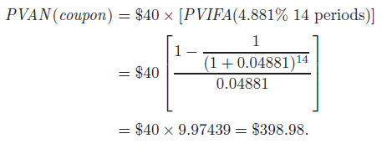

The present value of the coupon annuity is:
The present value of the par value is:

Slide 16
Thus, the current market price of the bond should be $398.98 plus 513.16, or $912.14. This is higher than the price of the bond in Example 6.1, since one-half of each year’s coupon payments occurs earlier. Since some cash flows arrive sooner, their present value is higher when they are discounted at the same YTM.
It is important to note that the present value of the par value is $513.16 in both Examples 6.1 and 6.2. Regardless of the frequency of the coupon cash flows, the present value of the part value remains the same. When the effective annual rate is 10%, a $1,000 lump sum cash flow seven years from now is worth $513.16 in present value terms, regardless of the frequency of the coupon payments.

Slide 17
Annual Percentage Rate or Stated Annual Interest Rate. When the bond interest rate is quoted as an APR, it is called a stated annual interest rate or nominal interest rate. Given an annual percentage rate, the periodic interest rate is APR/m, where m represents the number of periods or cash flows in a year. Recall that the APR assumes no period by- period compounding of cash flows, so it fails to account for interest on- interest. If a bond has a coupon rate of 8% with semiannual coupon payments and has a nominal interest rate of 10%, the bond’s periodic cash flows should be discounted at 10%/2% or 5% per 6-month period.

Slide 18
EXAMPLE 6.3 - Computing Price with a Stated Annual Rate
Suppose the bond in Example 6.2 had 10% stated annual interest rate. What should its price be?
With no other facts changing, the bond will still pay $40 every 6 months over the next 14 periods (7 years). It will repay its $1,000 par value at maturity. Since the stated annual rate is equivalent to an APR, the periodic interest rate will be APR/m, that is, 10%/2% or 5%. The present value of the coupon annuity is:

Slide 19

The present value of the par value is:
The current market price of the bond will be $395.94 plus $505.10, or $90,104. Why is the market price of the bond in Example 6.3 less than the $912.14 price found in Example 6.2? Because in Example 6.2, the 10% market interest rate represents an effective annual rate. In Example 6.3, the 10% stated rate (or APR) is equivalent to a YTM (or effective annual rate) of:
It is well known that higher discount rates lead to lower present values; in Example 6.3, a higher effective annual rate or YTM of 10.25% leads to a lower price.

Slide 20
6.2.2. Interest Rate, YTM, and Bond Price
A bond that sells below par value, such as the one in Example 6.2, is said to be selling at a discount and is called a discount bond. Someone who purchases the discount bond in Example 6.2 today and holds it to maturity will receive, in addition to the stream of coupon interest payments, a gain of $87.86, the difference between the bond’s price ($912.14) and its principal repayment ($1,000).
A bond’s price will reflect changes in market conditions while it remains outstanding with its fixed 8% coupon rate. The bond in the above example will no longer be attractive to investors when alternative investments yield 10%. The bond’s market price will have to fall in order to offer buyers a combined return of 10% from the coupon payments and the par value.

Slide 21
6.2.2. Interest Rate, YTM, and Bond Price (cont’d)
If the market YTM falls, to say 6.09%, the price of the 7-year bond in Example 6.2 will rise to $1,112.96 (check this on your own!), a price above the par value. The price of a discount bond will rise as it nears maturity if the market rate remains the same, since at maturity its price will equal par value. When a bond’s price exceeds its par value, it is said to be selling at a premium, and it is called a premium bond. The price of a premium bond will fall as it nears maturity if the market rate remains the same, since at maturity its price will equal its par value. The investor who holds the bond until maturity will receive the above-market coupon payments of 8% per year, offset by a loss of $112.96 (the difference between its purchase price and par value). In most cases when the bond sells at a premium, interest rates have fallen after the bond’s issue. This bond’s 8% coupon rate makes it very attractive to investors; buying pressure increases its price until its overall yield matches the YTM of 6.09% of other bonds of similar risk and maturity.

Slide 22
6.2.2. Interest Rate, YTM, and Bond Price (cont’d)
When they originally are issued, most bonds sell at prices close to par and offer coupon rates close to the market rates on bonds of similar maturity and risk. Over the life of a bond its price will fluctuate as a result of interest rate fluctuations in the economy. Our discussion of discounts and premiums shows that bond prices will vary inversely to interest rates. As interest rates rise in the Economy, bond prices fall; as interest rates fall, bond prices rise.

Slide 23
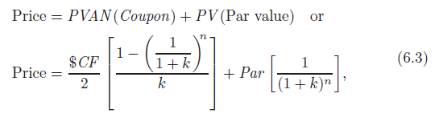
6.2.2.1. Calculating a YTM
Bond price quotes are available in the marketplace, either from bond dealers or from the daily price listings found in secondary sources, such as The Wall Street Journal. Both investors and financial managers must calculate the YTM on bonds, given known par values, coupon rates, times to maturity, and current prices. The YTM can be determined from the PVIFA and PVIF formulas we used to compute the bond price:

Slide 24
[The Relationship Between Interest Rates and Bond Prices — The Seesaw Effect],
where k represents the periodic interest rate and n is the number of semiannual periods until the bond matures. The YTM equals (1 + k)2 − 1; the stated annual rate equals k×2. But mathematics offers no simple technique for computing r.

Slide 25
6.2.3. Credit Risk, Interest Rate Risk, and Reinvestment Rate Risk
Basically, investors in domestic bonds face three types of risks: credit risk, interest rate risk, and reinvestment rate risk. Inventors in foreign bonds are subject to two additional risks: political risk and exchange rate risk.

Slide 26
6.2.3.1. Credit risk
The cash flows received by bond market investors are not certain; corporate debtors may pay interest payments late or not at all. They may fail to repay principal at maturity. To compensate investors for this credit or default risk, rates-of-return on corporate bonds are higher than those on government securities with the same terms to maturity. Government securities are presumed to be free of credit risk. Since perceptions of a bond’s default risk may change over its term, the bond’s YTM also may change, even if all else remains constant. Firms provide information on the riskiness of individual bond issues.

Slide 27
Higher bond ratings imply a lower risk of default and, given the risk/return tradeoff, lower expected return (ER) to investors. Lower bond ratings imply a higher level of default risk and higher ER. Investment quality bonds have ratings of BBB (or Baa) or higher. They are called investment quality as some institutional investors, such as pension funds and insurance companies, restrict themselves to investing only in these low-default risk issues. Non-investment quality bonds are called junk bonds or high-yield bonds to reflect their higher risk and higher ERs.

Slide 28


For those seeking a quick estimate of the return, the approximation method may be used. Here, the average annual dollar return to the investor of a bond that matures in n years is the coupon payment plus a straight line amortization of the bond’s premium (or discount):
The average amount invested in the bond is the average of it purchase price and par value:

Slide 29

The approximate YTM is the ratio of the average annual dollar return to the average investment.
Calculators and spreadsheets usually use a trial and error method for computing values of r. Various values of k are used until one is found, such that the present value of the cash flows equals the price within some (pre-specified) error range.

Slide 30
6.2.3.2. Interest rate risk
The general level of interest rates in an economy does not remain fixed; it fluctuates. For example, interest rates will change in response to changes in investors’ expectations about future inflation rates. A rise in interest rates renders the fixed coupon interest payments on a bond less attractive, lowering its price. Therefore, bond holders are subject to the risk of capital loss from such interest rate changes should the bonds have to be sold prior to maturity.

Slide 31
A long term to maturity, all else being equal, increases the sensitivity of a bond’s price to a given change in interest rates, as the discount rate change compounds over a longer time period. Similarly, a lower coupon rate also increases the sensitivity of the bond’s price to market interest rate changes. This occurs since lower coupons bonds have most of their cash flow occurring further into the future, when the par value is paid.

Slide 32
Because of interest rate risk, investors will demand a larger risk premium for a bond whose price is especially sensitive to market interest rate changes. Hence, we would expect higher YTM for long-term bonds with low coupon rates than for short-term bonds with high coupon rates. A bond’s duration is a measure of a bond’s sensitivity to market rate changes that takes maturity coupons and other factors into account..

Slide 33
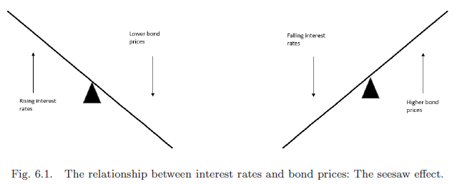
Duration is computed by means of a complicated-looking formula. The concept of duration is now discussed in the following section

Slide 34
6.2.3.3. Bond returns and duration
For a bond, YTM and “total return” are two different concepts. Total return for a fixed-income investment includes not only the income yield but also the interest on reinvested interest and price changes.
Compounded interest is the largest return component for investors that purchase and hold on to long-term bonds until they mature. For short-term investors that buy a bond hoping to sell it quickly at a higher price, fluctuations in a bond’s price caused by market interest rate or bond rating changes are the largest return component.

Slide 35
As we’ve seen in this chapter, a bond’s price moves inversely to prevailing interest rates. A measure of the price sensitivity of a bond to interest rate changes is called the bond’s duration. Higher duration bonds have larger price reactions to interest rate changes; lower duration bonds have smaller price reactions. One method of computing duration calculates it as the weighted average of the time to receive a bond’s cash flows; the weights are present values of each cash flow (coupon interest and par value) divided by the bond’s price.

Slide 36
The concept of duration has many applications; areas in which duration is used frequently include bank asset and liability management, investment analysis, and pension fund management. A common risk management technique in these areas is to set the duration of a pension fund’s asset equal to the duration of its liabilities. This way, as market rates fluctuate, the market value of the asset and liabilities will rise or fall together. By trying to set asset and liability durations equal to each other, the equity, or net worth will be little affected by changing interest rates. Further detail analysis of duration can be found in the Appendix C of this chapter.

Slide 37
6.2.3.4. Reinvestment rate risk
The return that an investor receives from a bond investment equals the bond’s YTM or effective annual rate only if the coupon payments can be reinvested at a rate equal to the bond’s YTM. Recall the form of the interest factor in bond price Equation 6.3: (1 + k)n. This assumes that all the cash flows are reinvested at the periodic rate k. Should future coupons be reinvested at a lower rate, the investor’s actual yield will be less than the bond’s YTM. Thus, reinvestment rate risk occurs when fluctuating interest rates cause coupon payments to be reinvested at different interest rates. Another illustration of reinvestment rate risk occurs when maturing bank CDs are rolled over into new CDs. The risk benefits the investor when the new CD rate is higher than the maturing CD rate; it works against the investor when the new CD rate is lower.

Slide 38
6.2.3.5. Risk of non-domestic bonds
Investors in domestic securities face a number of risks beyond those of domestic securities. Among these are political risk and exchange rate risk. Political risk can affect a bond investor in a number of ways. A foreign government may block currency exchanges, preventing the investor from repatriating coupon income. Social unrest may lead a foreign corporation to default on its bonds. Of course, exchange rate changes will cause fluctuations in the values of cash flows in terms of U.S. dollars; this is called exchange rate risk.

Slide 39
6.2.4. Zero Coupon Bonds
Zero coupon bonds pay no coupon interest and provide only one cash flow: payment of their par value upon maturity. Treasury bills are a form of zero coupon debt. An investor purchases a T-bill at a price below par and receives no interest or other cash flows until maturity. At that time, the investor receives the par value of the T-bill. The return on the security is the difference between its discount price and its par value.

Slide 40
There are two reasons for the popularity of zero coupon bonds: (1) the investor does not face a reinvestment rate risk (2) for certain investors (for example, those with IRAs) the tax of the bond return can be deferred until some future date. However, under IRS regulations, investors must pay yearly taxes on the implicit interest paid by the bonds; the IRS has special rules for determining this value. In essence, investors must pay taxes on income they have not received. Thus, zero coupon bonds are mainly purchased by tax-exempt investors who pay no tax on their investment returns, such as pension funds.

Slide 41
Issuing a zero coupon bond also helps lower borrowing costs for the firm. The original discount can be expensed for tax purposes on a straight-line basis over the life of the bond. Thus, rather than cash outflows from coupon interest payments, the issuing firm receives annual cash inflows from tax savings. However, the issuer must plan for a large capital requirement at the maturity of these bonds. Present value calculations to determine the price of a zero coupon bond are straight-forward, as the following example illustrates:

Slide 42

EXAMPLE 6.4 - Zeroing in on Bonds
A zero coupon bond with a par value of $1,000 has a maturity date 7 years from now. At what price would this bond provide a YTM to match the current market rate of 10%?
This problem requires finding the present value of a single future cash flow. The price will equal:
The current price of this bond should be $513.16.

Slide 43
6.3. Stock Valuation
We now turn to the valuation of common stock. A stockholder receives income from two sources: (1) dividend payments, and (2) capital gain from the change in stock price (which can, of course, be negative). The price of common stock reflects investors’ expectations of these two income sources.
The principle for determining an appropriate stock price is the same as that for determining a bond price: find the present value of expected future cash flows. With bonds, this is a relatively straightforward process; the typical corporate bond has a definite life, fixed coupon payments and par value, and an easily discernible YTM or stated annual interest rate.

Slide 44
Equity offers no such certainty. Common and preferred stocks generally are assumed to have infinite lives. For common stock, relevant cash flows (divided payments) are variable and depend upon firm growth, profitability, and investment opportunities. Finally, each firm can have its own required rate-of-return. Despite these difficulties, in this section we shall see that the present value of all future dividends should equal a stock’s current price, and that some simplifying assumptions can make the task of determining stock value much easier. Our discussion in this section focuses on common stock. As we shall see, the method for valuing preferred stock is a special case of common stock valuation.

Slide 45
It may seem rather strange to treat the stock price as nothing more than the present value of all future dividends. Investors generally buy stock with the intention of selling it at some future time, ranging from a few hours to 30 years or longer. Despite the length of any one investor’s time horizon, we can show that the current price of common stock should equal the present value of all future dividends.

Slide 46

Let the present value, or current market price, of a share of common stock be denoted by P0. Let d0, d1, d2, . . . be the successive annual dividends and P1, P2, . . . be the price per share of stock at the end of successive year. Suppose that a share of stock is held for 1 year. At this year’s end, after receiving dividend payment d1, the stockholder could sell the stock for an amount P1. If these future ERS are discounted at the required rate-of return, k, the present value of the investor’s cash flows comes to:

Slide 47


Suppose that someone else purchases the stock at price P1 at the end of the first year and holds it for 1 year. The purchase price should equal:
Substituting this information into Eq. (6.4) gives us:

Slide 48


Continuing in this way, looking N years into the future, we have:
If we continue this process indefinitely, the time horizon N becomes infinitely large. In that case, the final term on the right-hand side of Eq. (6.5) approaches zero, and we have the final result:

Slide 49
The present value of a share of stock is the sum of all future dividend payments, discounted to the present. It does not depend on the investment horizon of any individual investor.
To finance rapid growth, young firms often retain all their earnings; when they mature, they often begin paying out a portion of earnings as dividends. Second, at the very least, the firm’s stock should be worth the per-share liquidation value of its assets. Otherwise, an arbitrageur could buy all the outstanding stocks to purchase the firm and then make a profit by selling its real assets piece-by-piece. Most firms’ values as going concerns exceed their liquidation values; the price of any such firm will reflect its going-concern value.
As it stands, Eq. (6.6) is difficult to use, since it requires estimation of all future dividend payments and investors’ required return on the stock. Matters can be simplified considerably if the analyst can assume that the firm’s dividends will remain constant or will growat a constant rate over time.

Slide 50
6.3.1. Constant Dividend Growth Rate Model
If the firm’s dividends are expected to remain constant, so that d0 = d1 = d2 . . . , we can treat its stock as a perpetuity. This is how we value preferred stock. If a common stock is expected to have constant dividends, the valuation process is identical to that of preferred stock. The present value of a perpetuity is the cash flow divided by the discount rate. For stocks with constant dividends, this means Eq. (6.6) becomes P0 = d0/k.

Slide 51


Many firms have sales and earnings that increase over time; their dividends may arise, as well. If we assume that a firm’s dividends grow at an annual rate of g percent, next year’s dividend, d1, will be d0(1 + g); the dividend in 2 years’ time will be d0(1 + g)2. Generalizing,
Substituting this into Eq. (6.6) and doing some algebra gives an equation for the present value of all future dividends:
Derivation of Eq. (6.7) can be found in Appendix 6B.

Slide 52

Where d1 is equal to the current dividend d0 times (1 + g) or d1 = d0(1+g). Or, still more generally, the price at any future time t is given by:
where dt+1 = dt(1 + g).

Slide 53
This result, known as the Gordon model or the constant dividend growth model, provides a straightforward tool for common stock valuation. The main assumption of constant growth in dividends may not be realistic for a firm that is experiencing a period of high growth or negative growth (that is, declining revenues). Neither will constant dividend growth be a workable assumption for a firm whose dividends rise and fall over the business cycle. Therefore, a consequence of the Gordon model is that if the dividend growth rate and the discount rate k remain constant, the price per share of stock grows at the same rate as dividend per share (DPS).

Slide 54
The constant dividend growth model reveals that the following three factors affect stock prices, ceterus paribis: 1. The higher the dividend, the higher the stock price; 2. The higher the dividend growth rate, the higher the stock price; 3. The lower the required rate-of-return k, the higher the stock price.
The constant dividend growth model also assumes a dividend-paying stock; the model cannot give a value for a stock that does not pay dividends. Also, in the denominations of both Eqs. (6.7) and (6.8), the required rate-of return, k, must exceed the estimated growth rate, g. Otherwise, the formula gives a nonsense result.

Slide 55
Finally, the constant dividend growth model assumes estimates for k, the required rate-of-return, and g, the dividend growth rate. Some methods for estimating the growth rate, g, will be discussed in this chapter and Chapter 18, including the internal growth rate (the rate at which the firm can grow without raising outside financing) and the sustainable growth rate (the growth that is possible if the firm’s debt-to-equity ratio remains constant over time). These estimates must be used circumspectly, however, the dividend growth rate will not necessarily equal the firm’s growth rate of assets or sales.

Slide 56

EXAMPLE 6.5 - Constant Dividend Growth
A corporation is currently paying dividends of $5 per share on its common stock, and dividends are expected to grow at an annual rate of 6%. If investors discount future receipts at an annual rate of 10%, compute the stock’s price.
Using the notation of Eq. (6.7), we have k = 0.10, g = 0.06, and d0 = $5. Next year’s dividend, d1, is expected to equal $5 (1 + 0.06) = $5.30. Substituting these values into Eq. (6.7) gives us:
Under these conditions, the stock should sell for $132.50 per share.

Slide 57
A shareholder earns returns from both dividend payments and price changes. If dividend payments grow at a constant rate, what happens to the price of the stock? The Gordon model reveals that, if the dividend growth rate and the discount rate remain constant, the price per share of stock will grow at the same rate as dividends per share.

Slide 58

6.3.2. Rate-of-Return and Required Rate-of-Return
Share price provides only a step toward fully evaluating a stock investment. The analyst also must compare the investment to others based on rate-of return. Suppose that share of stock is purchased at price P0 and sold after 1 year at price P1. The total return to the investor is the sum of the dividend payment, d1, and the capital gain, so that:

Slide 59


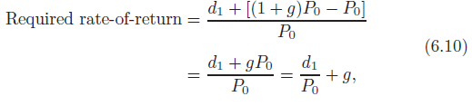
The annual rate-of-return on this investment is therefore:
We have just seen how the Gordon model implies that stock prices grow at constant rate g, so that:
Substituting this information into Eq. (6.9), the required rate-of-return calculation becomes:

Slide 60
which is the same result as solving Eq. (6.7) for r; the discount rate. This shows that under the Gordon model, the discount rate for future cash flows (Eq. (6.7)) is the investors’ expected rate-of-return (Eq. (6.10)). The required rate-of-return is sometimes called the market capitalization rate. From Eq. (6.10), we see that the market capitalization rate is the sum of the dividend yield, d1/P0, and the dividend growth rate, g, which is the same as the capital gains rate.

Slide 61

EXAMPLE 6.6 - Rate-of-Return
A share of common stock currently sells for $120. Current dividends of $6 per share are expected to grow at 7% per year. Find the rate-of-return required by investors in the stock. Using the notation of Eq. (6.10), we have P0 = $120, g = 0.07, d0 = $6, and d1 = $6 (1+0.07) = $6.42. Substituting this information into Eq. (7.10), we obtain:
Hence, the required annual rate-of-return is 12.35%.

Slide 62
Investors in common stocks face a number of risks that bond holders do not. This additional risk leads them to require a higher rate-of-return on a firm’s stock than on its debt securities. For example, in the event of corporate failure, the claims of stockholders have lower priority than those of bond holders, so the former face a greater risk of loss than the latter. Dividends can be variable and omitted, whereas bond cash flows have a legal obligation to be met.
If the general level of interest rates rises, investors will demand a higher required rate-of-return on stocks to maintain their risk premium differential over debt securities. From Eq. (6.7), as r rises, the stock price will fall. Therefore, stockholders risk capital loss from any general upward movement of market interest rate.

Slide 63
Also, future dividends, or dividend growth rates, are not known with certainty at the time the stock is purchased. Operating and financial leverage, as we saw in Chapter 5, lead to variations in earnings. If poor corporate performance or adverse general economic conditions lead investors to lower their expectations about future dividend payments, this will lower the present value of shares of the stock, leaving the stockholder with the risk of capital loss. As discussed in more detail in investments courses, stock analysts systematically review economic, industry, and firm conditions in great detail to gain insight into corporate growth prospects and the appropriate level of return that an investor should require of a stock.
The rate-of-return required by investors in a common stock reflects all of these potential risks. The difference in risk as compared to other investments will lead to investors to demand larger risk premiums and therefore higher required returns from common stock investments than from other, less risky investments.

Slide 64
6.3.3. Supernormal Growth Stocks
In formulating the Gordon model, it was assumed that dividends per share would grow at a constant rate, strictly less than the market capitalization rate, r. In practice, a corporation in an emerging industry may experience, for an initial period, abnormally high or supernormal growth rates. We would not expect these growth rates to be maintained indefinitely; rather, the industry will eventually enter a mature state where constant growth at a lower rate is a reasonable expectation. The Gordon model can be adapted to deal with such supernormal growth stocks. The initial period is treated separately with the constant growth assumption applied only to the mature phase of development.

Slide 65


Suppose, for example, that supernormal growth is expected for 3 years and that, thereafter, dividends are expected to grow at annual rate g. The valuation formula then becomes
Substituting dt+1 = (1+g)dt for t = 4, 5, 6, . . . , we then have

Slide 66
EXAMPLE 6.7
Over the next 3 years, a corporation is expected to pay dividends of $5, $6, and $6.75 per share of common stock. Thereafter, dividends per share are expected to grow at an annual rate of 7.5%. If investors require an annual rate-of-return of 12.5%, find the present value of a share of this stock.
In the notation of Eqs. (4.10) and (4.11), we have r = 0.125; g = 0.075; d1 = $5; d2 = $6; d3 = $6.75; and d4 = (1+0.075)(6.75) = $7.25625. Using Eq. (4.11), the present value is
Under our assumptions, a share of this stock should sell for $115.85.

Slide 67
6.4. Growth Rate Estimation and Its Application
The purpose of this section is to show how growth rates can be mathematically estimated. The application of these estimated growth rates is briefly discussed.

Slide 68

6.4.1. Compound-Sum Method
One method of estimating the growth rate uses the compounding process. Both discrete and continuous compounding are basic concepts in financial management and investment analysis. These concepts are expressed mathematically in Eqs. (6.14) and (6.15):
where
P0 =the price at time zero;
Pn =the price at time n;
i =the compound interest rate; and
e =a constant equal to 2.718.

Slide 69

Equation (6.14) describes a discrete compounding process and Eq. (6.15) describes a continuous compounding process.
The relationship between Eqs. (6.14) and (6.15) can be illustrated by using an intermediate expression such as
where m is the frequency of compounding in each year. If m = 4, Eq. (6.16) is a quarterly compounding process; if m = 365, it describes a daily process; and if m approaches infinity, it describes a continuous compounding process. Thus, Eq. (6.17) can be derived from Eq. (3.17) in the following manner.

Slide 70



Based upon the definition
Equation (3.17) can be rewritten as
The growth rate of earnings or dividends can be estimated either mathematically or statistically. Mathematically, the growth rate can be estimated by using either Eq. (6.16) or (6.17). Rewriting Eq. (6.16) using the symbol for growth rate, g, in place of i gives:

Slide 71


From Eq. (6.19), it is clear that
Given values for P0, Pn, and n, and using a compound sum table, the value of g can easily be obtained. This approach is called the compound-sum method for estimating growth rates. While this method is simple, it ignores other information points between the first and the last period.
Suppose there are two firms whose dividend payments patterns are as shown in Table 6.2, using the compound-sum method the growth rate of firm ABC can be calculated as

Slide 72
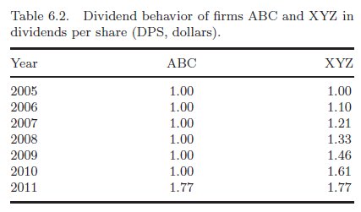
Using a compound-sum table where n = 6 and interest factor=1.77, g = 10%. The compound-sum method also yields a growth rate of 10% for firm XYZ. Yet, it is clear that the dividend behavior of these firms is distinctly different when looking at the dividends per share in Table 6.2.

Slide 73

6.4.2. Regression Method
To use all the information available to the security analysts, two regression equations can be employed. These equations can be derived from Eqs. (6.16) and (6.17) by letting i = g and taking the logarithm (ln):
Both Eqs. (6.21) and (6.22) indicate that Pn is linearly related to n. Using the data in Table 6.2 for companies ABC and XYZ, we can estimate the growth rates for their respective dividend streams. Graphs of the regression equations for ABC and XYZ are shown in Fig. 6.2. The slope of the regression using Eq. (6.21) for ABC shows an estimated value for growth of about 6%. The estimate for XYZ is 9.5%. If Eq. (6.22) had been used to estimate the growth, then the antilog of the regression slope estimate would equal the growth rate.

Slide 74

6.4.3. One-Period Growth Model
Another method of estimating the growth rate involves the use of percentage change in some variable such as earnings per share (EPS), dividend per share, or price per share in a one-period growth model. The one period growth model is the model in which the same growth will continue forever. b stands for the fraction of earnings retained within the firm, r stands for the rate-of-return the firm will earn on all new investments, and It stands for investment at t. Growth in earnings arises from the return on new investments. Therefore, earnings can be written as
where
Et =earnings in period t; and
Et−1 =earnings in period t − 1.

Slide 75

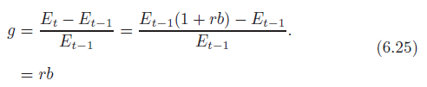

If the firm’s retention rate is constant, then:
Growth in earnings is the percentage change in earnings, or
Since a constant proportion of earnings is assumed to be paid out each year, the growth in earnings equals the growth in dividends, or

Slide 76



If firm M has a retention rate of 50% and an average return on investment of 20%, then the expected growth in dividends on earnings can be expressed as
Using this expression for growth, Eq. (6.8) can be rewritten as
Alternatively, this model can be stated in terms of the capitalization rate:

Slide 77

It is worthwhile to examine the implication of this model for the growth in stock prices over time. The growth in stock price is
Recognizing that Pt and Pt+1 can be defined by Eq. (6.26), with the exception that Dt+1 must be replaced by D(1 + br):
Thus, under the assumption of a constant retention rate, for a one-period model, dividends, earnings, and prices are all expected to grow at the same rate.

Slide 78


Investors may use a one-period model in selecting stocks, but future profitability of investment opportunities plays an important role in determining the value of the firm and its EPS and DPS. The rate-of-return on new investments can be expressed as a fraction, c (perhaps larger than one), of the rate-of-return security holders require, or
Substituting this into Eq. (3.28) and rearranging:

Slide 79
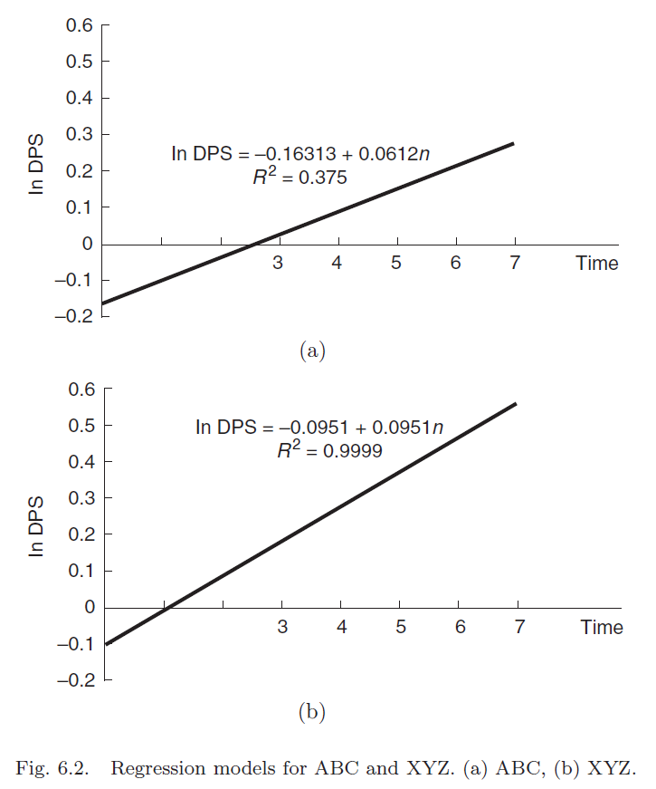

Slide 80
If a firm has no extraordinary investment opportunities (r =k), then c = 1 and the rate-of-return that security holders require is simply the inverse of the stock’s price/earnings ratio. Alternately, if the firm has investment opportunities that are expected to offer a return above that required by the firm’s stockholders (c > 1), the earnings/price ratio at which the firm sells will be below the rate-of-return required by investors.
An investor could predict next year’s dividends, the firm’s long-term growth rate, and the rate-of-return stockholders require for holding the stock. Equation (6.7) could then be solved for the theoretical price of the stock that could be compared with its present price. Stocks that have theoretical prices above actual price are candidates for purchase; those with theoretical prices below their actual price are candidates for sale or for short sale. Example 6.8 provides further illustration of the one-period growth model.

Slide 81



EXAMPLE 6.8 - The use of the one-period model can be illustrated by using the J&J data from Table 6.3.
Solution
At the end of 2009, J&J’s stock was selling for $64.41 a share. The capitalization rate can be calculated using Equation (3.28):
The current dividend yield is expressed:
If J&J’s dividend is expected to grow at 10% per year:
Thus, the required rate-of-return as estimated is 12.97%.

Slide 82
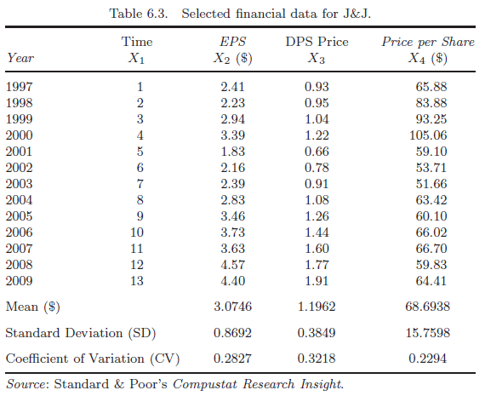

Slide 83

Alternatively, Eq. (6.26) could be used to estimate the theoretical value of J&J stock. If the dividend is expected to stay at $1.91, and k = 12.97, then estimates for the retention rate and the ER for investment are required.
For the sake of example, it is assumed that a retention rate of 50% and an ER from investment of 18% yields a value of 9% for b times r. This gives an estimated value for the stock of

Slide 84
While J&J’s stock would seem to be overvalued selling at $64.41 a share, notice the sensitivity of this valuation equation to both the estimate of the appropriate discount rate (required rate-of-return) and the estimate of the long-term growth rate. For example, if J&J’s required rate-of-return had been 11.965% rather than 12.97%, its theoretical price would have been $64.41.
It seems logical to assume that firms that have grown at a very high rate will not continue to do so in the infinite future. Likewise, firms with very poor growth might improve in the future. Although a single growth rate could be found, it is difficult to estimate this single number. In order to give greater flexibility to this technique, in many analysts use multiple period (two or three periods) growth-rate models. Each period has a specific growth rate associated with the firm’s prospects in the short run and also in the long run.

Slide 85
6.4.4. Two-Period Growth Model
The simplest extension of the one-period model is to assume that a period of extraordinary growth will continue for a certain number of years, after which growth will change to a level at which it is expected to continue indefinitely. This kind of model is called the two-period growth model.

Slide 86

If it is assumed that the length of the first period is n year, that the growth rate in the first period is g1, and that Pn is the price at the end of period n, then the value of the stock can be written as
where
d1 =the current DPS; and
gi =the growth rate during period i.

Slide 87
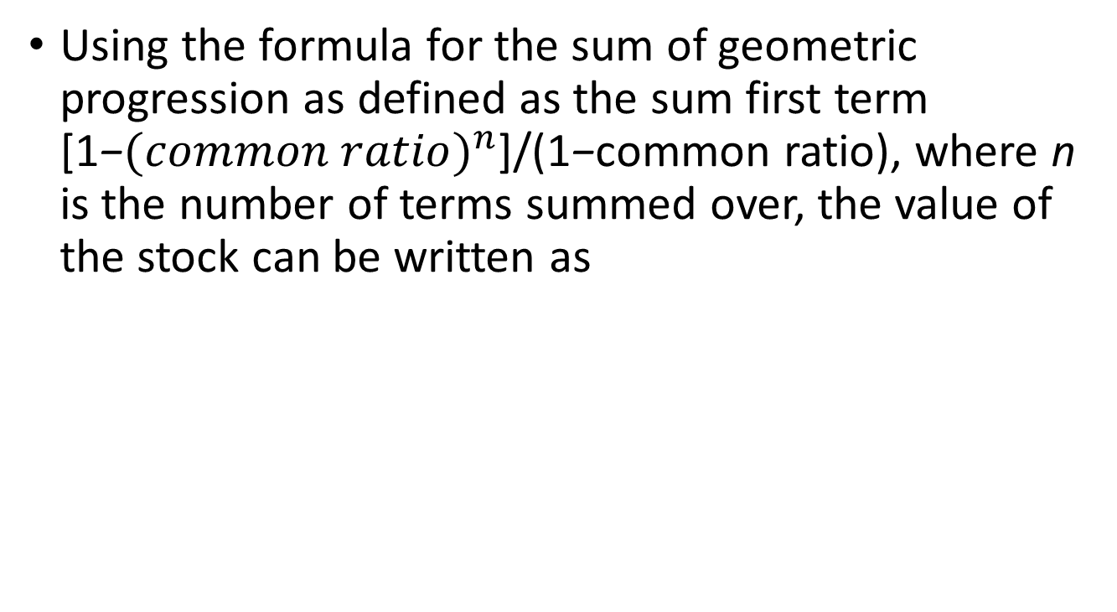
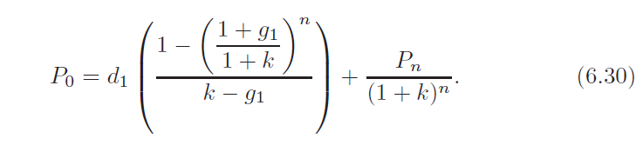

Slide 88


After n periods, it is assumed that the firm exhibits a constant growth forever. If g2 is the growth in the second period and dn+1 is the dividend in the n + 1 period, then:
The dividend in the n+1 period can be expressed in terms of the dividend in first period:

Slide 89
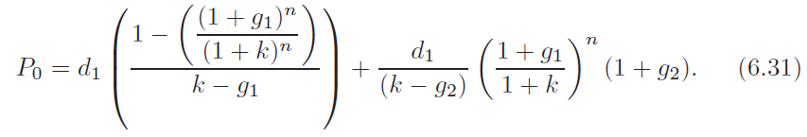
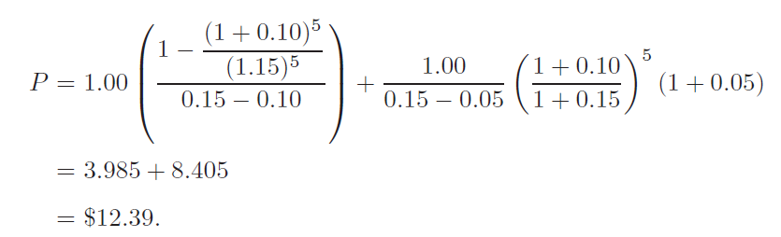
Making substitutions for Pn and dn+1 the two-period model becomes:
This formula can easily be solved for the theoretical price of any stock. For example, Firm OPQ pays a dividend of $1.00 per share which is expected to grow at 10% for 5 years and 5% thereafter. The investors in OPQ require a rate-of-return of 15%. The current price of OPQ stocks using Eq. (6.31) should be

Slide 90
6.4.5. Three-Period Growth Model
A logical extension of the two-period model is the three-period growth model. The three-period growth model implies that there exist three different growth rates for the whole growth valuation process. The resulting model assumes that in the first period growth is expected to be constant at some level. During period two, the growth changes from its value in period one to a different level. The third and final period is the period of steady-state growth.

Slide 91
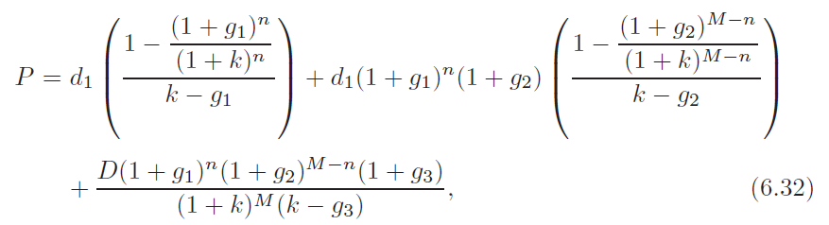
Look at Firm OPQ again. Instead of forecasting a growth rate of 5% during the second period, the three-period model is used to forecast at a 7% growth rate during the 6th–10th years and at a 5% growth rate from the 11th year thereafter, the price of OPQ stock can be calculated using Eq. (6.31).

Slide 92
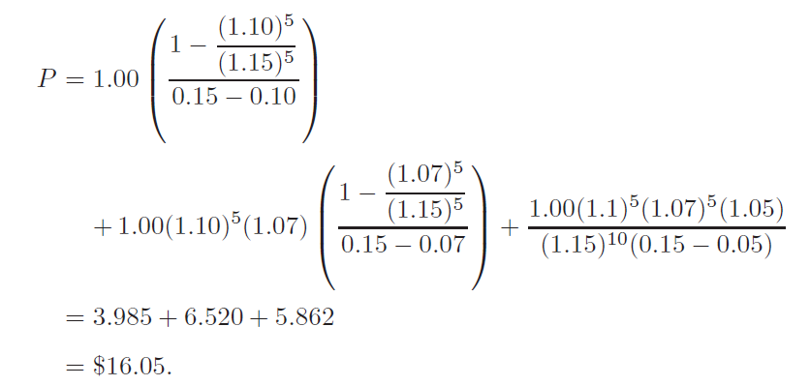
where M is the end of the second period and the other terms are defined as before.

Slide 93
The additional information about the three periods of OPQ’s growth gives a different answer for the theoretical market price of the shares. Since the firm experiences 5 years of growth at 7% during the second period (which is larger than the 5% growth assumed in the two-period model) the market price per share is $3.66 higher when we use the three-period model.
In Sample Problem 3.3, a set of actual data is employed to show how these concepts can be used to help security analysts and portfolio managers analyze the expected value of a firm.

Slide 94
EXAMPLE 6.9
To demonstrate how the concepts of growth rate and stock-valuation model discussed in the previous sections can analyze securities, the per-share values for price, earnings, and dividends of J&J during 1997–2009 are used (see the Table 6.3).
The mean and the SDs of the EPS are higher than the mean and SD of the DPS. As expected, on average J&J earns more per share in earnings than they pay out in dividends; nevertheless, the variability of the earning stream is greater than the variability of the dividend stream.
In comparing the dispersion of two different series there generally is a problem with simply comparing the magnitude of the respective SDs. The SD is an absolute measure of dispersion and as such is influenced by the numbers in the series. To compare the dispersion of two series, the CV, is usually employed. The CV is defined as the SD divided by the ER. The larger the CV, the greater the dispersion relative to the mean. In this case, the EPS still has a greater dispersion than the dividend series.

Slide 95
EXAMPLE 6.9 (cont’d)
The expected value per share for J&J is determined using the Gordon model as expressed in Eq. (6.31). To use this valuation approach, it is necessary to estimate the dividends per share in the next period, the capitalization rate, and the growth rate of dividends per share.
The capitalization rate can be estimated by the earnings yield method, the weighted cost of capital method, or the capital asset pricing model (CAPM) method (discussed in Chapter 9).
The following numerical example uses a required return of 16% for J&J and the compound-sum method of computing dividends per share growth rate (use of Eq. (6.32) yields a growth rate of 13%).

Slide 96

EXAMPLE 6.9 (cont’d)
Substituting these values into Eq. (6.31) yields:
This theoretical value is a higher than the average price for the period ($68.69) and the current price ($64.41). The main problems associated with this stock-valuation approach are the adequacy of using averages of past data to estimate the future and using the compound-sum method to estimate the growth rate.

Slide 97
EXAMPLE 6.9 (cont’d)
To estimate the related regression parameters and to provide a base for discussion of other implications, covariances and correlation coefficients for time, EPS, DPS, PPS, 1n PPS are presented in Tables 6.4(a) and 6.4(b). The covariance matrix in Table 6.4(a) presents variances (elements on the diagonal) and covariances (elements off the diagonal). The correlation matrix in Table 6.4(b) presents correlation coefficients.

Slide 98
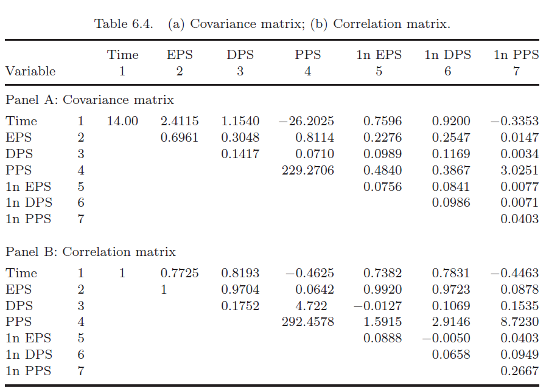

Slide 99
EXAMPLE 6.9 (cont’d)
Conceptually, both the covariance and the correlation coefficient can be used to measure the extent to which two variables move together. The correlation coefficient, which ranges from -1.0 (perfect negative correlation) to +1.0 (perfect positive correlation), is most commonly used because it is a standardized unit-free measure.

Slide 100
EXAMPLE 6.9 (cont’d)
Some implications can be drawn from the size and the magnitude of the correlation coefficients in Table 6.4(b). The correlation coefficient between time and price per share (row 1, column 4) is −0.4625, indicating that the price has decreased over time. The coefficient between time and dividends per share (row 1, column 3) is 0.8193, implying that dividends were generally increasing over time. The coefficient of correlation between time and EPS (row 1, column 2) is 0.7725, which is positive, and this implies increased in earnings over time.

Slide 101

EXAMPLE 6.9 (cont’d)
Following the format of Eqs. (6.31) and (6.32), the models for regressing X5 and X6 on X1 can be defined:
Where a0, a1 and b0, b1 = regression parameters; and e5 and e6 = error terms.

Slide 102
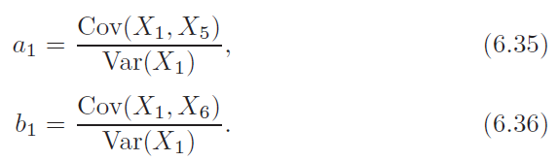
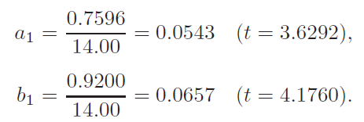
EXAMPLE 6.9 (cont’d)
The formulas necessary to estimate the slopes a1 and b1 are represented by
Based on the information listed in Table 6.4(a), the estimated slopes are

Slide 103
EXAMPLE 6.9 (cont’d)
The estimated student’s t-statistic, shown in parentheses, is used to show whether the regression estimate is significantly different from zero. Given values of the regression estimate and the degrees of freedom, we see that a1 is not significantly different from zero and that b1 is statistically significant. This verifies the aforementioned implications drawn from the correlation matrix — that is, the growth rate of EPS as estimated by a1 is essentially zero (5.43%) and the growth rate of dividends per share as estimated by b1 is positive at 6.57%.

Slide 104
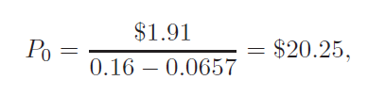
EXAMPLE 6.9 (cont’d)
Use of the regression-generated growth rate for dividends per share of 6.17% in the valuation equation yields:
which is closer to the average price for the period ($68.69) than the 2009 price of $64.41 per share. Thus, use of the regression method in this case is not as useful as the compound-sum method in valuing the shares of J&J.

Slide 105

6.5. Preferred Stock Valuation
Most preferred stock entitles the stockholder to a fixed dividend payment in perpetuity. There is no opportunity for the dividend to grow, so the term (1+g)t is dropped from the valuation model. Denoting the annual dividend payment by d0 and the required rate-of-return by r, we can substitute d0 = dt for t = 1, 2, 3, . . . to obtain the preferred stock valuation:

Slide 106


EXAMPLE 6.10
A share of preferred stock, yielding annual dividend payments of $5, sells $52. Find the rate-of-return required by investors in this stock.
The notation is P0 = $52 and d0 = $5. Because Eq. (6.37) implies
it follows that the required rate-of-return is
Therefore, investors in the stock require an annual rate-of-return of 9.62%.

Slide 107
EXAMPLE 6.10 (cont’d)
In some instances, preferred stock contains a participation provision. In these cases, in addition to the fixed dividend, preferred stockholders are allocated a share of any dividend remaining after the common stockholders receive a common share dividend equal to the preferred payment. If there is such a participation provision, Eq. (6.37) is not appropriate for the valuation of preferred stock.

Slide 108
EXAMPLE 6.10 (cont’d)
An adjustable rate preferred stock (ARPS) is a recently developed financial instrument designed to place the risk of fluctuating interest rates on the investor. The ARPS concept allows the dividend rate on preferred stock to vary, based on changes in the market rate of interest. For example, the ARPS rate may be set each quarter at 30 basis points above the 91-day Treasury bill rate, with an upper and lower bound, called a collar, set at some arbitrary level, such as 7–14%. ARPS appeals to corporate managers for two reasons: (1) dividends on ARPS, like the dividends on all preferred issues, enjoy an 80% exclusion from federal income tax, and (2) ARPS reflects current market return because of the quarterly adjustment in interest rates, thereby reducing the fluctuation in stock price.

Slide 109

EXAMPLE 6.10 (cont’d)
The valuation of ARPS is different than the valuation shown in Eq. (6.37), as follows:
The major difference between Eqs. (6.37) and (6.38) is that for preferred stock the d is fixed, whereas for ARPS the dividend is variable, dt.

Slide 110
6.6. Risk, Return, and Market Efficiency
This chapter defines the value of an asset as the present value of the expected cash flows that arise from owning that asset. It is the size, timing, and risk of the cash flows that determine the asset value.
To compute a present value, we need to know the expected future cash flows and appropriate discount rate, or the required rate-of-return at which to discount expected cash flows back to the present.
Chapter 6 identified three components of required rate-of-return: the real risk-free rate-of-return, inflation expectations, and risk premium.

Slide 111
The first two components of required rate-of-return are the same for all investments. Required returns differ as a result of different risk premiums; thus, finance professionals say that risk drives return. A low-risk investment will have a lower required return than a high-risk investment.
As security prices depend only on future expected cash flows and required returns, it stands to reason that prices should vary only because of changes in these variables.
Should unexpected good news occur, such as higher than expected earnings or continued economic growth without expected inflationary pressures, we would expect to see asset prices rise.
Should unforeseen bad news occur, such as higher than expected Federal Government budget deficits or lower than expected company sales, asset prices should fall.

Slide 112
Of course, the largest price changes affect the assets that are most sensitive to such news. Since the future cash flows of common stock are much less certain than those of bonds, common stock prices are more sensitive than bond prices to news announcements. This sensitivity causes greater price swings and more price variability for stocks than for bonds.
As compensation for this higher risk, investors demand higher risk premiums and higher required rates-of-return for common stock than for bonds. This suggests that stockholders should earn higher returns over time than bond-owners.

Slide 113
6.6.1. Historical Returns and Fluctuations
Evidence that higher returns go hand-in-hand with high risk is reproduced as Table 6.5. This table reports the average annual returns and SDs for different types of investments. The return distributions for small-company common stocks and all common stocks have large SDs, indicating much more risk than the bond investments. However, investors who undertake such risk earn higher rewards over the long haul, since stock returns reward investors more than conservative bond investments.
For an average risk stock under normal market conditions, the discount rate k for finding the present value of future dividends should be close to the 12% compounded average annual rate-of-return earned by the stock market since 1926.

Slide 114
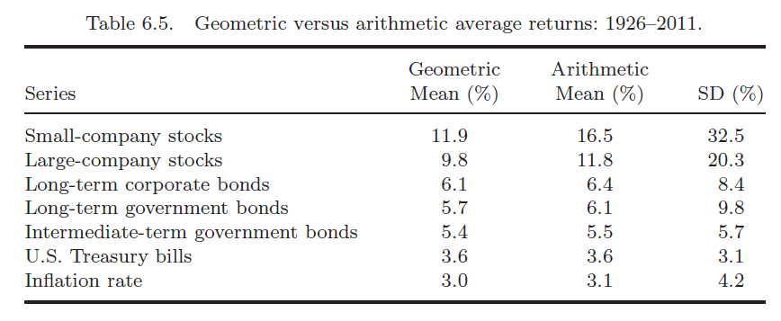

Slide 115
6.6.2. Efficient Capital Markets
Good or bad news can cause assets’ prices to change.
Good news surprises lead market participants either to reduce the risk premium they demand of an asset (thus decreasing its required return) or to increase their expectations for future cash flows. Either reaction leads to an increase in an asset’s price.
Bad news surprises lead the market to demand a higher risk premium (and required return) or to reduce its expectations for future cash flows; either reaction results in a falling asset price.

Slide 116
If a market adjusts prices quickly and in an unbiased manner after the arrival of important news surprises, it is said to be an efficient market.
If the market for IBM stock is efficient, we should see a quick price change shortly after any announcement of an unexpected event that affects sales, earnings, or new products. A quick movement in the price of a stock such as IBM should take no longer than several minutes. After this price adjustment, future price changes should appear to be random. That is, initial price reaction to the news should be unbiased or fully reflect the effects of the news.
Every time IBM’s stock price changes in reaction to new information, it should show no continuing tendency to rise or fall after the price adjustment. After new information hits the market and the price adjusts, no steady trend in either direction should persist.

Slide 117
Any consistent trend in the same direction as the price change or evidence of price corrections or reversals after the immediate reaction to news would be evidence of an inefficient market that does not quickly and correctly process new information to properly determine asset prices.
In an efficient market, it is difficult to consistently find stocks whose prices do not fairly reflect the present values of future expected cash flows. Prices will change only when the arrival of new information indicates that an upward or downward revision in this present value is appropriate.

Slide 118
This means that in an efficient market investors cannot consistently profit from trades made after new information arrives at the market. The price adjustment occurs so rapidly that no buy or sell order placed after the announcement can, in the long-run, result in return above the market’s average return.
An order to buy after the arrival of good news may result in large profits, but such a gain will occur only by chance, as will comparable losses. Stock price trends always return to their random ways after initially adjusting to the new information.

Slide 119
Efficient markets result from interactions among many market participants, all analyzing available information in pursuit of an advantage. Also the information flows or news they analyze must be random, both in timing and content.
The profit motive leads investors to try to buy low and sell high on the basis of new information and their interpretation of it. Hordes of investors analyzing all available information about the economy and individual firms quickly identify incorrectly priced stocks; resulting market pressures immediately push those stocks to their correct prices.
In an efficient market, this causes prices to move in a random walk, meaning that they appear to fluctuate randomly over time, driven by the random arrival of new information.

Slide 120
Although some studies refute this contention, the average performance of equity mutual funds usually is worse than that of overall market averages such as the S&P 500 on a year-by-year basis.
Different assumptions about information availability give rise to different types of market efficiency. A market in which prices reflect all public and privately available knowledge, including past and current information, is a strong-form efficient market. In this market, even corporate officers and other insiders cannot earn above-average, risk-adjusted profits from buying and selling stocks; even their detailed, exclusive information already is reflected in current stock prices.

Slide 121
In a semistrong-form efficient market, all public information, both past and current, is reflected in asset prices. The U.S. stock market is a fairly good example of a semistrong-form efficient market.
News about the economy or individual companies appears to produce quick stock price changes without subsequent trends or price reversals.

Slide 122
A weak-form efficient market is a market in which prices reflect all past information, such as information in last year’s annual reports, previous earnings announcements, and other past news.
A weak-form efficient market implies that such investors are wasting their time; they cannot earn above-average, risk-adjusted profits by projecting past trends in market variables.
Evidence indicates that historical information is not helpful in predicting future stock price performance.

Slide 123
6.6.3. Implications for Financial Managers
In terms of the above three categories, most researchers and analysts would conclude that the markets are generally semistrong-form efficient. Evidence shows that higher risk assets do earn higher returns and that stock price reactions to news events generally are rapid and unbiased.

Slide 124
This means that efficient markets provide valuable information to a firm’s managers. Stock price adjustments in reaction to announcements by the firm tell managers if their decisions are perceived by the marketplace to be shareholder-wealth enhancing or destroying.
Managers also can base their decisions on current market data, with a high degree of confidence that the interest rates the firm pays and the prices of its bonds and stocks reflect the current market opinion about the firm.

Slide 125
6.7. Exchange Rates and Investing Overseas
Investments outside one’s borders are exposed to exchange rate risk and political risk. The result of this exposure is that dollar returns may be higher or lower than the foreign country’s local currency returns, depending upon exchange rate fluctuations or political decisions to block/unblock currencies.

Slide 126
In general, a stronger dollar lowers the overseas investment returns to a U.S. investor.
For example, suppose the spot exchange rate today is $1 = 100. We convert $1 million into 100 million and invest it in the Japanese stock market. Over the course of a year, let’s assume our investment gains 10% in terms of the yen, so our Japanese investment is worth 110 million. But if the U.S. dollar strengthens so that now $1 purchases 105 yen, the value of our 110 million converts to (110 million/ 105/$) or $1,047,619 — a U.S. dollar return of only 4.76%. If the dollar had strengthened even further to, say, 115 yen to the dollar, our 10% local currency gain would convert to (110 million/115/$) or $956,521.74 — a loss of over 4.3% in U.S. dollar terms.
A stronger dollar can obliterate positive local currency returns. This can happen in both financial market and real asset investments.

Slide 127
What helps to increase overseas investment returns in U.S. dollar terms above their local currency returns in a weaker dollar.
In the above example, if the dollar had weakened to 90/$, our 110 million would convert to $1,222,222.22. The local currency return of 10% would have resulted in a U.S. dollar gain of over 22%.
Table 6.6 shows returns in a local currency terms and U.S. dollar terms during 1995. The U.S. dollar returns are higher than the local returns in countries such as Austria, Belgium, and Canada, indicating that the dollar weakened against those currencies during 1995. The U.S. dollar returns are lower than the local returns in countries such as Australia and Japan, showing the dollar strengthened against those currencies during 1995.

Slide 128
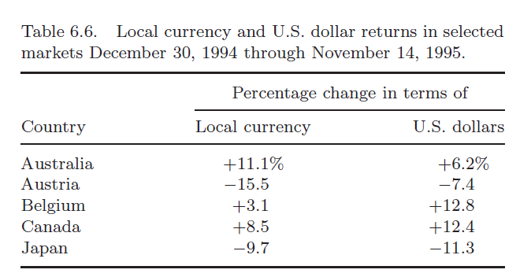

Slide 129
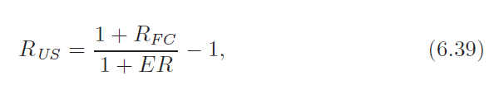

To an investor in the U.S., the U.S. return on an overseas investment is given by Eq. (6.39):
where RFC and ΔER are the return on investment in the foreign country and the change in the exchange rate, respectively.
For example, using the above example of a 10% return on our Japanese stock investments (100–110 million) and a 15% rise in the U.S. dollar (spot rate going from 100/$ to 115/$), the return to a U.S. investors is:
or −4.35%.

Slide 130
If we rearrange Eq. (6.39), we can view U.S. market returns from the perspective of non-U.S. investors:
A practical implication of Eq. (6.40) is to view it from an “expectational” perspective. That is, let RFC and RUS be expected stock or bond, market returns and let ΔER represent the expected change in the exchange rate. Then we see that foreign investors will purchase U.S. securities only when the ER is favorable relative to the return available in their home currencies, after controlling for exchange rate fluctuations.

Slide 131

Suppose that a Japanese investor can earn 4% on bonds in Japan and that the U.S. dollar is expected to fall 5% against the Japanese yen in the coming year. Equation (6.40) suggests that the Japanese investor will require approximately a 9.5% return on a similar U.S. investment:
Solving for RUS, we obtain:

Slide 132
The 9.47% U.S. dollar return, after adjusting for the 5% loss in value of the U.S. dollar when the Japanese investor converts dollars back to yen, will equal the 4% return available in Japan.
If the U.S. dollar was expected to lose 7% against the Japanese yen, a Japanese investor would require a U.S. interest rate of 11.83% before investing in U.S. securities.
Thus, a falling dollar pushes U.S. interest rates upward and increases the cost for the U.S. government, corporations, and individuals to borrow. Exchange rate fluctuations can affect U.S. interest rates.

Slide 133

6.8. Application Examples 6.8.1. Zero Coupon Bond Yield
Suppose a price quote specifies $250 for a zero coupon bond with a par value of $1,000. The bond matures in 15 years. What is the YTM on the bond, compounded annually?
A: We know that the present value is:

Slide 134

PV is the current price of $250; the future cash inflow is the par value of $1,000, paid at maturity. The number of years, N, is 15 and r is the unknown. Plugging in the known information and solving for r, we obtain:

Slide 135
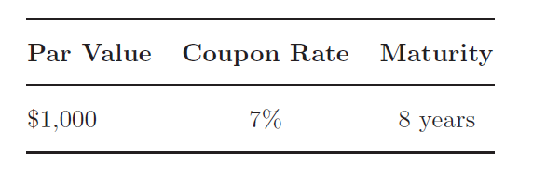
6.8.2. Valuation
Calculate the price of the following bond assuming that interest payments are made semiannually and future cash flows are discounted at a 10% nominal annual rate.

Slide 136
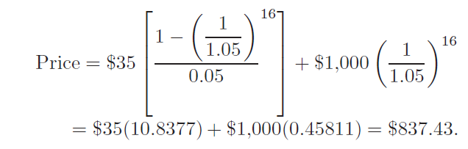
A: Since coupons are paid semiannually, the number of periods is 8 years× 2, or 16. The nominal rate of APR of 10% means the periodic interest rate is 10%/2 or 5%. Every 6 months, investors will receive an interest payment of [(0.07 × 1000)/2], or $35. The bond’s price will equal the present value of the coupon annuity plus the present value of the par value:
The bond should sell for $837.43 in the market.

Slide 137
6.8.3. Stock Valuation
Ana List estimates that Mertz Company’s dividend will grow at 5% a year into the foreseeable future. Mertz’s dividend this year is $1.80 a share.
(a) If stock investors require a 15% return on stocks with Mertz’s level of risk, what should the current price of Mertz stock be?
(b) Suppose Mertz’s price is $25 a share and the current dividend is $1.80 a share. If investors require a 15% return, what is the market’s estimate for Mertz’s constant dividend growth rate?

Slide 138


A: (a) Since dividends are assumed to grow at a constant rate of 5% annually, we can use the constant dividend growth model. The current dividend is $1.80; the required return is 15%; and the growth rate is 5%. Our estimate of Mertz’s stock price will be:
(b) Here we are given the current market price and dividend, and the required return. We can work backward to determine the constant growth rate that is constant with this data:

Slide 139
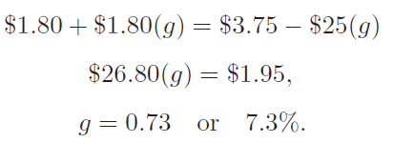
Multiplying through and solving for g, the growth rate, we have:
The market anticipates a 7.3% constant growth rate in Mertz’s dividend into the foreseeable future.

Slide 140
6.8.4. Return on Overseas Investment
Show that if the Japanese interest rate is 4% and the dollar is expected to fall 5% against the yen, a 9.47% U.S. interest rate is needed to offer the investor a 4% return in yen. Assume the current exchange rate is 105.0/$.
A: At the current spot rate, the Japanese investor can convert 10,500 into $100. 1 year later, the $100 has grown by 9.47% to $109.47. If the dollar does weaken by the expected 5%, the expected exchange rate after 1 year will be 99.75/$. If the Japanese investor converts the $109.47 at this expected exchange rate, he receives ($109.47) × (99.75/$1), or 10,919.93. Thus, the Japanese investor’s return is (10, 9191.63 − 10,500)/10,500, which equals 0.0400 or 4.00%.

Slide 141
Corporate bonds can be issued either at par, at a discount, or at a premium.
ABC Company would like to issue a new corporate bond that will mature in 10 years. The discount rate for this bond is r = 15%.What is the coupon rate needed for this bond to be issued at par. If the par value of this bond is $1,000 and the coupon rate is 10%, then what is the theoretical value of this bond?

Slide 142
6.9. Summary
A variety of factors influence the values of bond and stock issues. In assessing the values of these investments, we can use the notion of present value, discounting future cash flows at some appropriate discount rate. The rate at which the market discounts an investment’s expected future receipts depends on its perceived degree of risk. More risk leads the market to demand a higher expected rate-of-return.
An analyst computes the price of a bond from its par value, term to maturity, coupon payments, and periodic interest rate. When computing prices, it is important to distinguish between the stated or nominal annual interest rate on a bond, which is similar to an APR, and the bond’s YTM, which is similar to an EAR.

Slide 143
The value of a share of common stock is the present value of all future dividend payments per share. The price of the stock will depend upon investors’ perception of its risk and expectations about future dividend growth.
New information affecting future cash flows and investors’ required rates-of-return will result in changes in asset prices. How quickly those price changes occur will depend on the efficiency of the market.
In a strongform efficient market, prices reflect all public and private information.
In a semistrong-form efficient market, all past and current public information is reflected in current prices.
A weak-form efficient market reflects only past information.
Exchange rate fluctuations are a major source of risk-and-return when investing overseas. Overseas interest rates and investor expectations about the strength or weakness of the dollar have an effect on U.S. interest rates.

Slide 144
Appendix 6.A. The Relationship between Exchange Rates and Interest Rates
Exchange rates react to differences in interest rates, inflation rates, and income growth rates between countries. In addition, central bank intervention and trade barriers also influence exchange rates. Fluctuating exchange rates affect returns from overseas investments.
In domestic markets, there are two main sources of return: income (such as bond interest or stock dividends) and capital gains or losses from asset price changes. When investing overseas, there is a third source of risk-and return: the risk of converting foreign currency into domestic currency. If exchange rates vary over time, or currency conversion is blocked by the host country, the returns on foreign investments can be substantially affected. Therefore, changes in exchange rates should be considered before investing overseas.

Slide 145
For example, U.S. corporate treasurers want to invest excess cash in low-risk investments that offer the highest returns. In a global market, treasurers can look beyond Treasury bills or high-quality bank CDs.
Suppose the French government offers higher interest rates on its short-term debt than the T-bill rate. U.S. corporate treasurers will use their excess cash to buy francs at the spot rate and invest them at the higher French interest rates. To protect their investment returns from the risk of adverse exchange rate changes, U.S. treasurers will enter into forward market agreements. This allows them to lock in the exchange rate at which they can convert francs back into dollars when the debt instruments mature. The U.S. treasurer will generally be indifferent between investing excess funds in the United States or in France if the extra interest earned by investing at higher French rates is offset by a foreign exchange market loss caused by the difference between the spot and forward market exchange rates.

Slide 146

When this occurs, we have interest rate parity where investors are indifferent between investing at home or abroad as far as ER is concerned; any existing nominal risk-free interest rate disparity is offset by spot and forward exchange rate differentials. When interest rate parity exists, the following relationship is true.
The left-hand side of Eq. (6.A.1) reflects the return from converting dollars at the spot rate (S0), investing them at the foreign rate (1 + RFC), and then converting the currency back into dollars at the forward rate (F1). The right-hand side reflects the return from investing the dollars in the U.S.

Slide 147

For example, assume that the spot exchange rate is FF 5.2870/$, the 1-year-forward rate is quoted as FF 5.4930/$, and the U.S. and French 1-year interest rates are 4% and 8%, respectively. For every $1 invested in the U.S., the return is $1 (1 + 0.4) or $1.04. In this example, there is interest rate parity. The benefits of investing in France (the left-hand side of Eq. (6.A.1)) equal the benefits of investing in the U.S. (the right-hand side of Eq. (6.A.1)). Both choices lead to a return of $1.04 for every $1 invested.
Rearranging Eq. (6.A.1), we obtain the equilibrium relationship between nominal risk-free interest rates, spot rates, and forward rates:

Slide 148
Of course, the nominal risk-free interest rates and forward rate must all refer to the same period of time. The above example used 1-year interest rates and a 1-year forward rate. Shorter or longer time frames also could be used, as long as all the variables used them consistently.
Some forecasters use Eq. (6.A.2) as a means to forecast future exchange rates; that is, they assume the future spot rate will equal the current forward rate. Equations (6.11) and (6.12) in this chapter are based upon the interest rate parity relationship in Eq. (6.A.2), with the change in exchange rate, ΔER, being used in place of the percentage difference between the forward and spot rates.

Slide 149



Appendix 6.B. Derivation of Dividend Discount Model 6.B.1. Summation of Infinite Geometric Series
Summation of geometric series can be defined as:
Multiply both sides of Eq. (6.A.1) by R, we obtain
Subtract Eq. (6.C.1) by Eq. (6.C.2), we obtain
It can be shown

Slide 150

If R is smaller than 1, and n approaches to ∞, then Rn approaches to 0, i.e.,
Then

Slide 151
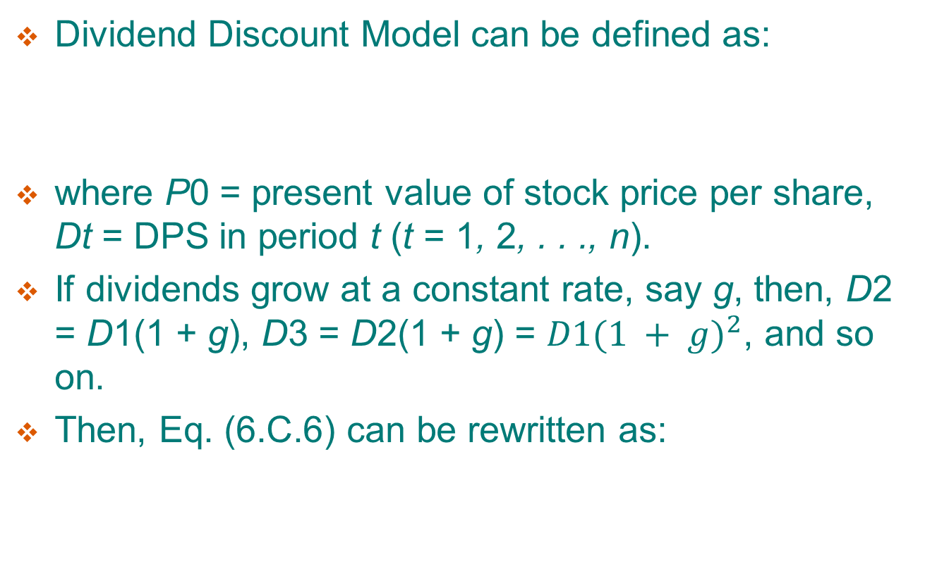

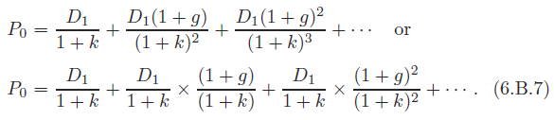
6.B.2. Dividend Discount Model

Slide 152
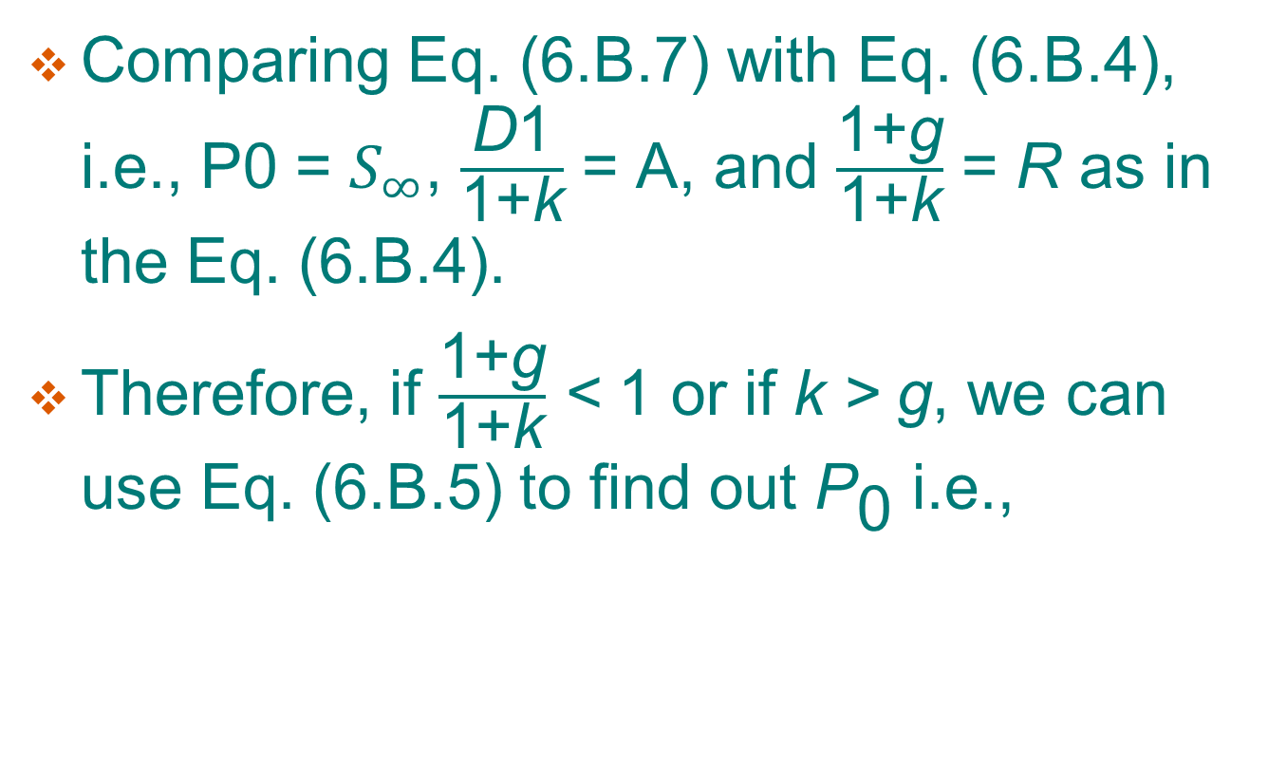
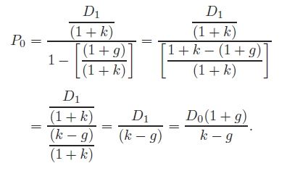

Slide 153
Appendix 6.C. Duration Analysis
As mentioned in Section 6.2, we briefly discussed the concept of duration and how it affects bond rate-of-return. In this Appendix, we will discuss duration measurement and its related issues in detail.
Section 6.C.1 discusses duration.
Section 6.C.2 discusses weighted-average term to maturity and duration.
Section 6.C.3 discusses convexity.

Slide 154
6.C.1. Duration
The traditional role of bonds as an asset category has changed over the past 15 years due to surging interest rates and the resultant price volatility. The use of bond maturity to reduce interest-rate risk in bond portfolios through maturity matching has become increasingly inadequate. By the 1970s, several researchers had recognized that maturity is an incomplete measure of the life and risk of a coupon bond.

Slide 155
The concept of duration is a practical measurement tool that could help immunize bond portfolios against interest-rate risk, and could also be used as a measure of price risk for bonds. Duration has emerged as an important tool for the measurement and management of interest-rate risk.

Slide 156
The purpose of this section is to review the historical development of duration, to examine its potential use by investors in alternative bond-portfolio immunization strategies, and to look at certain reservations that should be considered when using duration to immunize bond portfolios.

Slide 157
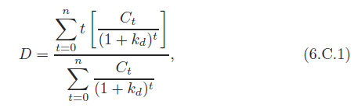
In 1938, Frederick Macaulay developed the concept of duration as part of an overall analysis of interest rates and bond prices. He was attempting to develop a more meaningful summary measure of the life of a bond that would correlate well with changes in bond price; he arrived at a weighted average of the time to each bond payment, with the weights being the present values of each payment relative to the total present value of all the flows:
where
Ct = the coupon-interest payment in periods 1 through n − 1;
Cn = the sum of the coupon-interest payment and the face value of the bond in period n;
kd = the YTM or required rate-of-return of the bondholders in the
market
t = the time period in years.

Slide 158
Thus, for the first semi-annual payment in the series between 0 and n, t would equal 0.5. The denominator of this equation is equal to the current price of the bond as estimated by the present value of all future cash flows.
The duration of a bond with a fixed maturity date declines just as maturity with the passage of time. The duration of a coupon bond, however, is always shorter than its maturity. Only for pure discount (zero-coupon) bonds will duration equal maturity. Duration is also affected by the size of the coupon and its YTM, decreasing as either increases.

Slide 159
It is useful to place the concept of duration in the perspective of other summary measures of the timing of an asset’s cash flow. Because the cash flows from bonds are specific, both as to timing and amount, analysts have derived a precise measure of the timing for bonds.
The most commonly used timing measure is term to maturity (TM), the number of years prior to the final payment on the bond. The
The advantage of TM is that it is easily identified and measured.
The disadvantage is that TM ignores interim cash flows and the substantial difference in coupon rates and the difference in sinking funds.

Slide 160
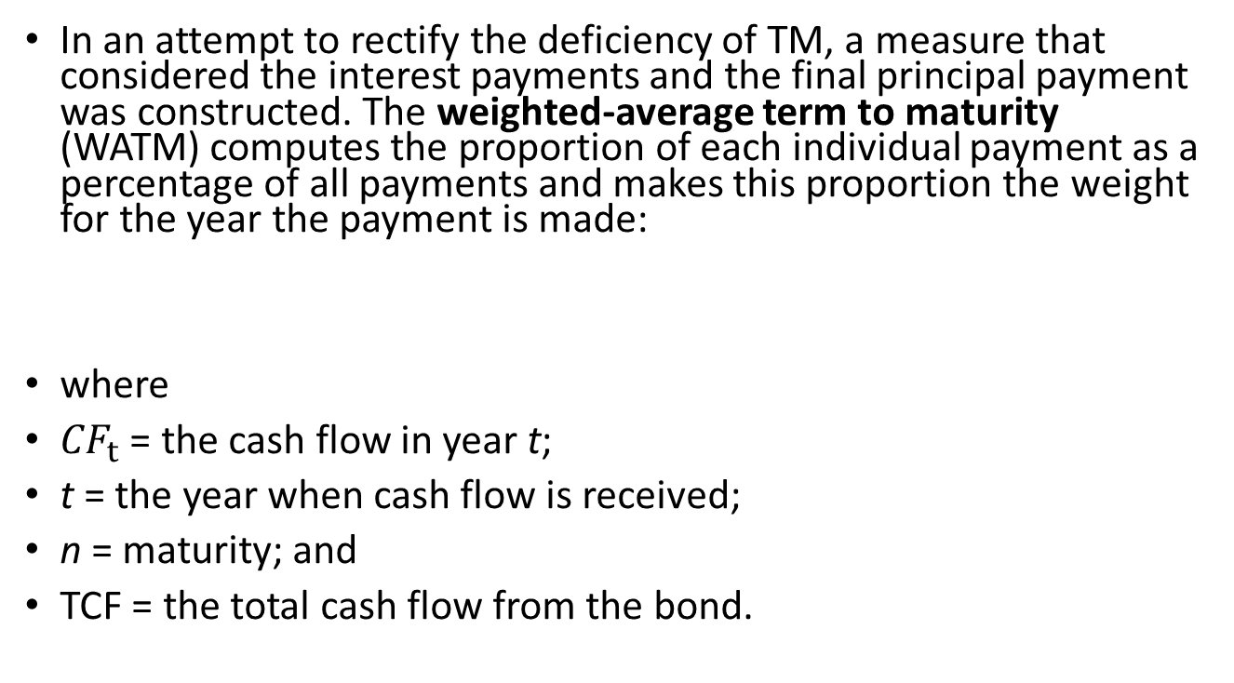
6.C.2. Weighted-Average Term to Maturity and Duration

Slide 161
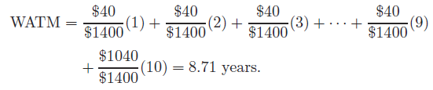
Sample Problem 6.C.1
Suppose a 10-year, 4% bond will have total cash-flow payments of $1,400. Thus, the $40 payment in CF1 will have a weight of 0.0287 ($40/$1,400), each subsequent interest payment will have the same weight, and the principal in year 10 will have a weight of 0.74286 ($1,040/1,400). Therefore:
The WATM is definitely less than the TM, because it takes account of all interim cash flows in addition to the final payment. In addition, a bond with a larger coupon has a shorter WATM because a larger proportion of its total cash flows is derived from the coupon payments prior to maturity — that is, the coupon-weighted average of the larger coupon is larger than the smaller coupon bond. The weighted-average term can be utilized to take into account sinking-fund payments, thus lowering the WATM.

Slide 162
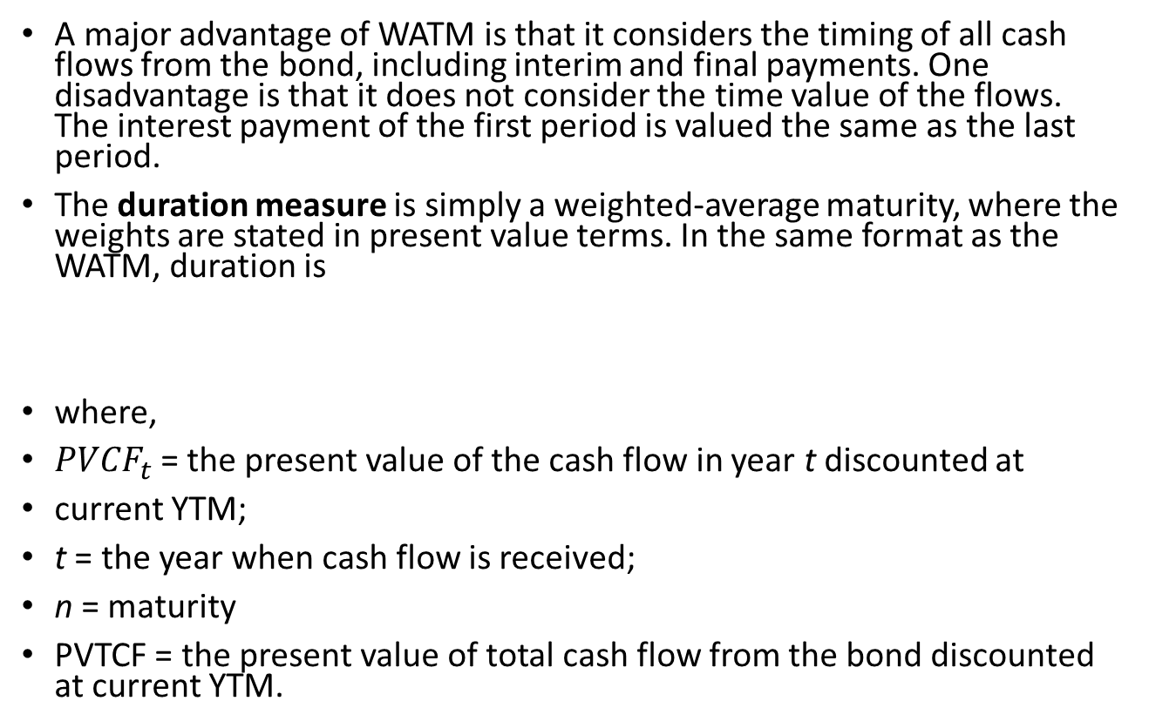
6.C.2.1. WATM versus duration measure

Slide 163
The time in the future when a cash flow is received is weighted by the proportion that the present value of that cash flow contributes to the total present value or price of the bond.
Similar to the WATM, the duration of a bond is shorter than its TM because of the interim interest payment. Duration is inversely related to the coupon of the bond.
The one variable that does not influence the average TM but can affect duration is the prevailing market yield. Market yield does not affect WATM because this measure does not consider the present value of flows. Nevertheless, market yield affects more on both the numerator of WATM and TM. As a result, there is an inverse relation between a change in the market yield and a bond’s duration.

Slide 164
Tables 6.C.1 and 6.C.2, taken from Reilly and Sidhu’s (1980) article, “The Many Uses of Bond Duration”, illustrate the difference between the timing measures. These two tables show the WATM and the duration, respectively. Due to the consideration of the time value of money in the duration measurement, duration is the superior measuring technique.
WATM is always longer than the duration of a bond, and the difference increases with the market rate used in the duration formula. This is consistent with the duration property of an inverse relation between duration and the market rate.

Slide 165
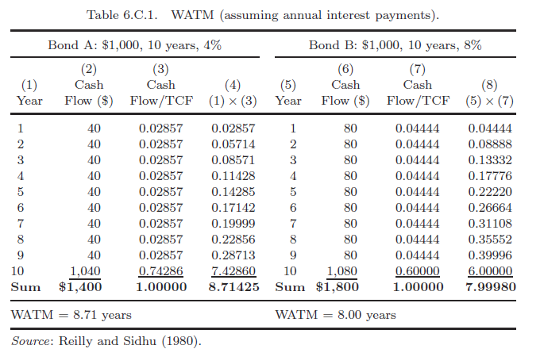

Slide 166
6.C.2.2. YTM
Based upon Chapter 5, YTM is an average maturity measurement in its own way because it is calculated using the same rate to discount all payments to the bondholder — thus, it is an average of spot rates over time. For example, if the spot rate for period two, r2, is greater than that for period one, r1, the YTM on a 2-year coupon bond would be between r1 and r2 — an underestimate of the 2-year spot rate. Likewise, the opposite condition would overestimate the 2-year spot rate. With the high volatility of interest rates that has existed in recent years, the difference can be dramatic. For example, in Britain during 1977, the 20-year spot rate of interest was approximately 20%, while the YTM on 20-year coupon bonds was only 13%. The reason for the larger discrepancy was that YTM was calculated as an average of the relatively low short-term spot rates and the relatively high long-term spot rates.

Slide 167
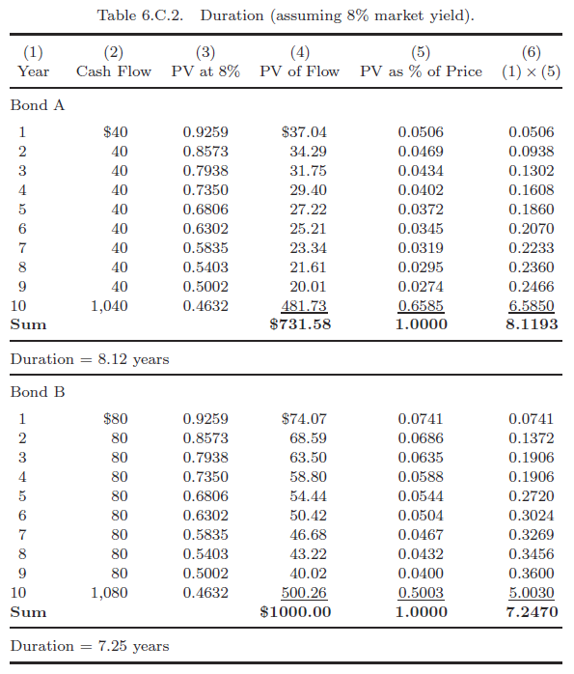

Slide 168
Until the 1970s, when interest-rate and bond-price volatility increased dramatically, the significance of the superiority of duration over average measurement of bond-portfolio risk was required for immunization against interest-rate risk. Studies comparing the success of portfolios immunized with a duration strategy and a maturity strategy have shown that duration outperforms maturity 75% of the time for a variety of planning periods. Duration also produces lower variances between realized and promised returns than either the maturity strategy or the na¨ıve strategy of annually rolling over 20-year bonds.

Slide 169

The motivation for bond investment is to secure a fixed cash flow over a particular investment horizon. Asset and liability portfolios of financial institutions often generate future cash-flow patterns that must conform to certain solvency and profitability restrictions. For example, insurance companies and pension funds, with definite future commitments of funds, invest now so that their future cash-flow stream will match well with their future commitment stream. Bond-immunization strategies are designed to guarantee the investor in default-free and option-free bonds at rate-of-return that approximates the promised rate (or YTM) computed at the outset of the investment. Nevertheless, the YTM will be equal to the RY only if the interim coupon payments are reinvestable at the YTM. If interest rates change, the RY will be lower or higher than YTM, depending upon the relationship between the bond’s measured duration D and the investor’s expected holding period H. Babcock (1975) devised a simple formula in which RY is computed as a weighted average of the YTM and the average RR available for coupon payments:

Slide 170
Therefore, the RY would equal the YTM only if the duration on the bond was kept equal to the time horizon of the investor. An increase in the RR would increase the return from reinvested coupons, but would at the same time decrease the bond value. Only holding the bond to maturity would prevent this value reduction from affecting the RY. Therefore, the overall impact of RR increases depends upon the extent to which the income effect offsets the value reduction. On the other hand, a decrease in the RR will decrease the return from reinvested coupons, but it will increase the bond values in the market. As shown in Eq. (6.C.4), these opposite impacts on RY will exactly offset each other only when D equals H.

Slide 171
If a more complete time spectrum of zero-coupon bonds of all types were readily available, bond-portfolio immunization would be a relatively simple process. Simply by choosing bonds with maturities equal to the length of an investor’s investment horizon, the rate-of-return would always be as promised by the YTM, regardless of interest-rate changes. Beginning with Treasury-bond sales of February 15, 1985, the U.S. Treasury has been cooperating with Wall Street firms in the stripping of coupon payments from new Treasury issues through separate registration of coupon and maturity payments, thus manufacturing a series of zero-coupon issues. However, since this applies only to Treasury issues, it is still necessary for investors to use duration models to immunize portfolios of non-Treasury bonds.

Slide 172
To immunize a bond portfolio, investors must match the duration of the portfolio with the length of their investment horizons. This must be accomplished within their assumed stochastic process of interest-rate movements and changes in the yield curve. If the yield curve changes during the holding period, the immunization process will break down and the RY will not equal the YTM as promised.

Slide 173
Since the hoped-for results of the passive duration-immunization method can be upset by interest-rate shifts, some investors may prefer to try to predict interest-rate changes and undertake an active immunization strategy. This would involve the formation of bond portfolios with durations intentionally longer or shorter than the investment-planning period. Since it is usually assumed that the market consensus about future interest rates is the most likely possibility, investors should pursue active strategies only if their forecasts of rates differ from those of the market. The investor, who expects the interest rate to be higher than the market forecast, should form a bond portfolio with a duration shorter than the length of the investment horizon. If successful, the income gains from reinvestment of coupons and maturing bonds will exceed the value loss on unmatured bonds: RY will exceed the YTM promised. If unsuccessful, the reinvestment return will not be enough to offset the value loss and RY will be less than YTM.

Slide 174
If the investor expects interest rates to be lower than the market forecast, the procedure would be the reverse of that described above— that is, to purchase a bond portfolio with a duration longer than the investment horizon. If successful, the lower reinvestment returns will be more than offset by the bond-value gains. Thus, the active immunization strategy relies solely upon the ability of the investor to predict the direction of future interest-rate changes and to take full advantage of market opportunities for realized returns greater than market rates. While this provides the investor with an opportunity for substantial returns, it can also result in substantial losses. Because of this, Leibowitz and Weinberger (LW, 1981) derived a “stop loss” active immunization strategy which they called contingent immunization. In this method, the portfolio manager pursues higher returns through active management unless the value of the portfolio declines to a level that threatens a minimum target return. At this point, the portfolio is switched into a pure immunization mode designed to provide the minimum target specified at the outset. Other researchers have developed similar strategies that rely on two portfolios — one actively and the other passively immunized. Interest changes could take place that would virtually wipe out the active portfolio, but they would not greatly affect the minimum target return of the two-portfolio combination.

Slide 175
6.C.2.3. The macaulay model
The duration model that is still most widely used because of its simplicity is the Macaulay model. However, basic limitations affect the use of this model. First, the current and forward spot rates are assumed to be equal over a specific planning horizon — that is, the yield curve is assumed to be flat. This is also one of the basic weakness of the YTM measurement. Second, this model provides an accurate measure of interest-rate risk only when there is a single parallel shift in the term of structure of interest rates — that is, there is only one shift within the holding period and it does not involve a change in yield-curve shape.

Slide 176
Most studies surveyed seem to indicate that the Macaulay model assumptions are unrealistic and too restrictive. Cox et al. (1979) noted that it does not take into account the dynamic nature of the term structure observed in the real world, in which yield curves can and do change in shape as well as location. As a result, a number of more complex duration models have been developed to measure risk when multiple term-structure shifts can affect the shape and location of the yield curve. Because the actual underlying stochastic process governing interest-rate changes is not known, only empirical analysis can determine whether the extra complexity of these models justifies their usage. Bierwag et al. (1982) extensively tested the Macaulay model along with four more complex duration models and found that duration-matching strategies generated realized returns consistently closer to promised yields than a maturity-matching strategy. Even more interesting, the Macaulay measure appeared to perform as well as the more complex models. Their findings suggest that single factor duration matching is a feasible immunization strategy that works reasonably well, even with the less complex (and thus less costly) Macaulay model.

Slide 177

Duration appears a better measure of a bond’s life than maturity because it provides a more meaningful relationship with interest-rate changes. This relationship has been expressed by Hopewell and Kaufman (1973) as:
where Δ =“change in”; P =bond price; D =duration; and i =market interest rate or bond yield.

Slide 178
For example, a bond with 5 years’ duration will decline in price by approximately 10% when market yield increases by 2%. Note that ΔP/P on the left-hand side of Eq. (6.C.5) is the percentage change in price, and Δi is the absolute change in yield level and not percentage change. Other useful generalizations can be made concerning the relationships of duration to various bond characteristics, as follows.

Slide 179
1. The higher the coupon, the shorter the duration, because the face value payment at maturity will represent a smaller proportional present value contribution to the makeup of the current bond value. In other words, bonds with small coupon rates will experience larger capital gains or losses as interest rates change. Additionally, for all bonds except zero-coupon-rate bonds, as the maturity of the bond lengthens the duration at the limit will approach (1 + YTM)/YTM. Table 6.C.3 shows the relationship between duration, maturity, and coupon rates for a bond with a YTM of 6%. At the limit (maturity goes to infinity), the duration will approach 17.667 (i.e., (1 + 0.06)/0.06).

Slide 180
As can be seen in Table 6.C.3, the limit is independent of the coupon rate: it is always 17.667. However, when the coupon rate is the same as or greater than the yield rate (the bond is selling at a premium), duration approaches the limit directly. Conversely, for discount-priced bonds (coupon rate is less than YTM), duration can increase beyond the limit and then recede to the limit. In the case of the bond with the 2% coupon at a maturity of 50 years, the duration is 19.452 — and this approaches the limit as maturity keeps increasing. These relationships are shown in Fig. 6.C.1. Regardless of coupon size, it is nearly impossible to find bonds with durations in excess of 20 years; most bonds have a limit of about 15 years.

Slide 181
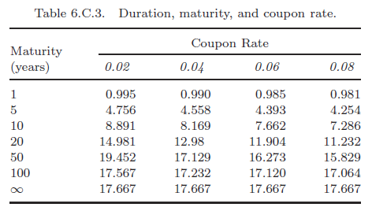

Slide 182
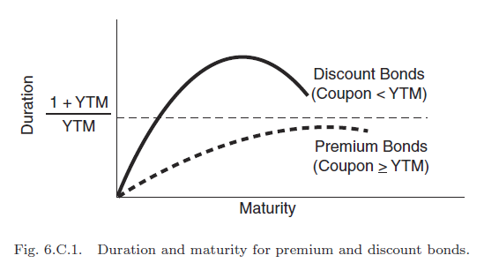

Slide 183
2. The higher the YTM, the shorter the duration, because YTM is used as the discount rate for the bond’s cash flows and higher discount rates diminish the proportional present-value contribution of more distant payments. As has been shown, at the limit duration is equal to (1 + YTM)/YTM; in Table 6.C.3 the relationship between duration and YTM is shown.

Slide 184
3. A typical sinking fund (one in which the bond principal is gradually retired over time) will reduce duration. Duration can be reduced by the sinking-fund or call provision. A large proportion of current bond issues do have sinking funds, and these can definitely affect a bond’s duration. An example will illustrate this fact. A 10-year 4% bond with a sinking fund of 10% of face value per year starting at the end of the fifth year has a duration of 7.10 years as compared to the duration of 8.12 years of a similar bond without a sinking fund. Table 6.C.5 provides further illustration.

Slide 185
The effect of a sinking fund on the time structure of cash flows for a bond is certain to the issuer of the bond, since the firm must make the payments: they represent a legal cash-flow requirement that will affect the firm’s cash flow. However, the sinking fund may not affect the investor since the money put into the sinking fund may not necessarily be used to retire outstanding bonds. Even if it is, it is not certain that a given investor’s bonds will be called for retirement.

Slide 186
4. For bonds of less than 5 years to maturity, the magnitudes of duration changes are about the same as those for maturity changes. For bonds of 5 to 15 years’ maturity, changes in the magnitude of duration are considerably less than those of maturity. For bonds with more than 20 years to maturity, changes in the magnitude of duration are very small relative to changes in maturity. As can be seen in Fig. 6.C.2, in the range of 0 to 5 years the relationship between duration and maturity is shown approximately by a straight line with a slope of 45◦. In the range of 5 to 10 years, the slope of the line is less, indicating a smaller change in duration for a given change in maturity. And for more than 20 years, the line is almost horizontal, showing a smaller change in duration for a given change in maturity.

Slide 187
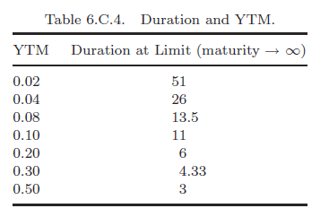

Slide 188
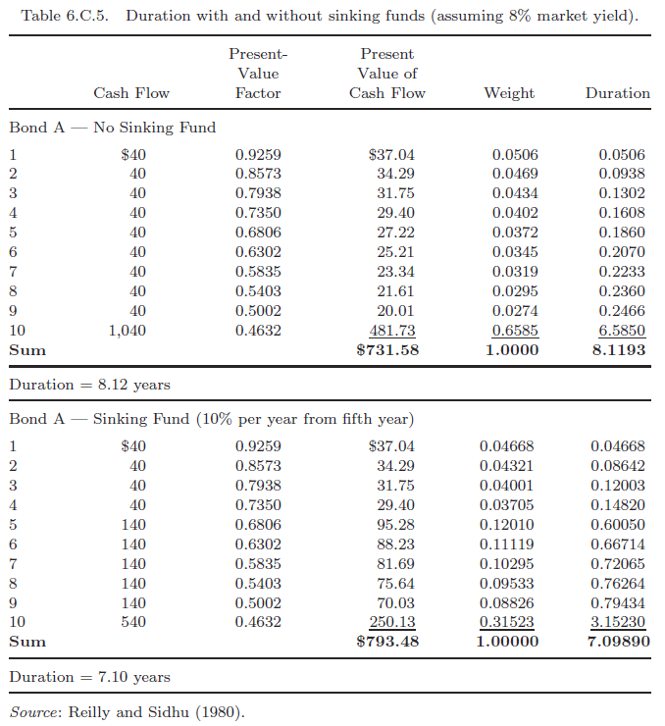

Slide 189
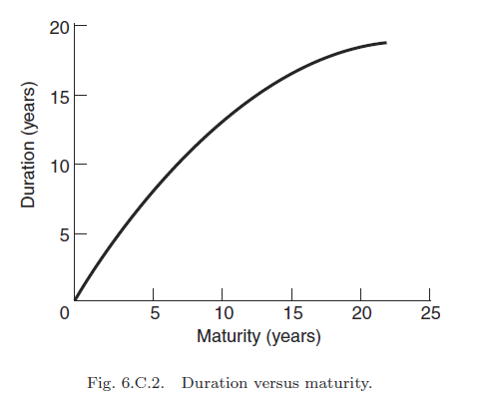

Slide 190
5. In contrast to a sinking fund, all bondholders will be affected if a bond is called. The duration of a callable bond will be shorter than a noncallable bond.
When a bond is callable, the cash flow implicit in the YTM figure is subject to possible early alteration. Most corporate bonds issued today are callable, but with a period of call protection before the call option can be exercised. At the expiration of this period, the bond may be called at a specified call price, which usually involves some premium over par.

Slide 191
To provide some measure of the return in the event that the issuer exercises the call option at some future point, the yield to call is calculated instead of the YTM. This computation is based on the assumption that the bond’s cash flow is terminated at the “first call date” with redemption of principal at the specified call price. The crossover yield is defined as that yield where the YTM is equal to the yield to call. When the price of the bond rises to some value above the call price, and the market yield declines to value below the crossover yield, the yield to call becomes the minimum yield. At this price and yield, the firm will probably exercise a call option when it is available. When prices go below the call price, the YTM is the minimum yield. Sample Problem 6.C.2 provides further illustration.

Slide 192
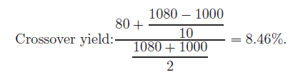
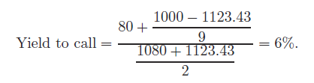
Sample Problem 6.C.2
To calculate the crossover yield for a 8%, 30-year bond selling at par with 10-year call protection, the annual return flow divided by the average investment can be used as an approximation for the yield. The implied crossover yield is 8.46%:
In 1 year’s time the bond’s maturity will be 29 years with 9 years to call. If the market rate has declined to the point where the YTM of the bond is 7%, which is below the crossover yield of 8.46%, the bond’s yield to call will be 6%.

Slide 193
If a bond-portfolio manager ignored the call option and computed the duration of this bond to maturity at a market yield of 7%, the duration would be 12.49 years. If duration was computed recognizing the call option at a price of $1,080 and using the yield to call of 6%, it would be 6.83 years.

Slide 194
Since a majority of corporate bonds have a call option, the effect of the call option upon a bond’s duration could have an effect on the bond manager’s investment decision. Therefore, the bond’s duration, both disregarding the call option and regarding the call option, must be considered in an investment decision. That is, if interest rates stabilize or continue to rise, the call-option duration is of less importance than the bond’s duration disregarding the call option. If interest rates fall, the call-option duration is of more importance.

Slide 195

6.C.3. Convexity
The duration rule in Eq. (23.5) is a good approximation for small changes in bond yield, but it is less accurate for large changes. Equation (23.5) implies that percentage change in bond price is linearly related to change in YTM. If this linear relationship is not hold, then Eq. (23.5) can be generalized as

Slide 196
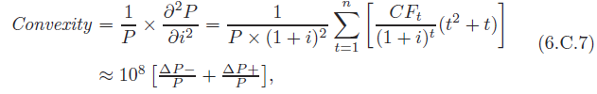
Where the Convexity is the rate of change of the slope of the price-yield curve as follows
where CFt is the cash flow at time t as definition in Eq. (6.C.2); n is the maturity; CFt represents either a coupon payment before maturity or final coupon plus par value at the maturity date. ΔP− is the capital loss from a one-basis-point (0.0001) increase in interest rates and ΔP+ is the capital gain from a one-basis-point (0.0001) decrease in interest rates.

Slide 197
In Eq. (6.C.6), the first term on the right-hand side is the same as the duration rule, Eq. (6.C.5). The second term is the modification for convexity. Notice that for a bond with positive convexity, the second term is positive, regardless of whether the yield rises or falls.
The more accurate Eq. (6.C.6), which accounts for convexity, always predicts a higher bond price than Eq. (6.C.5). Of course, if the change in yield is small, the convexity term, which is multiplied by (Δi)2 in Eq. (6.C.6), will be extremely small and will add little to the approximation. In this case, the linear approximation given by the duration rule will be sufficiently accurate. Thus convexity is more important as a practical matter when potential interest rate changes are large. Sample Problem 6.C.3 provides further illustration.

Slide 198
Sample Problem 6.C.3
Figure 23.4 is drawn by the assumptions that the bond with 20-year maturity and 7.5% coupon sells at an initial YTM of 7.5%. Because the coupon rate equals YTM, the bond sells at par value, or $1000. The modified duration and convexity of the bond are 10.95908 and 155.059 calculated by Eq. (6.C.1) and the approximation formula in Eq. (6.C.7), respectively.

Slide 199
If the bond’s yield increases from 7.5% to 8.0% (Δi = 0.005), the price of the bond actually falls to $950.9093. Based on the duration rule, the bond price falls from $1000 to $945.2046 with a decline of 5.47954%. Equation (6.C.5) as follows

Slide 200
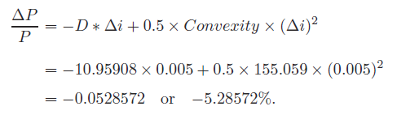
If we use Eq. (6.C.6) instead of Eq. (6.C.5), we get the bond price falls from $1000 to $947.1482 with a decline of 5.28572% by Eq. (6.C.6):
The duration rule used by Eq. (6.C.5) is close to the case with accounting for convexity in terms of Eq. (6.C.6).

Slide 201
However, if the change in yield are larger, 3% (Δi = 0.03), the price of the bond actually falls to $753.0727 and convexity becomes an important matter of pricing the percentage change in bond price. Without accounting for convexity, the price of the bond on dash line actually falls from $1000 to $671.2277 with a decline of 32.8772% based on the duration rule, Eq. (6.C.5) as follows

Slide 202
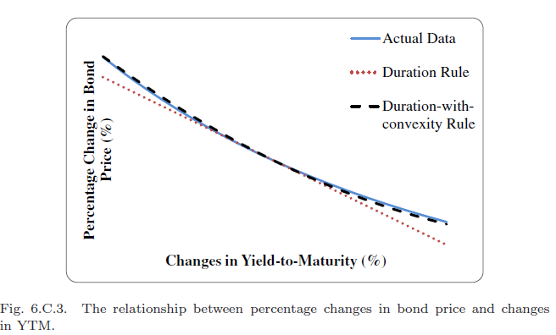

Slide 203
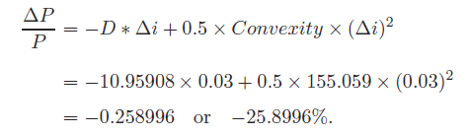
According to the duration-with-convexity rule, Eq. (6.C.6), the percentage change in bond price is calculated in following equation
The bond price $741.0042 estimated by the duration-with-convexity rule is close to the actual bond price $753.0727 rather than the price $671.2277 estimated by the duration rule. As the change in interest rate becomes larger, the percentage change in bond price calculated by Eq. (6.C.5) is significantly different from it calculated by Eq. (6.C.6). Saunders and Cornett (2013) have discussed why convexity is important in the risk management of financial institutions.

