Slide 1
Chapter 6
The Uses and Calculation of Market Indexes
By
Cheng Few Lee
Joseph Finnerty
John Lee
Alice C Lee
Donald Wort

Slide 2
Chapter Outline
6.1 Alternative Methods for Compilation of Stock and Price Indexes
  6.1.1 Price-Weighted and Quantity-Weighted Indexes
  6.1.2 Value-Weighted Indexes
6.2 Alternative Market Indexes
  6.2.1 Dow Jones Industrial Average
  6.2.2 Standard & Poor’s Composite 500 Index
  6.2.3 New York Stock Exchange Composite Index
  6.2.4 Wilshire 5000 Equity Index
  6.2.5 Standard & Poor’s Composite 100 Index
6.3 The User and Uses of Market Indexes
6.4 Historical Behavior of Market Indexes and the Implications of their Use for Forecasting
  6.4.1 Historical Behavior
  6.4.2 Implications
6.5 Market-Index Proxy Errors and their Impact on Beta Estimates and Efficient-Market-Hypothesis Tests
6.6 Index-Proxy Error, Performance Measure, and the EMH Test

Slide 3
Chapter 6: The Uses and Calculation of Market Indexes
Market Indexes
  determine of required rates of return for individual security for a security investment through the use of the capital asset pricing model (CAPM)
  provide insights into such economic variables as the growth of economic output and corporate returns

Slide 4
6.1 Alternative Methods for Compilation of Stock and Price Indexes
6.1.1 Price-Weighted, Value-Weighted, and Quantity-Weighted Indexes
In a price-weighted index the basic approach is to sum the prices of the component securities used in the index and divide this sum by the number of components
  Just like a simple arithmetic average
  i.e.-Dow-Jones Industrial Average
  A price-weighted index such as the DJIA is not strictly speaking as index at all — it is an average. The concept of indexing involves the comparison of currently computed averages with some base value. For example, the current levels of the Standard & Poor’s 500 index (S&P 500) are compared with the average level for the base period of 1941–1943. The S&P 500 is also the most widely used example of a value-weighted stock index.

Slide 5
6.1 Alternative Methods for Compilation of Stock and Price Indexes
6.1.1 Price-Weighted, Value-Weighted, and Quantity-Weighted Indexes
In a value-weighted stock index, the weight of each component stock is equal to its market value in relation to that of all the stocks included, where market value=price per share * number of shares outstanding.
  Two classical forms of indexes are the Paasche index and the Laspeyres index. While Laspeyre makes use of the total cost of purchasing from the base year, Paasche index makes use of the total cost of purchasing from the current year.
  The square-root of the product of the two indexes produces Fisher’s Ideal Price Index.
  The Value-Weighted Form of Fisher’s Ideal Price Index measures price inflation because quantity is held constant.

Slide 6
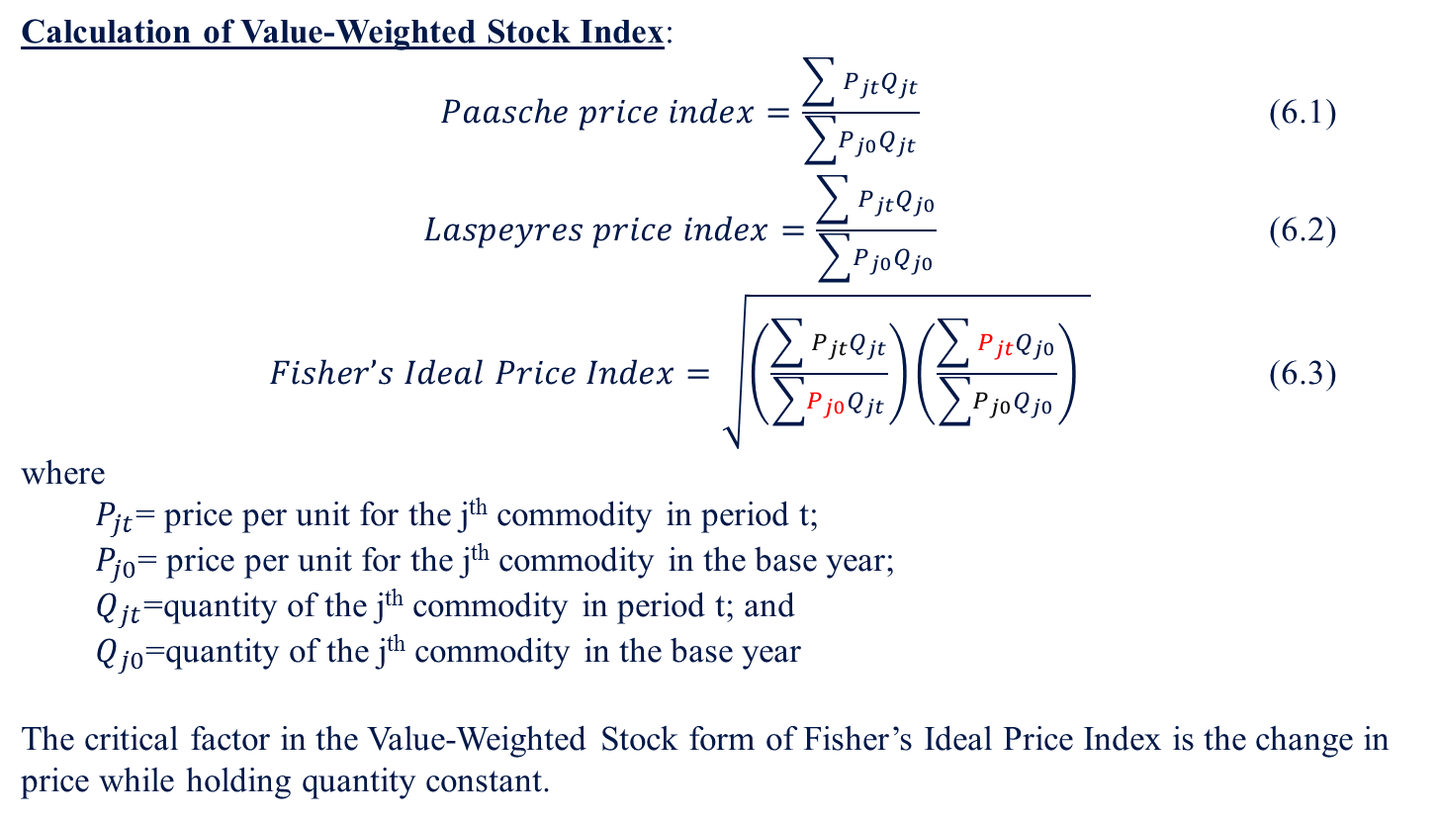
6.1 Alternative Methods for Compilation of Stock and Price Indexes
6.1.1 Price-Weighted, Value-Weighted, and Quantity-Weighted Indexes
Calculation of Value-Weighted Stock Index:
$Paasche price index=\frac{\sum{ P_{jt}Q_{jt}}}{\sum{{P_{j0}Q}_{jt}}}$ (6.1)
$Laspeyres price index=\frac{\sum{ P_{jt}Q_{j0}}}{\sum{{P_{j0}Q}_{j0}}}$ (6.2)
$Fisher’s Ideal Price Index=\sqrt{\left(\frac{\sum{ P_{jt}Q_{jt}}}{\sum{{P_{j0}Q}_{jt}}}\right)\left(\frac{\sum{ P_{jt}Q_{j0}}}{\sum{{P_{j0}Q}_{j0}}}\right) }$ (6.3)
where
  $P_{jt}$= price per unit for the j^{th} commodity in period t;
  $P_{j0}$= price per unit for the j^{th} commodity in the base year;
  $Q_{jt}$=quantity of the j^{th} commodity in period t; and
  $Q_{j0}$=quantity of the j^{th} commodity in the base year
The critical factor in the Value-Weighted Stock form of Fisher’s Ideal Price Index is the change in price while holding quantity constant.

Slide 7
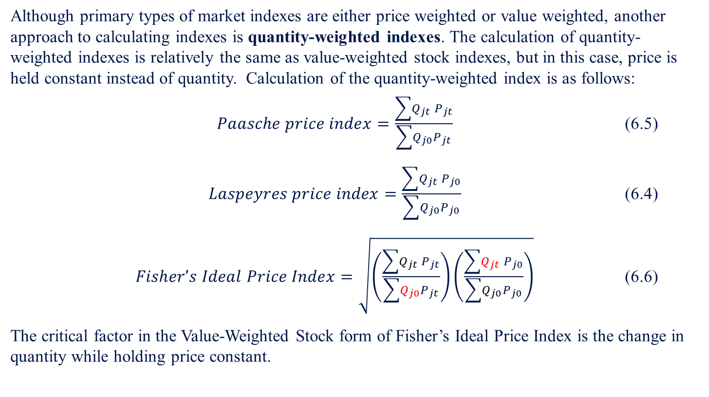
6.1 Alternative Methods for Compilation of Stock and Price Indexes
6.1.1 Price-Weighted, Value-Weighted, and Quantity-Weighted Indexes
Although primary types of market indexes are either price weighted or value weighted, another approach to calculating indexes is quantity-weighted indexes. The calculation of quantity-weighted indexes is relatively the same as value-weighted stock indexes, but in this case, price is held constant instead of quantity. Calculation of the quantity-weighted index is as follows:
$Paasche price index=\frac{\sum{Q_{jt} P_{jt}}}{\sum{Q_{j0}P_{jt}}}$ (6.5)
$Laspeyres price index=\frac{\sum{Q_{jt} P_{j0}}}{\sum{Q_{j0}P_{j0}}}$ (6.4)
$Fisher’s Ideal Price Index=\sqrt{\left(\frac{\sum{Q_{jt} P_{jt}}}{\sum{Q_{j0}P_{jt}}}\right)\left(\frac{\sum{Q_{jt} P_{j0}}}{\sum{Q_{j0}P_{j0}}}\right)}$ (6.6)
The critical factor in the Value-Weighted Stock form of Fisher’s Ideal Price Index is the change in quantity while holding price constant.

Slide 8
6.1 Alternative Methods for Compilation of Stock and Price Indexes
6.1.1 Price-Weighted, Value-Weighted, and Quantity-Weighted Indexes
Sample Problem 6.1 (pg. 201)
Using the tables for “Prices Of Stock In Four Pharmaceutical Corporations” and the “Average Volume of Transactions in Shares of Four Pharmaceutical Corporations,” calculate the quantity-weighted price index for the second week.
Prices of Stock in Four Pharmaceutical Corporations for the First 12 Weeks or 2010, with the Unweighted Aggregate Index of Prices
Week | Date | JNJ | MRK | PFE | MJN | Average | Index of Average
1 | 2010/1/11 | 64.56 | 39.47 | 19.49 | 46.81 | 42.58 | 100.00
2 | 2010/1/19 | 63.20 | 38.87 | 18.96 | 44.53 | 41.39 | 97.20
3 | 2010/1/25 | 62.86 | 38.18 | 18.66 | 45.23 | 41.23 | 96.83
4 | 2010/2/1 | 62.64 | 36.73 | 17.96 | 46.29 | 40.91 | 96.06
5 | 2010/2/8 | 62.72 | 36.92 | 17.80 | 45.05 | 40.62 | 95.40
6 | 2010/2/16 | 63.81 | 37.49 | 17.99 | 46.78 | 41.52 | 97.50
7 | 2010/2/22 | 63.00 | 36.88 | 17.55 | 47.30 | 41.18 | 96.71
8 | 2010/3/1 | 64.04 | 37.49 | 17.48 | 49.91 | 42.23 | 99.17
9 | 2010/3/8 | 64.18 | 37.16 | 17.08 | 51.99 | 42.60 | 100.05
10 | 2010/3/15 | 65.11 | 38.06 | 16.91 | 51.39 | 42.87 | 100.67
11 | 2010/3/22 | 64.38 | 37.43 | 17.14 | 51.83 | 42.70 | 100.26
12 | 2010/3/29 | 65.77 | 37.71 | 17.08 | 52.90 | 43.37 | 101.84
Average Volume of Transactions in Shares of Four Pharmaceutical Corporations for the First 12 Weeks of 2010 (hundreds of thousands)
Week | Date | JNJ | MRK | PFE | MJN
1 | 2010/1/11 | 121.4 | 177.6 | 514.3 | 22.2
2 | 2010/1/19 | 141.8 | 209.6 | 741.1 | 27.0
3 | 2010/1/25 | 151.1 | 164.4 | 508.9 | 33.2
4 | 2010/2/1 | 136.4 | 180.3 | 811.4 | 26.2
5 | 2010/2/8 | 104.5 | 153.0 | 583.2 | 21.0
6 | 2010/2/16 | 105.5 | 143.7 | 573.3 | 23.6
7 | 2010/2/22 | 101.5 | 161.6 | 572.6 | 18.5
8 | 2010/3/1 | 92.6 | 116.7 | 682.0 | 18.6
9 | 2010/3/8 | 137.7 | 155.7 | 587.7 | 24.2
10 | 2010/3/15 | 118.5 | 182.8 | 635.8 | 18.4
11 | 2010/3/22 | 95.0 | 133.6 | 642.6 | 18.1
12 | 2010/3/29 | 96.7 | 110.5 | 546.8 | 10.7

Slide 9
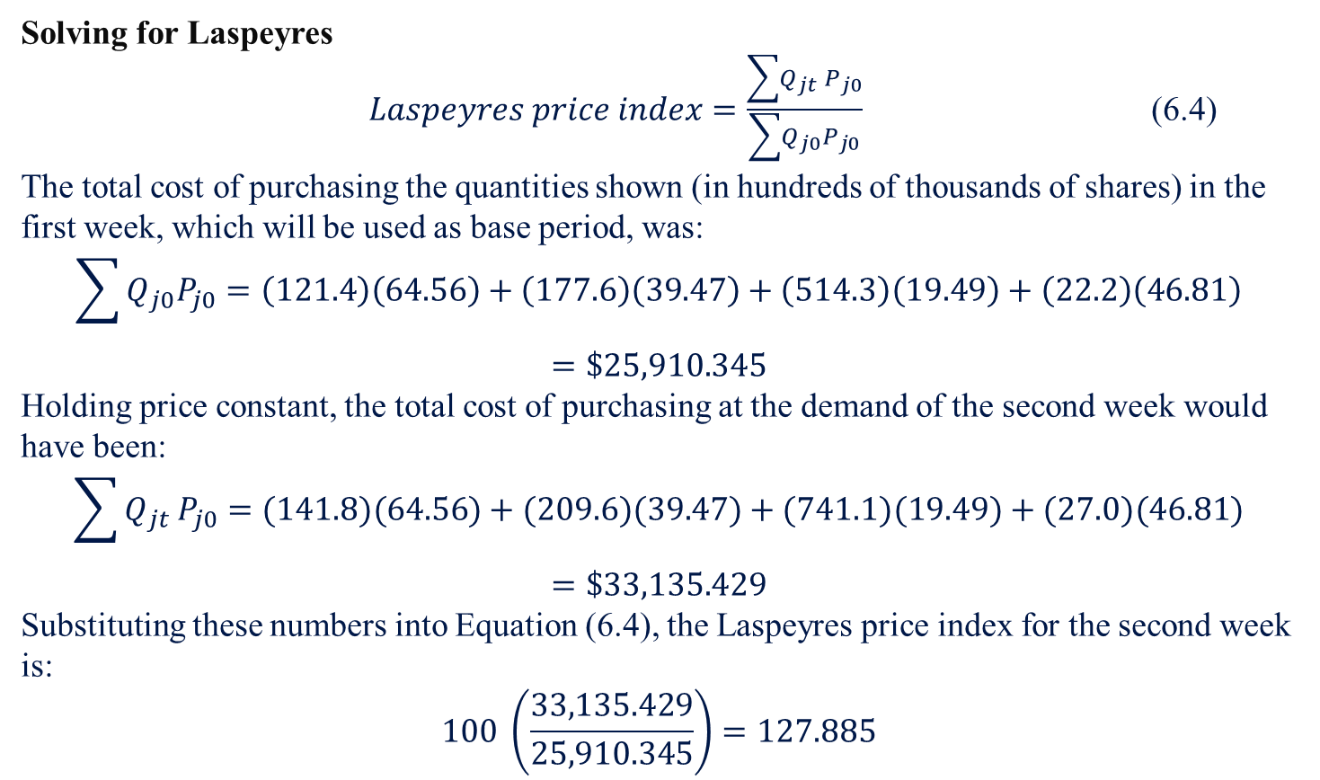
6.1 Alternative Methods for Compilation of Stock and Price Indexes
6.1.1 Price-Weighted, Value-Weighted, and Quantity-Weighted Indexes
Solving for Laspeyres
$Laspeyres price index=\frac{\sum{Q_{jt} P_{j0}}}{\sum{Q_{j0}P_{j0}}}$ (6.4)
The total cost of purchasing the quantities shown (in hundreds of thousands of shares) in the first week, which will be used as base period, was:
$$\sum{Q_{j0}P_{j0}}=\left(121.4\right)\left(64.56\right)+\left(177.6\right)\left(39.47\right)+\left(514.3\right)\left(19.49\right)+\left(22.2\right)\left(46.81\right)=\$25,910.345$$
Holding price constant, the total cost of purchasing at the demand of the second week would have been:
$$\sum{Q_{jt} P_{j0}}=(141.8)(64.56)+(209.6)(39.47)+(741.1)(19.49)+(27.0)(46.81)=\$33,135.429$$
Substituting these numbers into Equation (6.4), the Laspeyres price index for the second week is:
$$100 \left(\frac{33,135.429}{25,910.345}\right)=127.885$$

Slide 10
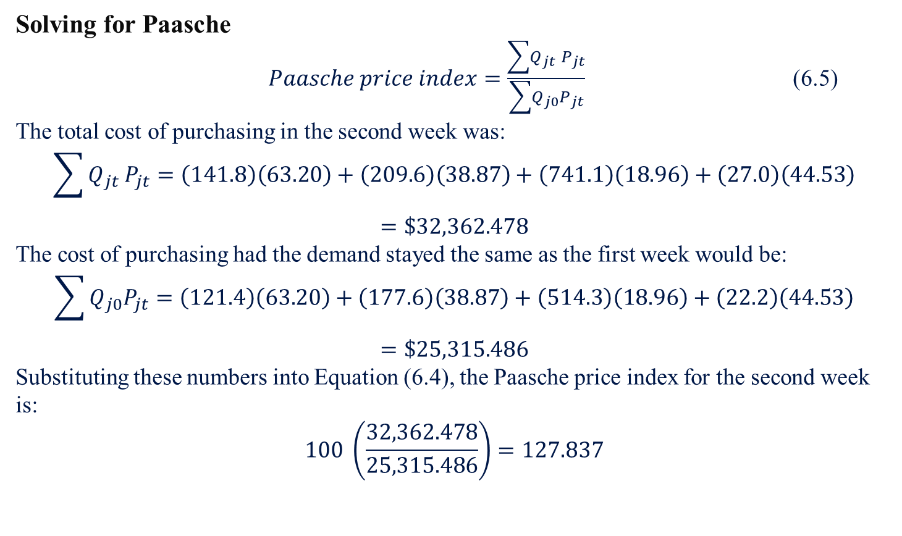
6.1 Alternative Methods for Compilation of Stock and Price Indexes
6.1.1 Price-Weighted, Value-Weighted, and Quantity-Weighted Indexes
Solving for Paasche
$Paasche price index=\frac{\sum{Q_{jt} P_{jt}}}{\sum{Q_{j0}P_{jt}}}$ (6.5)
The total cost of purchasing in the second week was:
$$\sum{Q_{jt} P_{jt}}=\left(141.8\right)\left(63.20\right)+\left(209.6\right)\left(38.87\right)+\left(741.1\right)\left(18.96\right)+\left(27.0\right)\left(44.53\right)=\$32,362.478$$
The cost of purchasing had the demand stayed the same as the first week would be:
$$\sum{Q_{j0}P_{jt}}=\left(121.4\right)\left(63.20\right)+\left(177.6\right)\left(38.87\right)+\left(514.3\right)\left(18.96\right)+\left(22.2\right)\left(44.53\right)=\$25,315.486$$
Substituting these numbers into Equation (6.4), the Paasche price index for the second week is:
$$100 \left(\frac{32,362.478}{25,315.486}\right)=127.837$$

Slide 11
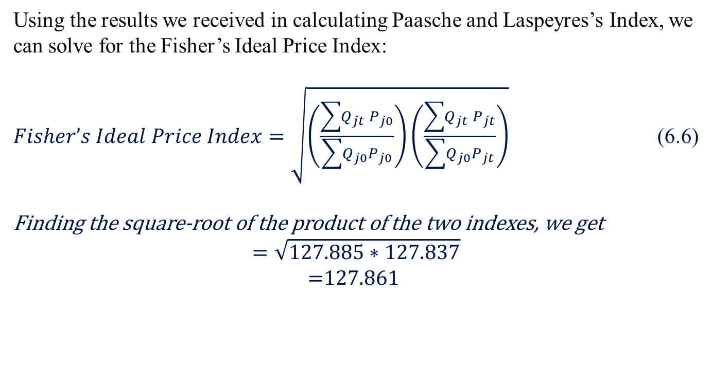
6.1 Alternative Methods for Compilation of Stock and Price Indexes
6.1.1 Price-Weighted, Value-Weighted, and Quantity-Weighted Indexes
Using the results we received in calculating Paasche and Laspeyres’s Index, we can solve for the Fisher’s Ideal Price Index:
$Fisher’s Ideal Price Index=\sqrt{\left(\frac{\sum{Q_{jt} P_{j0}}}{\sum{Q_{j0}P_{j0}}}\right)\left(\frac{\sum{Q_{jt} P_{jt}}}{\sum{Q_{j0}P_{jt}}}\right)}$ (6.6)
Finding the square-root of the product of the two indexes, we get
$$=\sqrt{127.885∗127.837}$$
$$\text{=}\text{127.86}\text{1}$$

Slide 12
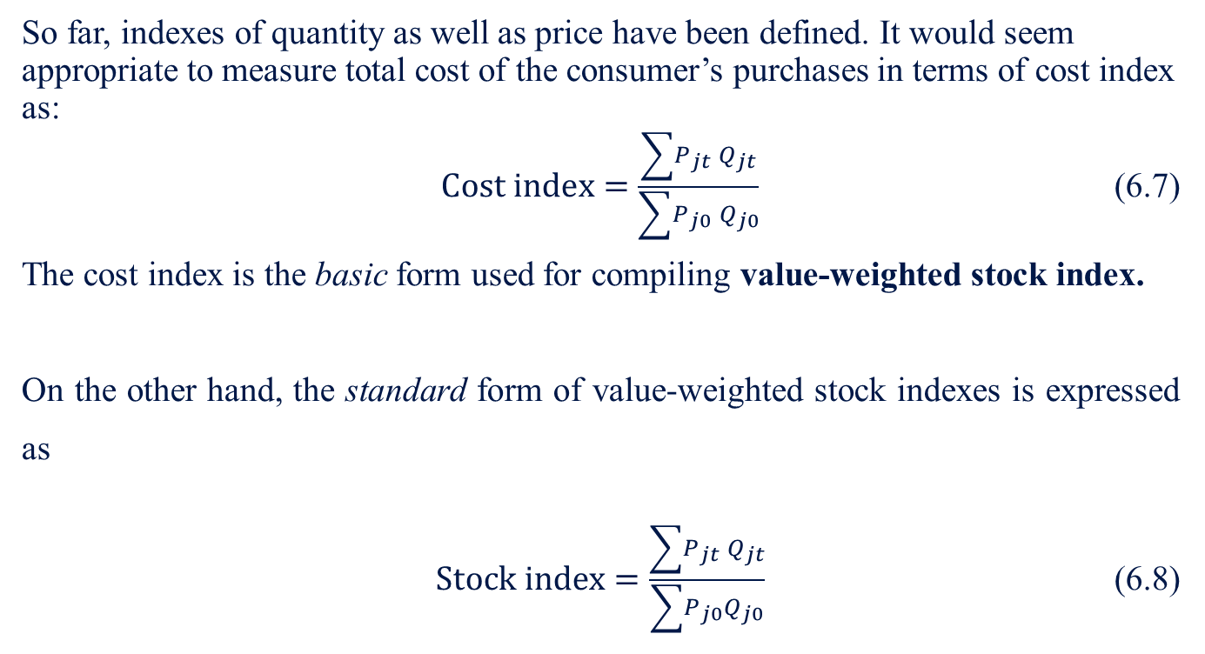
6.1 Alternative Methods for Compilation of Stock and Price Indexes
6.1.1 Price-Weighted, Value-Weighted, and Quantity-Weighted Indexes
So far, indexes of quantity as well as price have been defined. It would seem appropriate to measure total cost of the consumer’s purchases in terms of cost index as:
$Cost index=\frac{\sum{P_{jt} Q_{jt}}}{\sum{P_{j0} Q_{j0}}}$ (6.7)
The cost index is the basic form used for compiling value-weighted stock index.
On the other hand, the standard form of value-weighted stock indexes is expressed as
$Stock index=\frac{\sum{P_{jt} }Q_{jt}}{\sum{P_{j0}}Q_{j0}}$ (6.8)

Slide 13
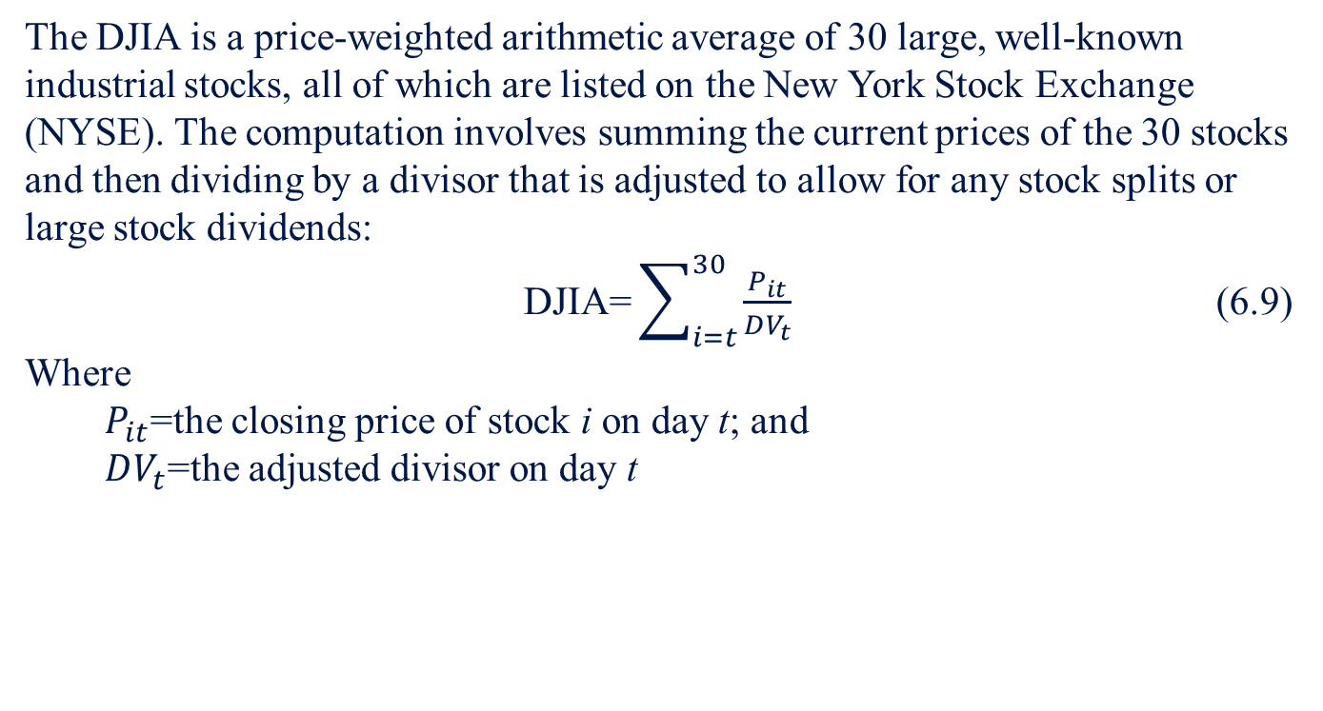
6.2 Alternative Market Indexes
6.2.1 Dow Jones Industrial Average
The DJIA is a price-weighted arithmetic average of 30 large, well-known industrial stocks, all of which are listed on the New York Stock Exchange (NYSE). The computation involves summing the current prices of the 30 stocks and then dividing by a divisor that is adjusted to allow for any stock splits or large stock dividends:
$\text{DJIA}\text{=}\sum_{i=t}^{30}{\frac{P_{it}}{DV_{t}}}$ (6.9)
Where
  $P_{it}$=the closing price of stock i on day t; and
  $DV_{t}$=the adjusted divisor on day t

Slide 14
6.2 Alternative Market Indexes
6.2.1 Dow Jones Industrial Average
As can be seen in Table 6-1, the adjustment process is designed to keep the index value the same as it would have been if the split had not occurred. For example, a 20% increase in the price of Stock A from Table 6-1 would in itself have caused a 10% increase in the value of the sample index before the split, while a 20% increase in Stock B would have cause only a 5% increase in the index value. After the two-for-one split of Stock A, a 20% increase in either Stock A or Stock B would produce the same effect on the index value (a 6.7% increase), illustrating a downward shift in the importance of Stock A relative to the other stocks in the sample. This type of an effect could lead to the fastest-growing stocks having the least importance in determining the index values.
Table 6-1 Adjustment of DJIA Divisor to Allow for a Stock Split
Stock | Price before Split | Price after 2-for-1 Stock Split by Stock A
A | 60 | 30
B | 30 | 30
C | 20 | 20
D | 10 | 10
Total | 120 | 90
 | Average = 120/4 = 30 Adjustment of Divisor = 90/30 = 3
 | Average = 90/30 = 30
 | Divisor before Split = 4 Divisor before Split = 3

Slide 15
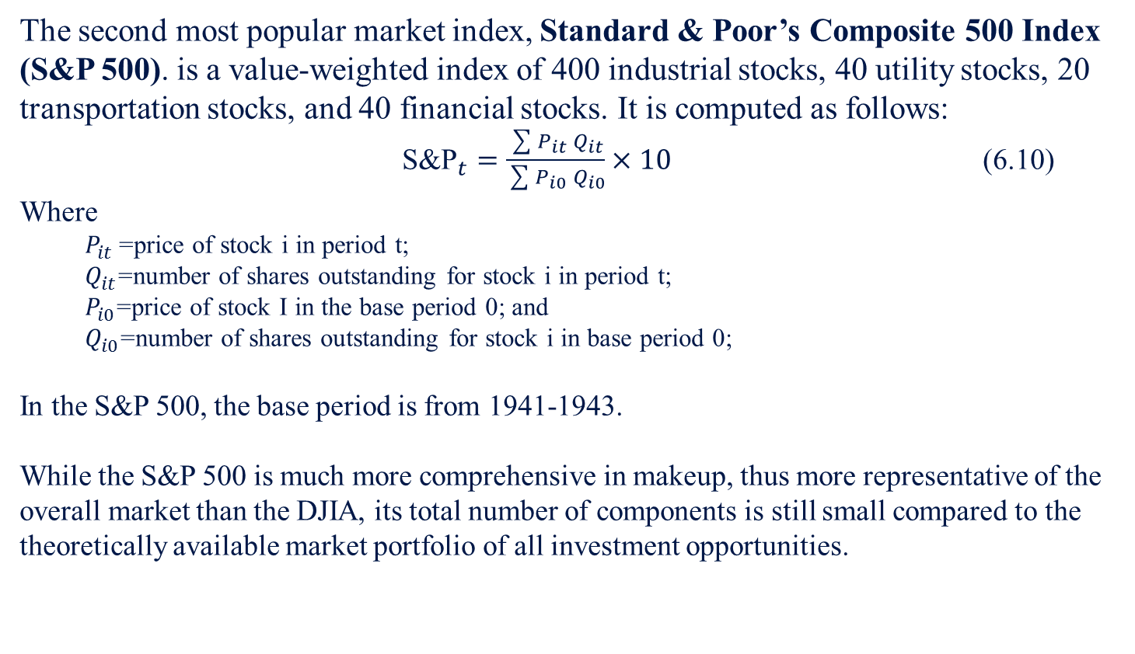
6.2 Alternative Market Indexes
6.2.2 Standard & Poor’s Composite 500 Index
The second most popular market index, Standard & Poor’s Composite 500 Index (S&P 500). is a value-weighted index of 400 industrial stocks, 40 utility stocks, 20 transportation stocks, and 40 financial stocks. It is computed as follows:
${\text{S}\text{\&}\text{P}}_{t}=\frac{\sum{P_{it }Q_{it}}}{\sum{P_{i0} Q_{i0}}}×10$ (6.10)
Where
  $P_{it }$=price of stock i in period t;
  $Q_{it}$=number of shares outstanding for stock i in period t;
  $P_{i0}$=price of stock I in the base period 0; and
  $Q_{i0}$=number of shares outstanding for stock i in base period 0;
In the S&P 500, the base period is from 1941-1943.
While the S&P 500 is much more comprehensive in makeup, thus more representative of the overall market than the DJIA, its total number of components is still small compared to the theoretically available market portfolio of all investment opportunities.

Slide 16
6.2 Alternative Market Indexes
6.2.3 New York Stock Exchange Composite Index
Another commonly used value-weighted index is the New York Stock Exchange Composite Index, inaugurated in 1966 and consisting of the market values of all of the common stocks listed on the NYSE. While it includes many more stocks than the S&P 500 (about 1,700), this index can still be criticized as a proxy for the market portfolio because it contains none of the companies that cannot be listed, or choose not to be listed, on the NYSE.

Slide 17
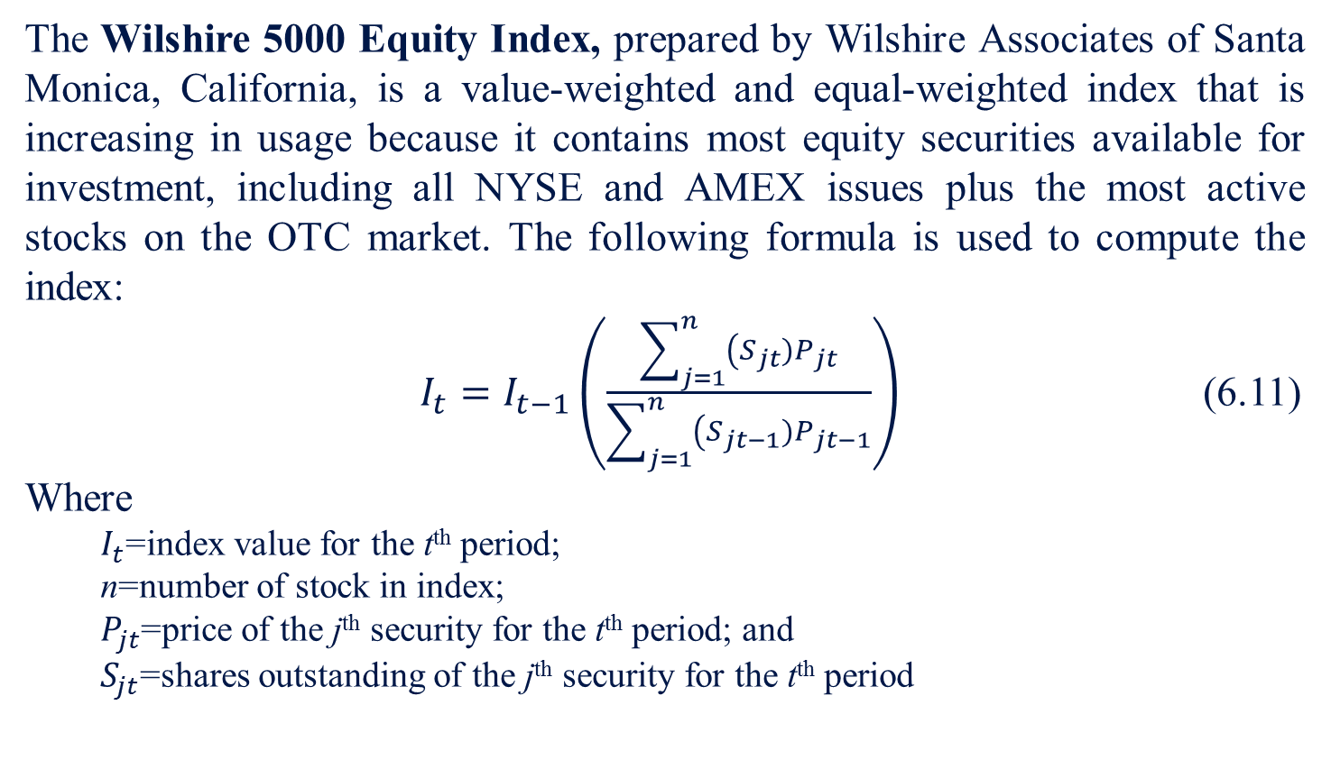
6.2 Alternative Market Indexes
6.2.4 Wilshire 5000 Equity Index
The Wilshire 5000 Equity Index, prepared by Wilshire Associates of Santa Monica, California, is a value-weighted and equal-weighted index that is increasing in usage because it contains most equity securities available for investment, including all NYSE and AMEX issues plus the most active stocks on the OTC market. The following formula is used to compute the index:
$I_{t}=I_{t−1}\left(\frac{\sum_{j=1}^{n}{\left(S_{jt})P_{jt}\right.}}{\sum_{j=1}^{n}{\left(S_{jt−1})P_{jt−1}\right.}}\right)$ (6.11)
Where
  $I_{t}$=index value for the t^{th} period;
  n=number of stock in index;
  $P_{jt}$=price of the j^{th} security for the t^{th} period; and
  $S_{jt}$=shares outstanding of the j^{th} security for the t^{th} period

Slide 18
6.2 Alternative Market Indexes
6.2.5 Standard & Poor’s Composite 100 Index
Very recently, a subset of the S&P 500 called the S&P 100 was developed for use in the futures and options markets. Although it may seem strange in the context of the increasing development of broader indexes that this more narrowly based index would be formed, it will become clear that the basis for its popularity is related to margin requirement in the options market.

Slide 19
6.2 Alternative Market Indexes
To illustrate the seven indexes just discussed, daily quotations from The Wall Street Journal for January 10 to January 25, 2010, are presented in Table 6-2.
Table 6-2 Major Stock Indexes for January 11, 2010–January 25, 2010
Indexes | DJIA | Nasdaq | S&P 500 | Wilshire 5000 | S&P 100
11-Jan | 10663.99 | 2312.41 | 1146.98 | 11838.1 | 528.61
12-Jan | 10627.26 | 2282.31 | 1136.22 | 11697.8 | 524.29
13-Jan | 10680.77 | 2307.9 | 1145.68 | 11819.2 | 527.93
14-Jan | 10710.55 | 2316.74 | 1148.46 | 11846.8 | 529.6
15-Jan | 10609.65 | 2287.99 | 1136.03 | 11715 | 524.11
19-Jan | 10725.43 | 2320.4 | 1150.23 | 11865.5 | 530.21
20-Jan | 10603.15 | 2291.25 | 1138.04 | 11744.9 | 524.73
21-Jan | 10389.88 | 2265.7 | 1116.48 | 11539.8 | 514.13
22-Jan | 10172.98 | 2205.29 | 1091.76 | 11289.1 | 502.35
25-Jan | 10196.86 | 2210.8 | 1096.78 | 11331.5 | 504.54

Slide 20
6.3 The User and Uses of Market Indexes
Among economists and statisticians, one of the major uses of stock-market indexes is as a leading economic indicator. Unlike econometric modeling, the leading economic indicator approach to forecasting does not require assumptions about what causes economic behavior. Instead, it relies on statistically detecting patterns among economic variables that can be used to forecast turning points in economic activity. Table 6-3 presents a list of the time series currently being used by the US Department of Commerce as leading economic indicators.
Table 6-3 The Index of Leading Indicators (Includes 12 Data Series)
BEA
Series Number | Description of Series | Weight
1 | Average workweek of production workers, manufacturing | 0.984
3 | Layoff rate, manufacturing (inverted) | 1.025
8 | New order, consumer goods and materials, 1972 dollars | 1.065
12 | Index of net business formation | 0.984
19 | Index of stock prices (Standard and Poor) | 1.079
20 | Contracts and orders, plant and equipment, 1972 dollars | 0.971
29 | Building permits, private housing | 1.025
32 | Vendor performance | 0.930
36 | Change in inventories on hand and on order, 1972 dollars | 0.957
92 | Percentage change in sensitive prices (smoothed) | 0.971
104 | Percentage change in total liquid assets (smoothed) | 1.011
105 | Money supply (M1), 1972 dollars | 1.065
Source: Department of Commerce. Handbook of Cyclical Indicators (May 1977).

Slide 21
6.3 The User and Uses of Market Indexes
Besides the seven indexes discussed in the last section, Merrill Lynch and Wilshire Associates have compiled an index called the Merrill Lynch and Wilshire Capital Markets Index (CMI). The CMI is a market-value weighted index created to measure the total return performance of the combined domestic taxable fixed-income and equity market. This unique new investment tool currently tracks more than 10,000 bonds and stocks. The CMI has been used in (1) asset-allocation decisions, (2) performance measurement, (3) sector-investment analysis, and (4) portfolio structuring.

Slide 22
6.4 Historical Behavior of Market Indexes and the Implications of their Use for Forecasting
  6.4.1 Historical Behavior
  Table 6-4 compare annualized rates of return computed over one-year through ten-year holding periods for pairs of the most widely used market indexes. These rates of return are computed using May 1, 2000, as the closing date of each holding period.
Table 6-4 Annualized Rates of Return: DJIA versus S&P 500 (Dividends Included)
 | Holding Period (years) | DJIA | S&P 500
 | 2001 | 3.7 | −11.6
 | 2002 | −9.0 | −15.0
 | 2003 | −10.8 | −9.7
 | 2004 | 15.1 | 16.3
 | 2005 | 2.7 | 6.3
 | 2006 | 6.7 | 6.6
 | 2007 | 22 | 20.5
 | 2008 | −7.3 | −8.5
 | 2009 | −35.0 | −34.4
 | 2010 | 23.4 | 18.5
The correlation coefficient between rates of return computed from these two indexes over this time period is 0.952989. This means that 95.30% of the movement in the returns on the DJIA can be considered to be related to the concurrent movement in returns on the S&P 500. So even though there are substantial differences in the way these indexes are computed, there is a high correlation in the way they behave.

Slide 23
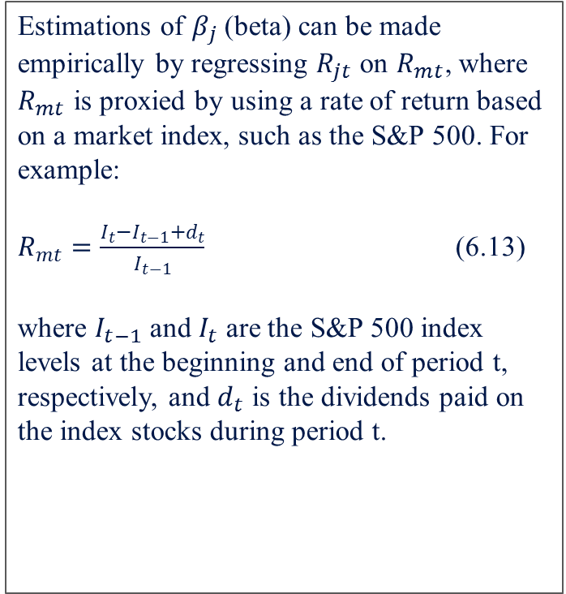
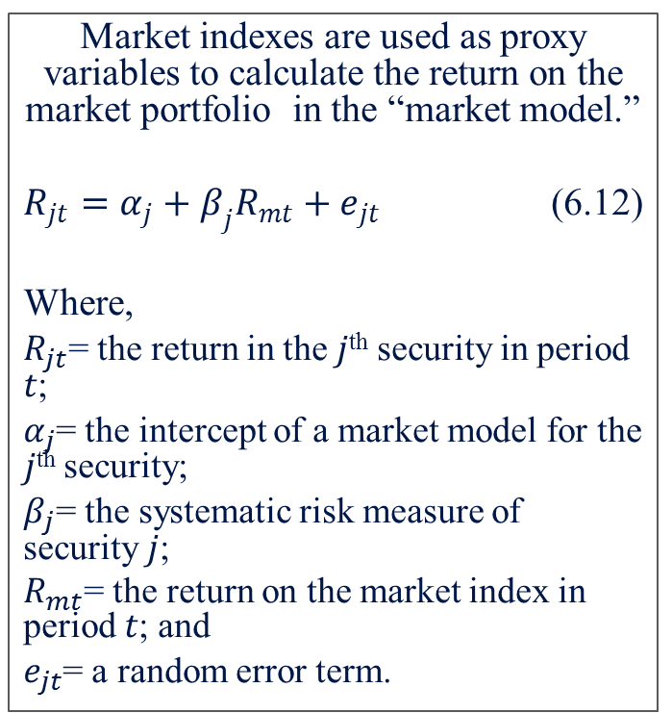
  6.5 Market-Index Proxy Errors and their Impact on Beta Estimates and Efficient-Market-Hypothesis Tests
Market indexes are used as proxy variables to calculate the return on the market portfolio in the “market model.”
$R_{jt}=α_{j}+β_{j}R_{mt}+e_{jt}$ (6.12)
Where,
$R_{jt}$= the return in the 𝑗^{th} security in period 𝑡;
$α_{j}$= the intercept of a market model for the 𝑗^{th} security;
$β_{j}$= the systematic risk measure of security 𝑗;
$R_{mt}$= the return on the market index in period 𝑡; and
$e_{jt}$= a random error term.
Estimations of $β_{j}$(beta) can be made empirically by regressing $R_{jt}$ on $R_{mt}$, where $R_{mt}$ is proxied by using a rate of return based on a market index, such as the S&P 500. For example:
$R_{mt}=\frac{I_{t}−I_{t−1}+d_{t}}{I_{t−1}}$ (6.13)
where $I_{t−1}$ and $I_{t}$ are the S&P 500 index levels at the beginning and end of period t, respectively, and $d_{t}$ is the dividends paid on the index stocks during period t.

Slide 24
6.6 Index-Proxy Error, Performance Measure, and the EMH Test
A potentially serious problem is involved in the use of a market index to represent the market portfolio. While an index such as the S&P 500 is also value weighted and includes many more component firms than a narrowly based index such as the DJIA, it includes only common-stock investments, and only a small proportion of the total available. A proxy, such as the S&P 500, may be mean-variance efficient, while the market portfolio is not, and it might be mean-variance inefficient when the market portfolio is efficient. Richard Roll (1977) thinks that the CAPM and the market portfolio are therefore untestable without accurate specification of the “true” market portfolio. Roll (1978) strengthens his argument by showing that different indexes used as proxies for the market portfolio can cause different portfolio-performance rankings.

Slide 25
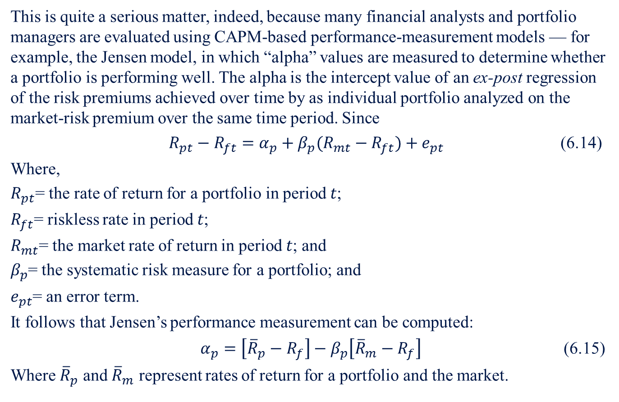
6.6 Index-Proxy Error, Performance Measure, and the EMH Test
This is quite a serious matter, indeed, because many financial analysts and portfolio managers are evaluated using CAPM-based performance-measurement models — for example, the Jensen model, in which “alpha” values are measured to determine whether a portfolio is performing well. The alpha is the intercept value of an ex-post regression of the risk premiums achieved over time by as individual portfolio analyzed on the market-risk premium over the same time period. Since
$R_{pt}−R_{ft}=α_{p}+β_{p}(R_{mt}−R_{ft})+e_{pt}$ (6.14)
Where,
$R_{pt}$= the rate of return for a portfolio in period 𝑡;
$R_{ft}$= riskless rate in period 𝑡;
$R_{mt}$= the market rate of return in period 𝑡; and
$β_{p}$= the systematic risk measure for a portfolio; and
$e_{pt}$= an error term.
It follows that Jensen’s performance measurement can be computed:
$α_{p}=\left[{\overline{R}}_{p}−R_{f}\right]−β_{p}\left[{\overline{R}}_{m}−R_{f}\right]$ (6.15)
Where ${\overline{R}}_{p}$ and ${\overline{R}}_{m}$ represent rates of return for a portfolio and the market.

Slide 26
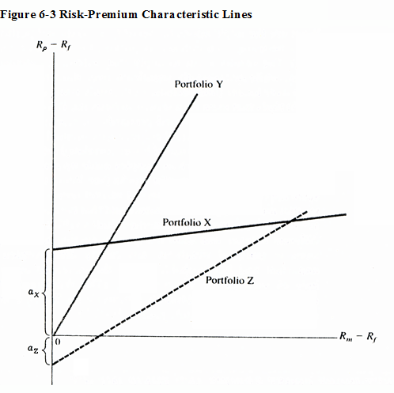
6.6 Index-Proxy Error, Performance Measure, and the EMH Test
A plot of risk-premium characteristic lines for three portfolios is shown in Figure 6-3. It can be said that Portfolio X has shown superior performance over the time period analyzed because its alpha is significantly positive. This is true because the CAPM model leads to the conclusion that, under equilibrium conditions, the alpha intercept should be equal to zero. Figure 6-4 also suggests that Portfolio Z has shown inferior performance because of the significantly negative alpha, and Portfolio Y has performed as would be predicted by the CAPM.

Slide 27
6.6 Index-Proxy Error, Performance Measure, and the EMH Test
The point being made here is that beta-estimation problems can have important and far-reaching implications. These empirical problems, as well as problems dealing with the fundamental assumptions of the theory, have led other researchers suck as Stephen Ross (1976) to seek alternative models, among them the arbitrage pricing theory (APT) discussed in Chapter 11. As will be seen in later chapters, these alternative models have empirical and theoretical problems of their own.

Slide 28
6.7 Summary
This chapter has described basic market-index information needed to do security analysis and portfolio management, as well as methods of compiling stock-market and price indexes and historical behavior of stock indexes. Moreover, the impact of proxy errors associated with market rates of return on beta estimation discussed in this chapter underscore the importance of alternative stock indexes for both individual and institutional investors.

